Slide 1
VOLTAGE PROFILE WORKING GROUP (VPWG)
APRIL 18, 2017

Slide 2
TOPICS
Generator Voltage Set Point Communication (NPRR 776)
Examples of the Lost Visibility Problem
Potential Solutions Discussed by VPWG
Notes:
2

Slide 3
TOPICS
Generator Voltage Set Point Communication (NPRR 776)
733 generating units in ERCOT
Examples of the Lost Visibility Problem
Potential Solutions Discussed by VPWG
Notes:
3

Slide 4
NPRR776 specifies that TSPs shall telemeter via ICCP Real-Time voltage at POI and Voltage Set Point to the ERCOT
KV POI – Real time voltage at the POI where the Generator’s Voltage Set Point changes will be observed
Voltage Set Point – TSP-desired Generator setting to adjust voltage control to current ERCOT grid conditions
These two data values per Plant will provide “common voltage visibility” between the TSP, ERCOT, the QSE and Generator so that everyone can see in real time how Generator is doing at holding the TSP’s voltage set point.

Slide 5
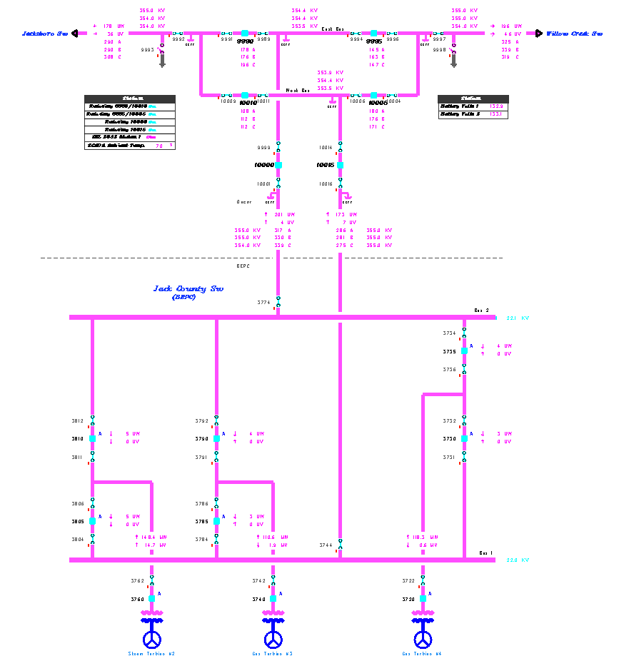
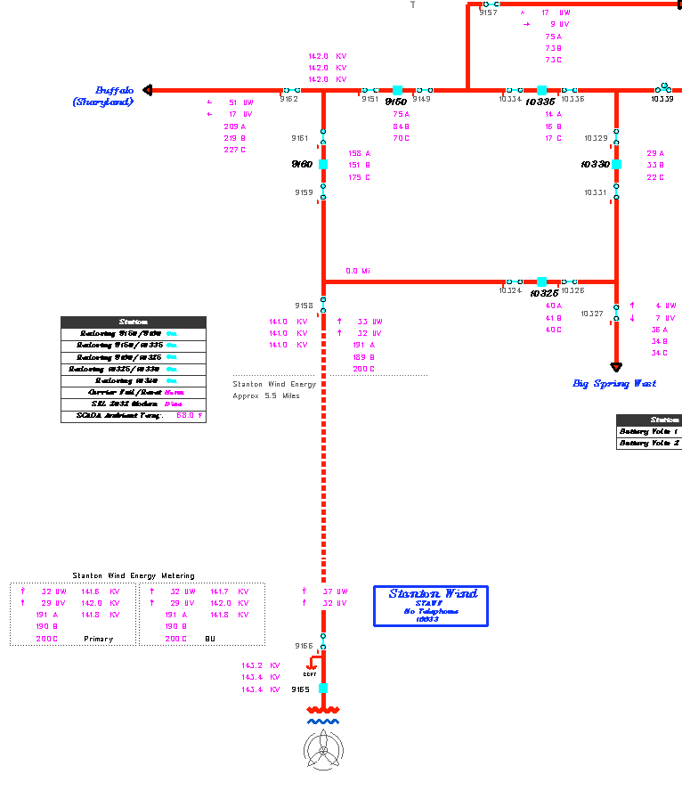
TSPs will submit NOMCRs for (1) the telemetered POI Voltage Measurement Point (it’s called “kv POI”) and (2) the Voltage Set Point.
KV POI*
KV POI *
* Voltage Set Point will be applied here
Plant #1
Plant #2

Slide 6
TOPICS
Generator Voltage Set Point Communication (NPRR 776)
Examples of the Lost Visibility Problem
Potential Solutions Discussed by VPWG
Notes:
6

Slide 7
Examples of the Lost Visibility Problem
With all the different bus configurations, there are often multiple voltage measurement points at the POI.
When Bus Outages occur, having only one voltage measurement point lead to problems. Either “common voltage visibility” is lost or point specified gives the wrong voltage (from the Grid, not the Generator).

Slide 8
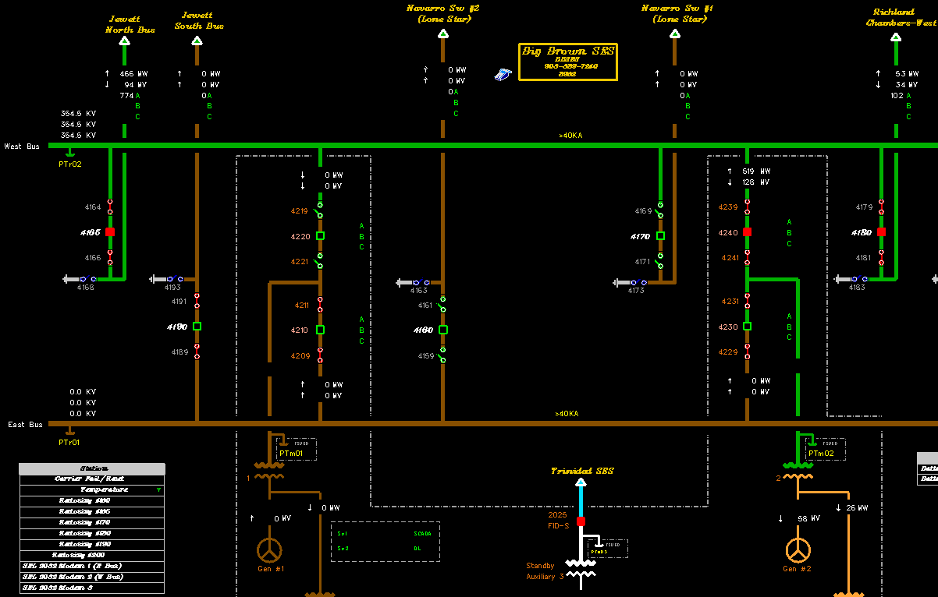
“Common Voltage Visibility” is Lost
Need Primary & Backup points
KV POI Lost
East Bus Out of Service on Outage
Generator online (Tied to the other Bus)
Set Point
354 kV

Slide 9
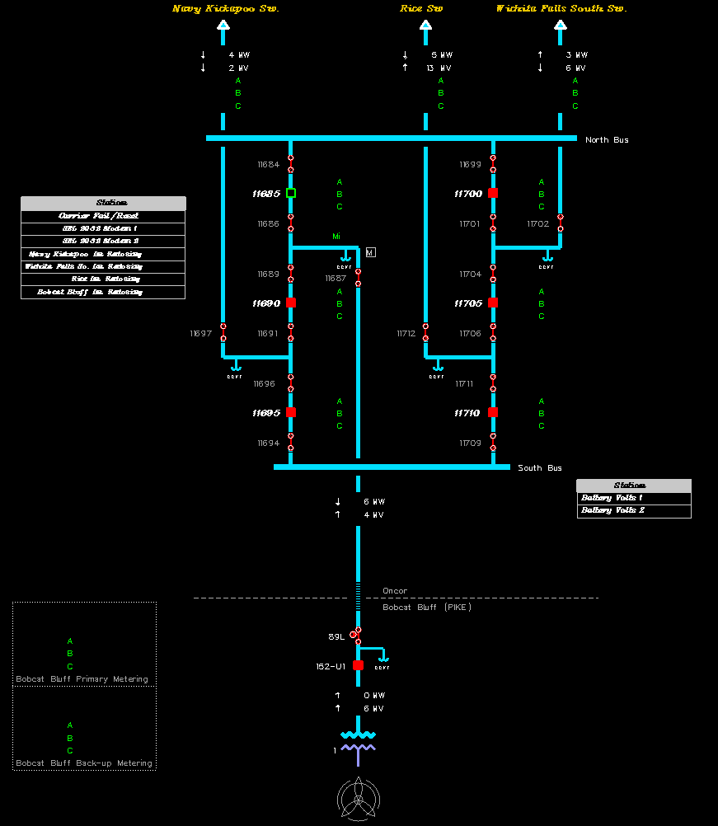
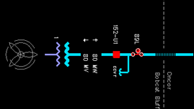
Wrong Voltage is Given- Not Voltage from Generator, but Voltage from the Grid
Wrong
Voltage!
Breaker 11685 Out of Service
Should be this
one.
( Matches
generator
flow & voltage)
Set Point
141 kV
Generator online (Tied to the other Bus)

Slide 10
TOPICS
Generator Voltage Set Point Communication (NPRR 776)
Examples of the Lost Visibility Problem
Potential Solutions Discussed by VPWG
Notes:
10

Slide 11
Submit Multiple Voltage Measurement Points to ERCOT
For double-bus configurations, TSPs submit NOMCRs for both a Primary POI voltage and a Backup POI voltage points.
For Breaker and Half or Ring Bus configurations, may sometimes need to be 3 points submitted.

Slide 12
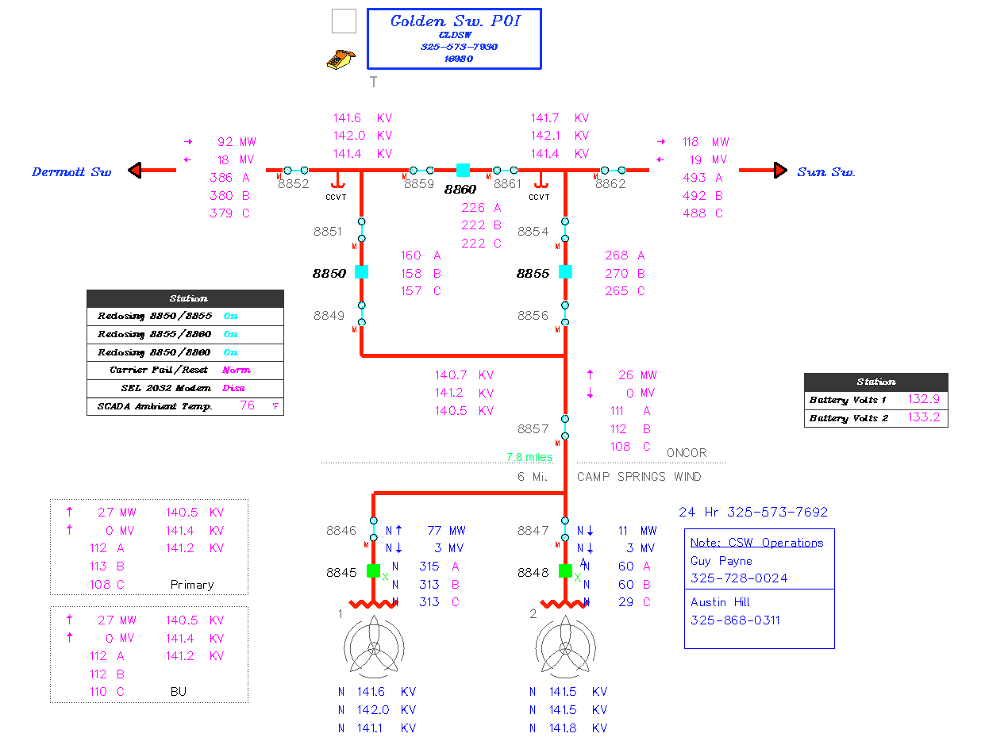
Submit Voltages from Generator's EPS Meter Channel where Available to the TSP (and coincide with the location of the POI)
Accurate Metering Data
Voltage Measurement Points
Primary
Available anytime Generation is Online
Back-up

Slide 13
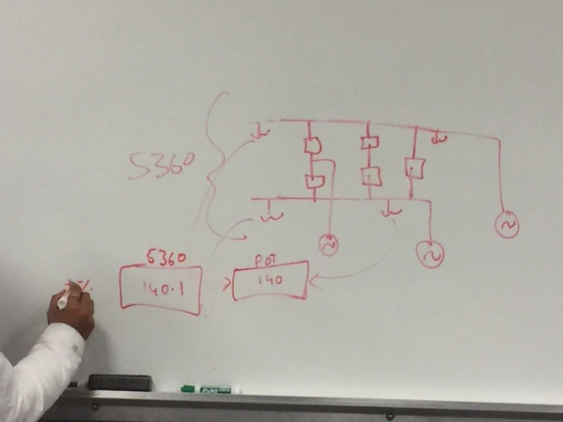
Use Logic, based on whichever Bus Sections are Out of Service, to Determine which Point gets sent to ERCOT for “KV POI”
Logic could be at TSP or at ERCOT
kV POI
Set Point

Slide 14
Use Logic to Pick the Voltage Measurement Point
ERCOT already has logic functions available in the ERCOT EMS that could be used to pick the appropriate point.
TSPs would need to submit the logic instructions in NOMCRs before these could be set up in the ERCOT EMS.
Since TSP’s have not previously used any Logic in NOMCRs, ERCOT has volunteered to provide training to those with an interest.

Slide 15
QUESTIONS?

