Slide 1
Panhandle Bus Definition
QMWG
June 5, 2017

Slide 2
Purpose
NPRR817, Create a Panhandle Hub, is under discussion and appears to have significant support; however, the confidence in the Hub definition is not strong. This analysis aims to provide options for ERCOT stakeholders to consider.
Disclaimer – this is the independent work of Megawatt Analytics, LLC and is not at the behest of any stakeholder and certainly should not be interpreted as such.

Slide 3
Rules of Hubs
Protocols
List of busses cannot be modified unless physically removed (3.5.1(2))
Perpetual (2.1)
Simple averages – quantity of generation or load at bus is irrelevant. (3.5.2)
Rules
Average price of aggregated nodes (§25.501 (g))

Slide 4
Patton Hub Recommendations
Avoid intra-hub congestion
The day-ahead market model should be used to test the definition of the hub by submitting large net energy purchases and sales at the hub location under a defined range of market conditions
The nodes selected for use in the hub should be electrically similar and have a relatively stable price relationship in aggregate
Resource node price correlations are strong, proposed hub bus correlations could be tested
Use consistent weighting of nodes between definition of the hub and the distribution methodology
Using non-energy weighted simple average is consistent with distribution methodology ( 4.5.1 (6) )
Notes:
http://megawattanalytics.com/storage/app/media/papers/TNTWhitepaperComments_PotomacEconomics-06240.pdf
4.5.1
(6) ERCOT shall allocate offers, bids, and source and sink of CRRs at a Hub using the distribution factors specified in the definition of that Hub in Section 3.5.2, Hub Definitions.

Slide 5
Methodology for Hub Analysis
Assume Panhandle GTC should be the basis for Hub definition;
Find SCED interval with only Panhandle GTC binding;
Sort using “LMPs by Electrical Bus” report;
Map electrical bus to substations using:
Settlement Points List and Electrical Buses Mapping
ERCOT Steady State Planning Data Dictionary
Day-Ahead PSS-E Network Operations Model and Supporting Files
Notes:
0800 4/27/17

Slide 6
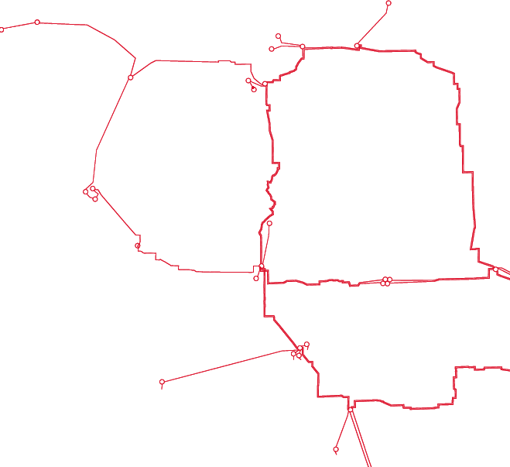
Raw Result- 30 Busses
SSPURTWO
MIAM1
PH1
RAILHEAD
PH2
ROUTE_66
CTT_GRAY
ABERNATH
AEEC
AJ_SWOPE
ALIBATES
ALN_CRK
ASTRA
BRISCOE
COTPLNS
CTT_CROS
CTT_GRAY
GRANDVW1
HRFDWIND
LHORN_N
MARIAH
MIAM1
OGALLALA
PH1
PH2
RAILHEAD
ROUTE_66
SALTFORK
SPLAIN1
SPLAIN2
SSPURTWO
TESLA
TULECNYN
W_CW_345
WAKEWE
WHIT_RVR
WINDMILL
AJ_SWOPE
ALN_CRK
GRANDVW1
ALIBATES
SALTFORK
MARIAH
WINDMILL
ASTRA
HRFDWIND
LHORN_N
OGALLALA
TESLA
TULECNYN
BRISCOE
CTT_CROS
WHIT_RVR
COTPLNS
ABERNATH
SPLAIN1
SPLAIN2
AEEC
W_CW_345
WAKEWE

Slide 7
Pare by Protocol?
Electrically Similar Settlement Points
Two or more distinct Settlement Points that are either mapped to the same electrical location in a market model or are mapped to locations that are connected by a transmission element with a reactance of less than 0.0005 per unit.
Notes:
Chapter 2, Definitions

Slide 8
Remove E.S.P. : 23 Busses
MIAM1
SSPURTWO
PH2
RAILHEAD
ABERNATH
AJ_SWOPE
ALIBATES
ALN_CRK
ASTRA
CTT_CROS
CTT_GRAY
GRANDVW1
LHORN_N
MARIAH
MIAM1
OGALLALA
PH2
RAILHEAD
ROUTE_66
SPLAIN1
SPLAIN2
SSPURTWO
TESLA
TULECNYN
W_CW_345
WHIT_RVR
WINDMILL
ROUTE_66
CTT_GRAY
AJ_SWOPE
ALN_CRK
GRANDVW1
ALIBATES
MARIAH
WINDMILL
ASTRA
LHORN_N
OGALLALA
TESLA
TULECNYN
CTT_CROS
WHIT_RVR
ABERNATH
SPLAIN1
SPLAIN2
W_CW_345

Slide 9
E.S.P. Trimmings
Raw Bus | Reactance | E.S.P. Bus
AEEC | 0.00006 | ABERNATH
SALTFORK | 0.00001 | ALN_CRK
BRISCOE | 0.00032 | TULECNYN
COTPLNS | 0.00001 | WHIT_RVR
HRFDWIND | 0.00001 | WINDMILL
PH1 | 0.00039 | RAILHEAD
WAKEWE | 0.00048 | W_CW_345
These changes appear to be reasonable, but note PH1 to Railhead included, but PH2 is not.

Slide 10
E.S.P. on the Margin
Raw Bus | Intuitive Bus | Reactance
GRANDVW1 | ALIBATES | 0.0005
SPLAIN1 | WHIT_RVR | 0.00051
OGALLALA | WINDMILL | 0.0006
RAILHEAD | CTT_GRAY | 0.0006
ROUTE_66 | ALIBATES | 0.0006
ASTRA | WINDMILL | 0.00069
LHORN_N | TULECNYN | 0.0008
PH2 | RAILHEAD | 0.00085
MIAM1 | CTT_GRAY | 0.00129
SPLAIN2 | WHIT_RVR | 0.00143
MARIAH | WINDMILL | 0.00161
SSPURTWO | AJSWOPE | 0.00376
Some of these are reasonable, but note GRANDVW1 is on the margin, SPLAIN1 is close, and PH2 does not qualify while its sister bus did.

Slide 11
E.S.P. – Remove Radial: 11 Busses
SSPURTWO
MIAM1
PH2
RAILHEAD
AJ_SWOPE
ALIBATES
CTT_CROS
CTT_GRAY
OGALLALA
RAILHEAD
TESLA
TULECNYN
W_CW_345
WHIT_RVR
WINDMILL
ROUTE_66
CTT_GRAY
AJ_SWOPE
ALN_CRK
GRANDVW1
ALIBATES
MARIAH
WINDMILL
ASTRA
LHORN_N
OGALLALA
TESLA
TULECNYN
CTT_CROS
WHIT_RVR
ABERNATH
SPLAIN1
SPLAIN2
W_CW_345

Slide 12
Statistics of Real Time RN LMPs
 | AEEC | BRISCOE | COTPLNS | GRANDVW1 | HRFDWIND | LHORN_N | MARIAH | MIAM1 | PH1 | PH2 | HB_NORTH | HB_WEST
AEEC | 1.00
BRISCOE | 1.00 | 1.00
COTPLNS | 1.00 | 1.00 | 1.00
GRANDVW1 | 1.00 | 1.00 | 1.00 | 1.00
HRFDWIND | 1.00 | 1.00 | 1.00 | 1.00 | 1.00
LHORN_N | 1.00 | 1.00 | 1.00 | 1.00 | 1.00 | 1.00
MARIAH | 1.00 | 1.00 | 1.00 | 1.00 | 1.00 | 1.00 | 1.00
MIAM1 | 1.00 | 1.00 | 1.00 | 1.00 | 1.00 | 1.00 | 1.00 | 1.00
PH1_UNIT1_2 | 1.00 | 1.00 | 1.00 | 1.00 | 1.00 | 1.00 | 1.00 | 1.00 | 1.00
PH2_U1_U2 | 1.00 | 1.00 | 1.00 | 1.00 | 1.00 | 1.00 | 1.00 | 1.00 | 1.00 | 1.00
HB_NORTH | 0.95 | 0.95 | 0.94 | 0.95 | 0.95 | 0.95 | 0.94 | 0.95 | 0.95 | 0.95 | 1.00
HB_WEST | 0.96 | 0.96 | 0.95 | 0.96 | 0.96 | 0.96 | 0.95 | 0.96 | 0.96 | 0.96 | 0.98 | 1.00
Mean difference = $0.08
Median = $0.00
Max difference = $59.72
Correlation between known Resource Nodes in the proposed hub is very strong, but weaker compared to existing Hubs. A better look would be to compare proposed Hub bus LMPs, but data is not readily available.

Slide 13
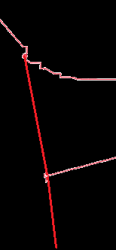
The Abernathy Option
Several potential plans would tie the panhandle in to the rest of the system through Abernathy making it an intuitive candidate for a Hub Bus.
PREZ Study Report
LP&L Option 4OW
Sharyland South Plains
OGALLALA
ABERNATH

Slide 14
Recommendation
RAILHEAD
ABERNATH
AJ_SWOPE
ALIBATES
CTT_CROS
CTT_GRAY
OGALLALA
RAILHEAD
TESLA
TULECNYN
W_CW_345
WHIT_RVR
WINDMILL
CTT_GRAY
AJ_SWOPE
ALIBATES
WINDMILL
OGALLALA
TESLA
TULECNYN
CTT_CROS
WHIT_RVR
ABERNATH
W_CW_345

Slide 15
Risks
Panhandle interface shifts?
Significant Lubbock upgrade beyond plan 4OW?
Additional Load Transfer to ERCOT?

Slide 16
Questions?
Brandon Whittle
www.megawattanalytics.com

Slide 17
Raw Result – 30 Busses
ABERNATH
AEEC
AJ_SWOPE
ALIBATES
ALN_CRK
ASTRA
BRISCOE
COTPLNS
CTT_CROS
CTT_GRAY
GRANDVW1
HRFDWIND
LHORN_N
MARIAH
MIAM1
OGALLALA
PH1
PH2
RAILHEAD
ROUTE_66
SALTFORK
SPLAIN1
SPLAIN2
SSPURTWO
TESLA
TULECNYN
W_CW_345
WAKEWE
WHIT_RVR
WINDMILL

Slide 18
Intuition? – 11 Busses, Debate!
RAILHEAD
AJ_SWOPE
ALIBATES
CTT_CROS
CTT_GRAY
OGALLALA
RAILHEAD
TESLA
TULECNYN
W_CW_345
WHIT_RVR
WINDMILL
CTT_GRAY
AJ_SWOPE
ALIBATES
WINDMILL
OGALLALA
TESLA
TULECNYN
CTT_CROS
WHIT_RVR
W_CW_345

