Slide 1
SMT Update To AMWG
January 2018

Slide 2
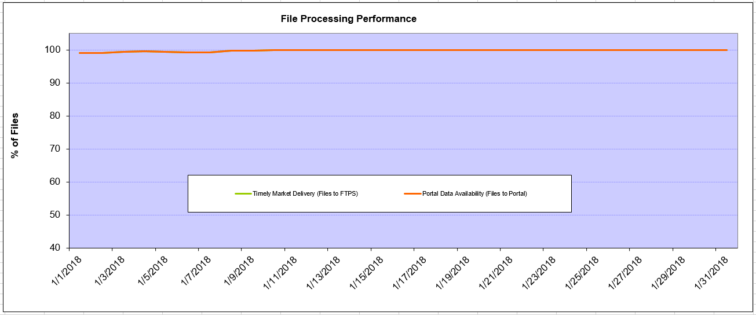
Monthly SMT Data Timelines AMWG CR 2014 002 End to End File Processing Completeness – Jan 2018
% Timely Market Delivery - % of files posted to market (FTPS) by 11:00pm out of # of files received by SMT by 11:00pm.
% Portal Data Availability - % of files loaded to the database for data availability on portal by 6:00am next day for the files received by 11:00pm
A LSE file includes usage data for up to 50,000 ESIIDs.
2

Slide 3
SMT API and FTPS Services Availability – Jan 2018
The service availability is measured as a percentage of number of minutes the service was available out of the total number of minutes in a month, excluding planned outages.
Observed Anomalies:
Mar-Apr 2015: SMT outage and subsequent recovery/catch-up impacted API availability. FTPS was available for most of the part except on 03/21-03/22 for 36 hours.
26 Jul 2015: Services were unavailable for 12 hours due to Flash storage issue
25 Jan 2016: Services were unavailable for 19 hours due to storage configuration issue
07 Mar 2016: API Services were unavailable for 7hours due to Oracle archiver issue.
12 Jul 2017: Due to network Outage FTP & API services are down for 20 minutes. FTPS & API availability is 99.95%.
Notes:
3

Slide 4
SMT Number of Accounts by Type AMWG CR 2014 009 – Jan 2018
Registered Users | ONC | CNP | AEPN | AEPC | TNMP | TOTAL
Active Residential Accounts | 72346 | 31359 | 2031 | 6274 | 4470 | 116480
Active Residential English Accounts | 72044 | 31084 | 2023 | 6127 | 4455 | 115733
Active Residential Spanish Accounts | 302 | 275 | 8 | 147 | 14 | 746
Non Active Residential Accounts | 26631 | 17211 | 1894 | 4324 | 1168 | 50700
Total Residential Accounts | 98977 | 48570 | 3925 | 10598 | 5638 | 167180
TDSP User | 352 | 28 | 10 | 18 | 1 | 409
TDSP Admin | 3 | 4 | 4 | 4 | 3 | 18
Small Business User | 96 | 49 | 1 | 2 | 3 | 151
Small Business Admin | 3238 | 1729 | 95 | 363 | 164 | 5759
Total Agreements (Includes Active and Pending) | 20480 | 3778 | 116 | 345 | 1466 | 26185
Energy Data Agreements (Includes Active and Pending) | 20480 | 3546 | 116 | 345 | 1466 | 25953
Han Device Agreements (Includes Active and Pending) | 0 | 231 | 0 | 0 | 0 | 231
Han Service Agreements (Includes Active and Pending) | 0 | 1 | 0 | 0 | 0 | 1
IN SMT
ESI IDs | 3574206 | 2489147 | 198299 | 870262 | 250226 | 7382140
Meters | 3518884 | 2489061 | 199124 | 870787 | 249525 | 7327381
HAN Devices | 3228 | 4130 | 135 | 267 | 31 | 7791
Acknowledgement | 0 | 0 | 0 | 0 | 0
Pending | 0 | 0 | 0 | 0 | 0
Meter Ready | 5 | 2 | 38 | 93 | 19
Provisioned | 3223 | 4128 | 97 | 174 | 12
HAN Messages (MTD) | 0 | 0 | 0 | 0 | 0 | 0
HAN Messages (YTD) | 0 | 0 | 0 | 0 | 0 | 0
HAN Messages (Cumulative) | 608 | 7412 | 0 | 0 | 0 | 8020
Simple Text Messages | 166 | 2934 | 0 | 0 | 0
Load Control Messages | 192 | 2658 | 0 | 0 | 0
Pricing Messages | 173 | 56 | 0 | 0 | 0
Cancellation Messages | 77 | 1764 | 0 | 0 | 0
Supplemental – (Friends)
Total Agreements | 1972 | 1533 | 82 | 114 | 70 | 3771
Accepted Agreements | 820 | 592 | 36 | 37 | 24 | 1509
Pending Agreements | 9 | 4 | 0 | 1 | 0 | 14
Revoked Agreements | 341 | 297 | 11 | 8 | 7 | 664
Expired Agreements | 761 | 608 | 33 | 68 | 39 | 1509
Terminated Agreements | 41 | 32 | 2 | 0 | 0 | 75
 | TDSPs | REP | Small Business | Regulatory | Third Party
Registered Entities | 5 | 123 | 5567 | 2 | 178
Registered Users | 409 | 913 | 151 | 8 | 28
Registered Admins | 18 | 186 | 5589 | 3 | 163
HAN Messages Sent By | 578 | 7418

Slide 5
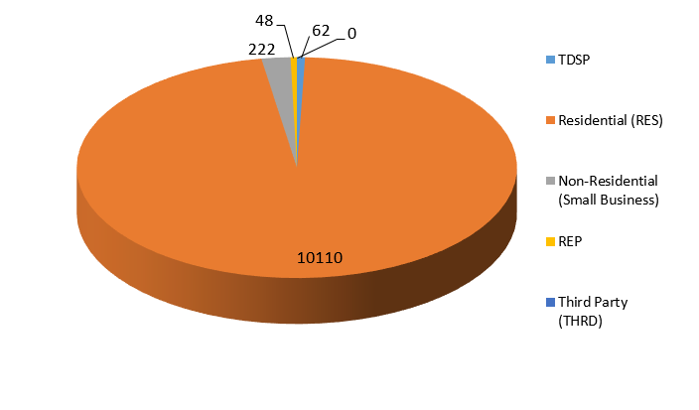
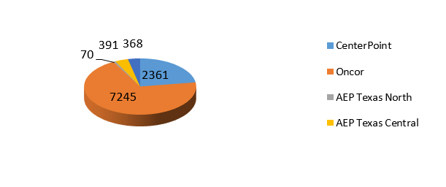
SMT ODR Details – Jan 2018
Total ODR Requests TDSP wise statistics:
Total ODR Requests User type statistics:

