Slide 1
5-min Intra-hour Wind Forecast Performance - July 2018
Operations Analysis Staff
ERCOT
Aug. 13, 2018
QMWG

Slide 2
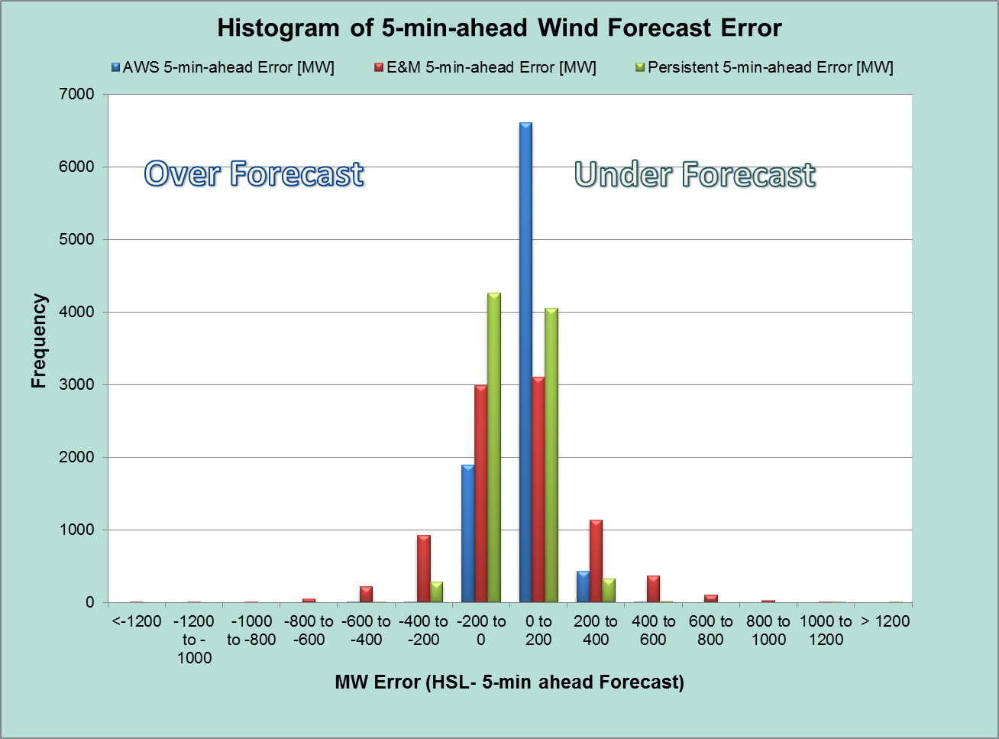
5-min-ahead Wind Forecast Error (July 2018)
 | AWS | E&M | Persistent
Monthly MAE (MW) | 76 | 171 | 81
MAE for Large Wind Ramp Events (MW)* | 106 | 297 | 186
Large Wind Ramp Events: > 100 MW/5 min or < -100 MW/5-min

Slide 3
Questions?

