Slide 1
KP1.1(2),(6),(7) and KP3(13)-(18): RUC Items and the Reliability Deployment Pricing Run
Analysis of Pricing Outcomes Under Scarcity with RUC-committed Resources in Real-Time Co-Optimization
ERCOT Staff
RTCTF
December 3rd, 2019

Slide 2
Purpose
Under today’s market design there are two different mechanisms for mitigating the pricing impact when ERCOT RUCs a Resource
  The Reliability Deployment Price Adder (RDPA)
  Modifications to the Real-Time On-Line Capacity (RTOLCAP) when calculating the ORDC price adders
The two different mechanisms treat the RUC capacity differently
  In the RDPA, the RUC Resource has a $1,500/MWh offer floor, as if the RUC Resource is online but fairly expensive to dispatch
  In the RTOLCAP, the RUC Resource’s HSL is removed entirely, as if the RUC Resource is not online
The PUC has directed that ERCOT’s market design for RTC preserve, as much as possible, the pricing outcomes during scarcity that currently exist without RTC
Under RTC, the ORDC price adders will be discontinued, so how can the RDPA be modified to achieve both the outcomes listed above?
This presentation describes an analysis of options for the RDPA under RTC and proposes language changes for Key Principles 1.1 and 3

Slide 3
Agenda
RTC Key Principles
  KP1.1
  KP3
Overview of how RUC-committed Resources are handled in SCED and ORDC
Introduction and Methodology of Analysis
Analysis Results
  Impact of Mitigation and AS Offers
  Scenario with EOC of $1,500/MWh in Dispatch and Pricing Run
  Scenario with EOC of $1,500/MWh in Dispatch Run and EOC administratively set to $11,000/MWh in Pricing Run
  Emulation of current process of handling ONRUC capacity in SCED and ORDC
Comparison and Discussion of Results
Proposed Changes to KP1.1 and KP3

Slide 4
KP1.1 Ancillary Service Demand Curves and Current Market Price Adders
As part of KP1.1, RTCTF has discussed the following principle concepts:
  2) The existing process of having a pricing run to capture the effects of reliability deployments will continue, as will the existing reliability deployment triggers for executing that process. However, the pricing run will be modified to also co-optimize energy and AS. To account for the co-optimization in the pricing run, the following modifications will be made to the inputs:
  AS offers from Reliability Unit Commitment (RUC) instructed Resources, including RMR Resources, will be removed for the pricing run or be assigned a pre-defined high AS offer price.
7) The existing policy of removing RUC and RMR capacity from the calculation of the ORDC adder will be preserved in effect as faithfully as possible. (Proposed by Luminant)

Slide 5
KP3 Reliability Unit Commitment
As part of KP3, RTCTF has discussed the following principle concept:
  The Energy Offer Floor for RUC-instructed Resources which have not opted out of RUC settlement will be $1,500/MWh for both the dispatch and pricing run.
  AS Offer Floors for RUC-instructed Resources which have not opted out of RUC Settlement will be $1,500/MWh, or the ASDC value at the AS Plan quantity, whichever is lower, for both the dispatch and pricing runs.

Slide 6
Current RUC Process in SCED and ORDC
RUC-committed Resources in SCED
RUC-committed Resources have an energy offer floor of $1,500/MWh
Energy Offer Curve of RUC-committed Resource is subject to mitigation in both the Dispatch and Pricing Runs of SCED
RUC-committed Resources in ORDC
In ORDC, ONRUC capacity is removed from RTOLCAP and thus removed from the scarcity pricing mechanism to ensure there are no RUC related diminishing effects on On-Line Reserve Price Adder
In ORDC, ONRUC capacity is included in RTOFFCAP only if the ONRUC Resource is qualified for RTCST30HSL for the SCED interval
Intended to keep RUC-committed Resources from diminishing the Real-Time On-Line Reserve Price Adder during scarcity conditions

Slide 7
Introduction
Analysis intended to determine how RUC-committed Resources are to be handled in both the Dispatch and Pricing Runs under RTC to best emulate the pricing outcomes of the current SCED and ORDC process during scarcity conditions
Using the RTC Automated Scenario Analysis Tool (link), we ran various scenarios with increasing demand levels to simulate committing a resource in varying scarcity conditions
Scenarios emulated SCED runs:
  Dispatch Run (both Step 1 and Step 2)
  Pricing Run (both Step 1 and Step 2)
Scenarios studied different energy offer prices for the RUC’d resource
  $1,500 as it would be submitted or created by SCED via a proxy offer
  An administratively set EOC of $11,000 in the Pricing Run only (~ equal to the Power Balance Penalty Price)
Scenarios also studied different AS offer prices for the RUC’d resource
  $1,500 for all AS products
  $2,000 for all AS products
  Max($1,500, AS product’s max price on ASDC)
  Zero quantity offers in the Pricing Run only

Slide 8
Methodology
Combinations of EOCs and AS offer prices were run for demand levels from 56,050MW to 61,250MW in increments of 200MW
The committed resource had an HSL = 500MW and an LSL = 100MW. Total system capacity without the committed resource was 62,000MW.
EOCs for the RUC’d Resource were $1,500 for the Dispatch Run and $1,500 or $11,000 for the Pricing Run
AS offers for the RUC’d Resource were $1,500, $2,000, or the max of $1,500 or the AS product’s max price on the ASDC
AS product’s maximum price on the demand curve, based on projected Post-NPRR863 AS quantities for May 2019, HE17:
AS Product | Plan Quantity | ASDC Max Price
REGUP | 296MW | $9,000
RRS | 2,564MW | $9,000
ECRS | 942MW | $4,250
NSPIN | 511MW | $1,500

Slide 9
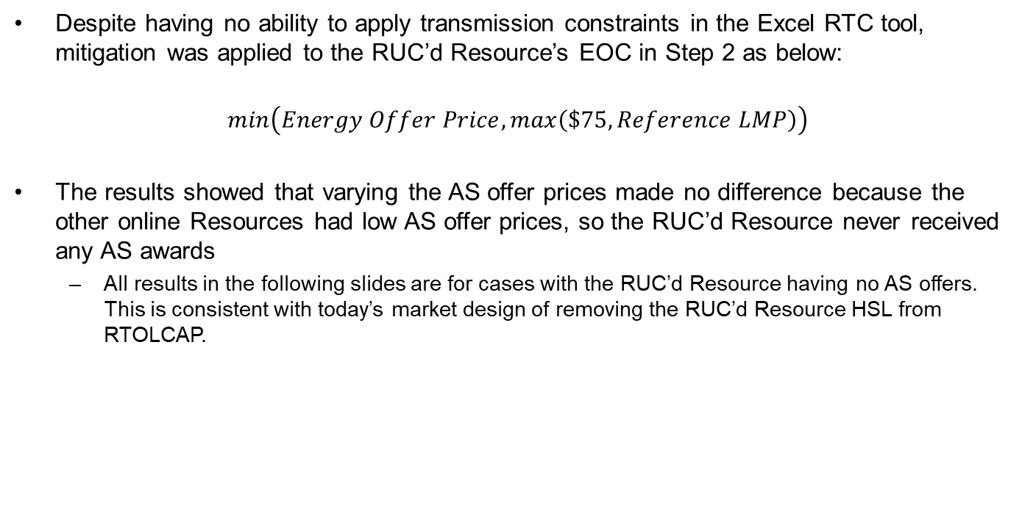
Mitigation and Impact of AS Offers
Despite having no ability to apply transmission constraints in the Excel RTC tool, mitigation was applied to the RUC’d Resource’s EOC in Step 2 as below:
$$min\left(Energy Offer Price, max\left(\$75, Reference LMP\right)\right)$$
The results showed that varying the AS offer prices made no difference because the other online Resources had low AS offer prices, so the RUC’d Resource never received any AS awards
  All results in the following slides are for cases with the RUC’d Resource having no AS offers. This is consistent with today’s market design of removing the RUC’d Resource HSL from RTOLCAP.

Slide 10
Results for runs with Pricing Run EOC = $1,500
Pricing Run System Lambda
Dispatch Run System Lambda
Reliability Deployment Price Adder

Slide 11
Results for runs with Pricing Run EOC = $11,000
Pricing run system lambda is higher because RUC’d Resource sets higher Reference LMP due to Step 1 EOC of $11,000/MWh instead of $1,500/MWh
In the Pricing Run the RUC’d resource’s EOC is higher than AS shortage prices, so the RUC’d Resource is not awarded energy during scarce conditions and does not create headroom on other Resources to provide room for AS awards
Dispatch Run System Lambda
Pricing Run System Lambda
Reliability Deployment Price Adder

Slide 12
Without RTC Scenario
For comparison to what is done today, a scenario was also made to emulate current implementation with the same set of online generators and demand levels as the RTC scenarios
  A case was run without the committed resource (with co-optimization) at the lowest load level to determine the AS Responsibilities of the non-RUC’d Resources
  The AS awards were then subtracted from the energy offer quantities of the non-RUC’d online generators to emulate a HASL
  All AS Plan requirements were then zeroed out and the spreadsheet tool re-run so that it only optimized energy dispatch and the resulting prices did not include opportunity cost
  As conditions became more scarce, portions of HASL were released
Using the resulting RTOLCAP values and next summer’s mu and sigma, a RTORPA was calculated
An all-in price was made by summing the dispatch run system lambda, RTORPA, and RDPA, with proper capping for each value as is done today
This process emulates today’s pricing outcome

Slide 13
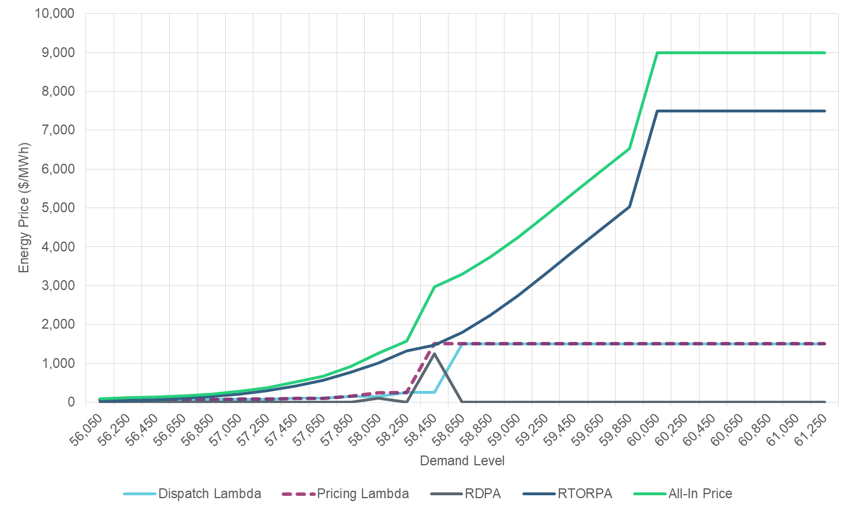
Results for runs without RTC
All-In Price
ORDC Adder (RTORPA)
Dispatch Run System Lambda
Pricing Run System Lambda
Reliability Deployment Price Adder

Slide 14
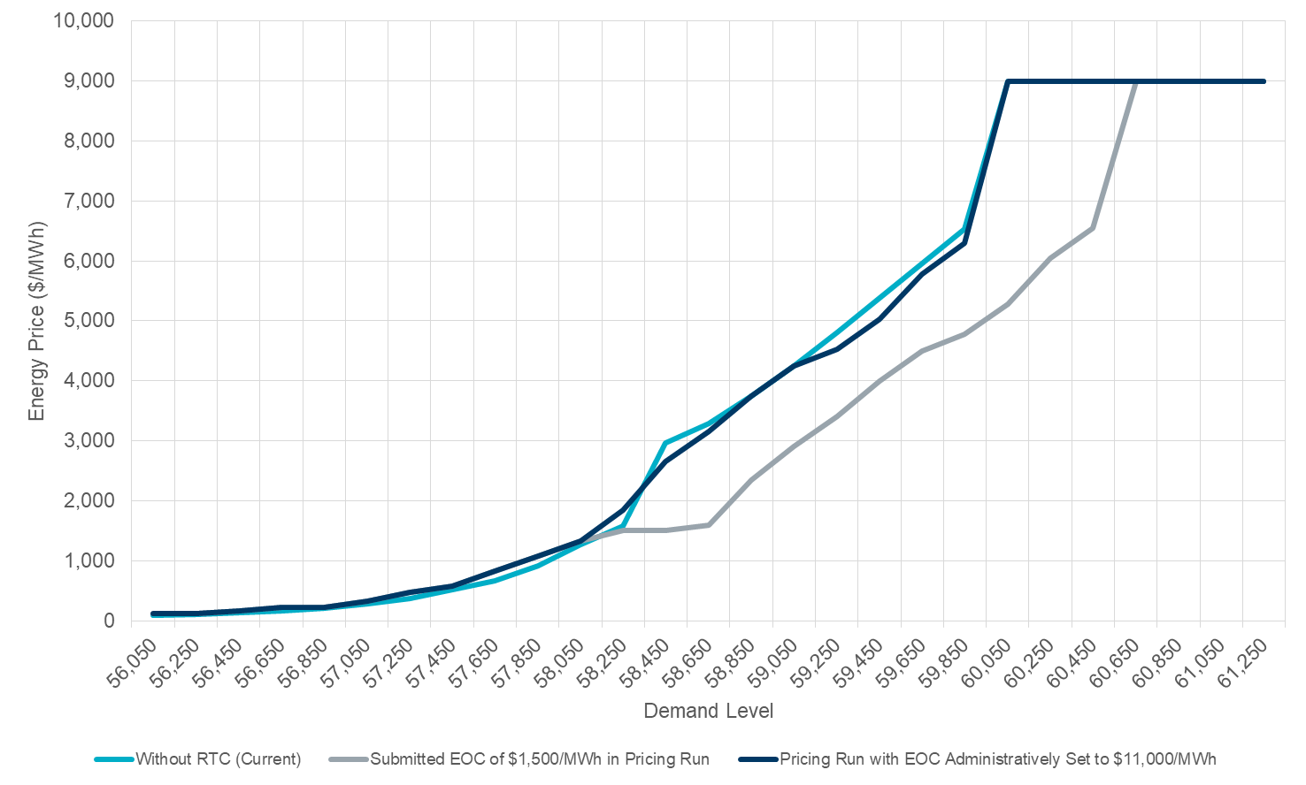
Comparison of Results | All-In Prices
Without RTC (current market outcome)
RTC with EOC of $11,000/MWh in Pricing Run
RTC with EOC of $1,500/MWh in Pricing Run
Both RTC scenarios use same Dispatch Run:
Energy offer price: $1,500/MWh
AS offer price: $1,500/MWh

Slide 15
Discussion of Results
In the scenario with the EOC set to $1,500 in both the Dispatch and Pricing run, the AS shortage prices are greater than the energy offer of the RUC-committed Resource
This allows headroom to be created on other Resources and thus the energy price to be set by a lower point on the ASDC or offer stack
Does not emulate current pricing outcomes in scarce conditions

Slide 16
Discussion of Results
In the scenario where the EOC is administratively set to $11,000/MWh in the Pricing Run, the energy offer is higher than the AS shortage prices and thus the RUC-committed Resource is not awarded energy during scarce conditions
This allows the energy price in the Pricing Run to be set as if the ONRUC capacity is excluded from the headroom
This EOC is still subject to mitigation for non-competitive constraints
Most similar to current implementation in both scarce and non-scarce conditions:
This approach would need review if the price adder design were to change from a system-wide price adder to locational price adders, as the design and effects of locational price adders are not fully understood at this point.
 | Dispatch Run | Pricing Run
Energy Offer | Floor of $1,500/MWh | Administratively set to $11,000/MWh
AS Offer | Floor of $1,500/MWh | None

Slide 17
KP1.1 Ancillary Service Demand Curves and Current Market Price Adders
ERCOT proposes the following language for KP1.1:
  2) The existing process of having a pricing run to capture the effects of reliability deployments will continue, as will the existing reliability deployment triggers for executing that process. However, the pricing run will be modified to also co-optimize energy and AS. To account for the co-optimization in the pricing run and to preserve the existing market design of removing RUC and RMR capacity from the calculation of scarcity prices, the following modifications will be made to the inputs:
  AS offers from Reliability Unit Commitment (RUC) instructed Resources, including RMR Resources, will be removed for the pricing run or be assigned a pre-defined high AS offer price.
  Energy Offers for RUC-instructed Resources, including RMR Resources, will be administratively set to $11,000/MWh for the pricing run. This EOC is still subject to mitigation for non-competitive constraints.
  7) The existing policy of removing RUC and RMR capacity from the calculation of the ORDC adder will be preserved in effect as faithfully as possible.

Slide 18
KP3 Reliability Unit Commitment
ERCOT proposes the following language for KP3:
  The Energy Offer Floor for RUC-instructed Resources which have not opted out of RUC settlement will be $1,500/MWh for both the dispatch and pricing run.
  All RUC-instructed Resources will have their Energy Offer Curve administratively set to a value just below the Power Balance Penalty Price (i.e., $11,000/MWh) in the pricing run only. This EOC is still subject to mitigation for non-competitive constraints.
  1718) The AS Offer Floors for RUC-instructed Resources which have not opted out of RUC Settlement will be $1,500/MWh for the dispatch run, or the ASDC value at the AS Plan quantity, whichever is lower, for both the dispatch and pricing runs.
  19) AS Offers for RUC-instructed Resources which have not opted out of RUC Settlement will be removed for the pricing run.

Slide 19
Discussion

