Slide 1
ERCOT Frequency Control Report
April 2020
ERCOT
Operations Planning
PDCWG | May 29th, 2020

Slide 2
Summary of April 2020
CPS1: 168.91%
Current CPS1 12-Month Rolling Average: 174.34%
0 BAAL Exceedance
6 hourly CPS1 score below 100%
BAAL-003 Events have updated through 2019
2018 BAAL-003 FRM Performance: -843.17
2020 RMS1 Statistics
Mean: 15.93 mHz
Min: 12.25 mHz
Max: 20.00 mHz
Energy Statistics
Total Energy: 26,926,064 MWh
Wind Energy: 7,396,274 MWh
Percent Energy from Wind: 27.47%
Solar Energy: 419,973 MWh
Percent Energy from Solar: 1.49%
Minimum System Inertia
Mean: 171,265
Max: 200,438 on Apr 17th
Min: 139,592 on Apr 8th

Slide 3
Frequency Control
CPS1, BAAL, & RMS1

Slide 4
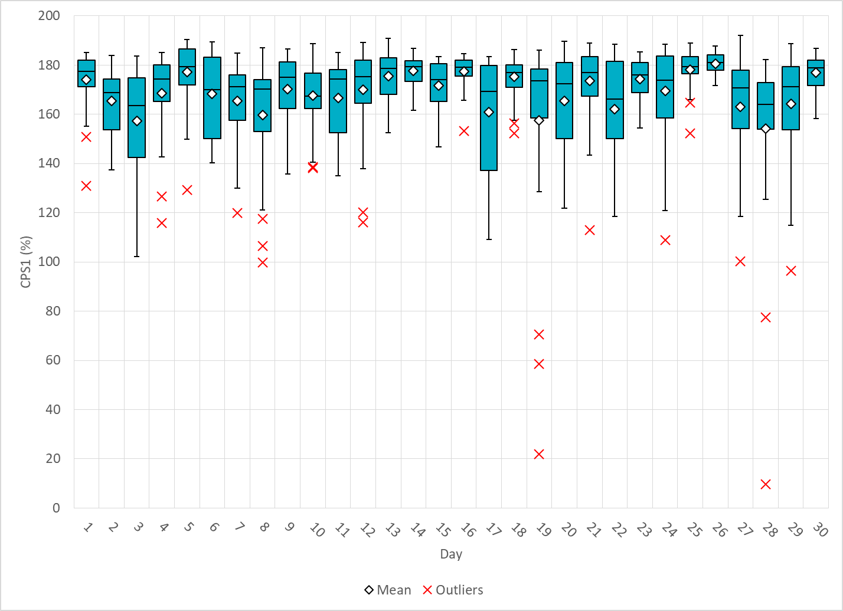
Hourly CPS1 by Day
Apr-20 CPS1 (%): 168.91
Notes:
Outliers:
1. 70.8% @ 16:00 4/19/2020:
Expected gen deviation:
Large expected gen deviation in the middle of the hour and the end of the hour. (-1834 MW @16:36; -1445 MW @16:54)
Negative throughout the hour. (-650 MW on average).
Two thermal units contribute significantly to total expected gen deviation from 16:35 to16:40.
Wind Ramp:
Consistent Wind down ramp throughout the Hour.
Large wind down ramps 301 MW/5min @16:20 and 229 MW/5min @ 16:25
2. 58.8% @ 17:00 4/19/2020:
Expected gen deviation:
Large expected gen deviation in the middle of the hour and the end of the hour. (-1306 MW @17:27; -1854 MW @17:49 )
Negative throughout the hour (-690 MW on average).
One unit had a runback due to losing BFP.
Large expected gen are mostly from renewables.
Wind Ramp:
Consistent Wind down ramp throughout the Hour.
Large wind down ramps 263 MW/5min @17:25 and 10005 MW/20min @ 17:40
3. 21.9% @ 18:00 4/19/2020:
Expected gen deviation:
Large expected gen deviation throughout the hour. (-1808 MW @18:38; )
Negative throughout the hour (-847 MW on average).
Large expected gen deviations are from both thermal units and renewables.
Three resources are not following there basepoints.
Wind Ramp:
Consistent Wind and solar down ramp throughout the Hour.
Average wind down ramp 258 MW/5min.
655 MW of Solar down ramp throughout the hour.
4. 77.1% @ 17:00 4/28/2020:
Expected gen deviation:
Large expected gen deviation at the end of the hour. (-1537 MW @17:54)
Significant bp deviation from solar resources at the beginning of the hour.
Negative throughout the hour (-357 MW on average).
Loss of Generation Event: 332 MW
Wind/solar Ramp:
Over 100 MW solar down ramp within 5 minutes.
5. 9.6% @ 18:00 4/28/2020:
Expected gen deviation:
Large expected gen deviation throughout the hour. (-1844 MW @18:43; )
Negative throughout the hour (-707 MW on average).
Large expected gen deviations are from both thermal units and renewables.
A thermal resource has significant deviation due to runback.
Wind Ramp:
Wind is fairly consistent throughout the hour.
Solar ramps down for roughly 900 MW.
DC Tie (import) ramps down for roughly 600 MW.
6. 96.3% @ 8:00 4/29/2020:
Expected gen deviation:
Large expected gen deviation at the end of the hour.
Frequency trending high at the end of the hour and reg-down being exausted.
Suspected cause of frequency incline is due to nonconforming load drop.

Slide 5
BAAL Exceedances & Violations
There were 0 BAAL exceedance in April

Slide 6
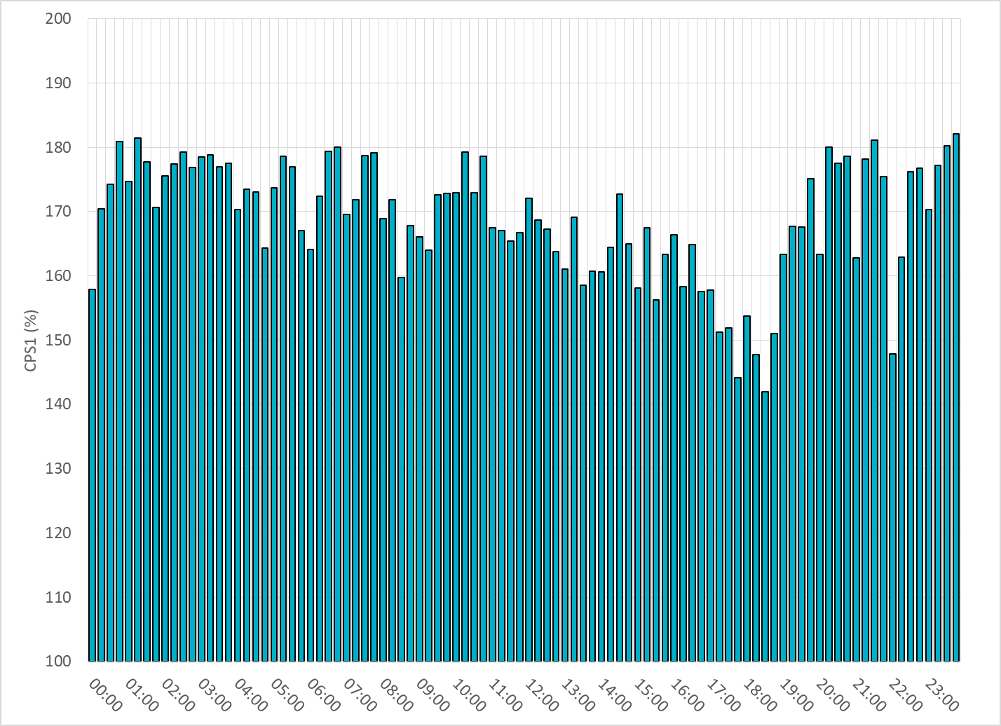
15-Minute Average CPS1%
Apr-20 CPS1 (%): 168.91

Slide 7
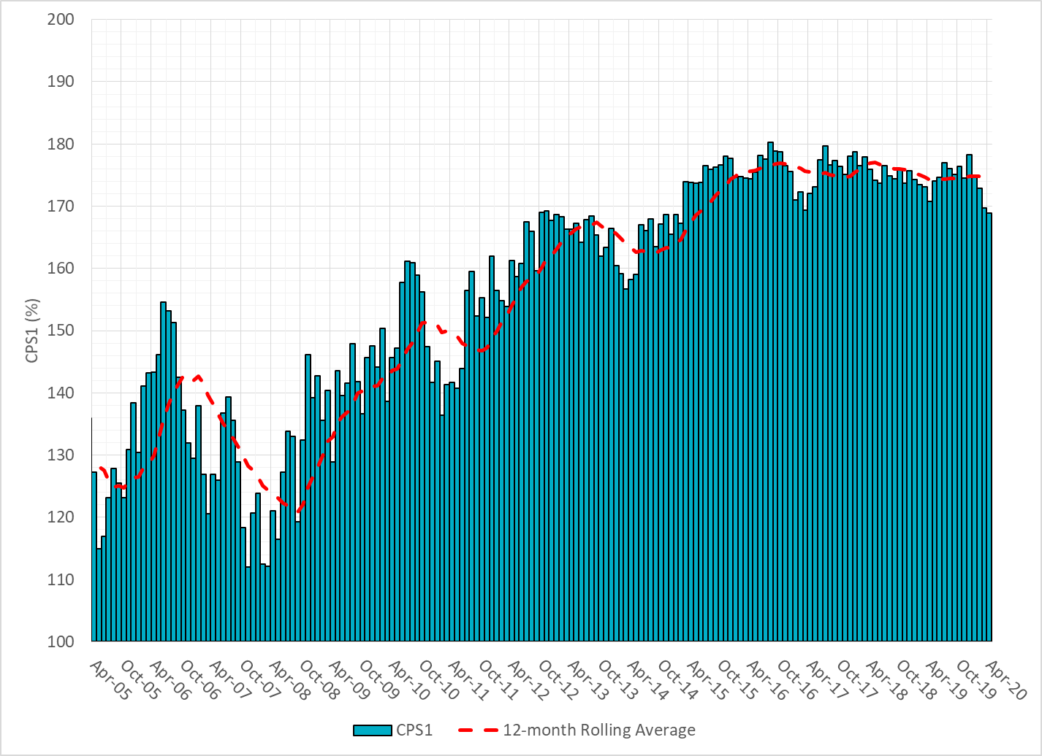
12-Month Rolling Average CPS1
Current 12-Month Rolling Average: 174.34%

Slide 8
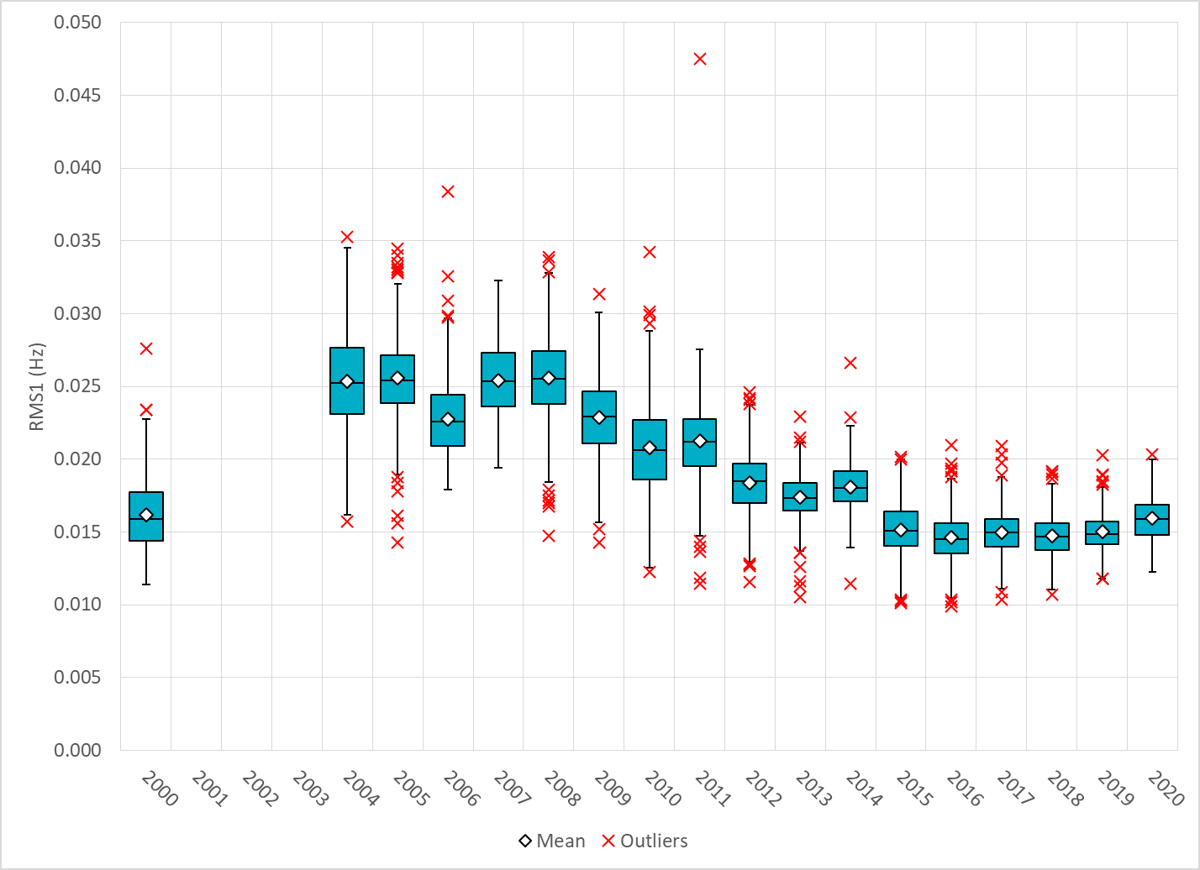
Daily RMS1 of ERCOT Frequency by Year

Slide 9
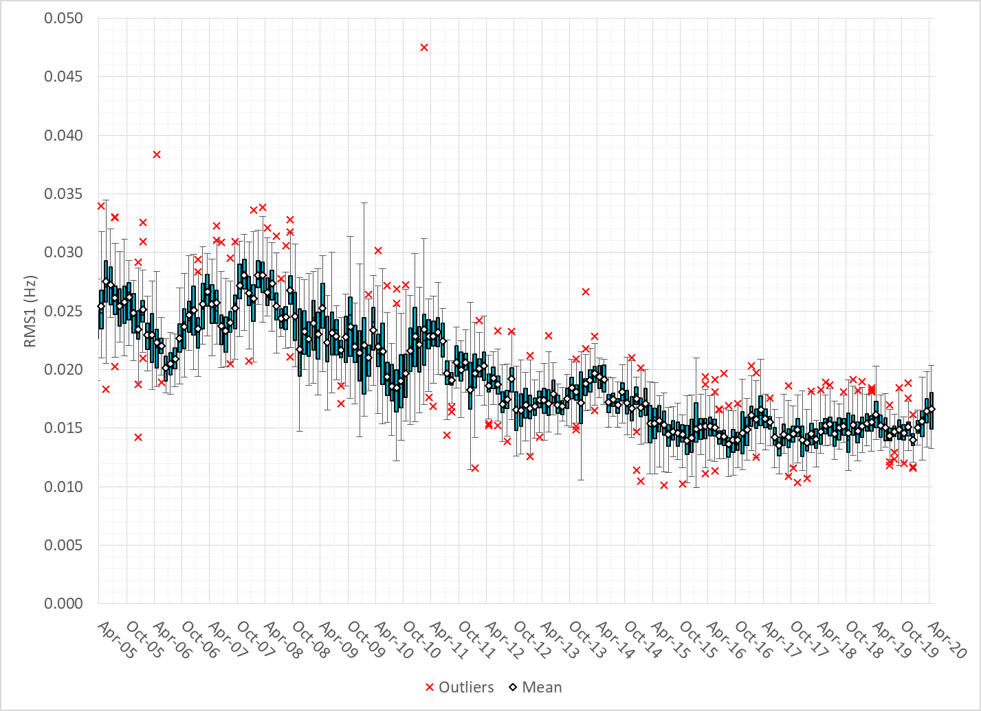
Daily RMS1 of ERCOT Frequency by Month

Slide 10
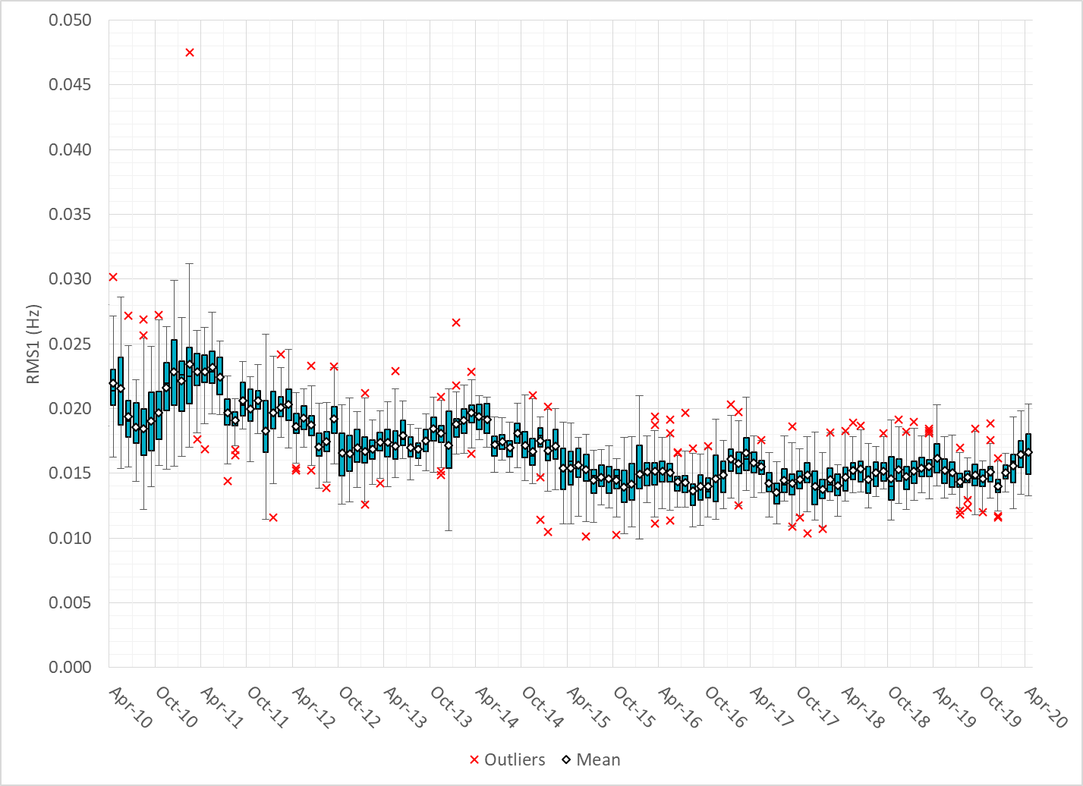
Daily RMS1 of ERCOT Frequency by Month

Slide 11
Frequency Profile Comparison

Slide 12
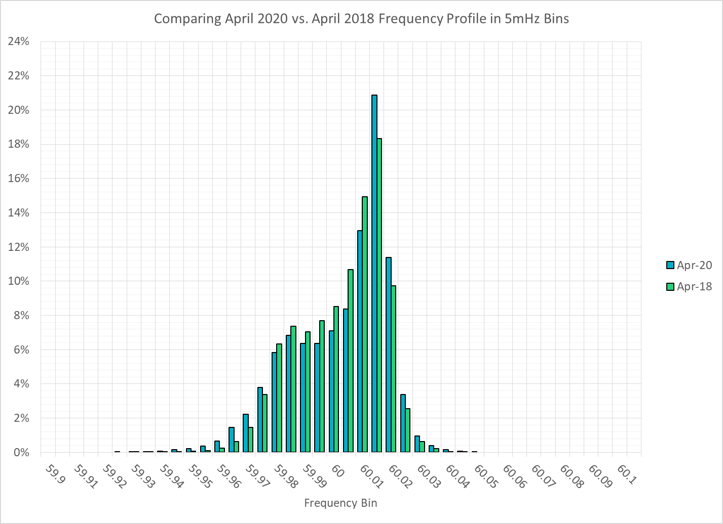
Frequency Profile Comparison

Slide 13
Frequency Profile Comparison

Slide 14
Time Error Correction

Slide 15
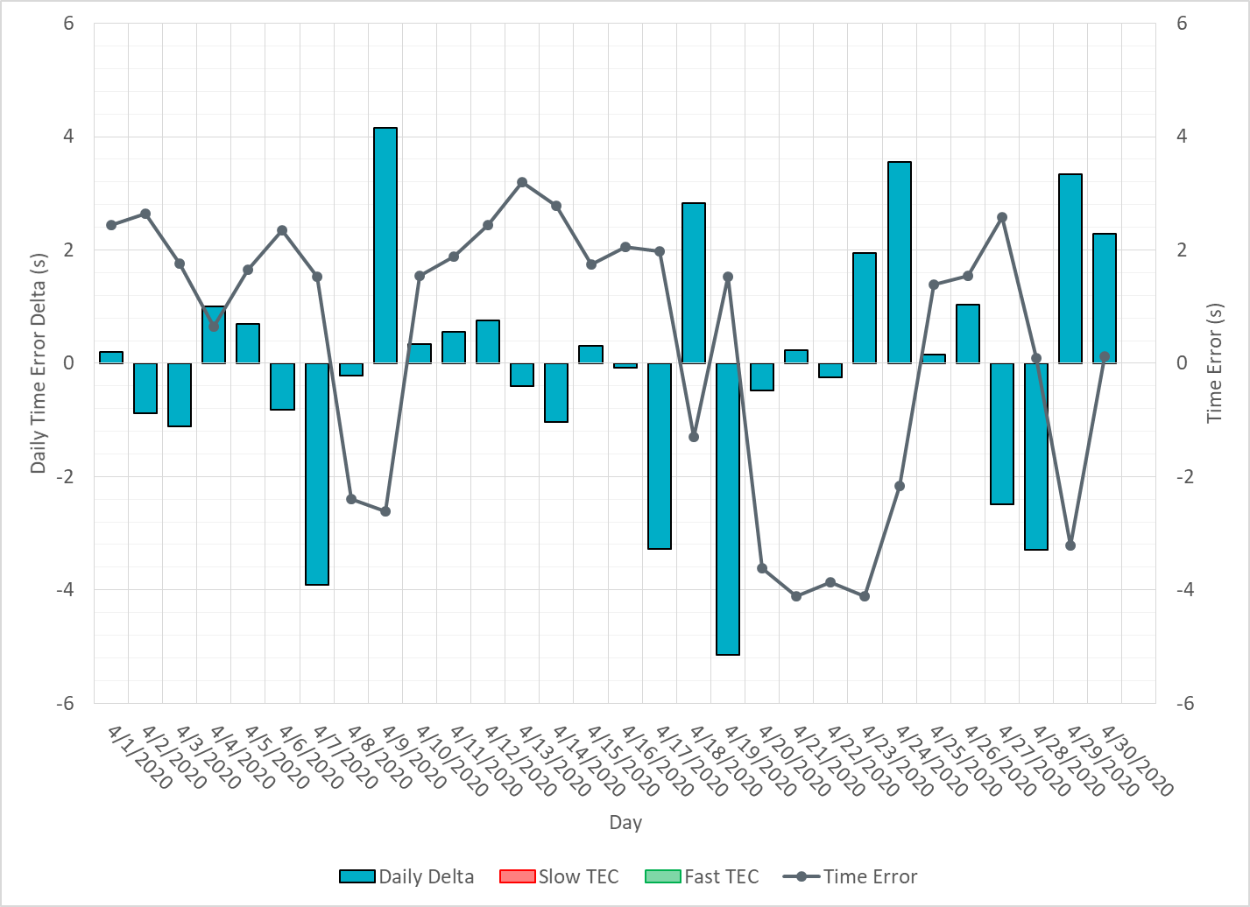
ERCOT Daily Time Error

Slide 16
Time Error Corrections Log Summary
There have been no time error corrections since December 2016

Slide 17
BAL-003 Performance

Slide 18
Op. Year 2018 BAL-003 Selected Events – Update
Notes:
BAL-003

Slide 19
Op. Year 2018 BAL-003 FRM Performance - Update
Notes:
OP2018: FRO = -381.0, FRM_median = -843.17, FRM_average = -959.7
OP2019: FRO = -381.0
OP2020: FRO = -425.0, FRM_median = -811.14, FRM_average = -892.5

Slide 20
ERCOT Energy Statistics

Slide 21
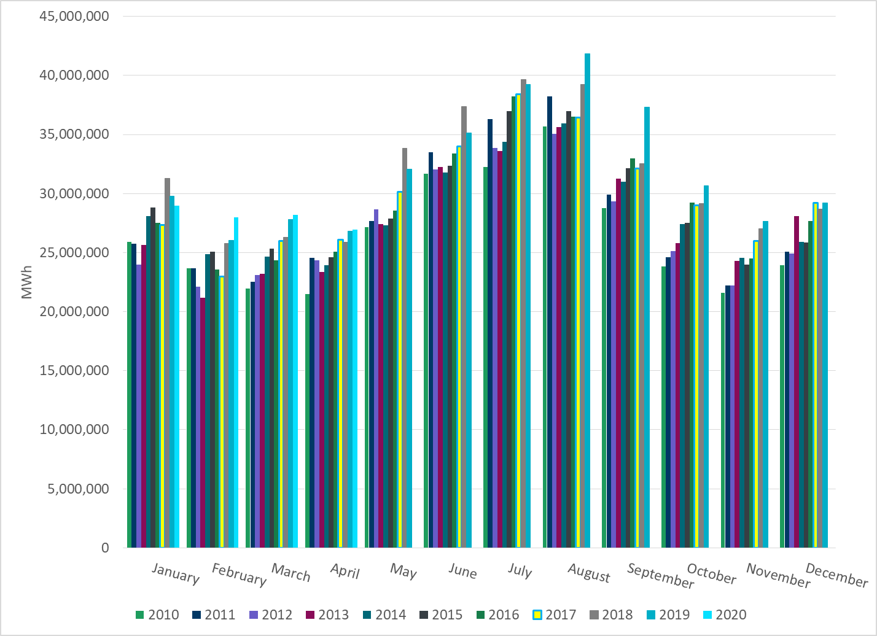
Total Energy
Notes:
26,926,064 MWh

Slide 22
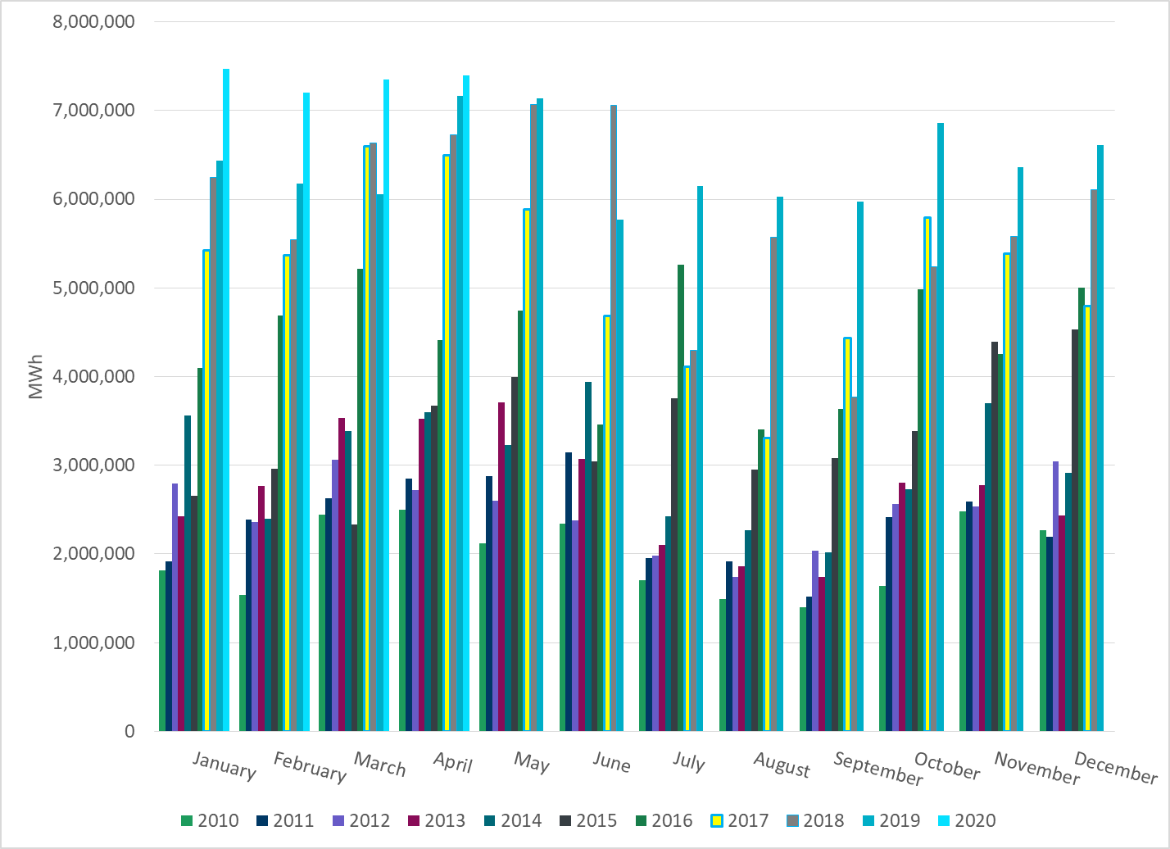
Total Energy from Wind Generation
Notes:
7,396,274 MWh

Slide 23
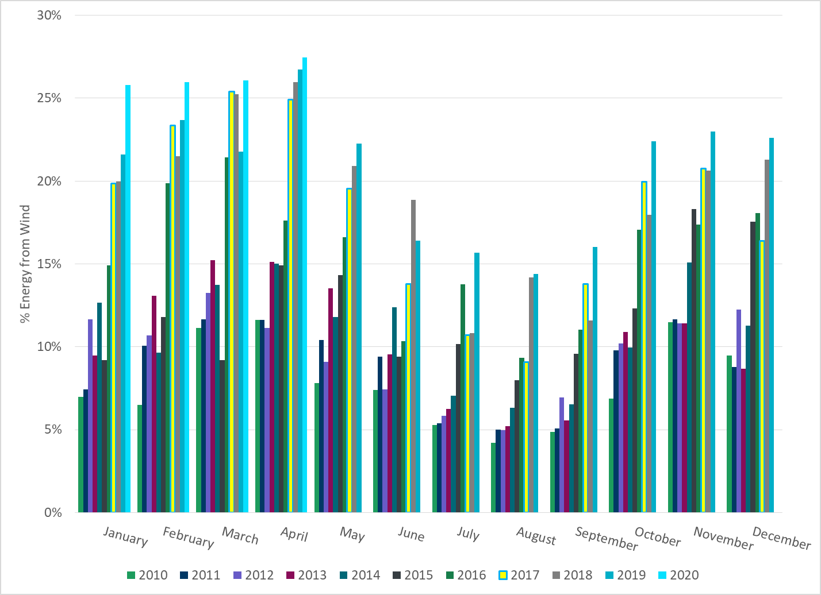
% Energy from Wind Generation
Notes:
27.4%

Slide 24
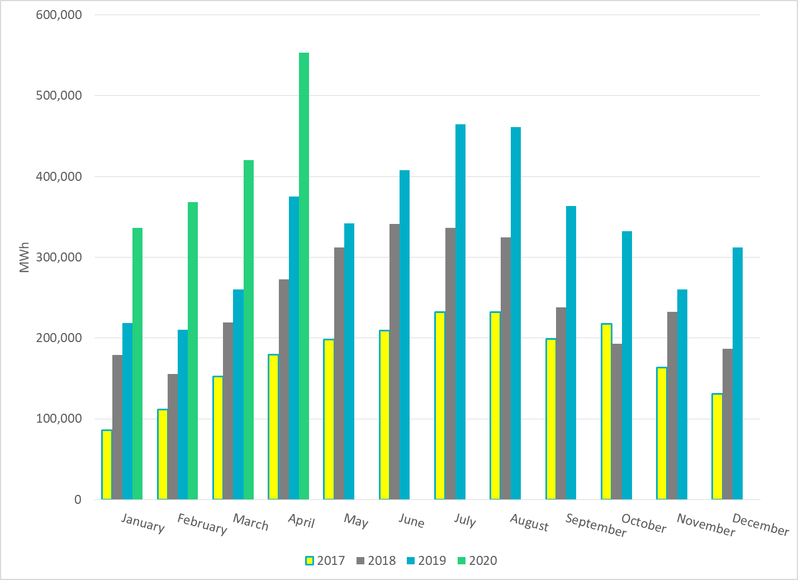
Total Energy From Solar Generation
Notes:
553,191 MWh

Slide 25
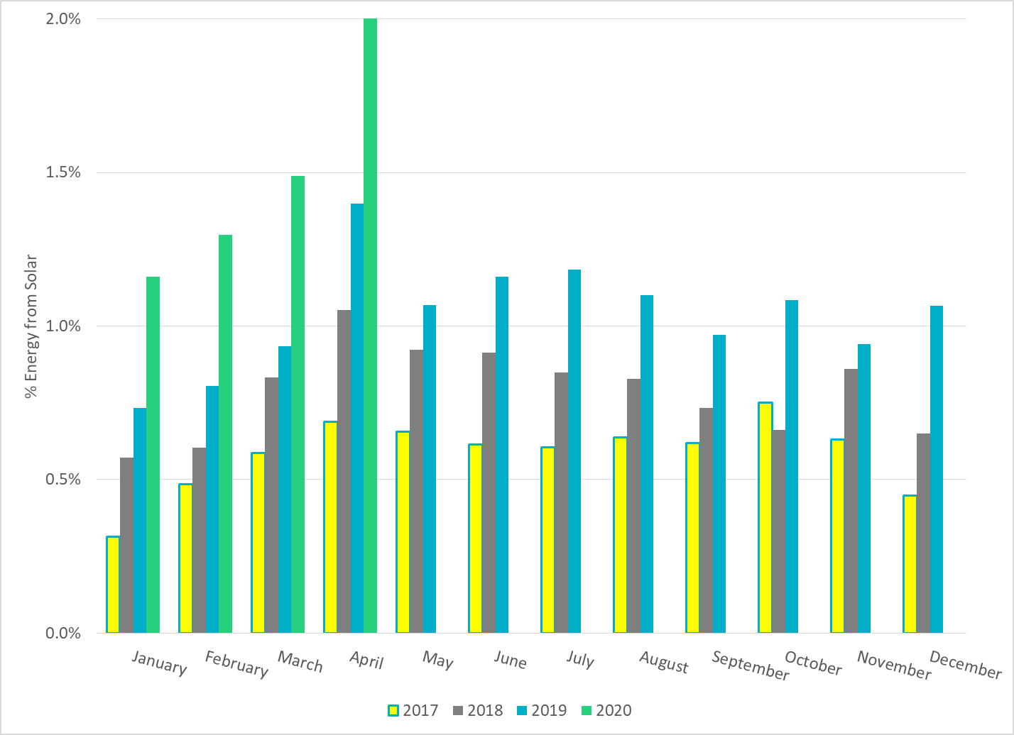
% Energy from Solar Generation
Notes:
2.05%

Slide 26
ERCOT System Inertia

Slide 27
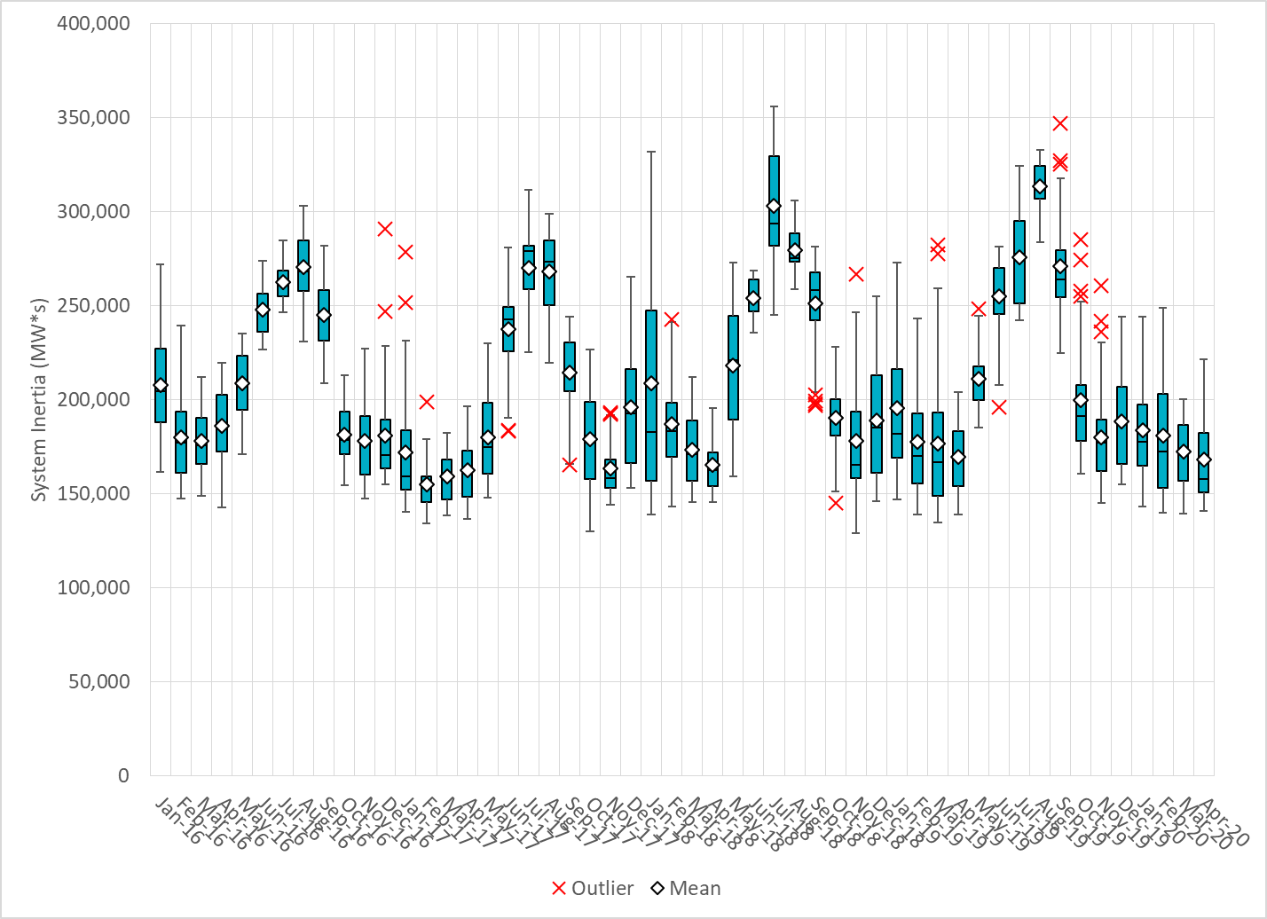
Daily Minimum System Inertia
Notes:
Minimum Inertia = 140,684 MW*s on 4/27/2020
Previous Minimum was 128,759 MW*s on 11/18/2018.
Data:
Mean: 168,047
Max: 221,369 on Apr 8th
Min: 140,684 on Apr 27th

Slide 28
Questions?
Thank you!

