Slide 1
ERCOT Non-FME Frequency Events
September 2020
ERCOT
Operations Planning
PDCWG | October 14th, 2020

Slide 2
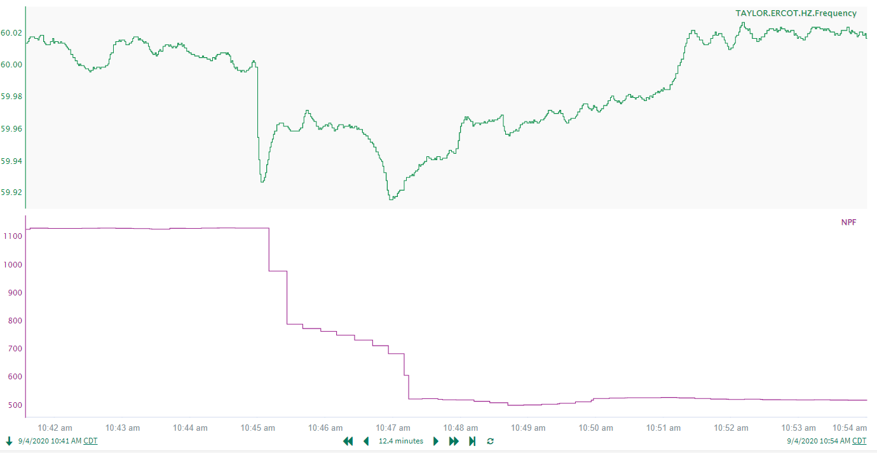
9/4/2020 10:44:59
Notes:
Partial trips while carrying 1131 MW (Initial loss of about 200 MW)
Starting Frequency: 59.9990 Hz
Minimum Frequency: 59.9270 Hz
A-C Time: 4 seconds
Recovery Time: 6 minutes and 14 seconds (90th percentile is 7 minutes and 10 seconds)
RRS Deployed: 0 MW
Trip Reason: Operator Log shows the trip was due to Low Lube Oil Pressure
No Selection Reason: Loss of MW was too low. Frequency nadir wasn’t low enough.

Slide 3
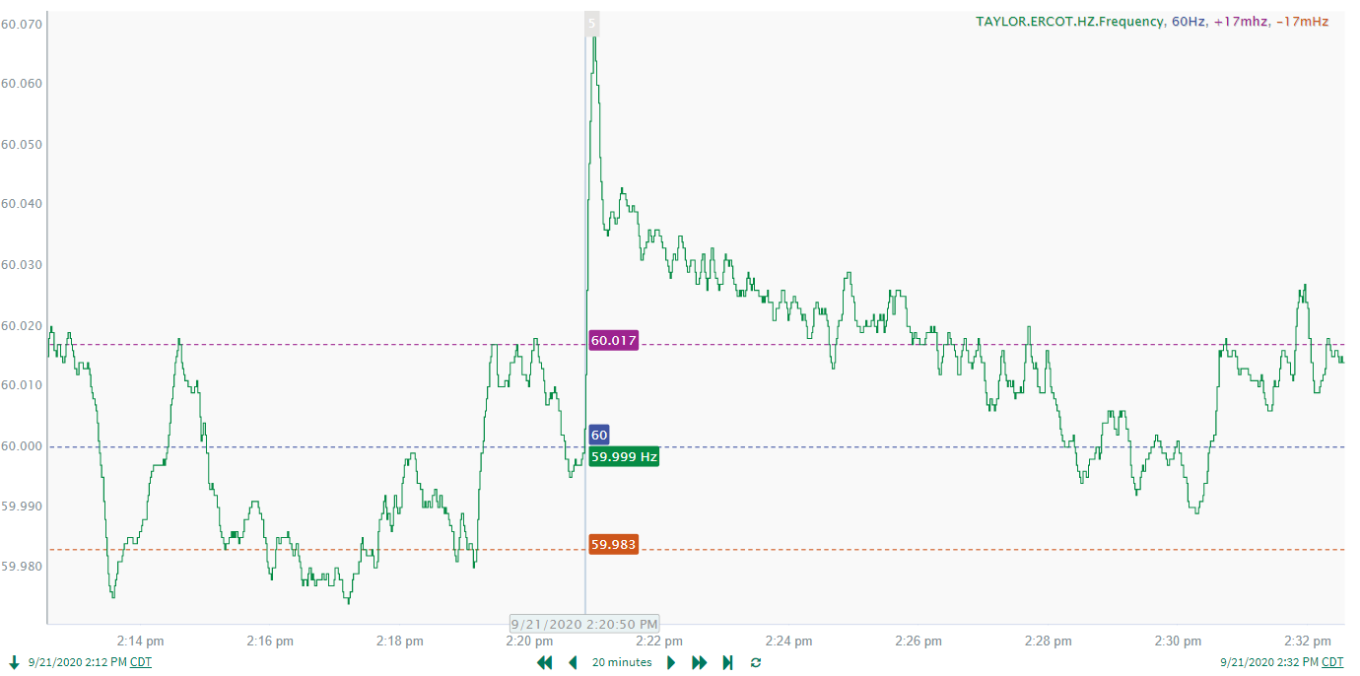
9/21/2020 12:20:50
Notes:
About 218 MW of Load Loss
Starting Frequency: 59.9980 Hz
Maximum Frequency: 60.068 Hz
A-C Time: 9 seconds
Recovery Time (back to deadband): 3 minutes and 48 seconds (90th percentile is 7 minutes and 10 seconds)
RRS Deployed: 0 MW
Trip Reason: No information available.
No Selection Reason: Measured Loss of load was too low. Max Frequency was not high enough
Notes: Draft Disturbance Report was posted and RFIs were sent out to IRRs that failed to respond.

Slide 4
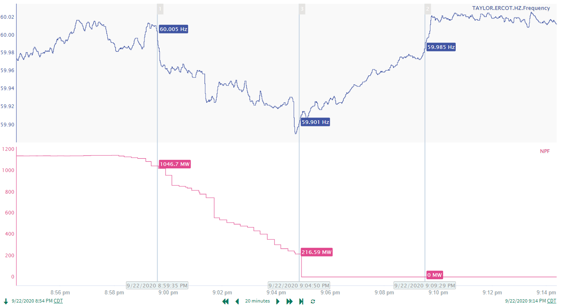
9/22/2020 20:59:31
Notes:
Resource ran back while carrying 1145.9 MW over a 7 minute period
Starting Frequency: 60.005 Hz
Minimum Frequency: 59.89 Hz
RRS Deployed: 778 MW
Trip Reason: Suspected cause of trip was condensate supply instrumentation
No Selection Reason: Run back led to a drag in frequency rather than a clean decline

Slide 5
Questions?
Thank you!

