Slide 1
Review of the RUC Instructions in September
ERCOT Staff
September 22, 2021
WMWG

Slide 2
Introduction
ERCOT has been procuring additional Ancillary Services (A/S) beginning July 12, 2021. Specifically,
ERCOT has been procuring 2,800 MW of Responsive Reserve Service (RRS) over the peak hours. This will continue till December 31, 2021*.
ERCOT has been procuring additional Non-Spinning Reserve Service (Non-Spin) quantities such a minimum of 6,500 MW of up A/S (i.e., Regulation Up (Reg Up), RRS and Non-Spin) will be procured in all hours.
Between September 1 and December 31, 2021*, Non-Spin quantities have been setup such that the sum of Reg Up, Non-Spin and RRS, less RRS expected to be provided by Load Resources (CLR and NCLR), is equal to 6,500 MW for every operating hour.
ERCOT has continued to use the RUC process to maintain a margin of 6,500 MW between committed generation capacity (including offline Non-Spin) and active load forecast for hours ending 14 through 21.
*A/S quantities per the 2022 A/S Methodology are expected to be effective beginning Jan 1, 2022.

Slide 3
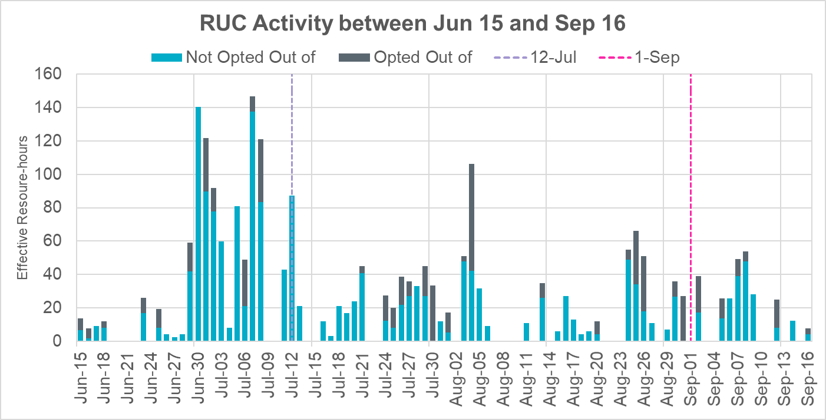
RUC Activity beginning June 15, 2021
There continues to be a visible reduction in the RUC activity.

Slide 4
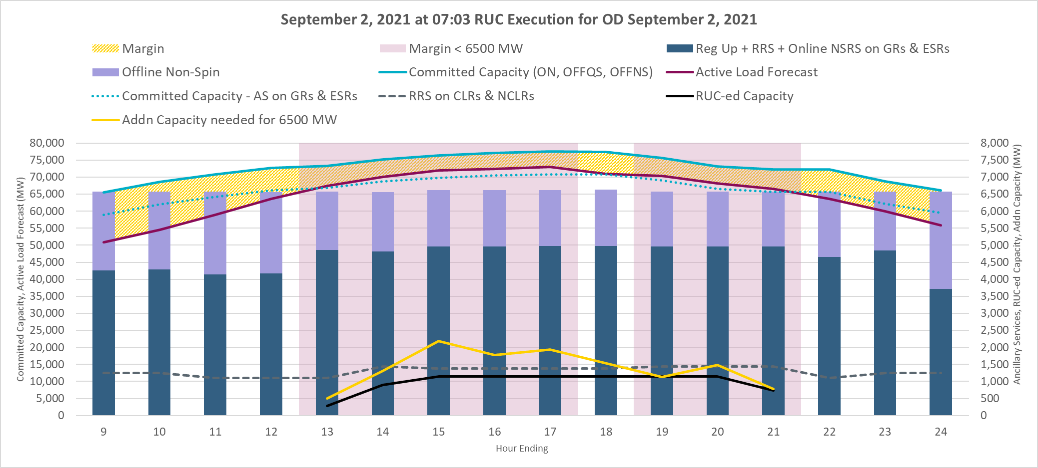
RUC Activity for September 2, 2021
To maintain a margin of 6,500 MW between committed generation capacity (including offline Non-Spin) and active load forecast, approx. 1,141 MW capacity was RUC-ed following the 07:03 RUC execution for HE14 through HE21.

Slide 5
RUC Activity for Sep 05, 2021
To maintain a margin of 6,500 MW between committed generation capacity (including offline Non-Spin) and active load forecast, following RUCs were conducted.
Approx. 40 MW capacity was RUC-ed following the 09/04 23:03 RUC execution for HE15 through HE18
Approx. 1,031 MW capacity was RUC-ed following the 08:03 RUC execution for HE15 through HE20

Slide 6
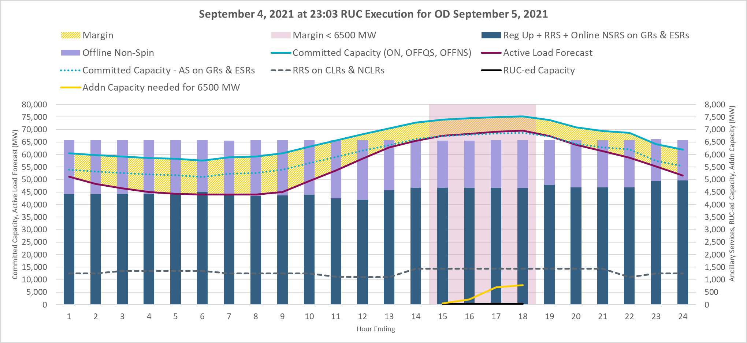
11pm RUC Execution on September 4, 2021
Margin for peaks hours was below 6,500 MW and additional capacity was RUC-ed.

Slide 7
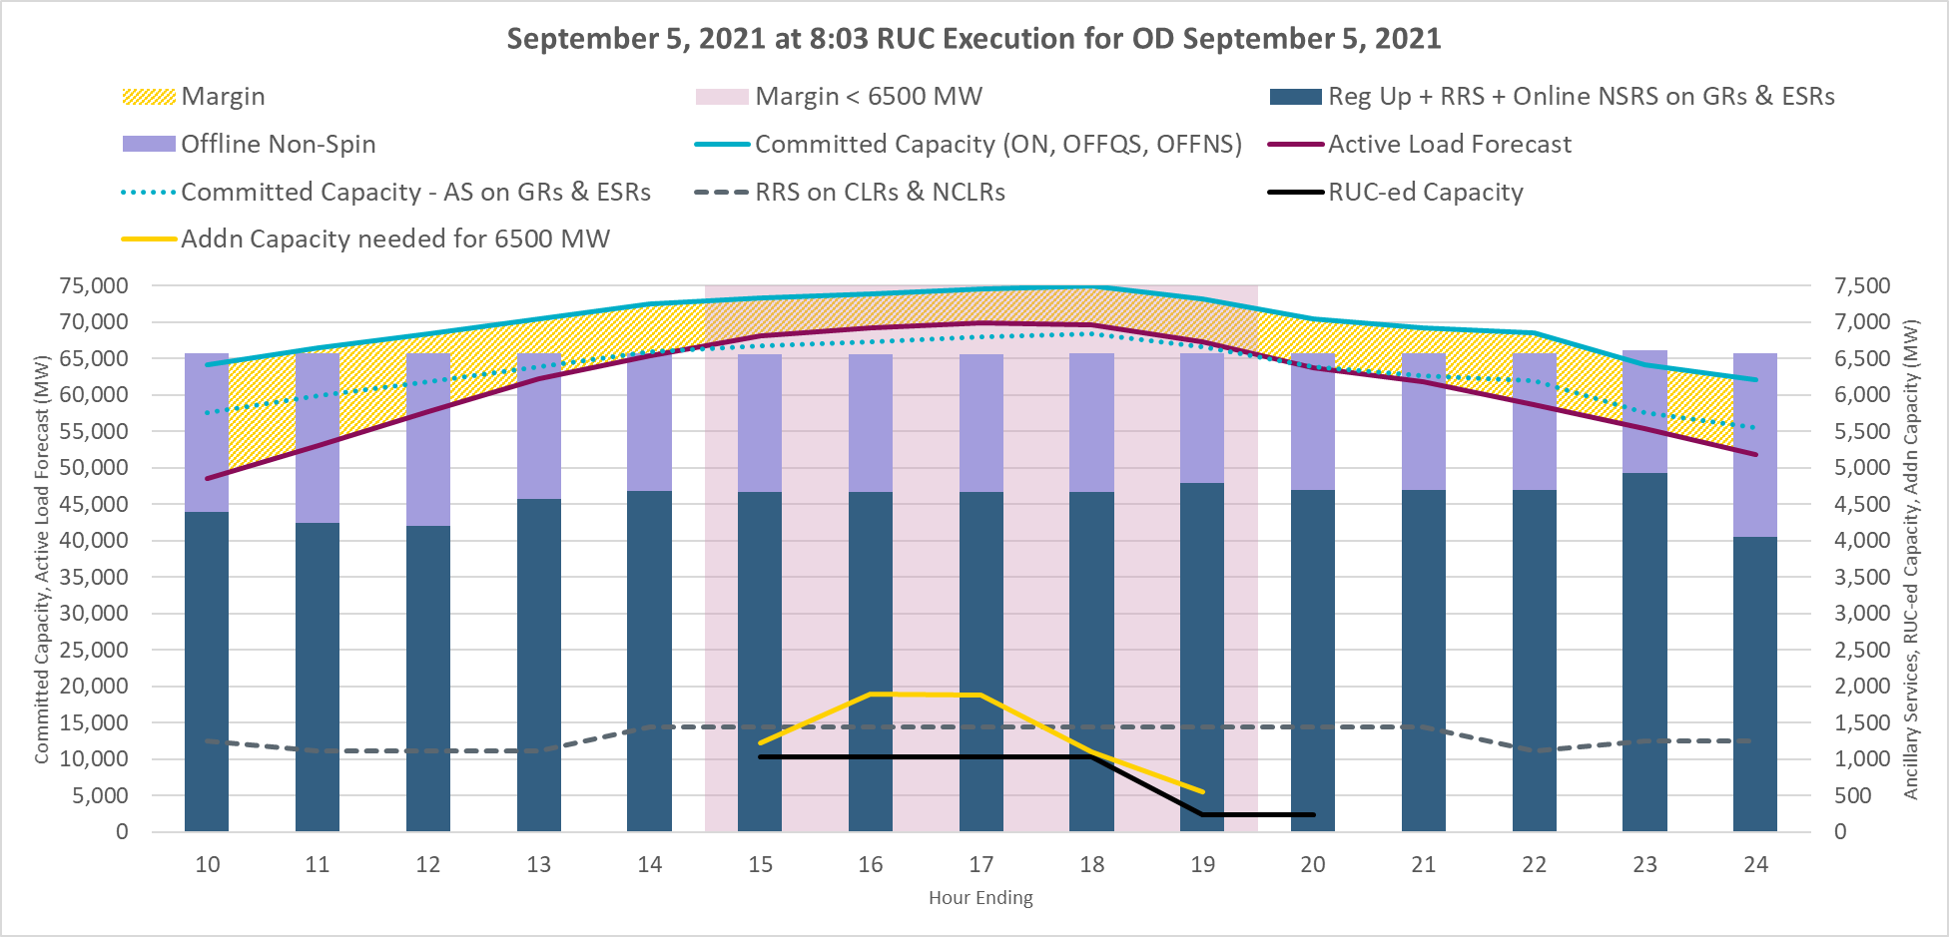
8am RUC Execution on September 5, 2021
Margin for peaks hours was below 6,500 MW and additional capacity was RUC-ed.

Slide 8
RUC Activity for Sep 07, 2021
To maintain a margin of 6,500 MW between committed generation capacity (including offline Non-Spin) and active load forecast, following RUCs were conducted.
Approx. 110 MW capacity was RUC-ed following the 09/06 19:03 RUC execution for HE01 through HE24 (for capacity and minimum runtime of 24 hours)
Approx. 125.5 MW capacity was RUC-ed following the 00:03 RUC execution for HE15 through HE20
Approx. 392 MW capacity was RUC-ed following the 7:03 RUC execution for HE15 through HE18
Approx. 239 MW capacity was RUC-ed following the 9:03 RUC execution for HE15 through HE18

Slide 9
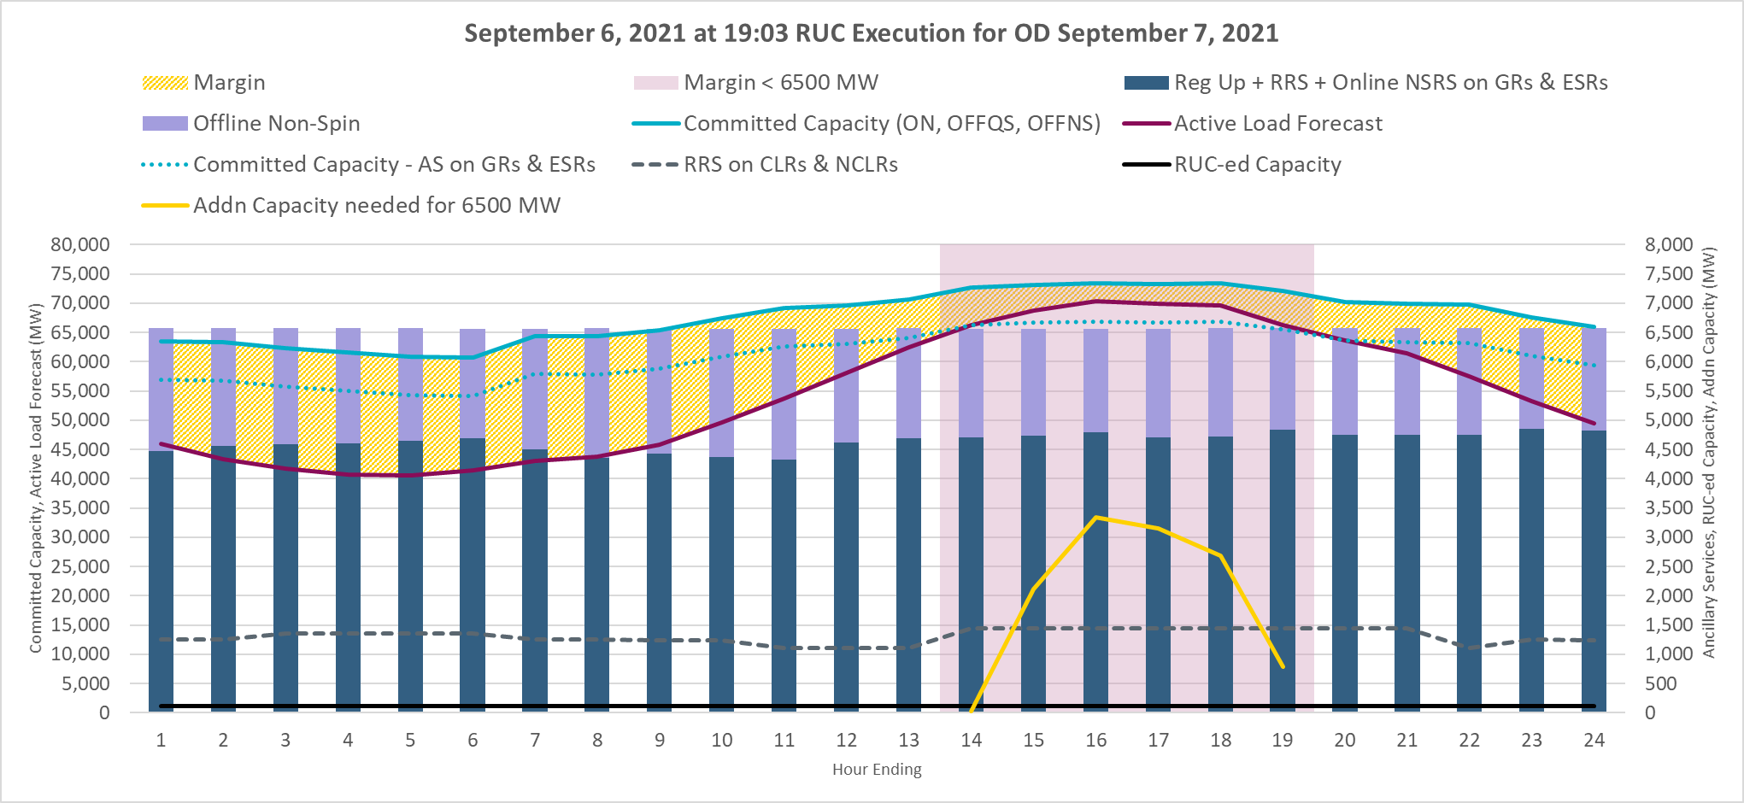
7pm RUC execution on September 6, 2021
Margin for peaks hours was below 6,500 MW and additional capacity was RUC-ed (for capacity and minimum runtime of 24 hours).

Slide 10
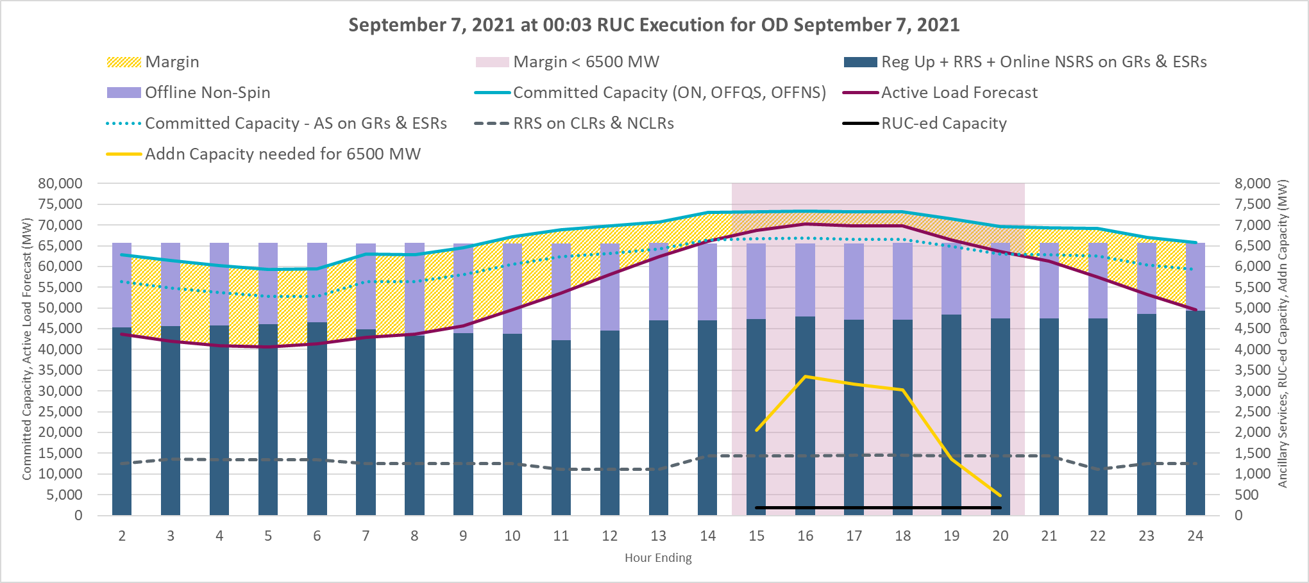
12am RUC execution on September 7, 2021
Margin for peaks hours was below 6,500 MW and additional capacity was RUC-ed.

Slide 11
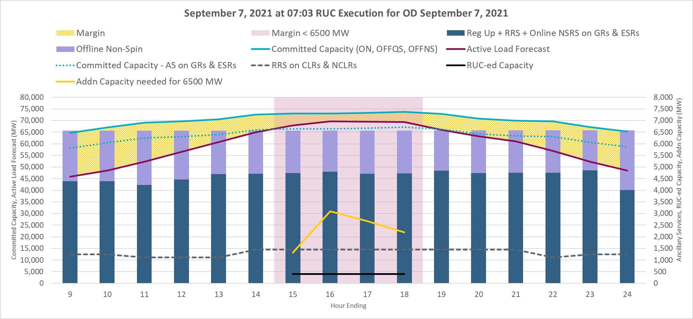
7am RUC execution on September 7, 2021
Margin for peaks hours was below 6,500 MW and additional capacity was RUC-ed.

Slide 12
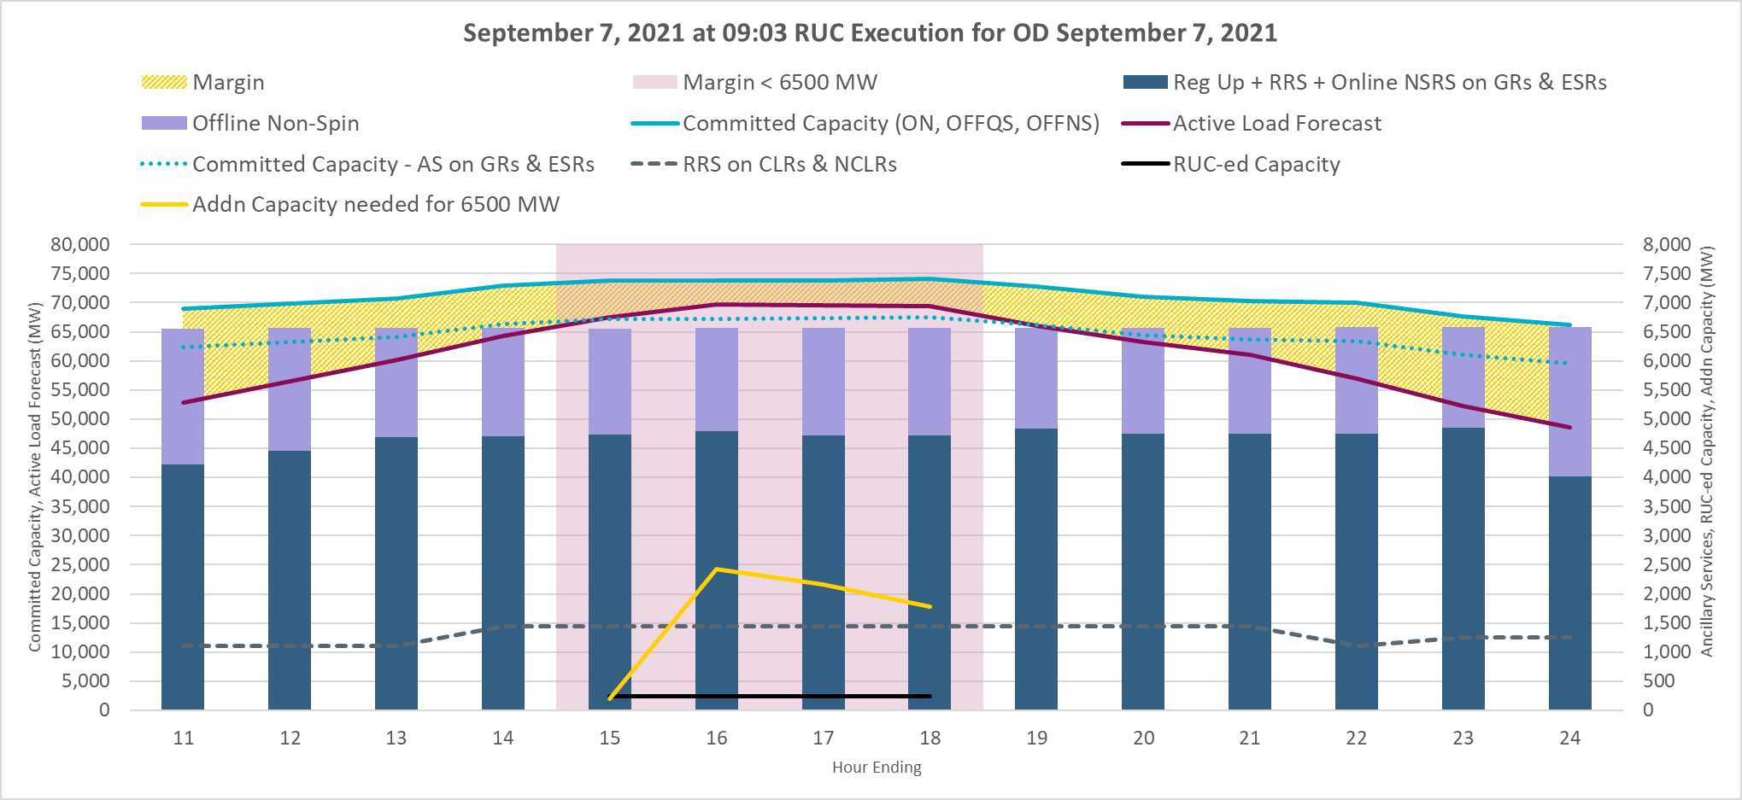
9am RUC execution on September 7, 2021
Margin for peaks hours was below 6,500 MW and additional capacity was RUC-ed.

Slide 13
RUC Activity for Sep 08, 2021
To maintain a margin of 6,500 MW between committed generation capacity (including offline Non-Spin) and active load forecast, following RUCs were conducted.
Approx. 110 MW capacity was RUC-ed following the 09/07 20:03 RUC execution for HE01 through HE24 (for capacity and minimum runtime of 24 hours)
Approx. 203 MW capacity was RUC-ed following the 2:03 RUC execution for HE14 through HE21
Approx. 195 MW capacity was RUC-ed following the 7:03 RUC execution for HE15 through HE24
Approx. 170 MW capacity was RUC-ed following the 9:03 RUC execution for HE16 through HE21

Slide 14
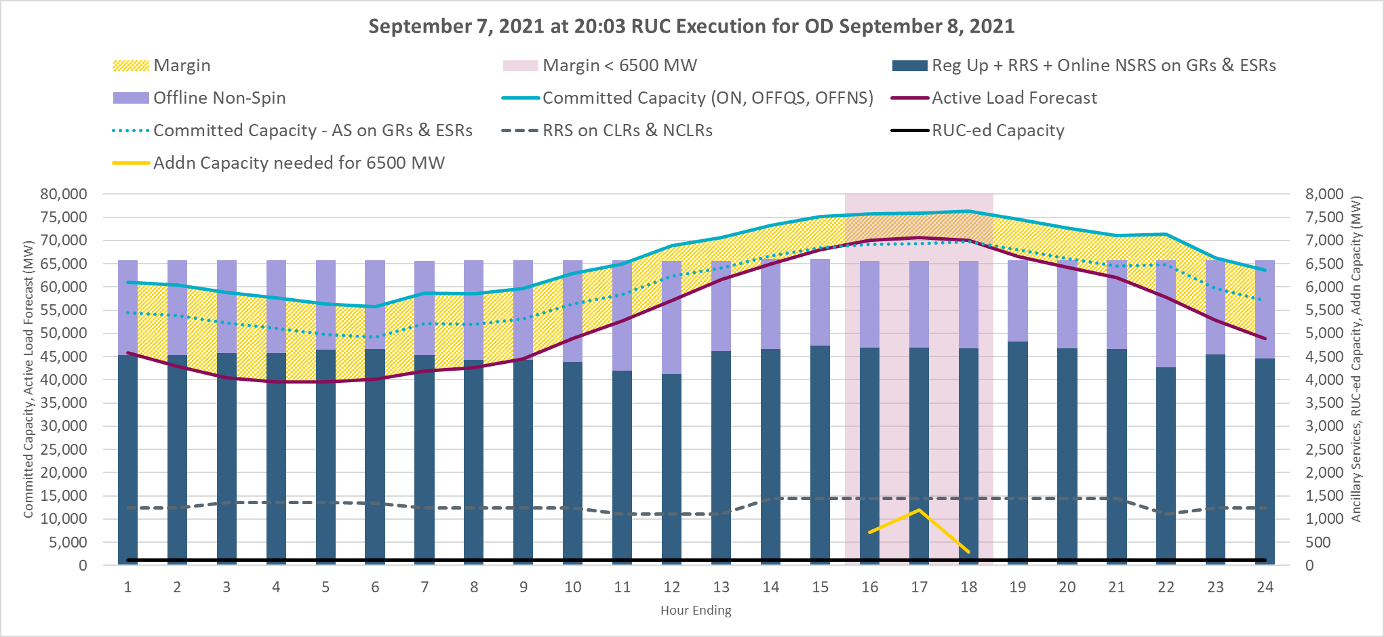
8pm RUC execution on September 7, 2021
Margin for peaks hours was below 6,500 MW and additional capacity was RUC-ed (for capacity and minimum runtime of 24 hours).

Slide 15
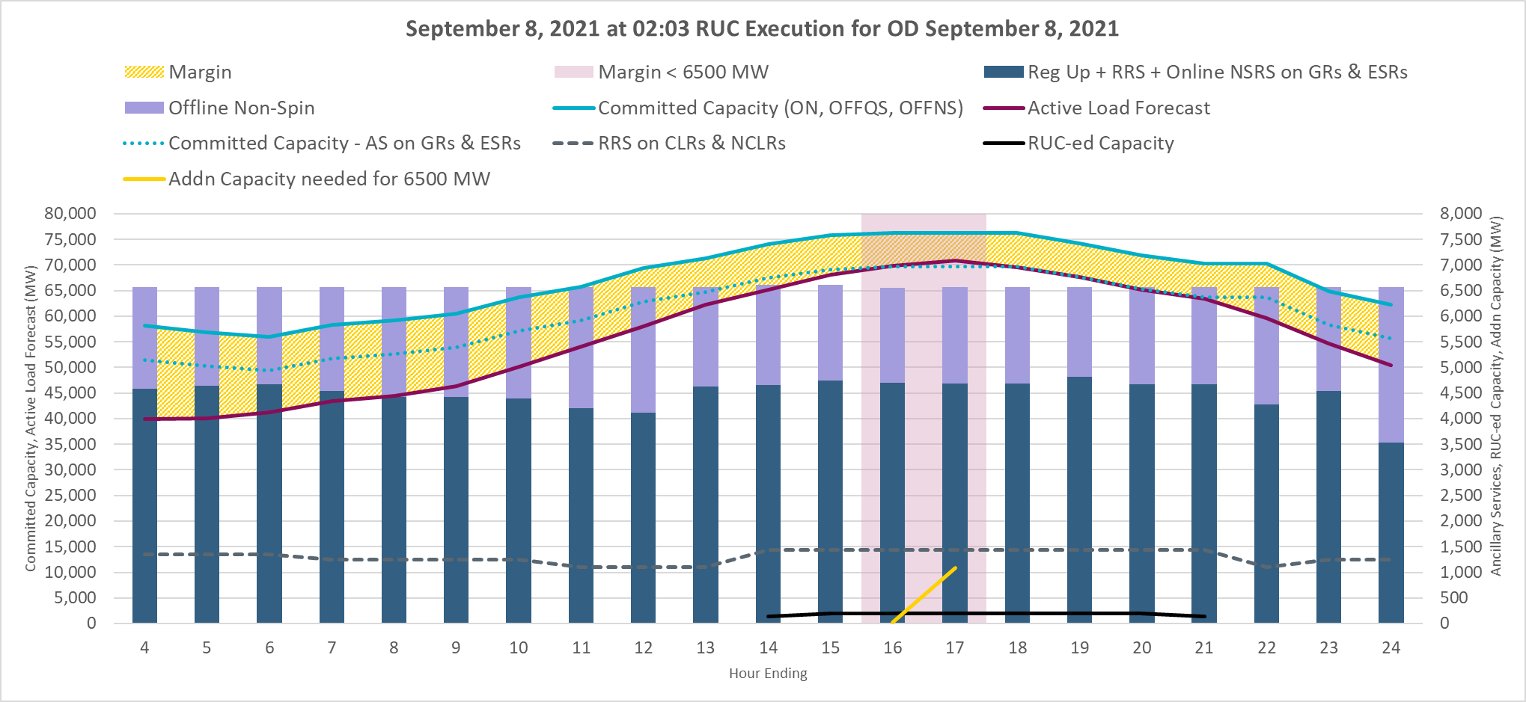
2am RUC execution on September 8, 2021
Margin for peaks hours was below 6,500 MW and additional capacity was RUC-ed.

Slide 16
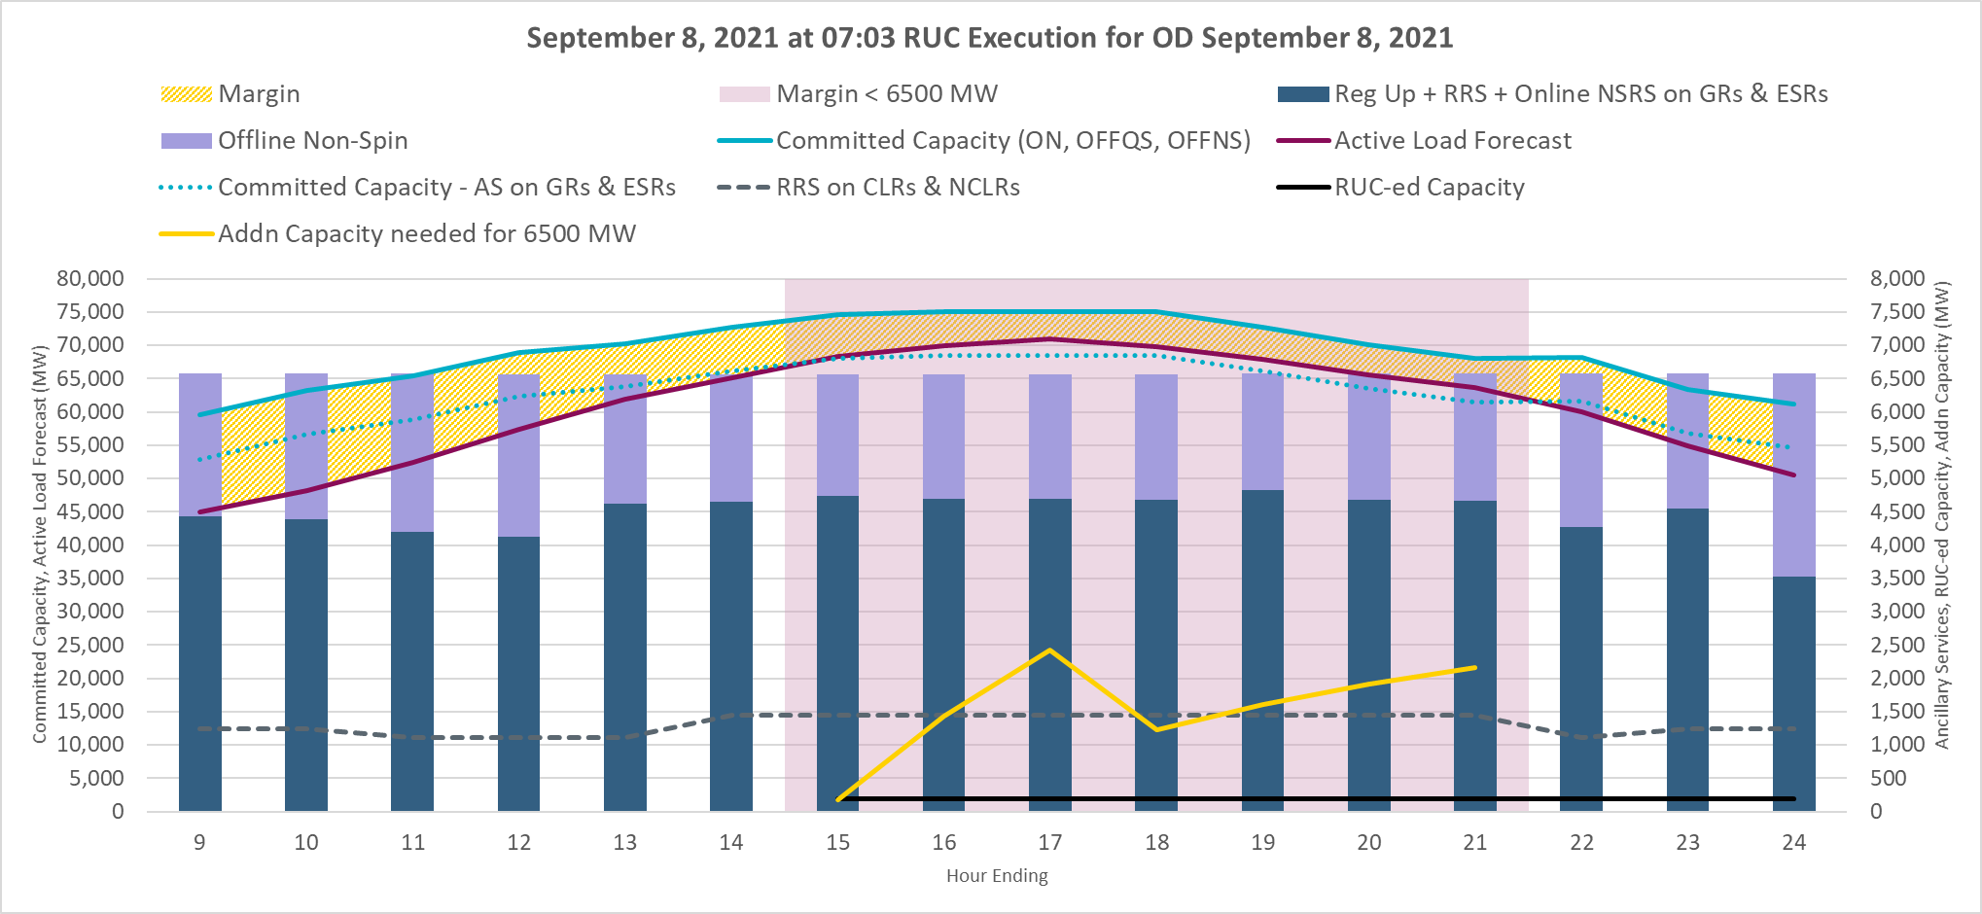
7am RUC execution on September 8, 2021
Margin for peaks hours was below 6,500 MW and additional capacity was RUC-ed.

Slide 17
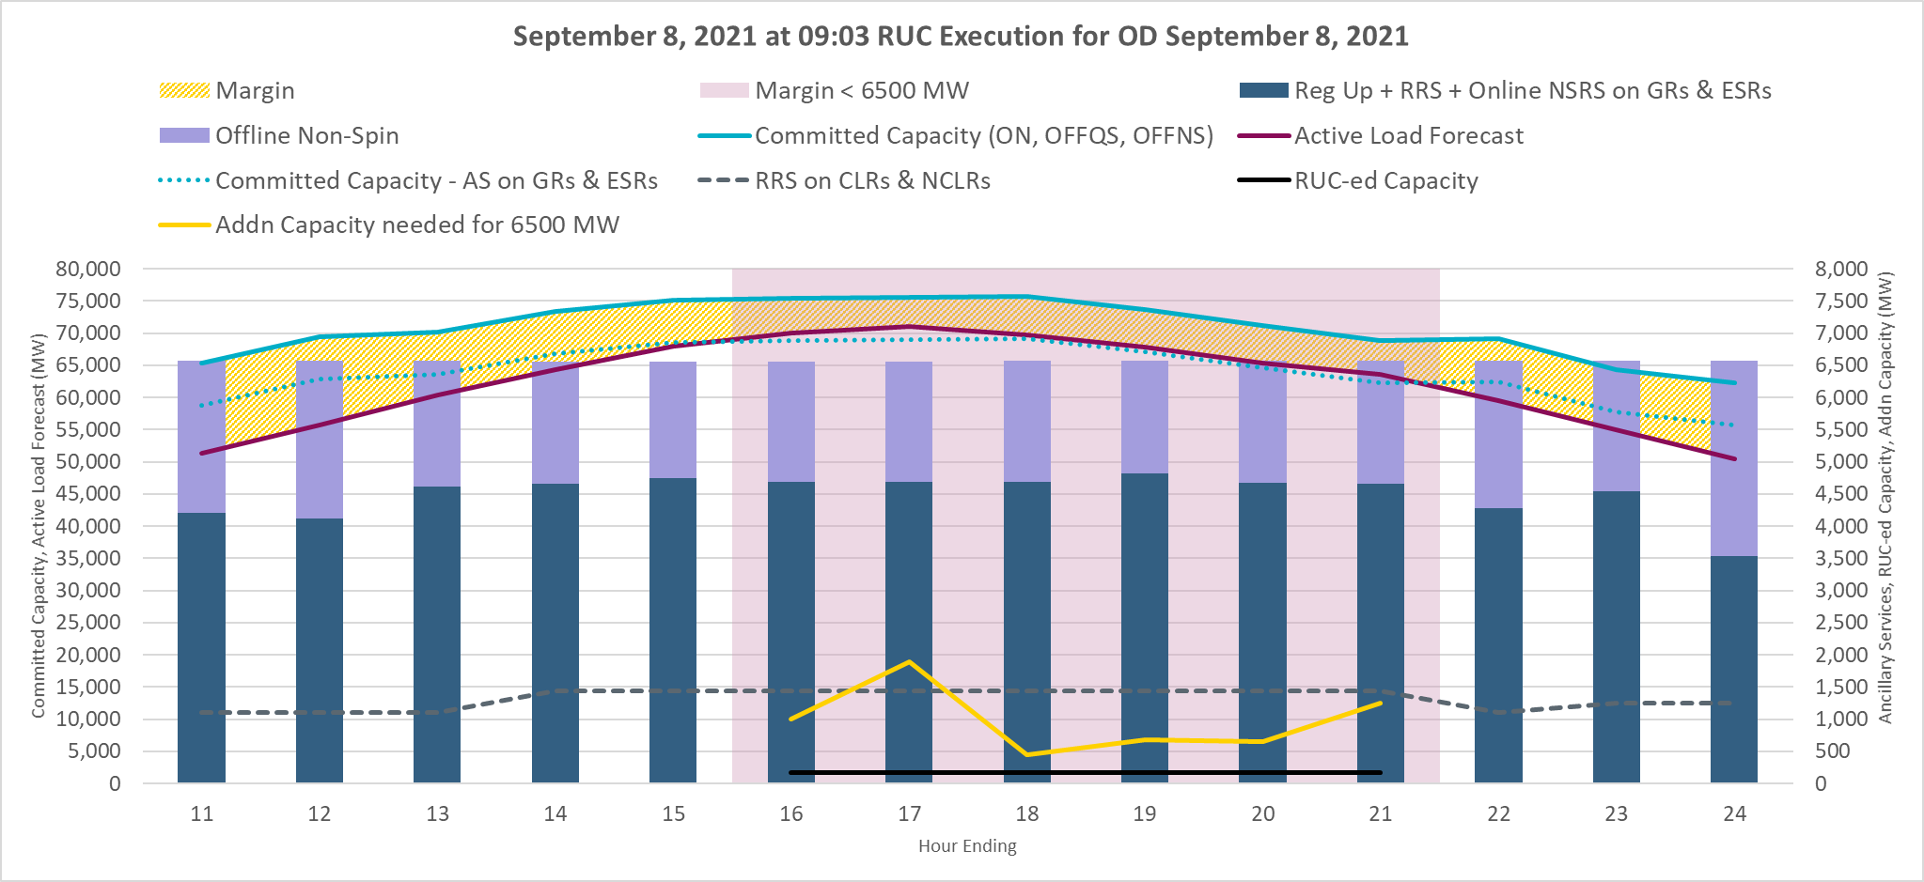
9am RUC execution on September 8, 2021
Margin for peaks hours was below 6,500 MW and additional capacity was RUC-ed.

Slide 18
RUC Activity for Sep 14, 2021
To maintain a margin of 6,500 MW between committed generation capacity (including offline Non-Spin) and active load forecast, following RUCs were conducted.
Approx. 637 MW capacity was RUC-ed following the 07:03 RUC execution for HE16 through HE21
Approx. 654 MW capacity was RUC-ed following the 14:03 RUC execution for HE19 through HE21
Approx. 170 MW capacity was VDI RUC-ed following 17:03 RUC execution for HE20 through HE21

Slide 19
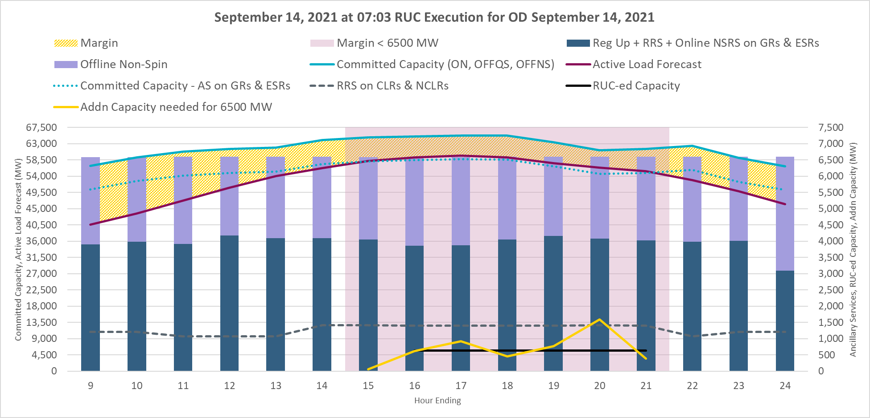
7am RUC execution on September 14, 2021
Margin for peaks hours was below 6,500 MW and additional capacity was RUC-ed.

Slide 20
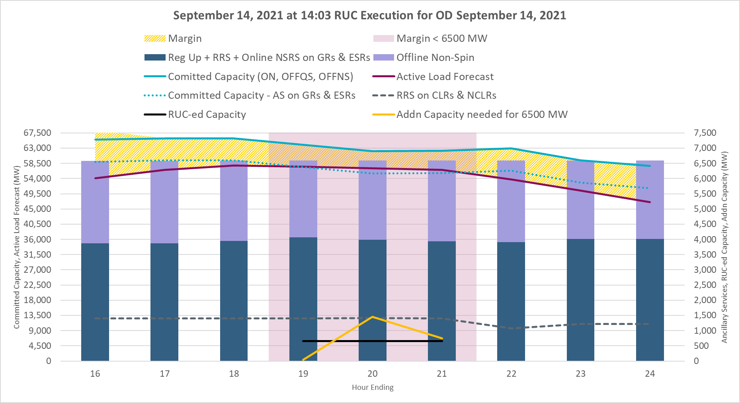
2pm RUC execution on September 14, 2021
Margin for peaks hours was below 6,500 MW and additional capacity was RUC-ed.

Slide 21
Summary
ERCOT has been procuring additional A/S beginning July 12, 2021.
There continues to be a visible reduction in the RUC activity. ERCOT has continued to use the RUC process to maintain a margin of 6,500 MW between committed generation capacity (including offline Non-Spin) and active load forecast for hours ending 14 through 21.
ERCOT will continue to work with stakeholders on refining its processes.

