Slide 1
ERCOT Planned Project Success Tracking and Other Interconnection Queue Trends
Dan Mantena
Resource Adequacy
April 4, 2022

Slide 2
Outline
This presentation highlights a new proposed report from ERCOT Resource Adequacy that will track topics of interest for SAWG related to the interconnection queue
The report would be updated on an annual frequency
Initial topics
Success rates of planned generation projects
Development cycle trends for planned projects (from initial request to operational)
Delays to the in-service dates for planned projects
Interactive Tableau Dashboard Demo (for success rates analysis)

Slide 3
Assumptions for Success Rates and Development Cycle Analysis
To account for the development cycle of generation projects, the success rate statistics in this analysis were limited to projects requested between 2002 and 2018 into the ERCOT queue
Successful projects are defined as a planned generation projects that have become operational resources (received Commercial Operations Approval or Synchronization Approval from ERCOT)
Due to Protocol confidentiality provisions, only those projects for which a Full Interconnection Study (FIS) has been requested are included in this dataset. (based on GIS reporting practice)
These statistics do not account for delays to in-service dates (Projected Commercial Operations Date)
Storage DGRs, wind repowers, thermal upgrade projects were excluded from this dataset due to having different interconnection milestone requirements compared to new Generation Resource (GR) projects.
Analysis based on queue data snapshot from 2/28/22

Slide 4
Success rates of planned generation projects in ERCOT queue

Slide 5
Development Cycle for Planned Projects Duration in Years for average successful project (from Queue Request to Commercial Operations or Synchronization Approval to ERCOT Grid)

Slide 6
Delays to the in-service dates for planned projects Delay represents a change in the in-service date made by the project developer or ERCOT Resource Integration Department

Slide 7
Delays to the in-service dates for planned projects Delay represents a change in the in-service date made by the project developer or ERCOT Resource Integration Department

Slide 8
Delays to the in-service dates for planned projects Delay represents a change in the in-service date made by the project developer or ERCOT Resource Integration Department

Slide 9
Delays to the in-service dates for planned projects Delay represents a change in the in-service date made by the project developer or ERCOT Resource Integration Department

Slide 10
Delays to the in-service dates for planned projects Delay represents a change in the in-service date made by the project developer or ERCOT Resource Integration Department

Slide 11
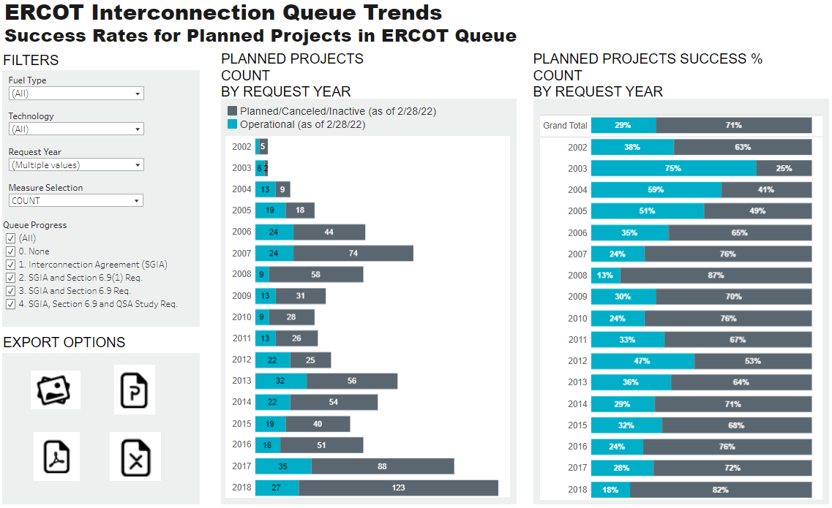
Interactive Tableau Dashboard Demo

Slide 12
Wrap-up
Are there any other interconnection queue topics that would be useful for SAWG stakeholders?
If you have any questions on this analysis or requests for additional research, here is my contact info:
Dan Mantena, dan.mantena@ercot.com

Slide 13
Appendix
Appendix slides provides the success rates of projects that reached the signed interconnection agreement milestone by fuel and technology on an annual basis
Screenshots are from the Tableau Dashboard highlighted in earlier slides.

Slide 14
Annual Success Rates by Project Count - Battery Energy Storage

Slide 15
Annual Success Rates by Project Count - Solar

Slide 16
Annual Success Rates by Project Count - Wind

Slide 17
Annual Success Rates by Project Count - Coal

Slide 18
Annual Success Rates by Project Count – Natural Gas

Slide 19
Annual Success Rates by Project Count – Natural Gas CC

Slide 20
Annual Success Rates by Project Count – Natural Gas CT

Slide 21
Annual Success Rates by Project Count – Natural Gas ST

Slide 22
Annual Success Rates by Project Count – Natural Gas ICE

Slide 23
Annual Success Rates by Project Capacity - Battery Energy Storage

Slide 24
Annual Success Rates by Project Capacity - Solar

Slide 25
Annual Success Rates by Project Capacity - Wind

Slide 26
Annual Success Rates by Project Capacity - Coal

Slide 27
Annual Success Rates by Project Capacity – Natural Gas

Slide 28
Annual Success Rates by Project Capacity – Natural Gas CC

Slide 29
Annual Success Rates by Project Capacity – Natural Gas CT

Slide 30
Annual Success Rates by Project Capacity – Natural Gas ST

Slide 31
Annual Success Rates by Project Capacity – Natural Gas ICE

