Slide 1
ERCOT Frequency Events
April 2022
ERCOT
Operations Planning
PDCWG | May 18, 2022

Slide 2
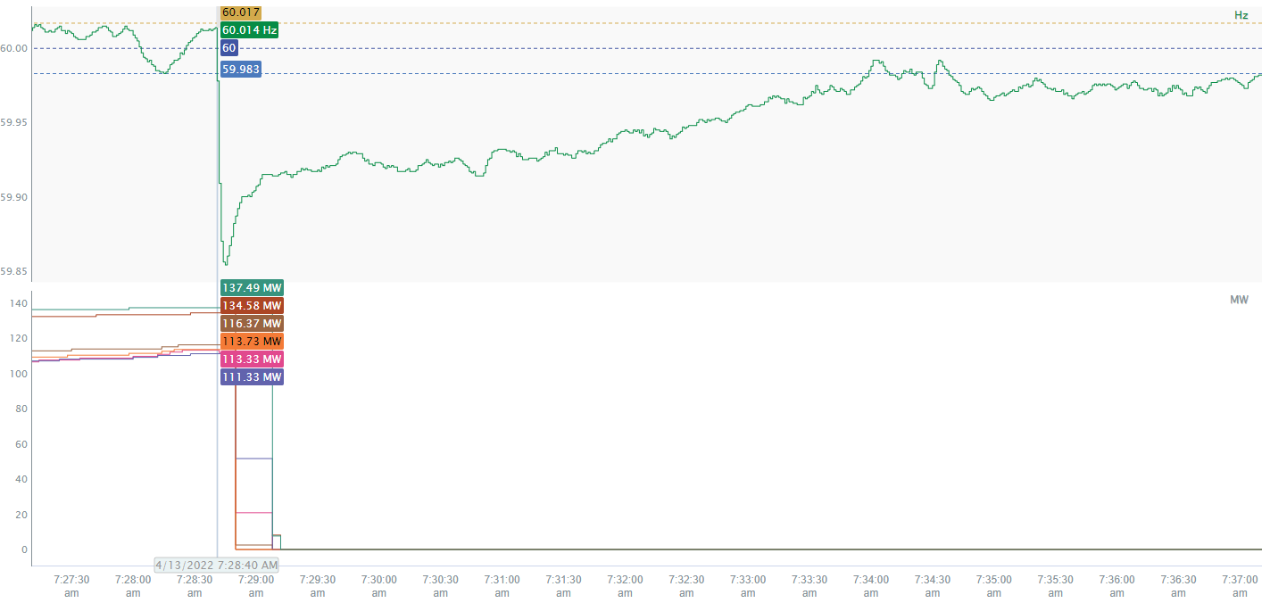
4/13/2022 7:28:40(FME)
Notes:
The units tripped offline while carrying approximately 725 MW.
Starting Frequency: 60.014 Hz
Maximum Frequency: 59.854 Hz
A-C Time : 5 seconds
Recovery Time(back to deadband): 5 minutes 19 seconds
RRS Deployed: 1040 MW
Trip Reason: Lightning Strike
Contextual Information: A total of 252 MW of regulation up was deployed and a 300 MW SCED Manual Offset was applied during the event.

Slide 3
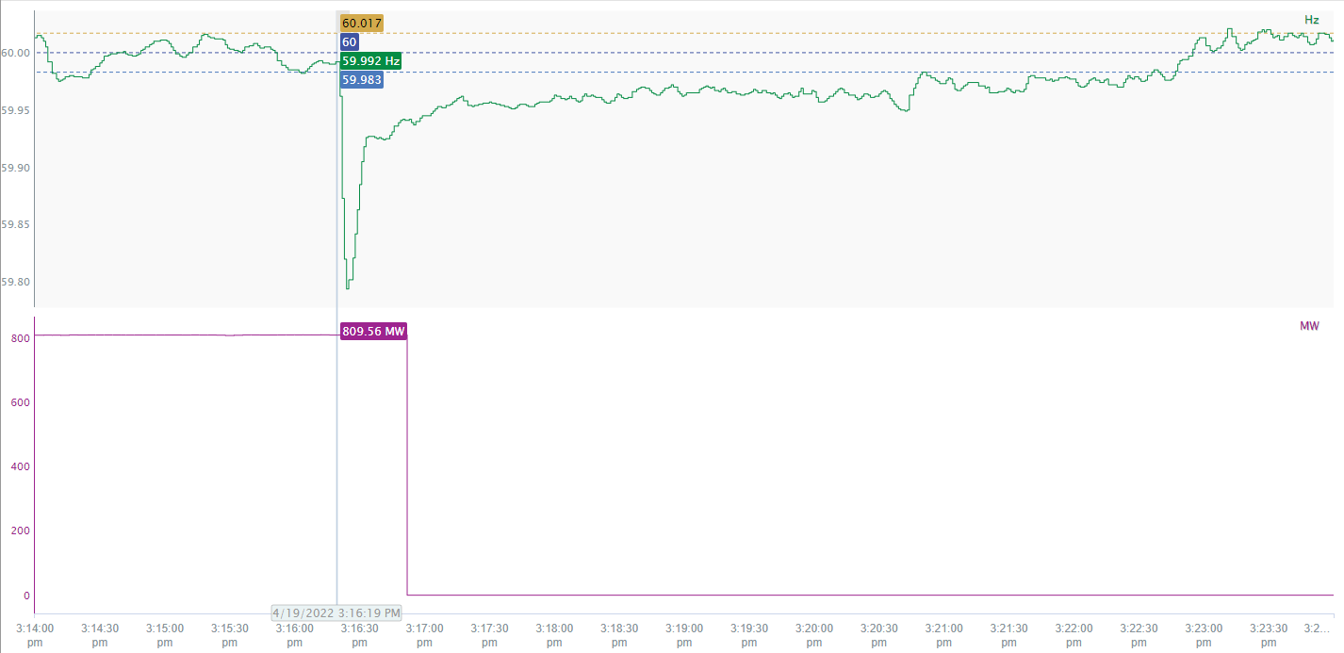
4/19/2022 15:16:19(FME)
Notes:
The units tripped offline while carrying approximately 810MW.
Starting Frequency: 59.992Hz
Minimum Frequency: 59.794 Hz
A-C Time : 5 seconds
Recovery Time(back to deadband): 6 minutes and 28 seconds
RRS Deployed: 1159 MW
Trip Reason: Not available.
Contextual Information: A total of 407 MW of regulation up was deployed during the event and a 200 MW SCED Manual Offset was applied during the event.

Slide 4
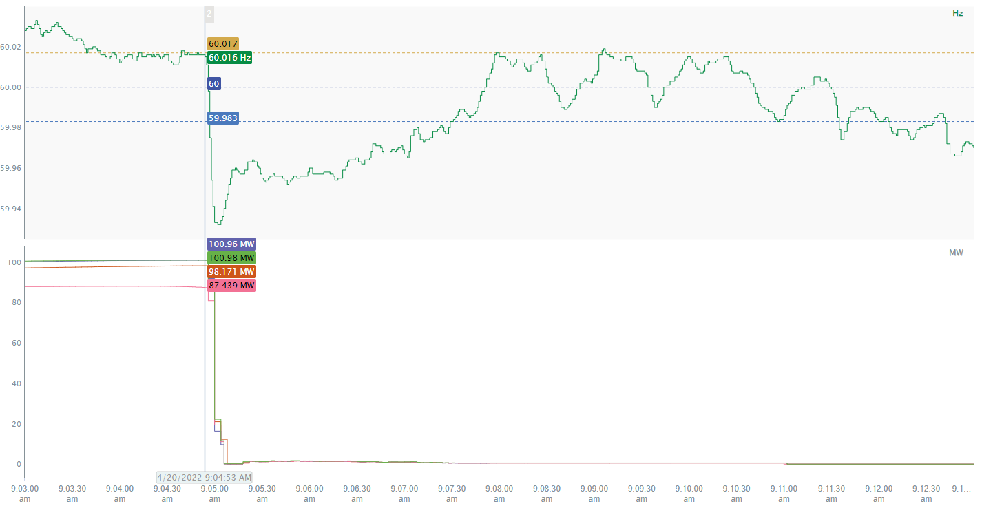
4/20/2022 9:04:53(Non-FME)
Notes:
The units tripped offline while carrying approximately 384MW.
Starting Frequency: 60.016 Hz
Minimum Frequency: 59.932 Hz
A-C Time: 10 seconds
Recovery Time (back to deadband): 2 minutes 36 seconds
Trip Reason: Not available.

Slide 5
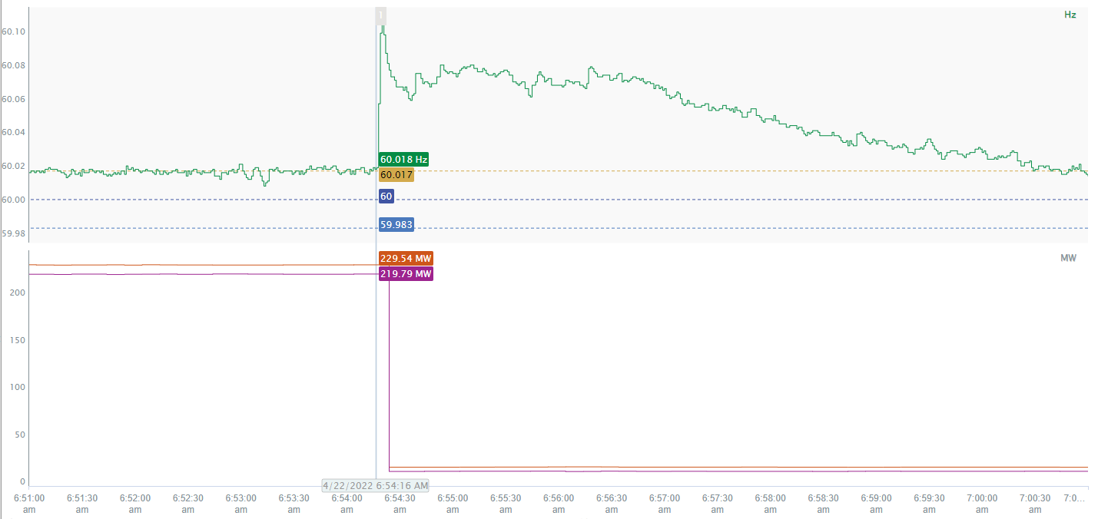
4/22/2022 6:54:16(FME)
Notes:
The loads tripped offline while carrying approximately 450 MW.
Starting Frequency: 60.018Hz
Minimum Frequency: 60.106Hz
A-C Time : 4 seconds
Recovery Time(back to deadband): 6 minutes and 15 seconds
Trip Reason: Loss of transmission line.
Contextual Information: A total of 211 MW of regulation down was deployed during the event.

Slide 6
Questions?
Thank you!

