Slide 1
ERCOT Technology Working Group (TWG)
August 4, 2022

Slide 2
ERCOT TWG – Venkat Tirupati
WELCOME

Slide 3
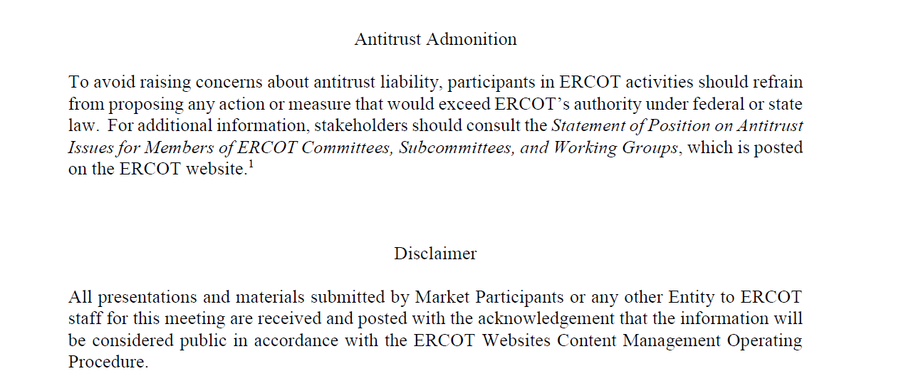
ERCOT TWG

Slide 4
ERCOT TWG Agenda
Item # | Item Description | Presenter
1 | Antitrust admonition | Venkat Tirupati
2 | Project Update | Troy Anderson
3 | Discussion of Projects with Interface Change Requirements NPRR863/FFRA delivery NPRR1120 Create Firm Fuel Service NPRR863/ECRS scope delivery Market Readiness for FFRA in MOTE | Matt Mereness
4 | NERC EMSWG Update | Wei Qiu - NERC
9 | Updates for Awareness CIM 16 Upgrade ERCOT EMS Upgrade Project Operator Real-Time Messaging SCR820 Public API and API improvements TLS 1.2 Certification IE11 EOL and multiple cert workaround in Chromium browsers MarkeTrak system Updates Retail API Redesign TEXAS SET 5.0 Project Future replacement of T-Mobile Managed Services Future replacement of T-Mobile MPLS Circuits | ERCOT Staff
10 | Future topics of interest | Venkat Tirupati
11 | Adjourn | Venkat Tirupati

Slide 5
ERCOT TWG – Troy Anderson
Project Update

Slide 6
ERCOT TWG – Matt Mereness
Projects with Interface Change Requirements
NPRR863/FFRA scope delivery
NPRR1120 Create Firm Fuel Service
NPRR863/ECRS scope delivery
Market Readiness for FFRA in MOTE

Slide 7
ERCOT TWG – Wei Qiu
NERC Update

Slide 8
ERCOT TWG – Venkat Tirupati
CIM 16 Upgrade
ERCOT EMS Upgrade Project
Operator Real-Time Messaging SCR820
Public API and API improvements
TLS 1.2 Certification
IE11 EOL and multiple cert workaround in Chromium browsers

Slide 9
ERCOT TWG – Venkat Tirupati
MarkeTrak system Updates
Retail API Redesign
TEXAS SET 5.0 Project
Future replacement of T-Mobile Managed Services
Future replacement of T-Mobile MPLS Circuits

Slide 10
ERCOT TWG – Open Forum
Q & A

Slide 11
ERCOT TWG
Thank You

