Slide 1
2023 Southwest UT Disturbance
Southwestern Utah: April 10 , 2023
Joint NERC and WECC Staff Report
Ryan D. Quint, PhD, PE
Director, Engineering and Security Integration
North American Electric Reliability Corporation
September 2023

Slide 2
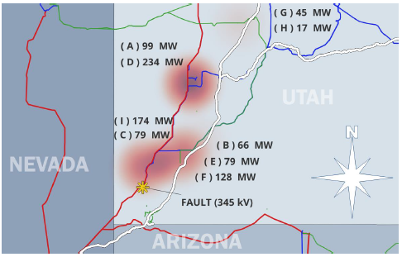
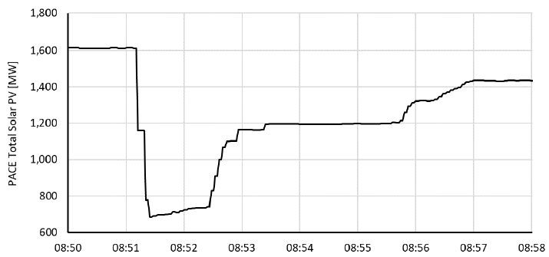
Overview of Disturbance
April 10, 8:51 Pacific Time
Single-line-to-ground fault on 345 kV transmission circuit in SW Utah
Fault cleared in 3.5 cycles
No generation tripped consequentially due to line outage
Aggregate unexpected solar reduction of 921 MW
Across 9 plants (some with multiple phases or units)

Slide 3
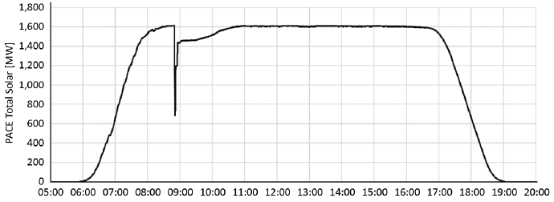
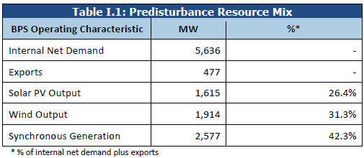
Overview of Disturbance

Slide 4
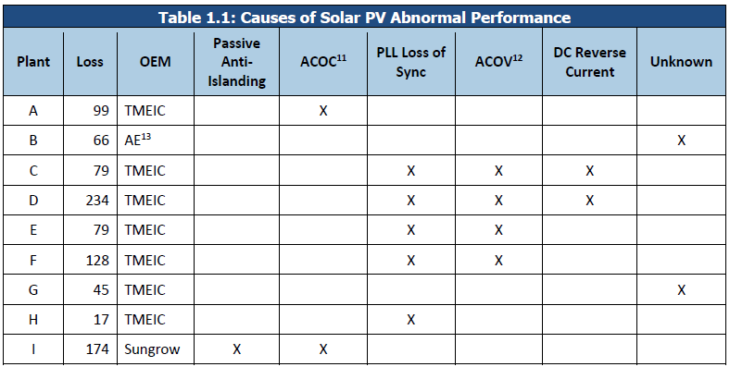
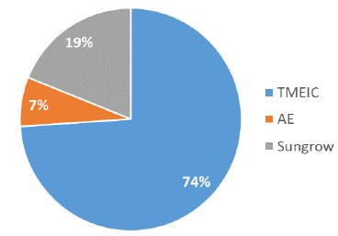
Causes of Reduction

Slide 5
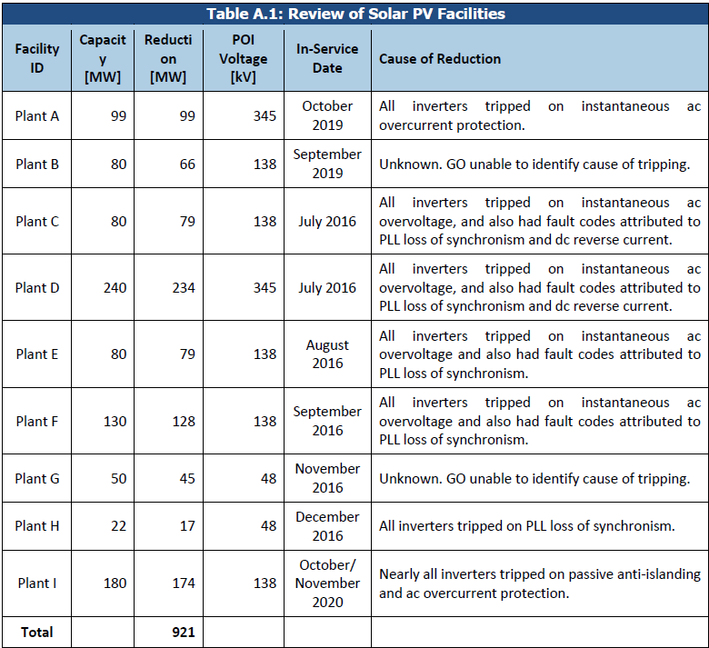
Overview of Plants
Mostly BES facilities
Mostly (not all) “older” / “legacy” facilities

Slide 6
Other Findings
All causes of reduction previously identified in past reports
Unexpected field settings
Facility 1: All but 2 inverters set with FRT disabled; all abnormally tripped on ac overcurrent; remaining 2 inverters had momentary cessation set
Facility 2: Inverter protection reported by GO did not match documented settings by inverter OEM “as left” during commissioning; not owner-configurable settings, so neither GO nor OEM could explain which was “correct”
Systemic performance issues persist
GOs aware of past disturbance reports; no proactive action being taken to address performance deficiencies
OEMs also aware of performance issues but fixes not being deployed
Need for comprehensive ride-through standard
Enhanced PacifiCorp modeling requirements

Slide 7
Key Takeaways and Recommendations
Similarities and differences with Odessa disturbances
Findings applicable to all Regions across North America
Accurate modeling and studies is critically important, and appears to be poor presently
Establishing detailed interconnection requirements is absolutely essential, should be taken very seriously across North America
Lack of industry action reinforcing need for NERC Standards efforts
NERC Project 2023-02 to ensure proactive risk mitigation
NERC Project 2020-02 to ensure comprehensive ride-through performance standard
Reiterated need for Level 2 NERC Alert regarding inverter-based resource performance issues

Slide 8
Recent and Upcoming IBR Risk Mitigation Activities
Posting of IBR Webinar Series Slides, Recording, FAQ, and Highlights (~Sept 2023)
EMT Boot Camps (~Aug-Sept 2023)
Disturbance Report on 2022 Battery Energy Storage System Events in California (~Sept-Oct 2023)
Report on Key Findings and Recommendations from Level 2 NERC Alert on IBR Performance Issues (~Oct-Nov 2023)
Level 2 NERC Alert on IBR Modeling Issues (~Q4 2023 or Q1 2024, tentative)
IRPS and EMTTF Work Plan Items (Q4 2023-Q1 2024)
IBR Standards Gap Analysis
Guidance on Interconnection Studies
Guidance on Commissioning Practices
Guidance on EMT Studies

Slide 9
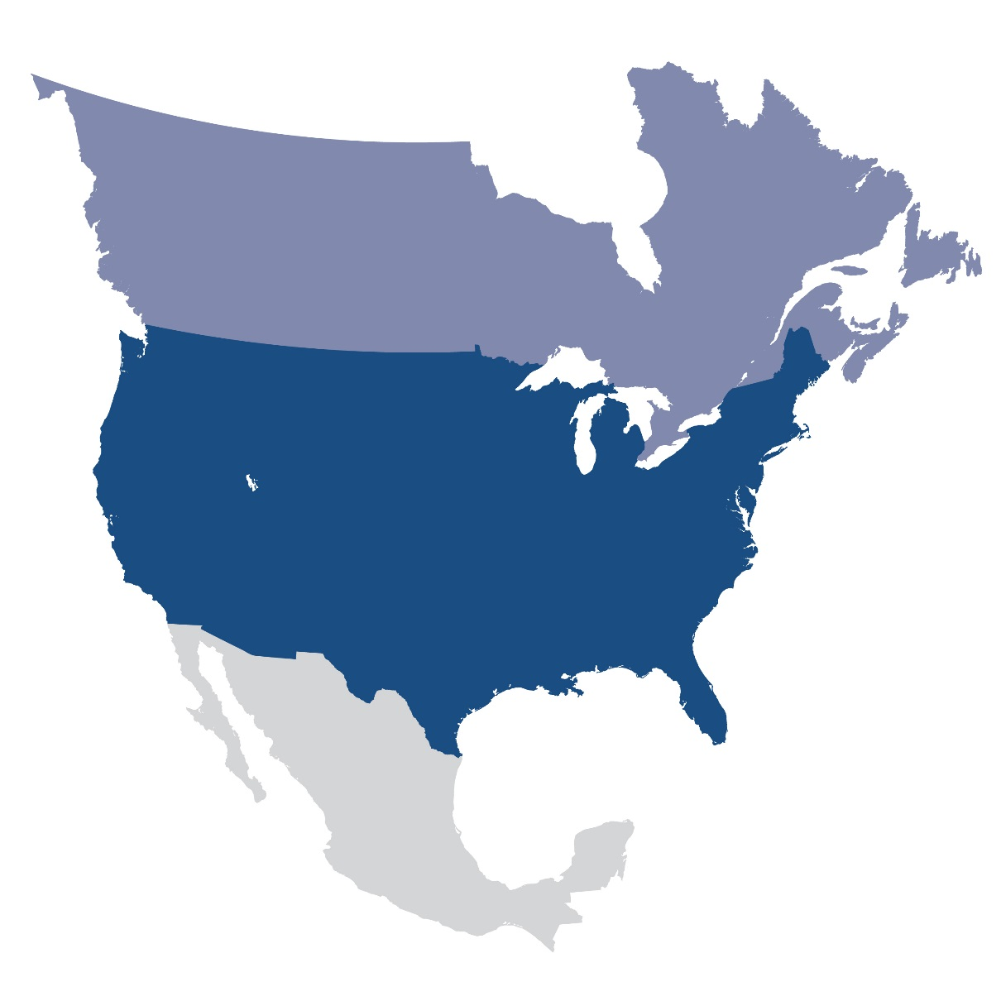
Questions and Answers
Ryan D. Quint, PhD, PE
Director, Engineering and Security Integration
ryan.quint@nerc.net

