Slide 1
Status of Reliability Standard, VOLL and CONE Studies
Pete Warnken
Resource Adequacy
Supply Analysis Working Group
February 16, 2023

Slide 2
Reliability Standard Scenario Study
Working on the fourth modeling phase:
Higher granularity on a narrowed range of frequency (LOLE) levels; i.e., 1-in-7, 1-in-8, 1-in-9, 1-in-10, 1-in-11, 1-in-12, 1-in-13, 1-in-14
Use the December 2023 CDR report as the base for portfolio development to derive the frequency targets
Focus on a total societal cost metric to estimate the incremental costs for reducing each MW of Expected Unserved Energy (EUE)
Will also estimate the incremental cost of meeting all three reliability standard criteria at specified levels (for example, 0.1 frequency/15-hour max duration/14 MW max magnitude); this is equivalent to a standard with zero exceedance probabilities for magnitude and duration
Results are expected to be filed for the March 21 PUCT Open Meeting

Slide 3
Value of Lost Load (VOLL) Study
Texas PUC decision on use of an interim VOLL for the Reliability Standard analysis
VOLL survey expected to be rolled out in late March, likely after the PUCT Open Meeting on the 21st
Completing review of the consulting team’s working draft of survey questions, scenarios and demographic/customer class stratification
Other prerequisite activities:
Coordinating communications information with the PUC (survey website, FAQs, outreach email, etc.)
Final push to expand NOIE participation
Complete VOLL survey project by end of Q3

Slide 4
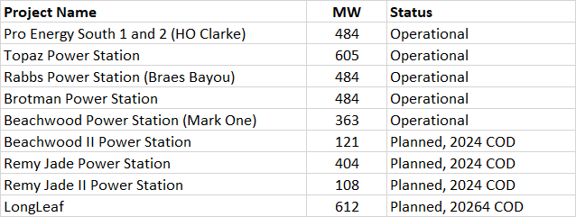
Cost of New Entry (CONE) Study
Consultant team—Brattle Group and Sargent & Lundy—are working on the dispatchable and solar/battery hybrid reference technology characterizations
Selected dispatchable reference technology is a General Electric LM6000PC aeroderivative gas turbine with intercooling
LM6000PC used for nine WattBridge/ProEnergy operational and planned projects in the ERCOT region:
A presentation on the two reference technologies is planned for the next SAWG meeting

