Slide 1
RMTTF
Tomas Fernandez NRG
Debbie McKeever ONCOR
Melinda Earnest AEP Texas

Slide 2
Recently Held Retail Training Classes
Retail 101 | Wednesday, May 1st
TXSET | Thursday, May 2nd

Slide 3
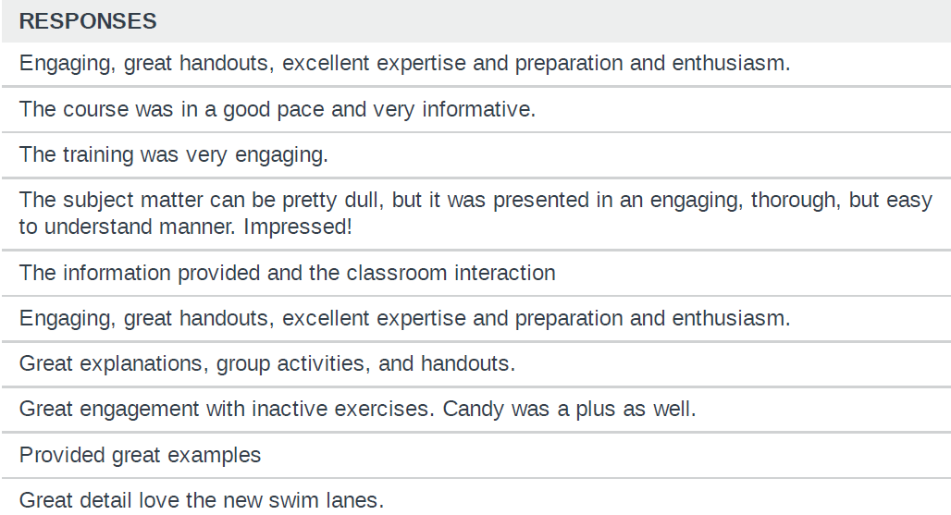
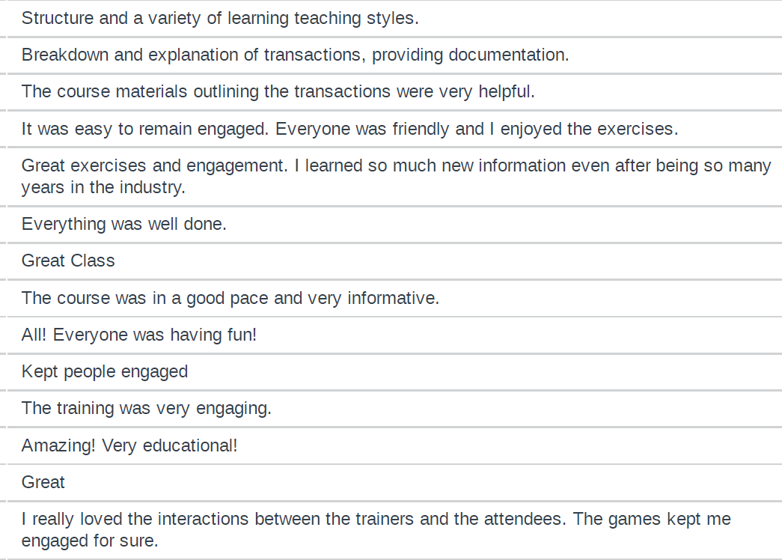
Comments from Survey
36 of 40 class participants took the survey

Slide 4
On-Demand ERCOT Retail Training Modules Available 24/7
MarkeTrak Online Training Modules -
Marketrak Overview
Switch Hold Removal
Cancel With/Without Approvals
Inadvertent Gains/Losses & Rescissions
Usage and Billing
Other D2D Subtypes
Bulk Insert
MarkeTrak Admin Functionality
Data Extract Variances (DEV) LSE Subtypes
Data Extract Variances (DEV) Non-LSE Subtypes
Emails and Notifications
Reporting – Background & GUI
Web-based Training Classes -
Retail 101
TXSET
Mass Transition

Slide 5
Upcoming 2024 RMTTF Meetings
Monthly meetings listed below will be held at 9:30 AM unless noted otherwise. All meetings have WebEx capability.
In person meetings have locations listed.
Thursday, June 20 – Full Day In person and WebEx Oncor
Friday, June21 - ½ Day In person and WebEx Oncor
No meeting in July
Thursday, August 8 Web-Ex only
Thursday, September 12 Web-Ex only
Thursday, October 10 Web-Ex only
Thursday, November 7 Web-Ex only
Thursday, December 12 Web-Ex only
See addresses below for meetings being offered in person:
Oncor, 1616 Woodall Rodgers Fwy Dallas, Tx 75202

Slide 6
Questions?
If you have suggestions for training or questions, please contact one of the RMTTF co-chairs noted below. Tomas Fernandez, NRG tomas.fernandez@nrg.com Melinda Earnest, AEP mdearnest@aep.com Debbie McKeever, Oncor deborah.mckeever@Oncor.com

