Slide 1
ERCOT Annual Inertia Analysis
05/15/2024
ERCOT Staff

Slide 2
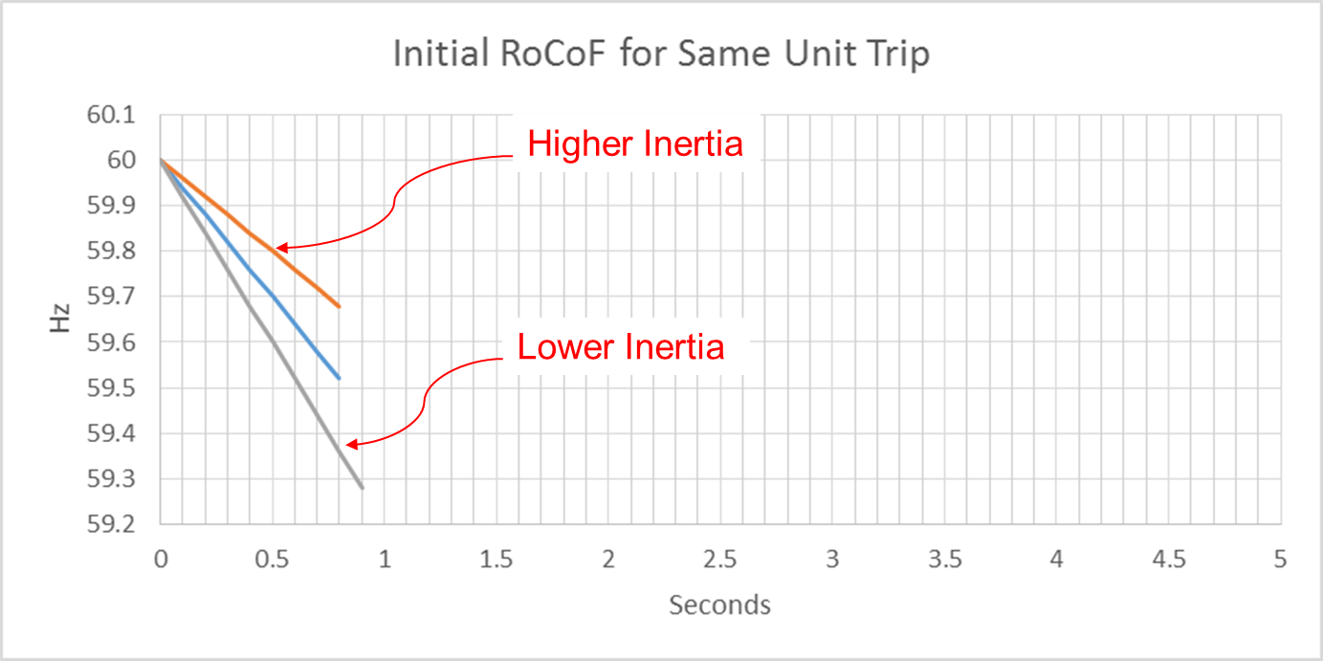
Effect of Synchronous Inertia on System Frequency
With the increasing integration of inverter-based resources (IBRs), fewer synchronous machines are online, potentially resulting in extended periods of lower overall system inertia
Higher system inertia → Lower RoCoF
Lower system inertia → Higher RoCoF
UFLS trigger
RoCoF: Rate of Change of Frequency

Slide 3
Inertia Calculation
In 2013, as instantaneous wind power penetration reached 30%, ERCOT started analyzing impacts of IBR on system inertia
In 2015, ERCOT implemented a real-time inertia calculation using inertia parameters of each individual synchronous generator and its status (on/off) telemetry
$M_{sys}=\sum_{i∈I}{H_{i}∙{MVA}_{i}}\left[GW∗s\right]$
where I is the set of online synchronous generators or condensers, MVA_{i} is MVA base of on-line synchronous generator or synchronous condenser i, and H_{i} is inertia constant for on-line generator or synchronous condenser i in a system (in seconds on machine MVA_{i})

Slide 4
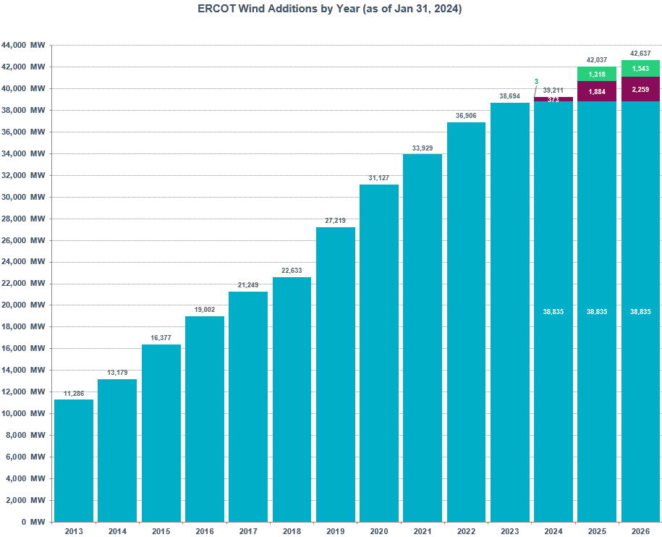
Wind Generation Capacity
+1,788 MW
+2,977 MW
+2,802 MW
+3,908 MW
+4,587 MW
+1,384 MW
+2,247 MW
+2,625 MW
+3,198 MW
+1,893 MW

Slide 5
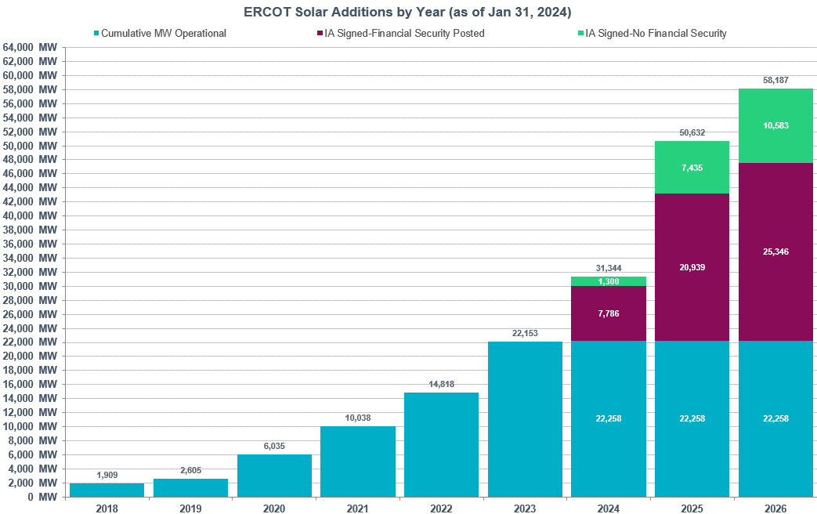
Solar Generation Capacity
+7,335 MW
+4,780 MW
+4,003 MW
+3,429 MW
+696 MW

Slide 6
Inertia Analysis

Slide 7
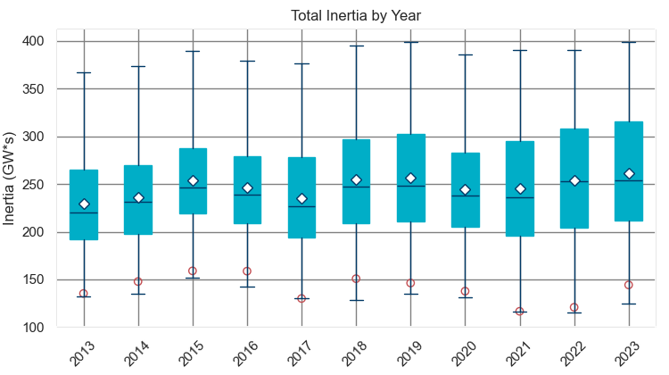
Total Inertia 2013-2023
Date and Time | 2013 3/10 3:00 AM | 2014 3/30 3:00 AM | 2015 11/25 2:00 AM | 2016 4/10 2:00 AM | 2017 10/27 4:00 AM | 2018 11/03 3:30 AM | 2019 3/27 1:00 AM | 2020 05/01 2:00 AM | 2021 03/22 1:00 AM | 2022 03/21 2:00 AM | 2023 04/18 3:00 AM
Min synch. Inertia (GW*s) | 132 | 135 | 152 | 143 | 130 | 128.8 | 134.5 | 131.1 | 116.6 | 115.0 | 124.3
System load at minimum synch. Inertia (MW) | 24,726 | 24,540 | 27,190 | 27,831 | 28,425 | 28,397 | 29,883 | 30,679 | 31,767 | 33,784 | 35,578
Non-synch. Gen. in % of System Load | 31 | 34 | 42 | 47 | 54 | 53 | 50 | 57 | 66 | 65 | 61
Red circles denote inertia at max IRR penetration (= IRR Gen/Total Gen)

Slide 8
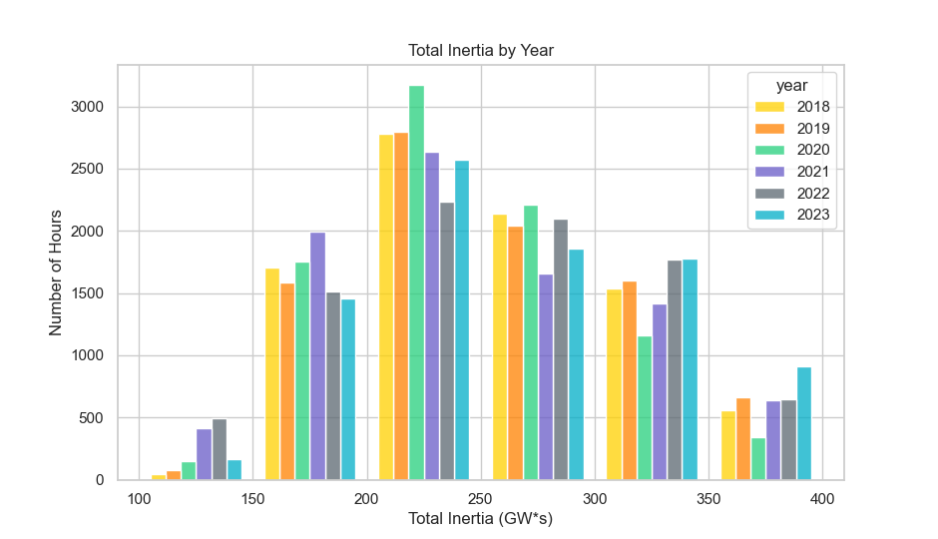
Total Inertia by Group 2018-2023
In 2023, less hours below 150 GW*s and more hours above 350 GW*s

Slide 9
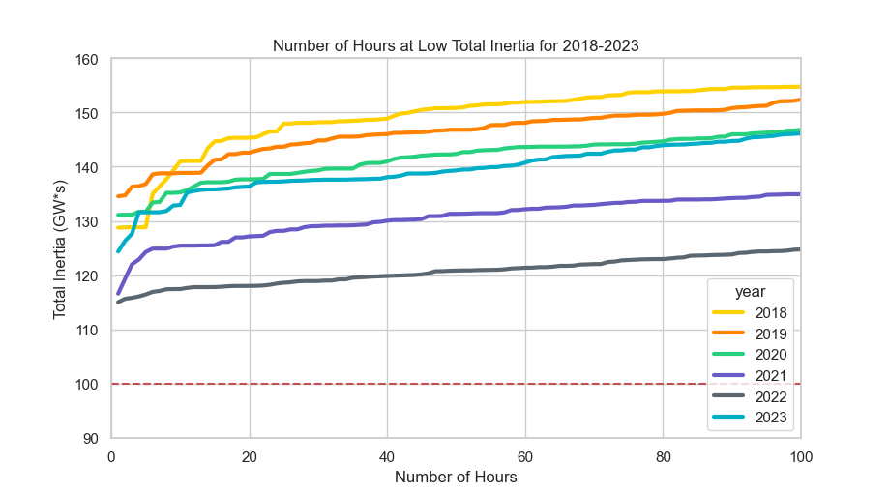
Lowest 100 Hours of Total Inertia 2018-2023
Similar trends for 2020 and 2023
 | 2018 | 2019 | 2020 | 2021 | 2022 | 2023
Lowest Inertia Hour (GW*s) | 129 | 135 | 131 | 117 | 115 | 124
100th Lowest Inertia Hour (GW*s) | 155 | 152 | 147 | 135 | 125 | 146

Slide 10
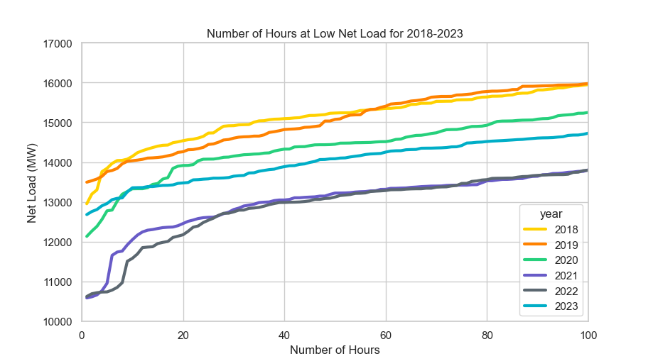
Net Load during the Lowest 100 Inertia Hours 2018-2023
Similar trends for 2020 and 2023

Slide 11
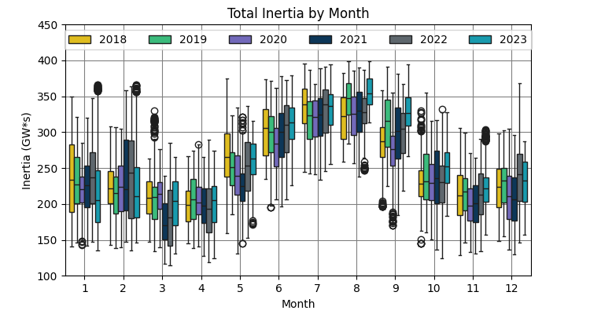
Total Inertia by Month 2018-2023
In 2023, the spring (Mar and Apr) and summer (Aug to Oct) show higher inertia compared to previous years

Slide 12
Observation 1

Slide 13
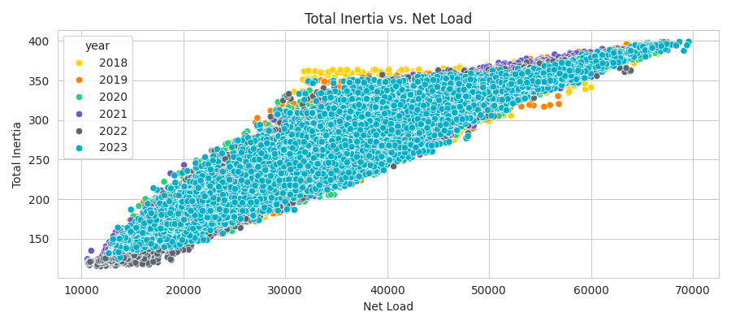
Correlation between Inertia and Net Load
Inertia and net load exhibit a strong correlation

Slide 14
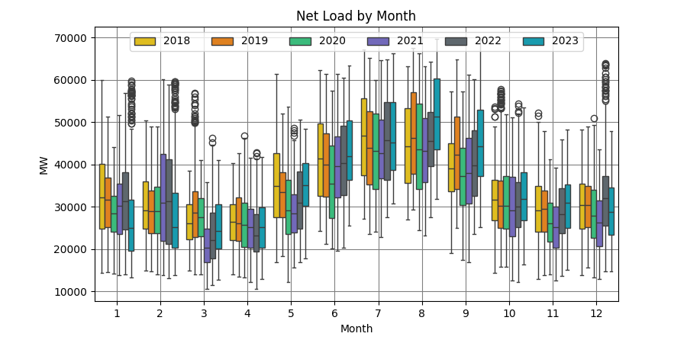
Net Load by Month 2018-2023
In 2023, the average inertia increased significantly due to the higher summer (Aug-Oct) net load
Net Load = Load – Wind Generation – Solar Generation

Slide 15
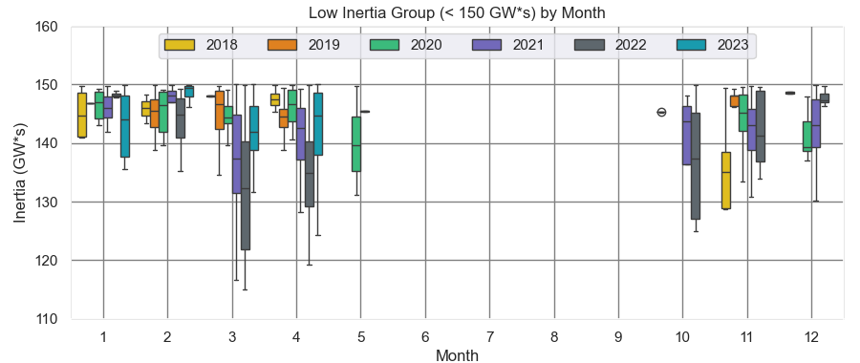
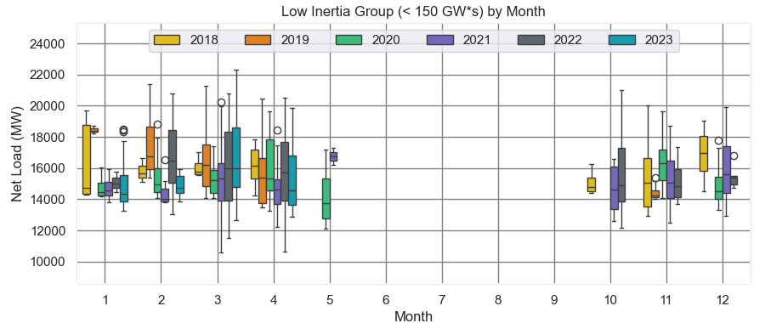
Low Inertia Group (< 150 GW*s) by Month 2018-2023
In the spring of 2023, inertia increased drastically in the low inertia group, but net load did not increase significantly

Slide 16
Observation 2

Slide 17
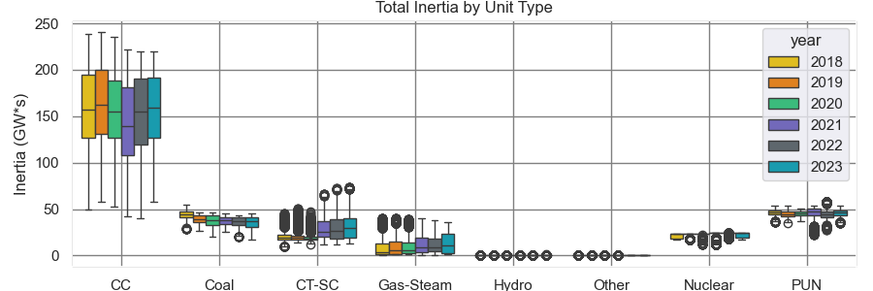
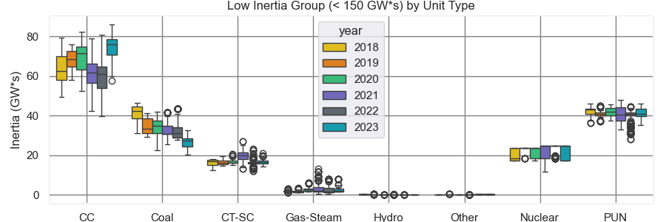
Inertia Group by Unit Type 2018-2023
In the low inertia group, CC inertia increased rapidly in 2023
Two coal units retired (3.085 GW*s)

Slide 18
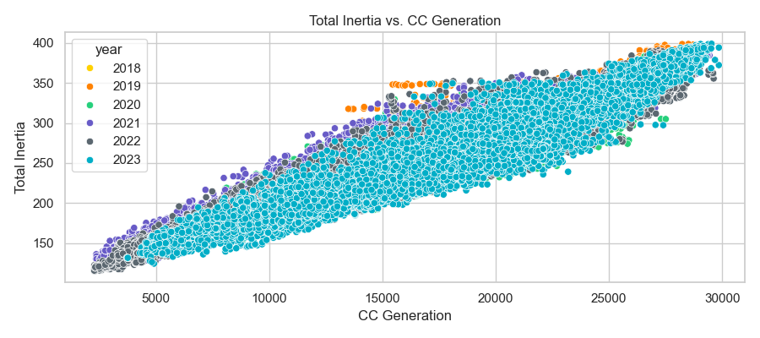
Correlation between CC Generation and Total Inertia
CC Generation and Total Inertia exhibit a strong correlation

Slide 19
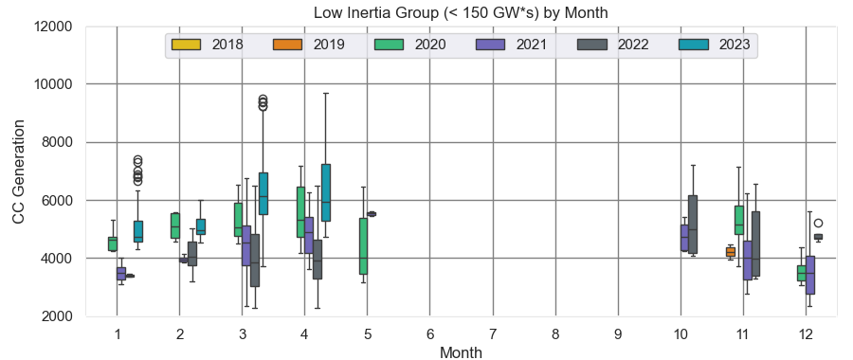
CC Generation in Low Inertia Period by Month 2018-2023
In the spring of 2023 (Mar-Apr), CC Generation increased significantly compared to Spring 2022 during the low inertia period

Slide 20
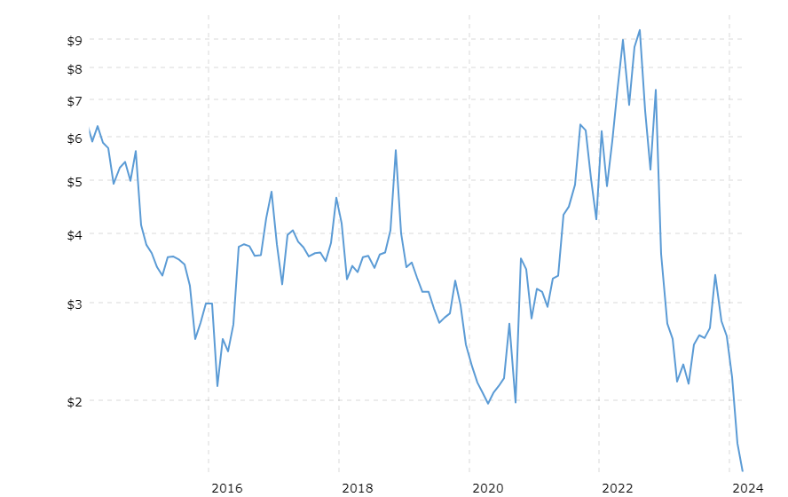
Natural Gas Prices 2015-2023
May 2023
$2.14
Source: Macrotrends (Natural Gas Prices)

Slide 21
Summary
Lowest system inertia in 2023 was 124 GW*s
2023 experienced less hours below 150 GW*s than in previous years; more hours above 350 GW*s
In 2023, the average inertia increased significantly due to the higher summer (Aug-Oct) net load
Higher total load offset the increase in IRR generation
In 2023, higher contribution from combined cycle units was correlated with the lowest system-wide inertia hours
CC generation was significantly increased in Spring (Mar, Apr)
Lower natural gas prices led to more dispatch of CC units during the lower inertia period

Slide 22
Thank you!
Questions

