Slide 1
Weatherization & Inspection
Overview of Attachment K and Supplement to Attachment K
Brandon Manley
Senior Weatherization Program Analyst
Date: 5/28/2024

Slide 2
Weatherization & Inspection Program Overview
Background
Under the PUCT Rule 16 TAC § 25.55 (“the Rule”), the ERCOT Weatherization and Inspection (W&I) Team has been actively performing Resource Entity (RE) and Transmission Service Provider (TSP) onsite inspections since December of 2021.
This past winter inspection season, we inspected 340 REs and 129 TSPs using our new field service application, which was the first phase of the technology project.
Beginning Summer 2023, ERCOT joined the Natural Gas Pipeline Coordination requirement together with the Declaration of Summer Weather Preparedness requirement.
Discussion Items
Declaration of Natural Gas Pipeline Coordination
ERCOT Weatherization & Inspection Market Participant Portal Overview
Declaration of Summer Weather Preparedness Forms (Attachment K & Supp to Attachment K)
Questions
2
Notes:
Inspections are executed by both our internal ERCOT inspector team as well as our Contract Inspector Teams.
The rule requires that all generation resources be inspected every 3 years and 10% of TSPs each year, which is our guide to setting our targets each season.
All MPs are required to submit DoWPs twice a year that are signed by the generation entity or transmission service providers “highest ranking representative, official, or officer with binding authority…attesting to the completion of all applicable activities…”
This process for submitting their Declaration of Weather Preparedness will be moved to our Market Participant Portal
Last summer we rolled out the first phase of this project and technology release internally to our inspectors; Specifically, it was the field service management component.

Slide 3
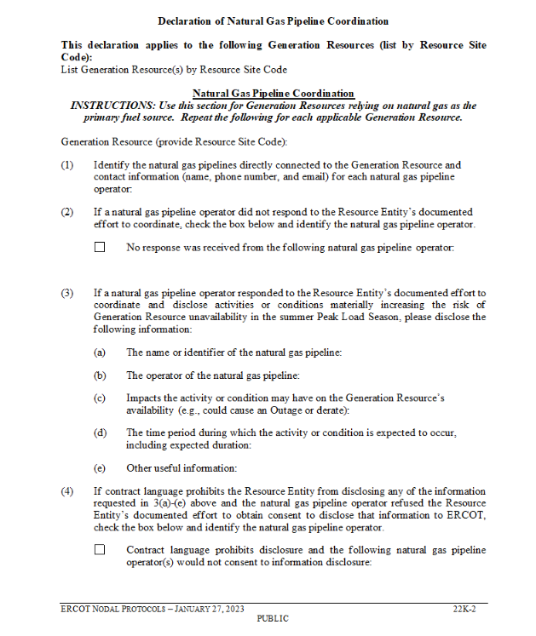
Declaration of Natural Gas Pipeline Coordination
Attachment K and Supplement to Attachment K
16 TAC §25.55 (c)(3)(B)(iv)
Authorizes ERCOT to specify additional information for inclusion into declarations
Consolidating pipeline coordination declaration into weatherization declaration required by PUCT rules reduces administrative burden on MPs and ERCOT
ERCOT Nodal Protocols Section 22:
Declaration of Natural Gas Pipeline Coordination
This form is used to identify natural gas pipelines directly connected to the Generation Resource as well as contact information associated with each natural gas pipeline operator.
Accessible at: https://www.ercot.com/mktrules/nprotocols/current
**These requirements are applicable to ERCOT Resource Entities**
Notes:
16 TAC 25.55(c)(3)(B)(iv)
Includes any additional information required by the ERCOT protocols in effect as of April 1 of the year in which the declaration is submitted;

Slide 4
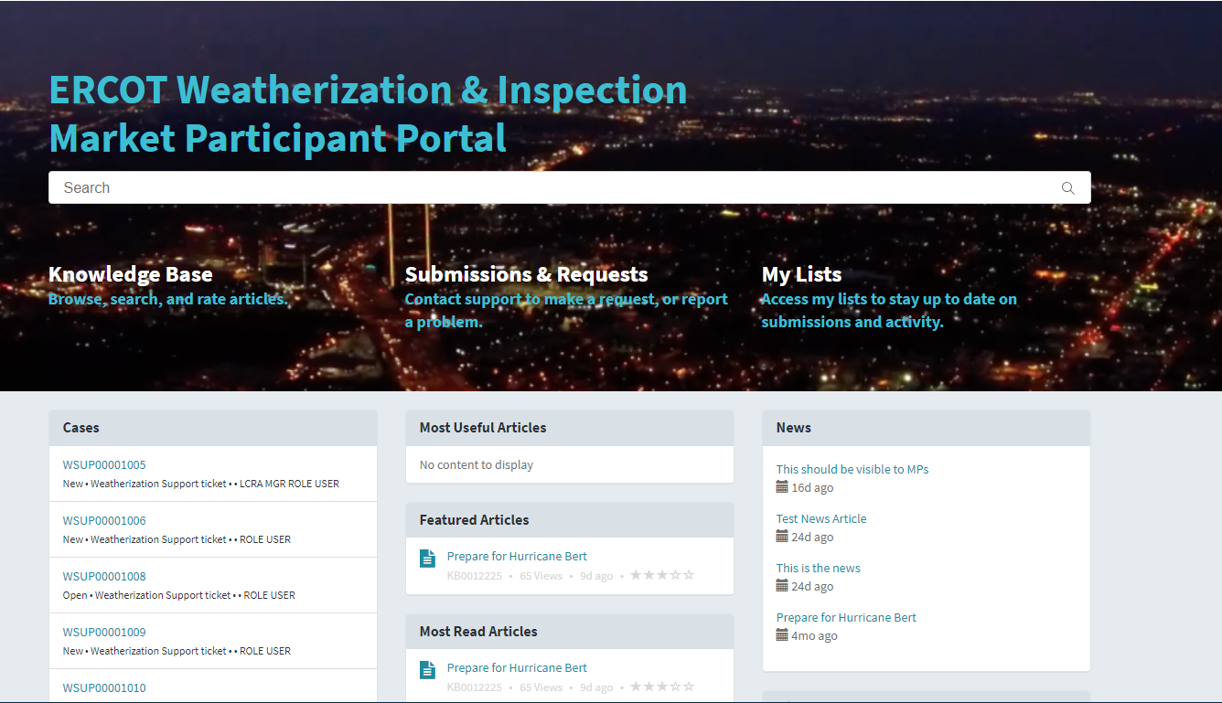
ERCOT Weatherization & Inspection Market Participant Portal Overview
Once you are logged in, you will be taken to the home page with a title: ERCOT Weatherization & Inspection Market Participant Portal
Search Bar – Search frequently asked questions
Knowledge Base – Knowledge articles
Submissions & Requests – Where you will submit your Declaration of Weather Preparedness
My Lists – Access your various cases (DoWP, NOI, CP, etc.)

Slide 5
Declaration of Weather Preparedness (DoWP) Forms
Attachment K & Supplement to Attachment K
In the field labeled ‘List Generation Resources’ Select the Resources that use natural gas as the primary fuel source

Slide 6
Thank You!
Additional W&I Summer Readiness details at: https://www.ercot.com/gridinfo/generation/summerready

