Slide 1
NPRR1186 Go Live Updates
Rachel Villarreal
May 29, 2024

Slide 2
NPRR1186 Status
Objective of this NPRR is to implement improvements prior to the RTC+B project for better ESR State of Charge Awareness, Accounting, and Monitoring.
NPRR Status
On 1/18/2024, PUCT remanded this NPRR to the ERCOT Board.
Suggested modifications to section 8.1
ERCOT submitted comments to remove the revisions to Protocols Section 8.1
ERCOT Board approved
PUCT approved

Slide 3
ERCOT System Changes
New ICCP Telemetry points for ESR additions

Slide 4
ERCOT System Changes
External Specs/xsd changes
3 new fields are being added to COP submissions
Max SOC
Min SOC
TargetBeginSOC
Changes are backward compatible for Non-ESRs
Changes are in the ErcotTransactionTypes.xsd

Slide 5
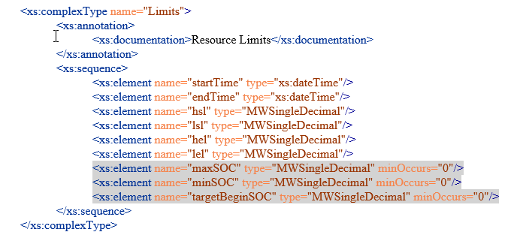
ERCOT System Changes
External Specification changes
The gray highlighted elements below were added for this NPRR

Slide 6
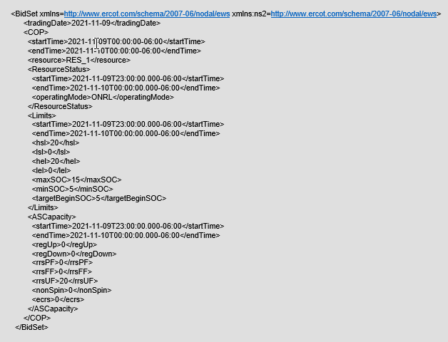
ERCOT System Changes
External Specification changes
COP submission xml example with SOC changes

Slide 7
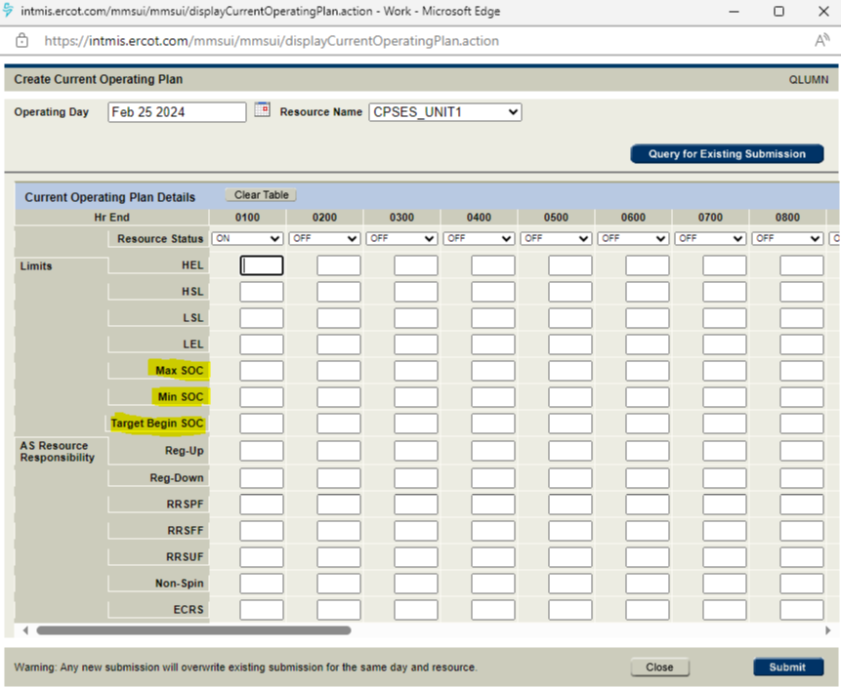
ERCOT System Changes
Market Manager UI changes
COP Submission with SOC changes

Slide 8
Timelines
ICCP Handbook was updated with new telemetry changes. ICCP handbook can be found at below link
https://www.ercot.com/services/mdt/userguides
Draft version of External Specs (XSD) changes (EIP External Interfaces Specification v1.26) are available in ercot.com (https://www.ercot.com/services/mdt/xsds).
MOTE and Go Live Timelines
MOTE Testing started from 05/20/2024
Go live date - 06/27/2024

Slide 9
High Level Go Live Plan
Go Live on 06/27/2024 and First Operating Day is 06/27/2024
Real-Time Go Live
Real-Time system changes deployments start around 3:41 PM and complete by around 4:15 PM.
Real-Time system changes of the NPRR will be activated around 4:30 PM i.e., EMS will start calculating ESRs updated HASL/LASL to be used in SCED dispatch based on current SOC telemetry points (SOC/Max/Min SOC) from 4:30 PM.
Telemetered Max/Min SOC values are validated against Registration data.

Slide 10
High Level Go Live Plan
COP Submissions Go Live
Market/COP Submissions related system changes (API/Market Manager) will be deployed and available for ESR COP submissions from around 4:30 PM.
ESR COPs submitted for remainder of Operation Day 06/27 and for future Operating Days before go live should be resubmitted after go live on 06/27.
Non-ESR COP submissions should leave SOC fields blank otherwise COP submissions for Non-ESR resources will fail.
All ESRs COP submissions with SOC fields populated are expected to be available on or before 8:00 PM.
COP SOC fields are expected to have up to two decimals.

