Slide 1
PDCWG Report to ROS
Chair: Kevin Bunch, EDF Trading North America
Vice Chair: Chad Mulholland, NRG
ROS
June 6th, 2024

Slide 2
Report Overview & Notes
Report Overview
Meeting Minutes
Annual Inertia Presentation
NOGRR Draft – RRS Limitations
NOGRR 263
ERCOT Frequency Control Metrics and Regulation Reports
Analysis of Disturbances/Frequency Events
TRE Report
SAR Draft (BAL-001 for ESRs)
PFR by Resource Type
ROS Open Action Items
Other Items
NDA List Review
BAL-001-TRE-2 FMEs and IMFR
1 FME in the month of April
Frequency Control Report

Slide 3
Frequency Measurable Events Performance

Slide 4
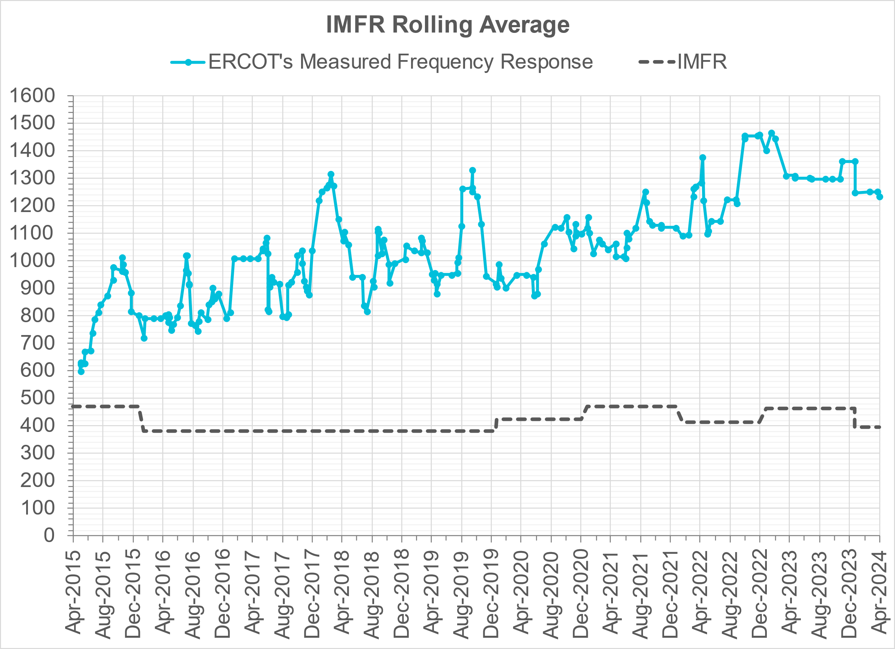
Interconnection Minimum Frequency Response (IMFR) Performance
IMFR Performance currently
1236.68 MW/0.1HZ
Frequency Response Obligation (FRO): 395 MW/0.1 Hz

Slide 5
Questions?

Slide 6
Frequency Control Report
April 2024

Slide 7
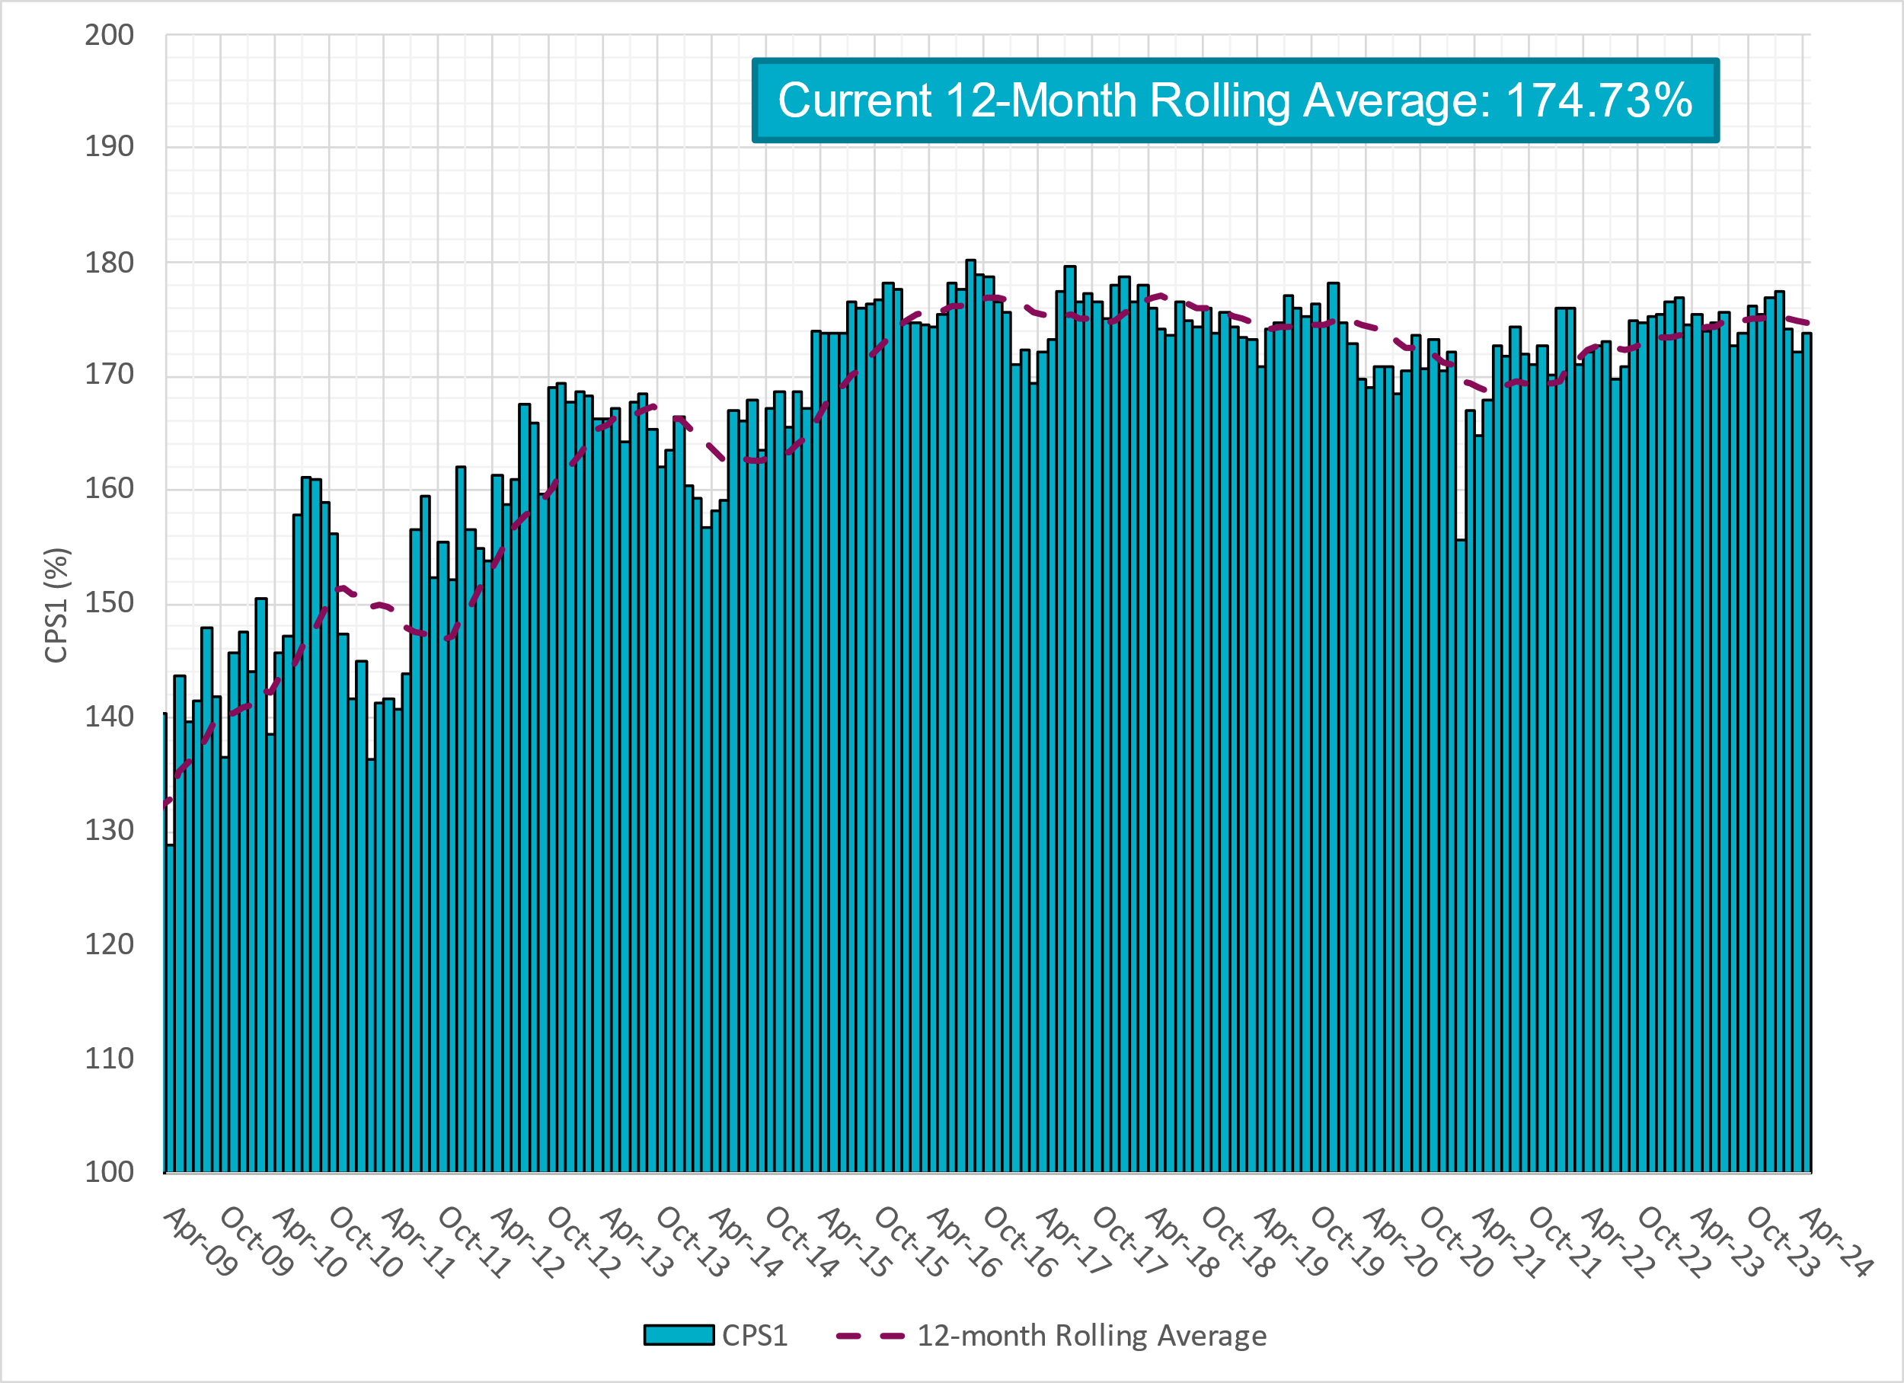
CPS1 Performance

Slide 8
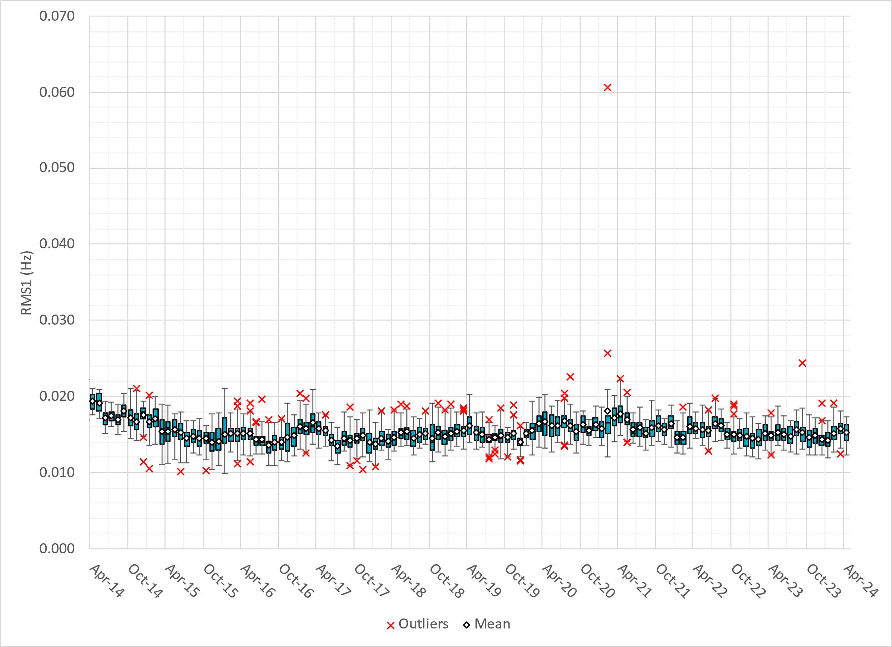
RMS1 Performance of ERCOT Frequency
Notes:
15.31 mHz on avg for April 2024

Slide 9
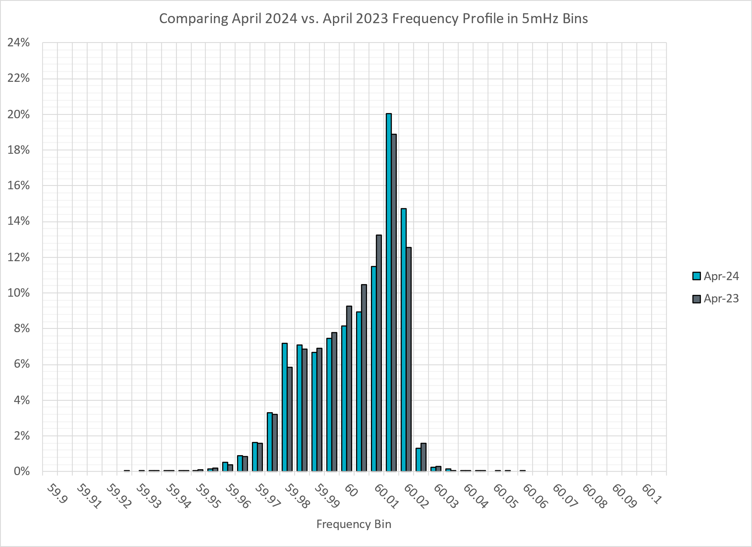
Frequency Profile Analysis

Slide 10
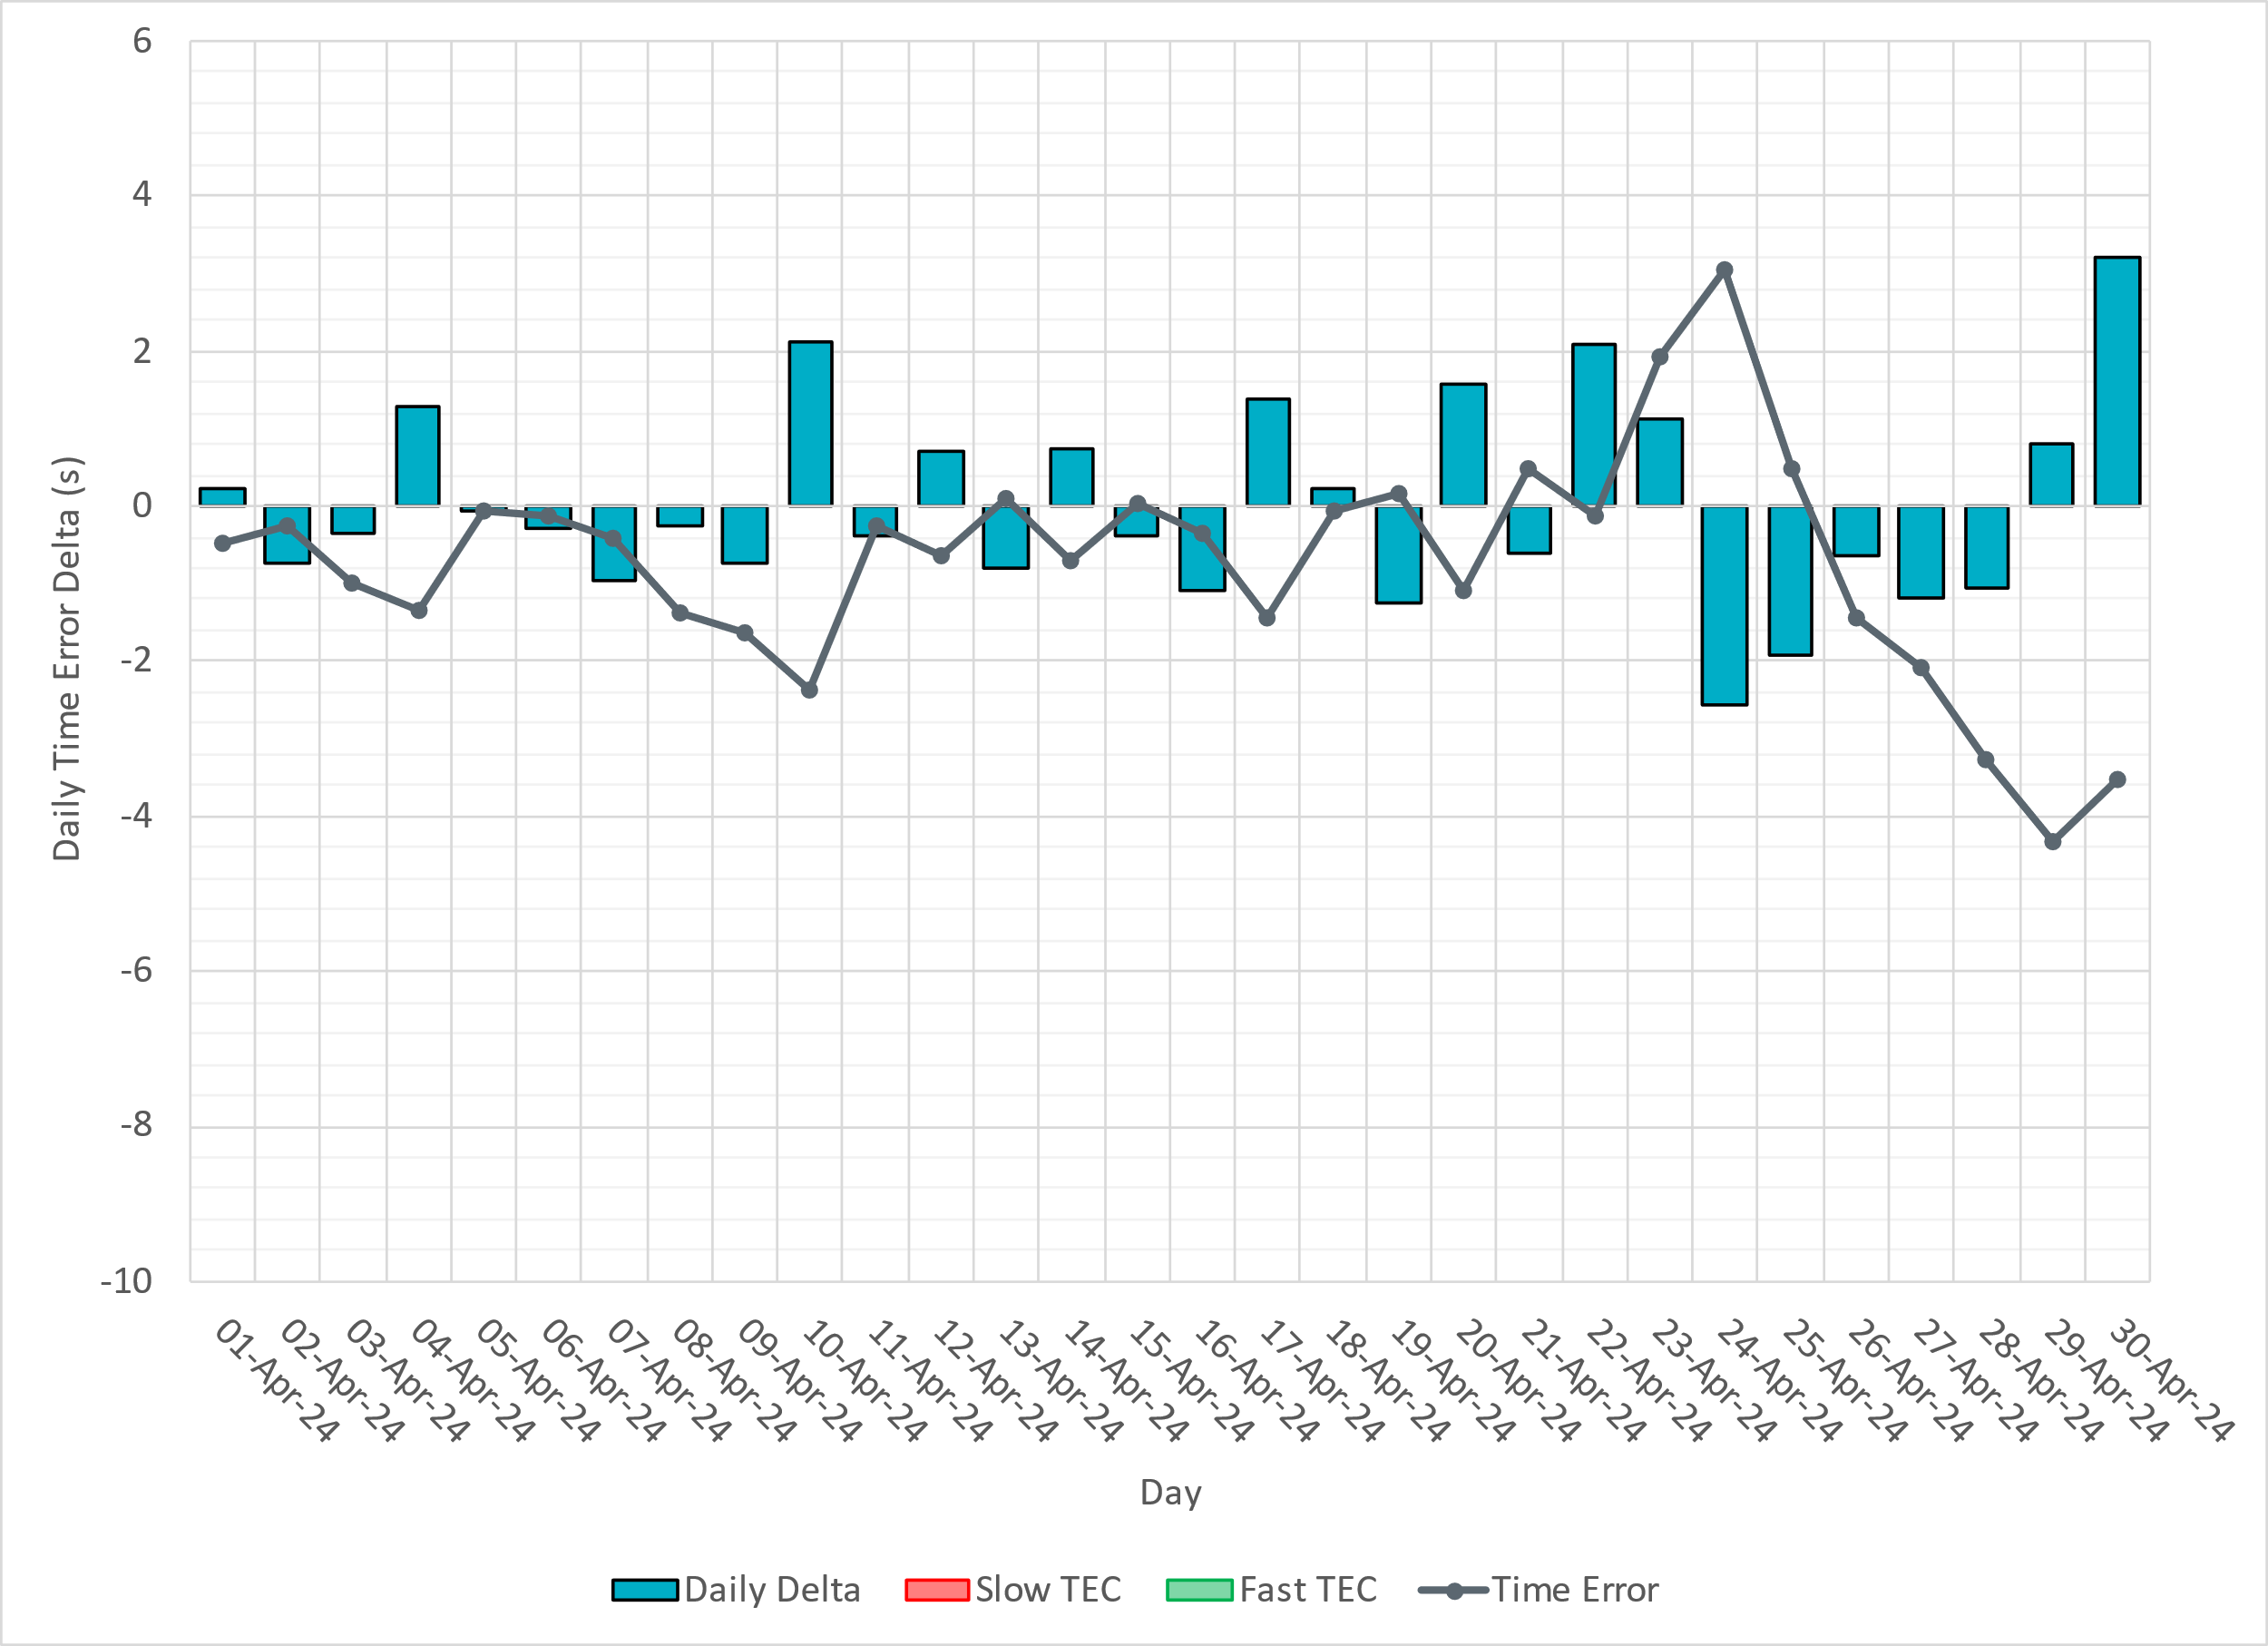
Time Error Corrections

Slide 11
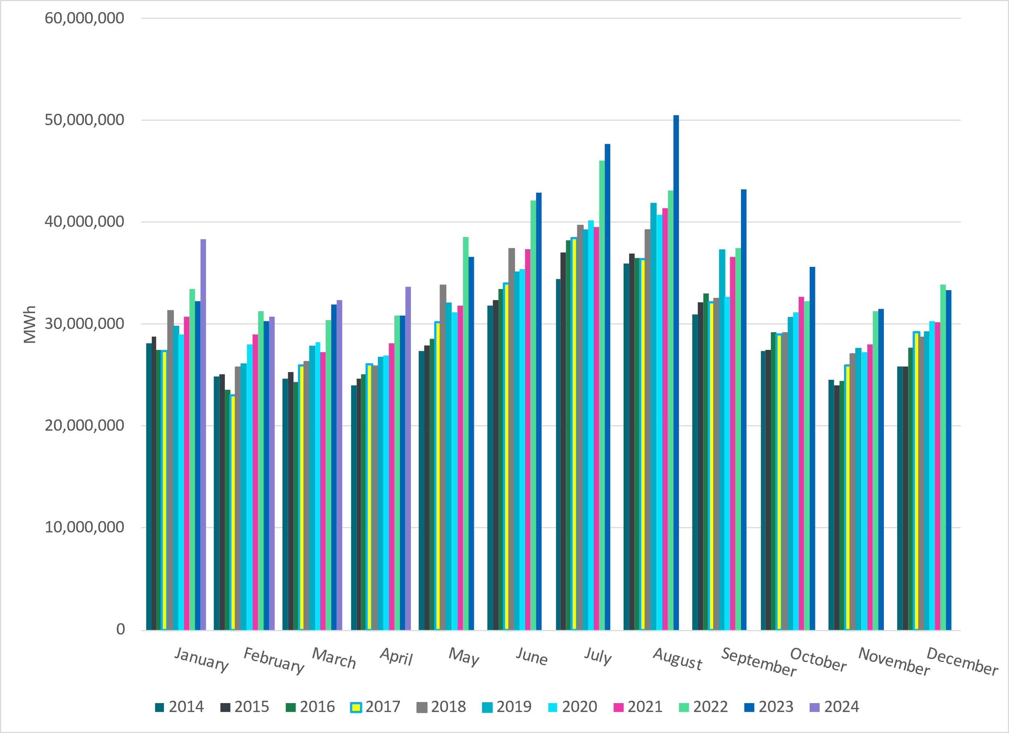
ERCOT Total Energy
Notes:
33,644,368 MWh

Slide 12
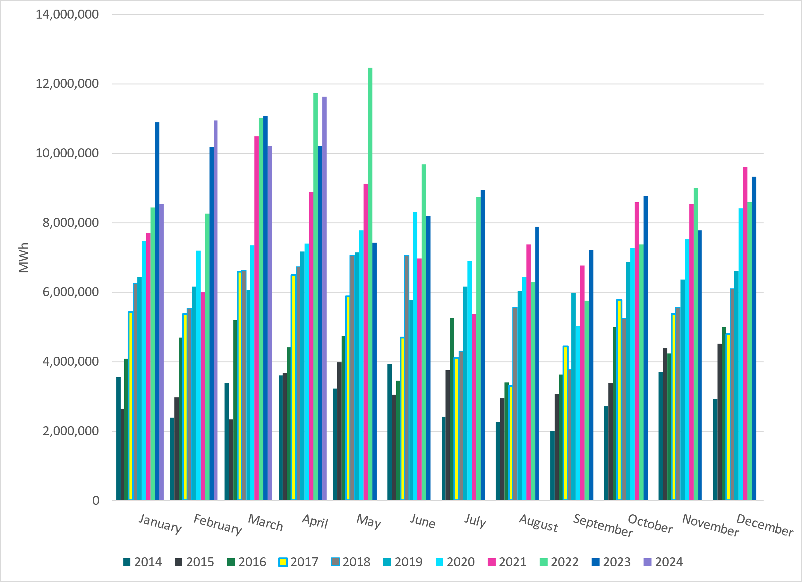
ERCOT Total Energy from Wind Generation
Notes:
11,622,240 MWH

Slide 13
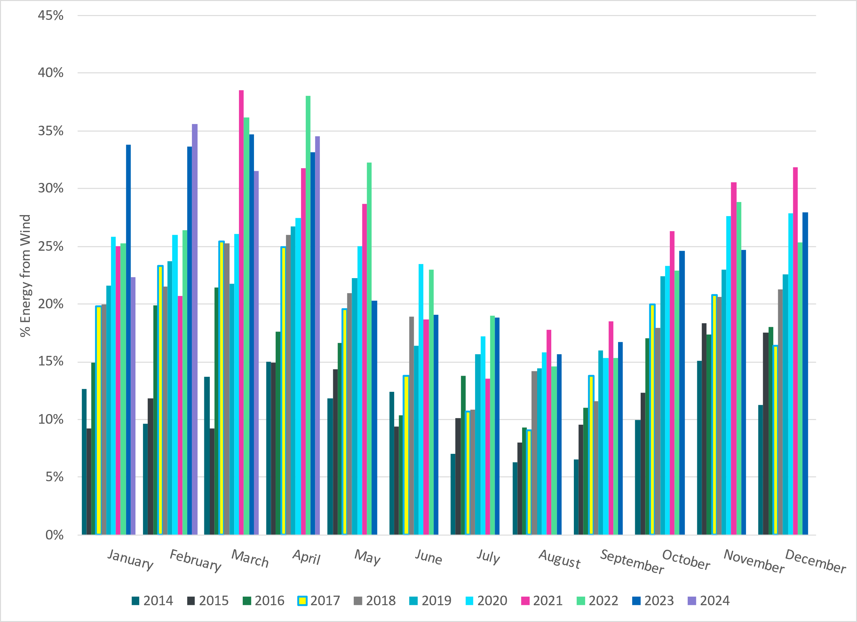
ERCOT % Energy from Wind Generation
Notes:
34.54% of total energy was provided by wind generation

Slide 14
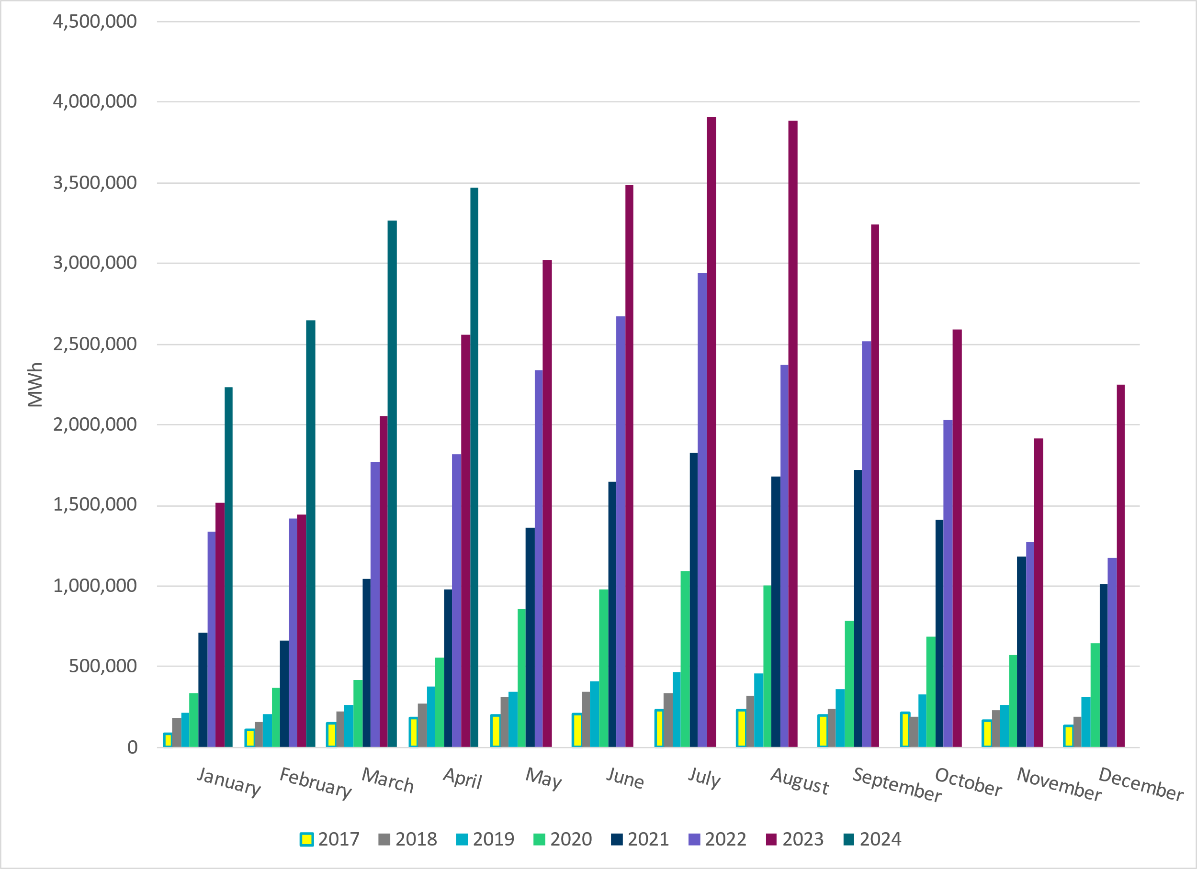
ERCOT Total Energy from Solar Generation
Notes:
3,472,621 MWh

Slide 15
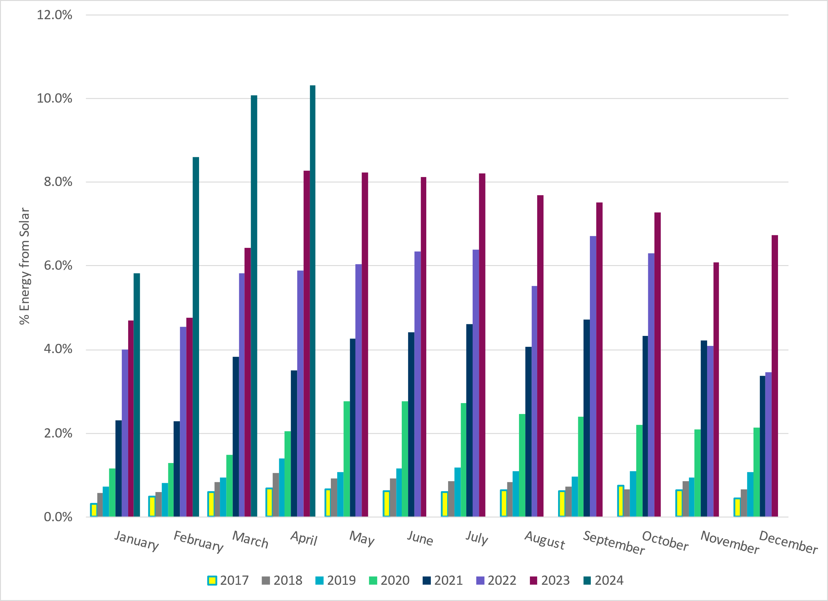
ERCOT % Energy from Solar Generation
Notes:
10.32% of total energy was provided by solar generation

Slide 16
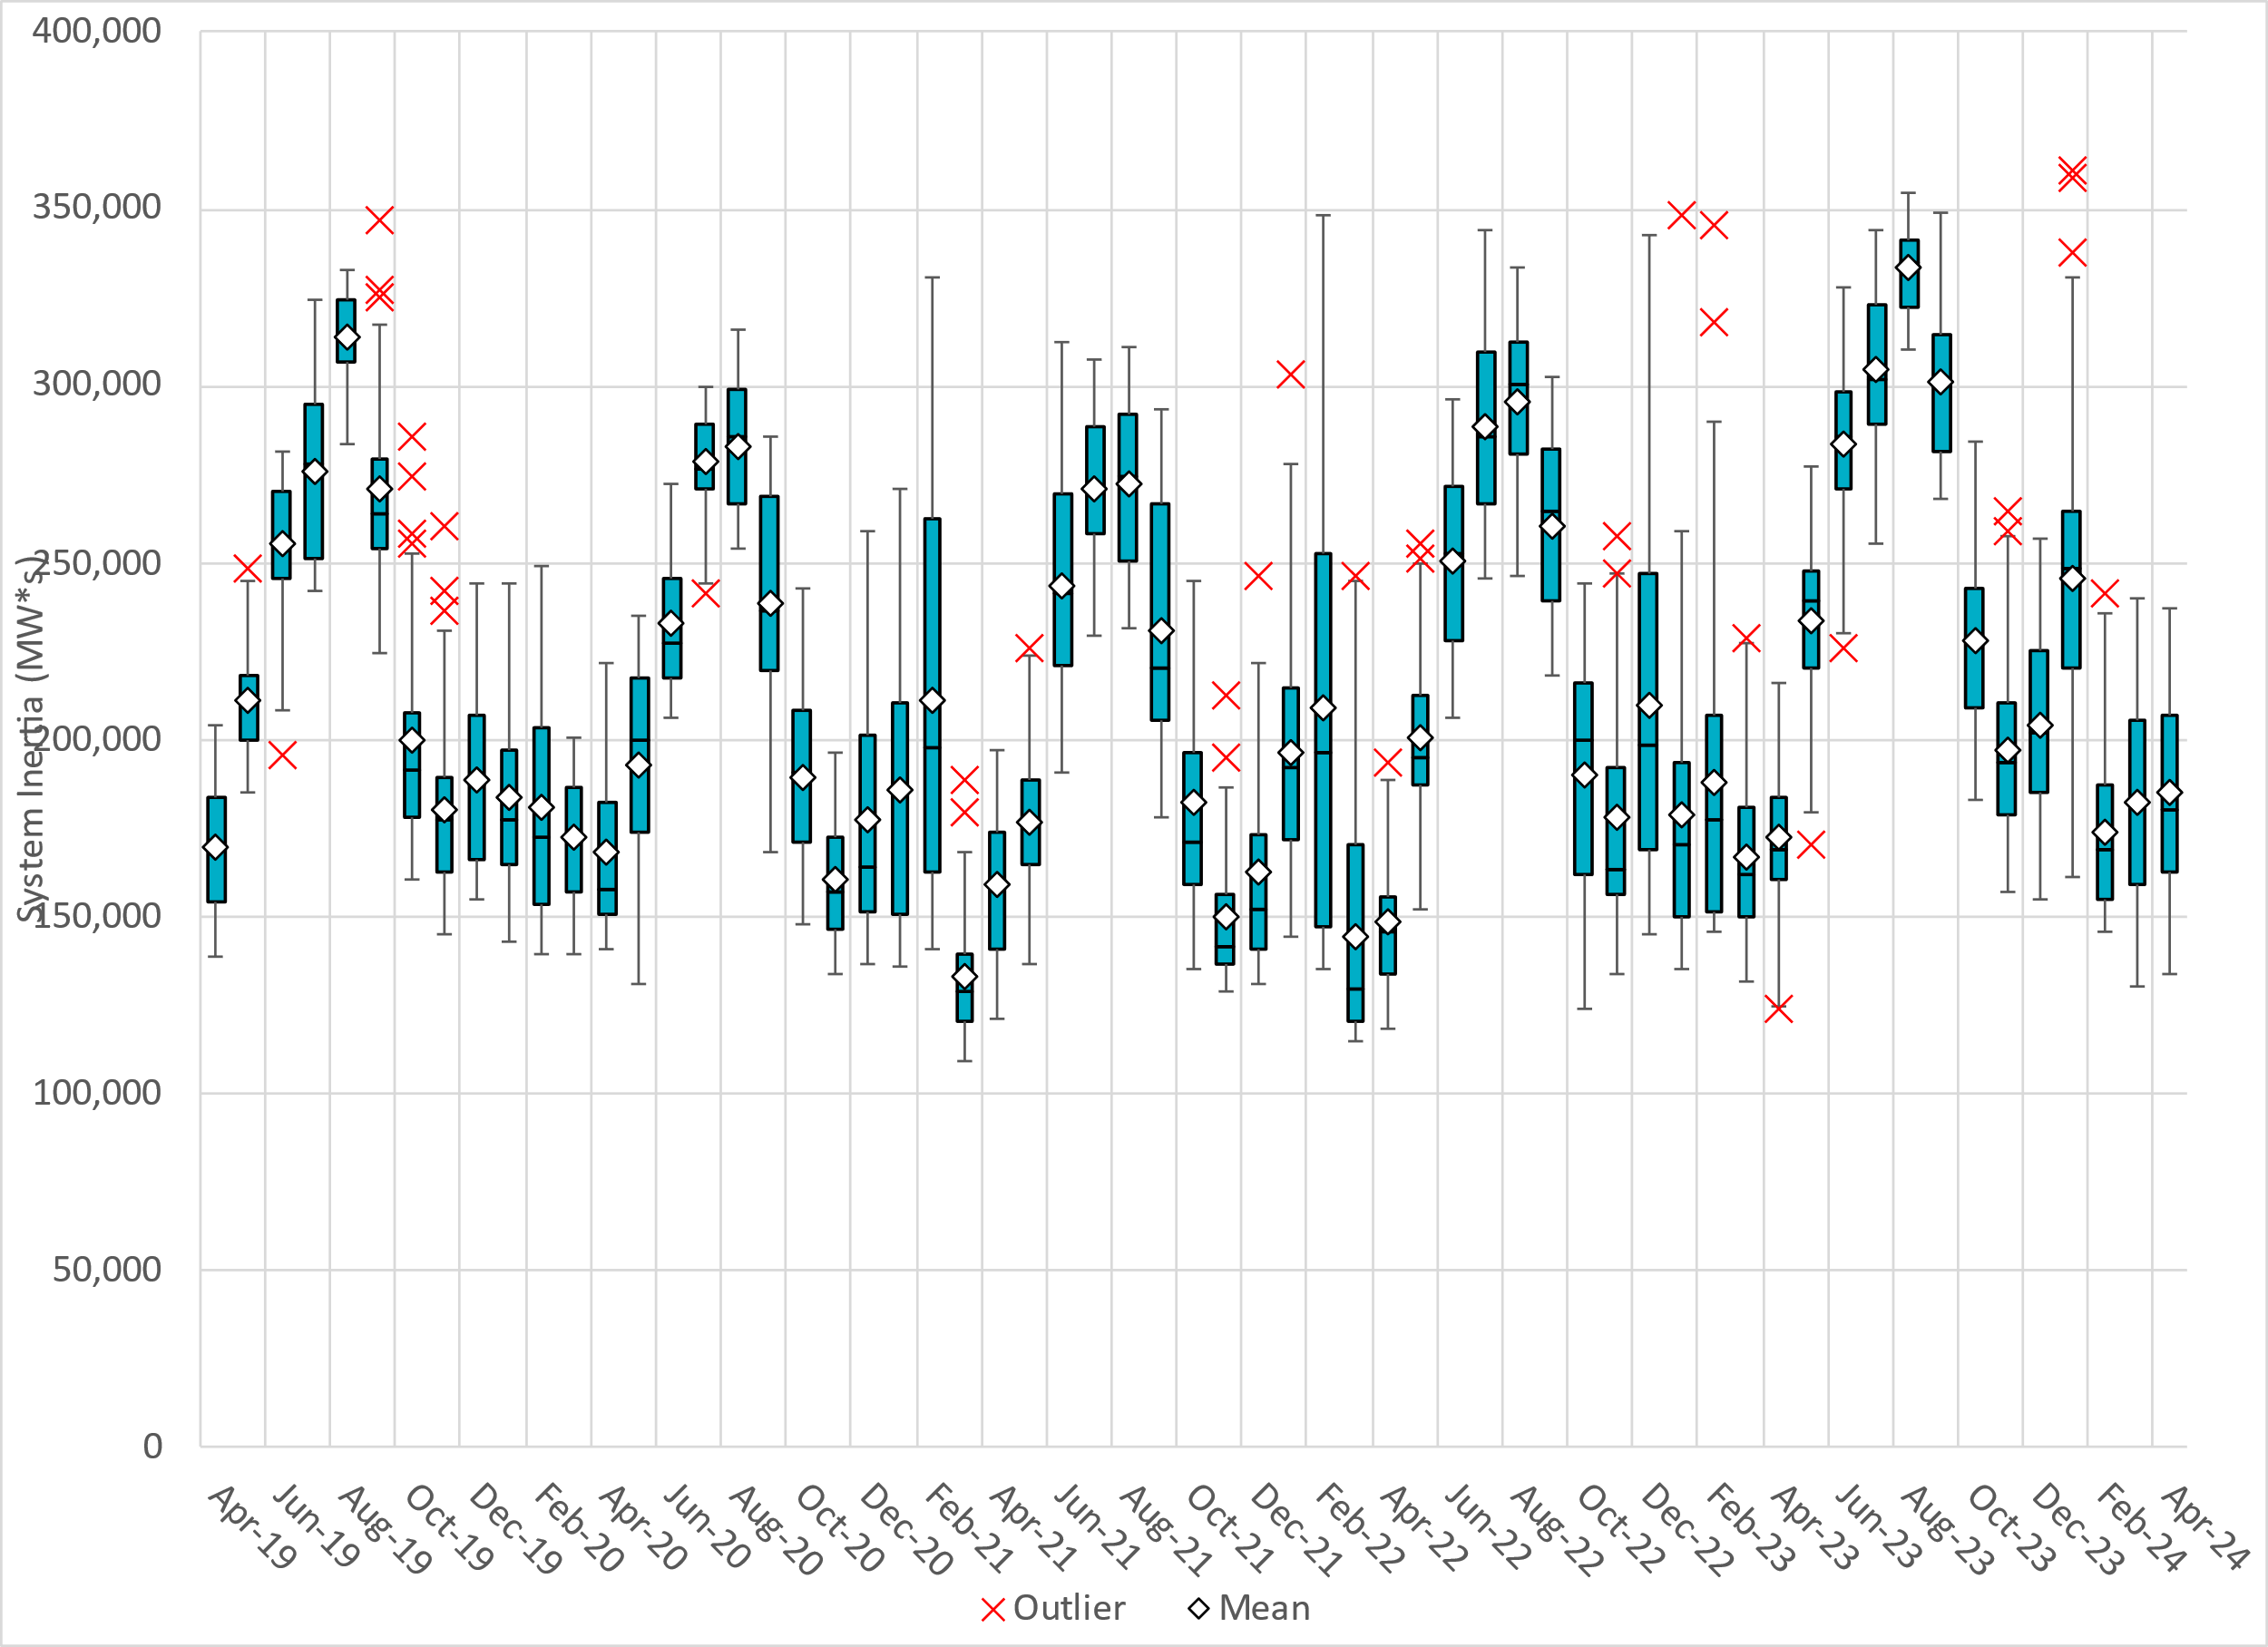
ERCOT Daily Minimum System Inertia
Notes:
Minimum Inertia in April 2024 = 133,953.45 MW*s on April 6th
Historical Overall Minimum was 109,029 MW*s on 3/22/2021
April Data:
Mean: 184,725 MW*s
Max: 236,951 MW*s on April 17th
Min: 133,953.45 MW*s on April 6th

Slide 17
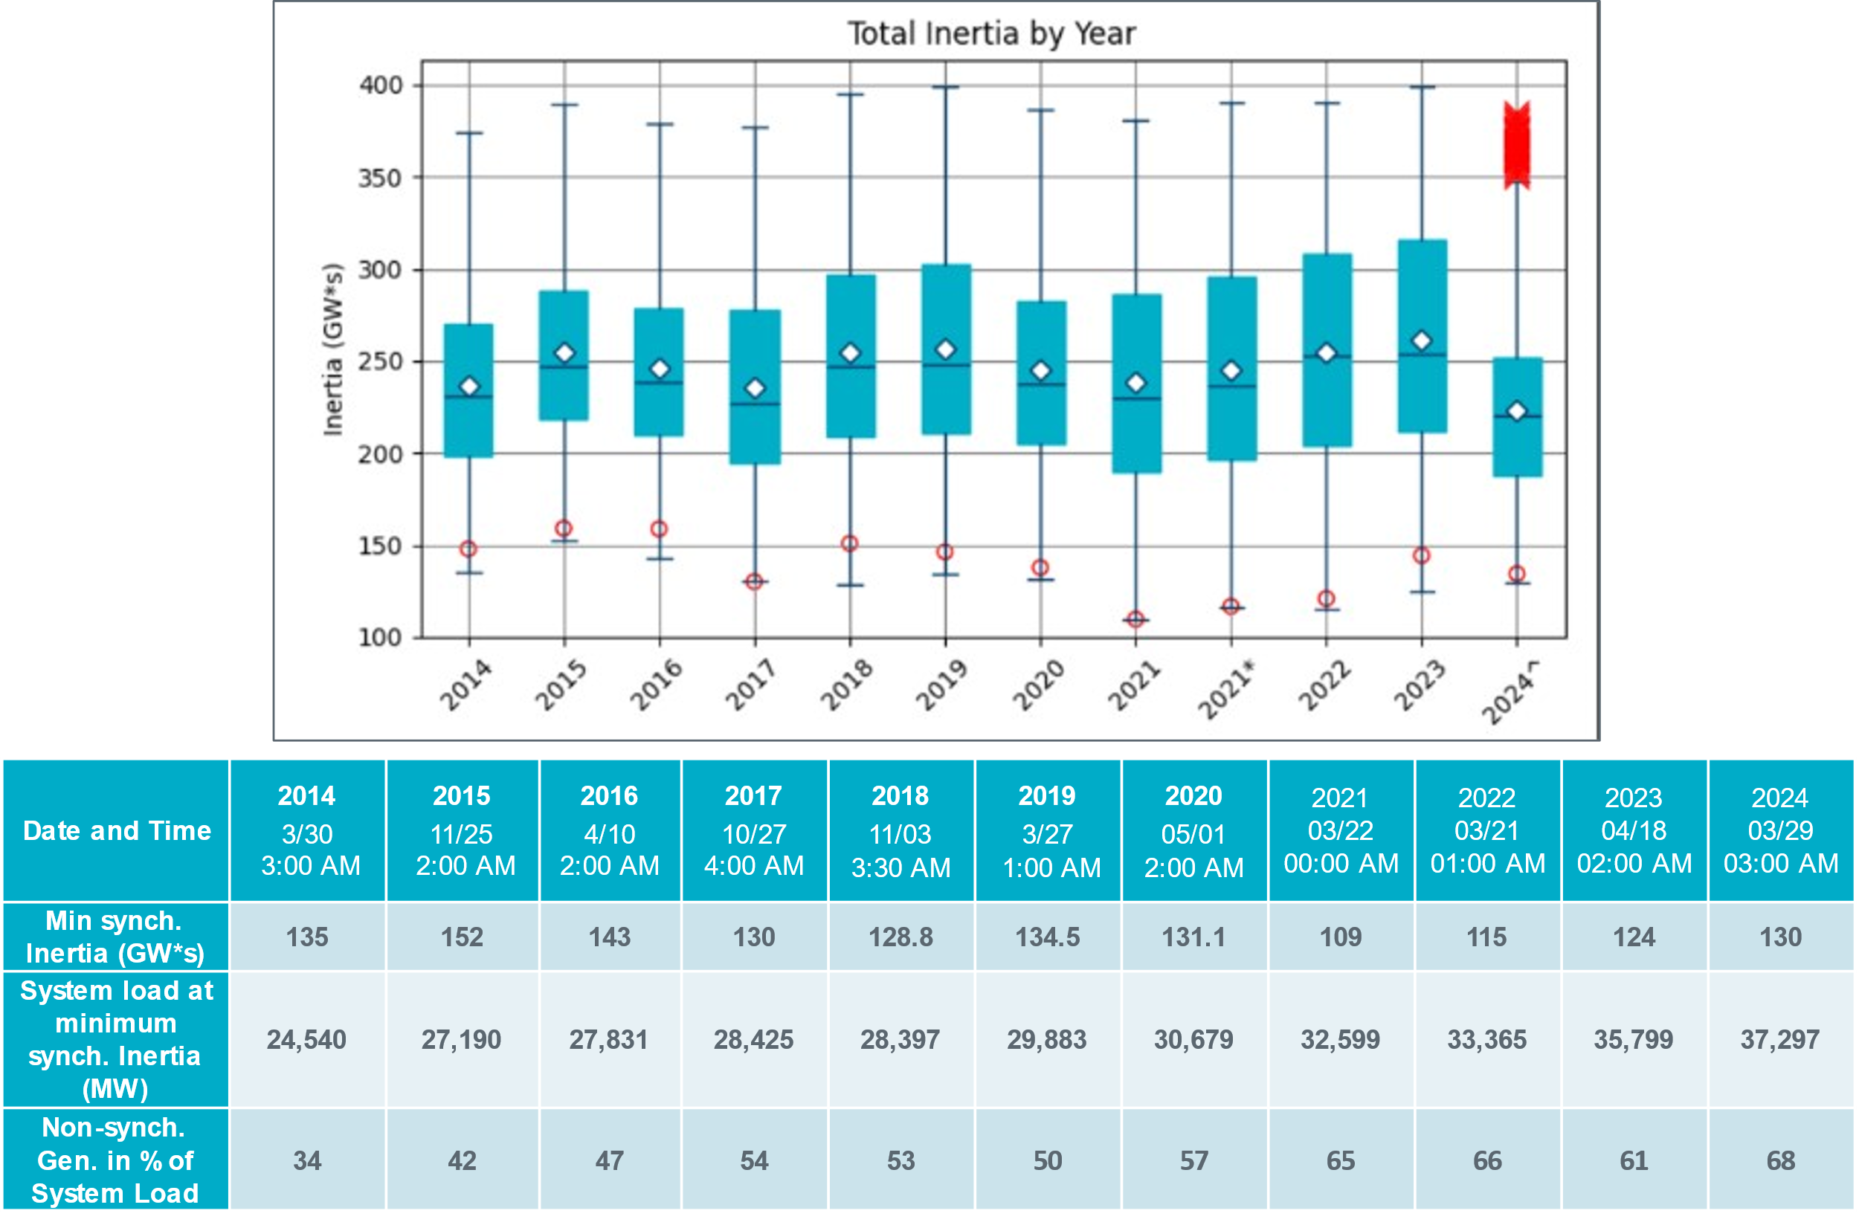
ERCOT Inertia Trend
Notes:
Summary of ERCOT intertia for the previous 10 years. Lowest inertia this year was on February 25th.
For each box, the central mark (red line) is the median, the edges of the box (in blue) are the 25th and 75th percentiles, the whiskers correspond to +/- 2.7 sigma (i.e., represent 99.3% coverage, assuming the data are normally distributed. The corresponding lowest inertia in each year is given in the table.
The circle on each boxplot is showing inertia during time when highest portion of load was served by wind/solar generation in that year.
^ indicates a partial year.

