Slide 1
RIOO ESR Project Implementation
Joel Koepke
6/12/2024

Slide 2
Topics
ERCOT’s Transition to Single-Model ESR Representation
RIOO Project Overview and Milestones
Upcoming Data Request

Slide 3
RTC+B: Transition to Single-Model Representation of ESRs
A key goal of the RTC+B project is to transition from a combo-model representation of ESRs to a single model
All ERCOT systems currently represent an ESR as a load/generator pair
RIOO
Model
EMS/MMS
Post-RTC+B go-live, all core systems will utilize the single-model representation for ESRs
RIOO
Model
EMS/MMS
RIOO will be the first application to make this transition

Slide 4
Current State: Combo Model Used in All Systems
Currently, RIOO and all downstream systems represent ESRs as a generator and load pair
RIOO
Model
EMS/MMS
Outputs
Separate submissions must be made to add/update the load or generator
All communications (e.g., ICCP, reporting, etc.) reference either the load or generator
Now through Q3 2024

Slide 5
Post RIOO ESR Project: Single Model in RIOO Only
After the RIOO ESR Project, RIOO will no longer represent an ESR as individual loads and generators. Downstream systems will continue to use the combo model.
ERCOT will translate single model submissions into the combo model
RIOO
Model
EMS/MMS
Outputs
Changes to both the charging and discharging sides of the ESR can be done in one submission
Downstream systems will continue to use the combo model
ERCOT will also bring key ESR information into the model to support RTC+B testing
Q3 2024 through Q4 2025

Slide 6
Post RTC+B: Single Model Used in All Systems
After RTC+B go-live (Q4 2025), all systems will represent an ESR as a single object
RIOO
Model
EMS/MMS
Outputs
Q4 2025

Slide 7
RIOO ESR Project
This change supports the RTC+B program and precedes other downstream application updates
RIOO
RIOO
Combo Model
Single Model
The goal of the RIOO ESR project is to implement a single-model representation of Energy Storage Resources

Slide 8
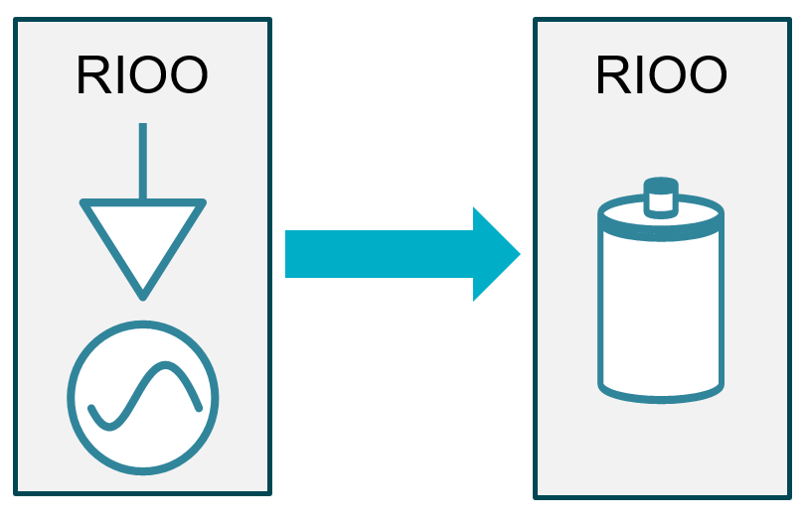
RIOO ESR Project: Milestones
The ESR project enables single model submissions
The ESR project has two key milestones:
Application updated to accept single-model submissions for new interconnection requests
Target Date: 7/25/2024
All in-flight and commissioned ESRs programmatically converted from combo-model to single-model
Target Date: 9/26/2024
Prior to the ESR conversion, ERCOT will request additional information to support the transformation.

Slide 9
ESR-Specific Data Request
Additional information is needed to support the conversion to a single-model representation for ESRs, to ensure proper RIOO functionality, and to prepare for RTC+B functionality changes
For Example:
Reactive Capability During Charging
Count of Inverters
Maximum/Minimum SOC
Round Trip Efficiency
ERCOT will be initiating an RFI to collect this information in the upcoming weeks. The collection mechanism and dates are still being determined.

