Slide 1
ERCOT Frequency Events
May 2024
ERCOT
Operations Planning
PDCWG | June 19, 2024

Slide 2
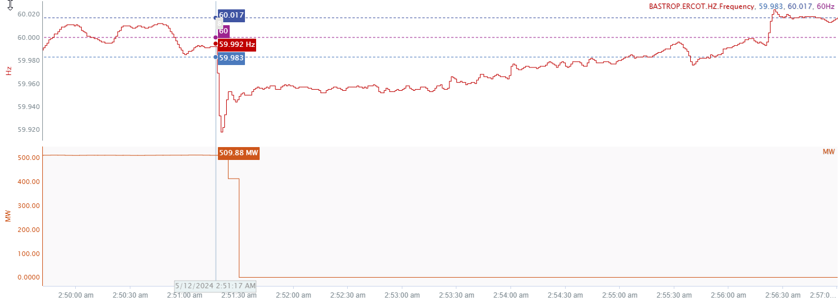
5/12/2024 2:51:17(FME)
Notes:
The unit tripped offline while carrying approximately 510 MW
Starting Frequency: 59.992 Hz
Minimum Frequency: 59.918 Hz
A-C Time : 3 seconds
Recovery Time(back to deadband): 3 minutes 43 seconds
ECRS Released: 0 MW
Trip Reason: Differential expansion and vibration
Contextual Information: A total of 194 MW of regulation Up was deployed during the event

Slide 3
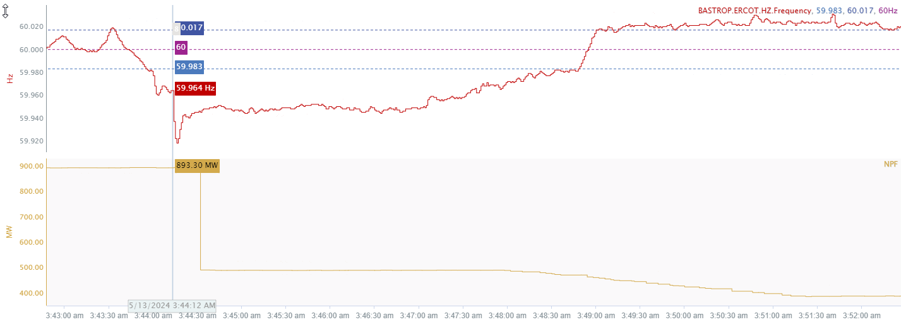
5/12/2024 3:44:12 (Non-FME)
Notes:
The CC experienced partial trip for loss of approximately 405 MW
Starting Frequency: 59.964 Hz
Minimum Frequency: 59.918 Hz
A-C Time : 3 seconds
Recovery Time(back to deadband): 4 minutes 33 seconds
ECRS Released: 0 MW
Trip Reason: Unknown
Contextual Information: A total of 200 MW of regulation up was deployed and SCED manual offset of 300 MW was applied during the event.

Slide 4
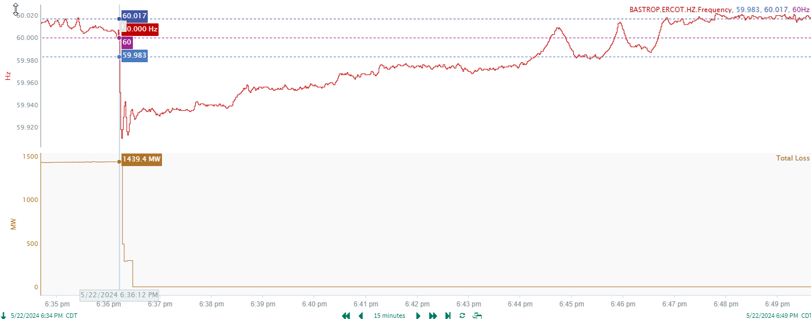
5/22/2024 18:36:12 (Non-FME)
Notes:
Two CC trains tripped offline for combined loss of approximately 1439 MW
Starting Frequency: 60.00 Hz
Minimum Frequency: 59.910 Hz
A-C Time : 3 seconds
Recovery Time(back to deadband): 9 minutes 00 seconds
ECRS Released: 0 MW
Trip Reason: Feed water and tube leak issue
Contextual Information: A total of 461 MW of regulation up was deployed and SCED offset of 350 MW was applied during the event.
No Selection Reason: Approximately 400 MW of price sensitive load tripped.

Slide 5
Questions?
Thank you!

