Slide 1
NERC EMSWG Update
Wei Qiu, NERC EA
ERCOT TWG Conference Call
June 26, 2024

Slide 2
2024 Monitoring and Situational Awareness Technical Conference
Location: ReliabilityFirst in Cleveland, OH
Date and Time:
Tuesday, October 8, 2024, 9 am – 5 pm
Wednesday, October 9, 2024, 9 am - 12 pm
Theme: Insightful Evolution: Bridging Yesterday’s Trends with Tomorrow’s Innovations
AI/ML in Real-Time Operations: Exploring benefits and risks of AI and ML in real-time operations.
FERC 881: Discussing the implementations and strategies related to compliance with FERC Order No. 881.
Human Performance in Control Rooms: Examining best practices and technologies to enhance human performance and decision-making in control room environments.
EMS Upgrade: Addressing challenges and lessons learned from EMS upgrade.

Slide 3
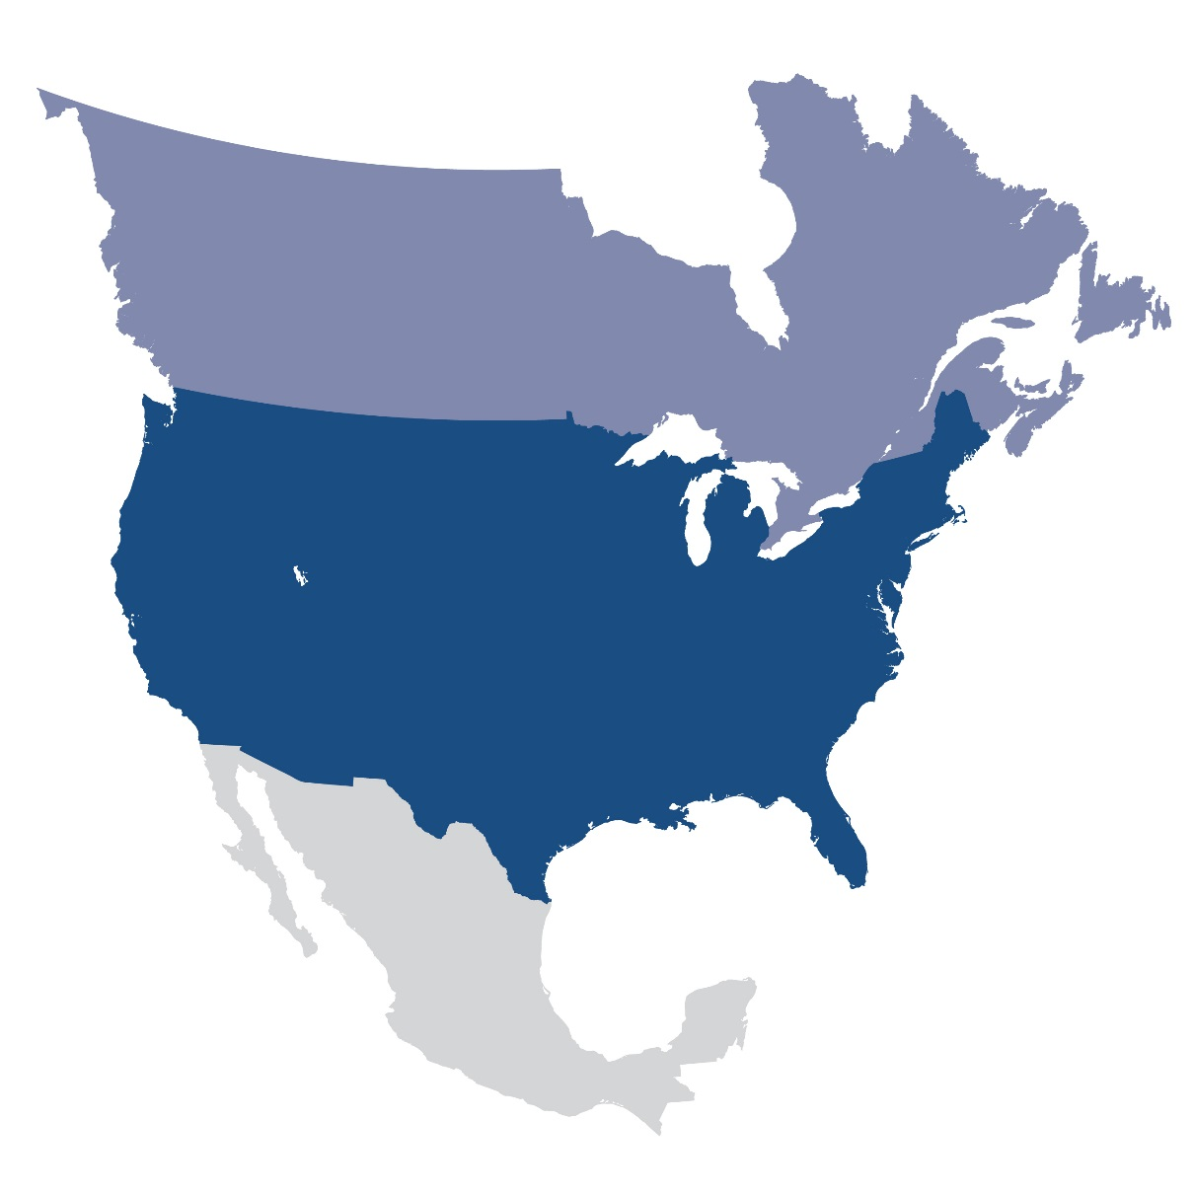
Questions and Answers
Contact Information:
wei.qiu@nerc.net

