Slide 1
Updating ERCOT Load Zones - Impacts on Prices and Congestion Rent
Presented by:
Potomac Economics
ERCOT Independent Market Monitor
July 15, 2024

Slide 2
Purpose
Load Zone definitions have remained the same since 2003, even with significantly changing congestion patterns over the years
Load growth
New generation
Numerous network topological changes
Starting in 2020, the ERCOT IMM has recommended re-evaluation of the Load Zones in order to minimize intra-zonal congestion and provide better incentives for demand response

Slide 3
Methodology
Input dataset time range is real-time 5-minute electrical bus LMPs from January 2021 to April 2024
Only used the congestion components of the LMPs
Then using the load MW at each electrical bus (the same values currently used for calculation of Load Zone LMPs), weigh the congestion components to determine a value at the substation level
Apply k-means clustering process to group substations into set number of new zones
Randomly assign substations to a group
Compute the centroid of the group
Move substations to groups where the distance between the substation to the centroid is least
Once everything is moved, recalculate the centroid of the newly formed groups
Repeat process until no substation is moved
Distance computation:${Max[\sqrt{{\left(y_{a}−y_{b} \right)}^{2}+{\left(x_{a}−x_{b} \right)}^{2}}, 0.00001]}^{2}∗ \sqrt{Max\left(\left|{CC}_{a}−{CC}_{b}\right|, 0.001\right)}$
where (x_{a}, y_{a}) and CC_{a} are the coordinates and congestion component for Substation a, and (x_{b}, y_{b}) and CC_{b} are the coordinates and congestion component for the centroid

Slide 4
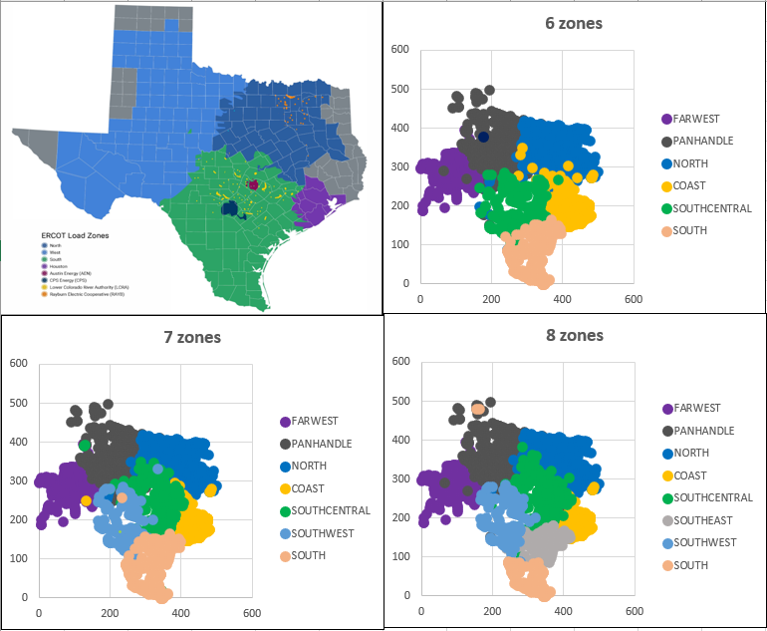
Clustering Process Visualization

Slide 5
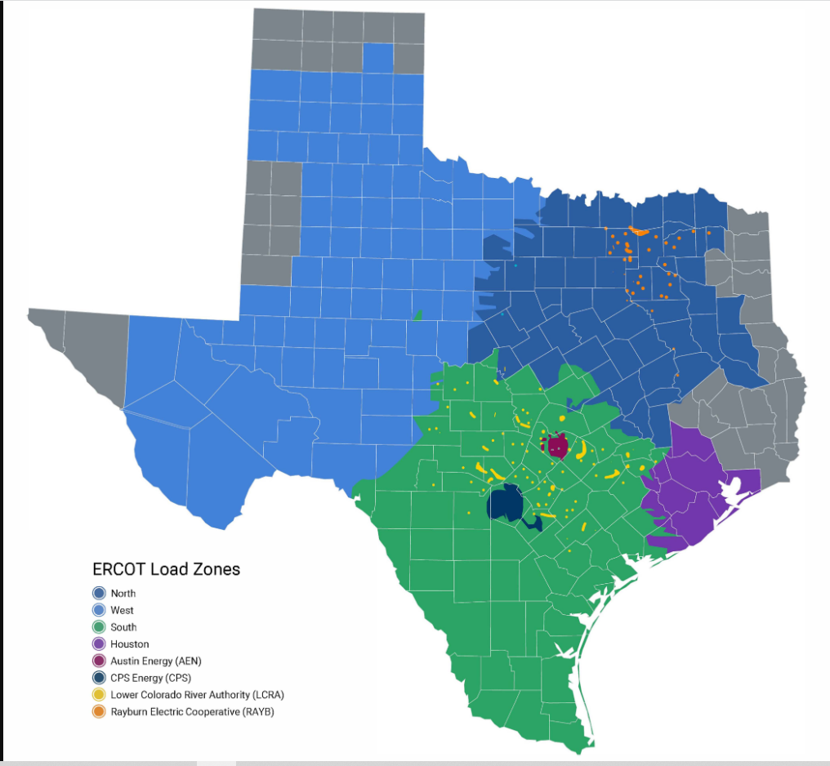
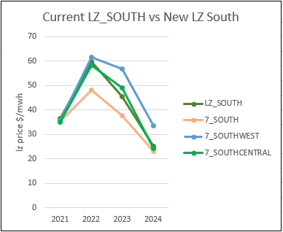
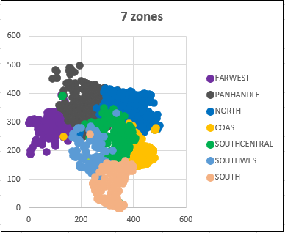
Load Zone prices between Current South and New South Zones

Slide 6
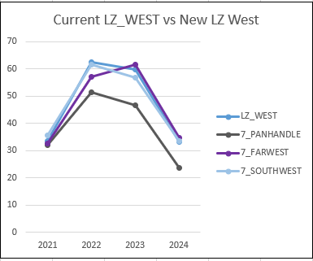
Load Zone prices between Current West and New West Zones

Slide 7
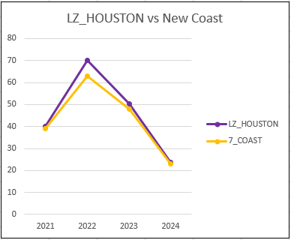
Load Zone prices between Current Houston and New Coast Zone

Slide 8
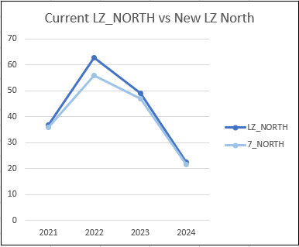
Load Zone prices between Current North and New North Zone

Slide 9
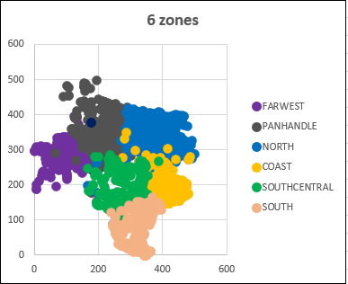
Real-Time Congestion Rent (in MM) Comparison Between Current Load Zones and New Load Zones
 | Cross Zone | West | South | Houston | North
2021 | $226.8 | $389.2 | $906.9 | $168.3 | $361.0
2022 | $590.1 | $503.4 | $1101.7 | $247.6 | $373.2
2023 | $233.1 | $798.4 | $958.3 | $98.8 | $311.6
2024 | $57.4 | $277.3 | $216.1 | $18.8 | $78.7
 | Cross Zone | FarWest | Panhandle | North | Coast | SouthCentral | South
2021 | $795.7 | $91.5 | $239.1 | $196.3 | $347.6 | $71.9 | $309.2
2022 | $1369.6 | $122.6 | $211.0 | $193.8 | $433.2 | $77.9 | $399.9
2023 | $1189.7 | $60.0 | $351.9 | $199.8 | $254.4 | $71.9 | $255.7
2024 | $336.9 | $4.3 | $140.3 | $25.7 | $31.0 | $28.2 | $82.1

Slide 10
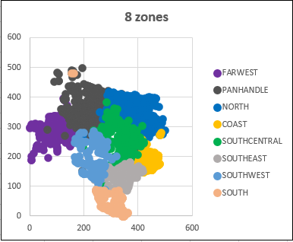
Real-Time Congestion Rent (in MM) Comparison For Layers with More Groups
 | Cross Zone | FarWest | Panhandle | North | Coast | South Central | South West | South
2021 | $759.5 | $91.5 | $196.3 | $194.1 | $310.1 | $82.5 | $77.3 | $340.0
2022 | $1307.2 | $122.6 | $174.9 | $191.7 | $391.6 | $42.5 | $115.7 | $461.9
2023 | $1043.1 | $60.0 | $279.0 | $200.0 | $235.4 | $121.4 | $145.8 | $298.5
2024 | $294.3 | $4.3 | $137.2 | $18.1 | $34.7 | $17.5 | $36.9 | $105.5
 | Cross Zone | FarWest | Panhandle | North | Coast | South Central | South East | South West | South
2021 | $1017.9 | $91.5 | $196.3 | $191.2 | $209.5 | $92.0 | $75.1 | $30.1 | $147.8
2022 | $1618.6 | $122.6 | $174.9 | $190.3 | $324.7 | $37.0 | $133.9 | $56.0 | $150.0
2023 | $1419.4 | $60.0 | $279.3 | $151.4 | $94.8 | $121.6 | $82.2 | $56.8 | $117.9
2024 | $328.4 | $4.3 | $137.2 | $17.7 | $24.2 | $28.4 | $20.8 | $25.2 | $62.2

Slide 11
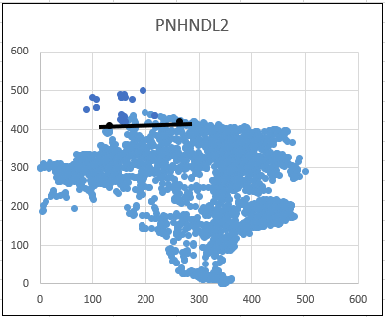
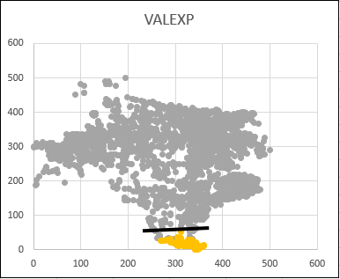
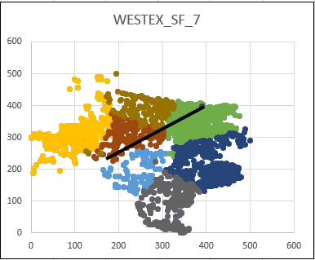
Load zones based on GTCs

Slide 12
Questions?

Slide 13
Appendix

Slide 14
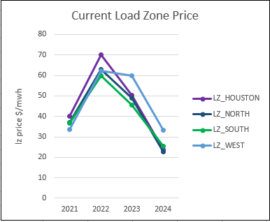
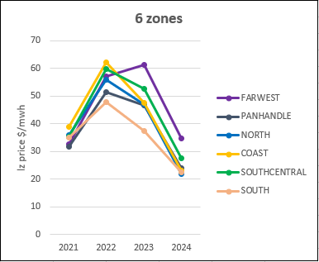
Load Zone prices between Current Zones and New Zones

Slide 15
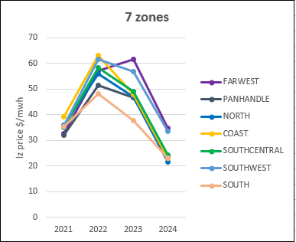
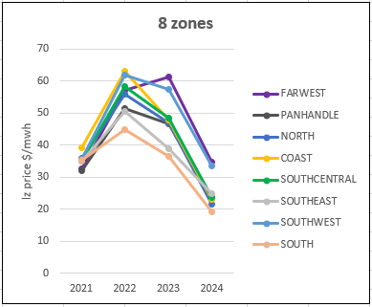
Load Zone prices between Current Zones and New Zones

