Slide 1
Credit Exposure Update
Market Credit Work Group
ERCOT Public
July 2024

Slide 2
Monthly Highlights May 2024 - June 2024
Market-wide average Total Potential Exposure (TPE) increased from $1.82 billion in May 2024 to $2.18 billion in June 2024.
TPE increased due to higher forward adjustment factors
Discretionary Collateral is defined as Secured Collateral in excess of TPE,CRR Locked ACL and DAM Exposure
Average Discretionary Collateral increased from $3.88 billion in May 2024 to $4.23 billion in June 2024
No unusual collateral call activity

Slide 3
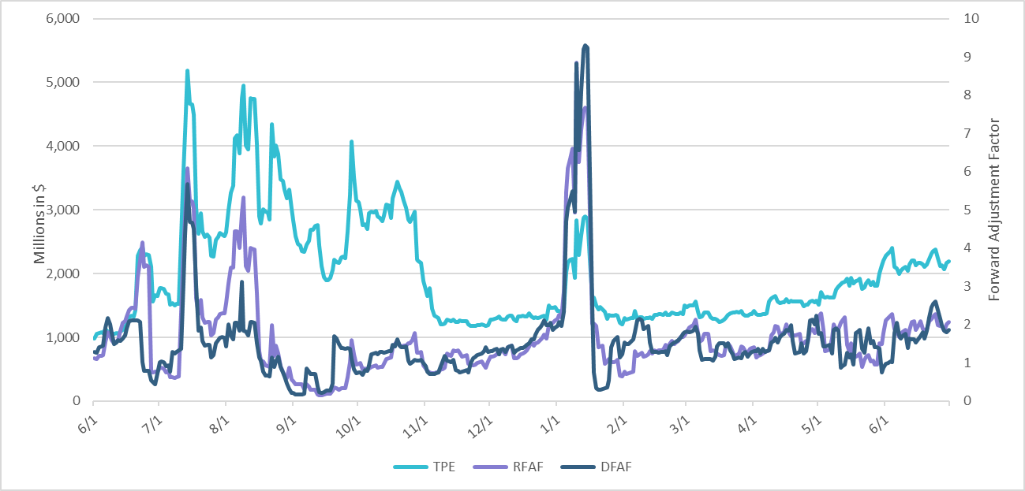
TPE and Forward Adjustment Factors: June 2023 – June 2024
*TPE adjusted to exclude short pay entities eliminating data skew

Slide 4
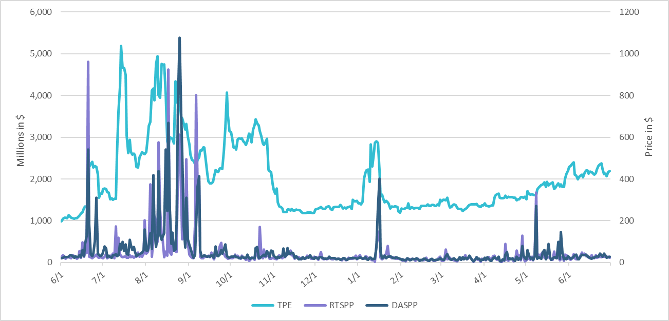
TPE/Real-Time & Day-Ahead Daily Average Settlement Point Prices for HB_NORT:H June 2023 – June 2024
* TPE adjusted to exclude short pay entities eliminating data skew

Slide 5
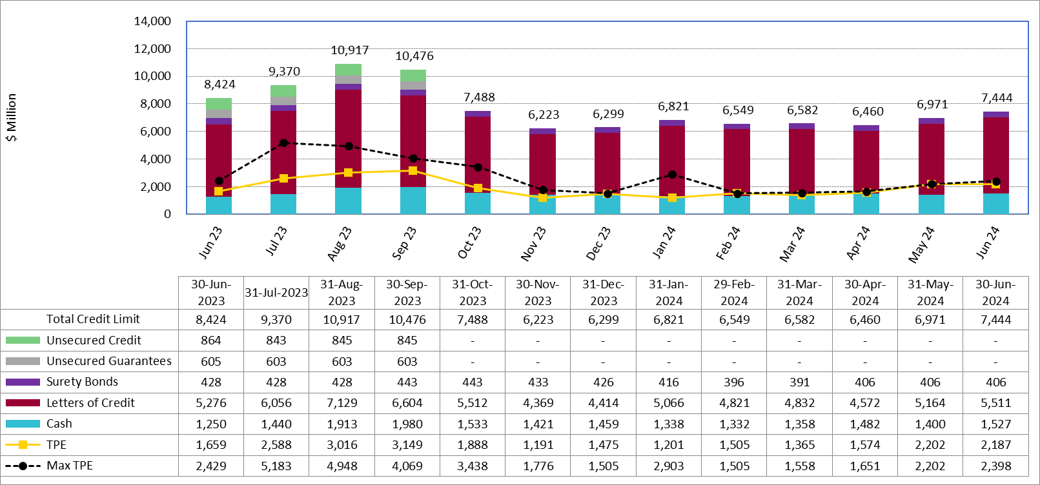
Available Credit by Type Compared to Total Potential Exposure (TPE): June 2023 – June 2024
Numbers are as of month-end except for Max TPE
Max TPE is the highest TPE for the corresponding month

Slide 6
Issuer Credit Limits vs Total LC Amounts Per Issuer: End-June 2024
As of June 30, 2024
There are a total of 37 banks that have issued LCs.

Slide 7
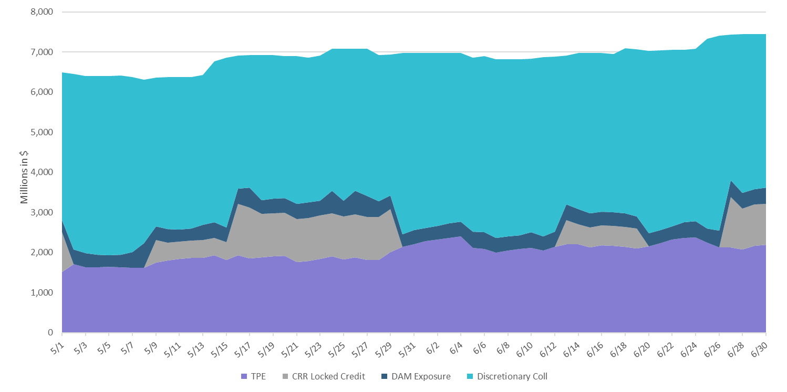
Discretionary Collateral May 2024 – Jun 2024
* Discretionary collateral doesn’t include Unsecured Credit Limit or parent guarantees

Slide 8
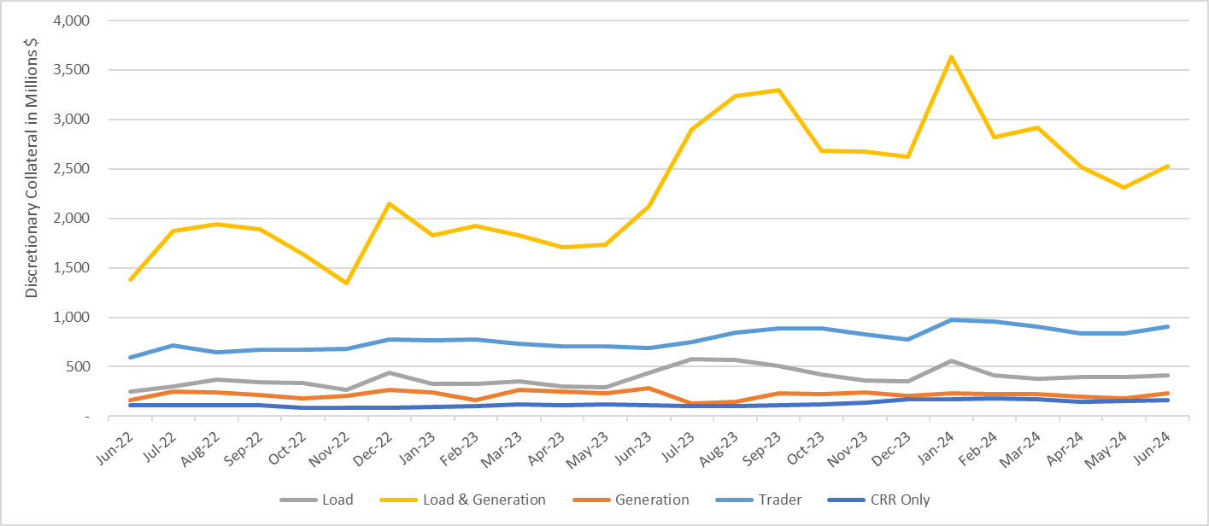
Discretionary Collateral by Market Segment June 2022 - June 2024
* Discretionary Collateral adjusted to exclude short pay amounts eliminating data skew

Slide 9
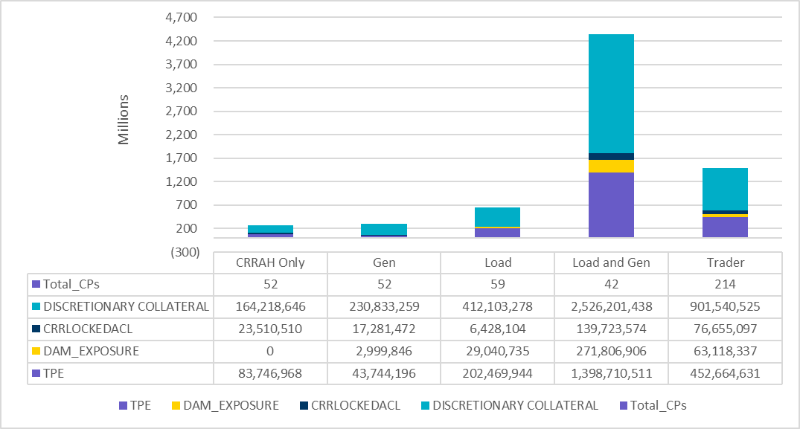
TPE and Discretionary Collateral by Market Segment - June 2024
Load and Generation entities accounted for the largest portion of discretionary collateral

Slide 10
TPEA Coverage of Settlements May 2023 - May 2024
Invoice Exposure | Historical | Future
Existing Invoice Exposure | RTLCNS + UDAA | M1 Days (including current day) Forward Charge Invoice Amounts
New Invoice Exposure | 7 Days Back Net Invoice Amounts (Charges & Credits) | M1 Days (including current day) Forward Net Invoice Amounts (Charges & Credits); Excluding: 1) Securitization Invoices; 2) CRR Auction Invoices; and 3) Subchapter N Funds Distribution Invoice
TPEA closely approximates actual/invoice exposure

Slide 11
TPEA Coverage of Settlements May 2023 - May 2024
Invoice Exposure | Historical | Future
Existing Invoice Exposure | RTLCNS + UDAA | M1 Days (including current day) Forward Charge Invoice Amounts
New Invoice Exposure | 7 Days Back Net Invoice Amounts (Charges & Credits) | M1 Days (including current day) Forward Net Invoice Amounts (Charges & Credits); Excluding: 1) Securitization Invoices; 2) CRR Auction Invoices; 3) Subchapter N Funds Distribution Invoice
*TPEA exceeds invoice exposure

Slide 12
TPEA Coverage of Settlements May 2023 - May 2024
Invoice Exposure | Historical | Future
Existing Invoice Exposure | RTLCNS + UDAA | M1 Days (including current day) Forward Charge Invoice Amounts
New Invoice Exposure | 7 Days Back Net Invoice Amounts (Charges & Credits) | M1 Days (including current day) Forward Net Invoice Amounts (Charges & Credits); Excluding: 1) Securitization Invoices; 2) CRR Auction Invoices; 3) Subchapter N Funds Distribution Invoice
Invoice exposure generally exceeds TPEA

Slide 13
TPEA Coverage of Settlements May 2023 - May 2024
Invoice Exposure | Historical | Future
Existing Invoice Exposure | RTLCNS + UDAA | M1 Days (including current day) Forward Charge Invoice Amounts
New Invoice Exposure | 7 Days Back Net Invoice Amounts (Charges & Credits) | M1 Days (including current day) Forward Net Invoice Amounts (Charges & Credits); Excluding: 1) Securitization Invoices; 2) CRR Auction Invoices; 3) Subchapter N Funds Distribution Invoice
*TPEA generally exceeds invoice exposure

Slide 14
TPEA Coverage of Settlements May 2023 - May 2024
Invoice Exposure | Historical | Future
Existing Invoice Exposure | RTLCNS + UDAA | M1 Days (including current day) Forward Charge Invoice Amounts
New Invoice Exposure | 7 Days Back Net Invoice Amounts (Charges & Credits) | M1 Days (including current day) Forward Net Invoice Amounts (Charges & Credits); Excluding: 1) Securitization Invoices; 2) CRR Auction Invoices; 3) Subchapter N Funds Distribution Invoice
* TPEA generally exceeds Invoice exposure

Slide 15
TPEA Coverage of Settlements May 2023 - May 2024
Invoice Exposure | Historical | Future
Existing Invoice Exposure | RTLCNS + UDAA | M1 Days (including current day) Forward Charge Invoice Amounts
New Invoice Exposure | 7 Days Back Net Invoice Amounts (Charges & Credits) | M1 Days (including current day) Forward Net Invoice Amounts (Charges & Credits); Excluding: 1) Securitization Invoices; 2) CRR Auction Invoices; 3) Subchapter N Funds Distribution Invoice
*TPES exceeds actual/invoice exposure

Slide 16
Questions

