Slide 1
ERCOT Frequency Events
June 2024
ERCOT
Operations Planning
PDCWG | July 24, 2024

Slide 2
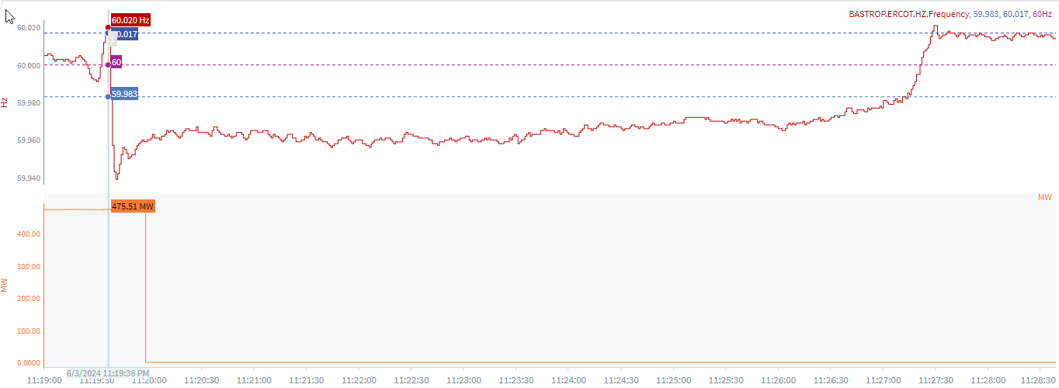
6/3/2024 23:19:36(Non-FME)
Notes:
The unit tripped offline while carrying approximately 475 MW
Starting Frequency: 60.020 Hz
Minimum Frequency: 59.939 Hz
A-C Time : 4 seconds
Recovery Time(back to deadband): 7 minutes 38 seconds
ECRS Released: 0 MW
Trip Reason: Unknown at this time
Contextual Information: A total of 78.3 MW of regulation Up was deployed during the event
No Selection Reason: C point is too small

Slide 3
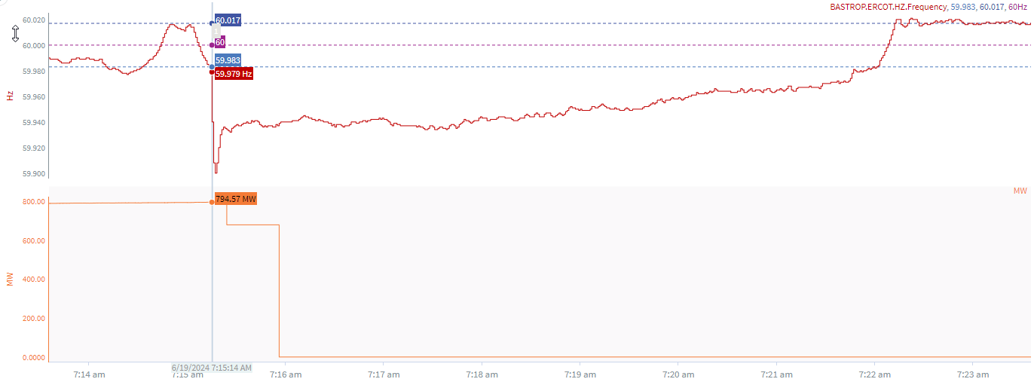
6/19/2024 7:15:14(Non-FME)
Notes:
The unit experienced runback and tripped offline while carrying approximately 678 MW
Starting Frequency: 59.979 Hz
Minimum Frequency: 59.900 Hz
A-C Time : 3 seconds
Recovery Time(back to deadband): 6 minutes 47 seconds
ECRS Released: 0 MW
Trip Reason: Flame scanner lost on boiler
Contextual Information: A total of 168 MW of regulation up was deployed and SCED manual offset of 200 MW was applied during the event.
No Selection Reason: unit experienced runback, not clean trip.

Slide 4
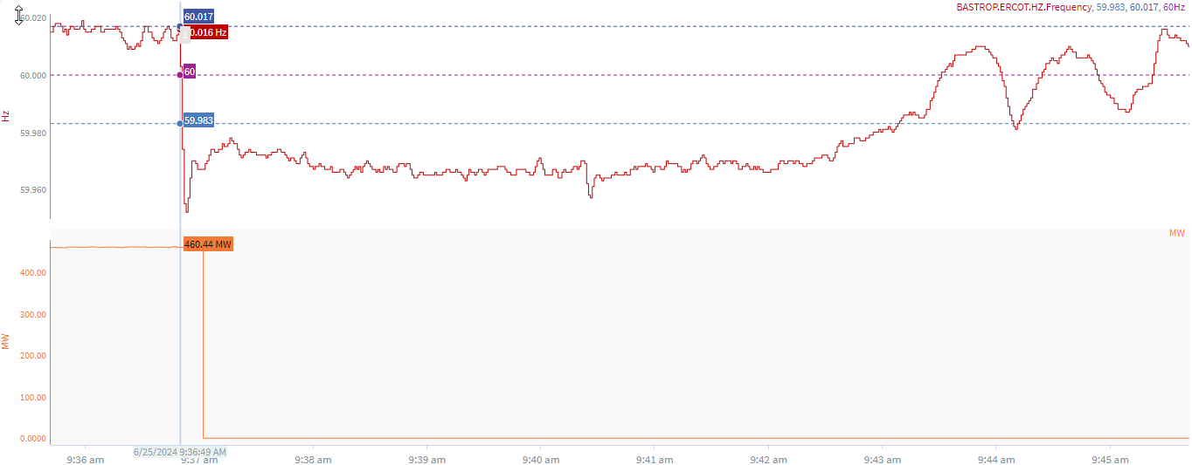
6/25/24 9:36:49(Non-FME)
Notes:
The unit tripped offline while carrying approximately 460 MW
Starting Frequency: 60.016 Hz
Minimum Frequency: 59.952 Hz
A-C Time : 4 seconds
Recovery Time(back to deadband): 6 minutes 20 seconds
ECRS Released: 0 MW
Trip Reason: Feed water and tube leak issue
Contextual Information: A total of 245 MW of regulation up was deployed during the event.
No Selection Reason: Delta frequency is too small

Slide 5
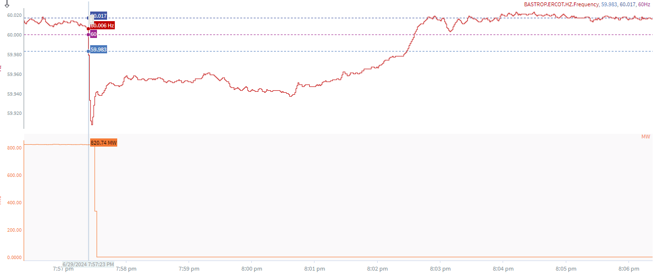
6/29/2024 19:57:23(FME)
Notes:
The unit tripped offline while carrying approximately 821 MW
Starting Frequency: 60.006 Hz
Minimum Frequency: 59.908 Hz
A-C Time : 4 seconds
Recovery Time(back to deadband): 5 minutes 5 seconds
ECRS Released: 0 MW
Trip Reason: Exciter issue
Contextual Information: A total of 544 MW of regulation up was deployed and SCED manual offset of 350 MW was applied during the event.
.

Slide 6
Questions?
Thank you!

