Slide 1
Large Loads Introduction
July 2024
ERCOT
Operations Planning
PDCWG | July 24, 2024

Slide 2
Introduction
As defined in NPRR1234, a Large Load is “One or more Facilities at a single site with an aggregate peak Demand greater than or equal to 75 MW behind one or more common Points of Interconnection (POIs) or Service Delivery Points.”
The Large Flexible Load Task Force (LFLTF) provides Large Load Interconnection Queue Status Updates monthly.
ERCOT has conducted some analysis on Large Flexible Loads and their impact on Regulation and frequency control.

Slide 3
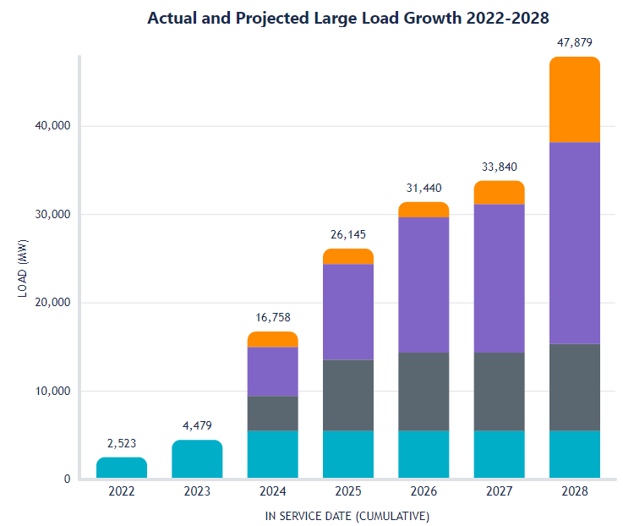
Large Load Projects in Queue
There is currently 5,479 MW of Large Loads Approved to Energize in 2024.
ERCOT is tracking 16,758 MW of Large Loads currently active or seeking interconnection as of 2024. This is projected to grow to 48,665 MW in 2028.
Approved to Energize – Projects that have received Approval to Energize from ERCOT Operations. NOTE: not all MWs in this category have been observed to be operational.
Planning Studies Approved – Projects that have received ERCOT approval of required interconnection studies. Any MWs that were not approved are reclassified as No Studies Submitted.
Under ERCOT Review – Projects that have studies under review by ERCOT.
No Studies Submitted – Projects that are tracked by ERCOT but that have not yet provided sufficient information for ERCOT to begin review. Additionally, MWs that were not approved by ERCOT after review of planning studies are included in this category until a path to interconnect these MWs is identified, or the customer cancels the interconnection request.
Per July 8th, 2024 LFLTF

Slide 4
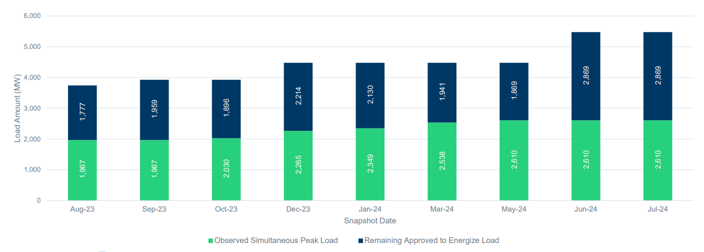
Consumption of Large Loads Approved to Energize
Of the 5,479 MW that have received Approval to Energize, ERCOT has observed a simultaneous peak consumption of 2,610 MW.
This is the maximum value of the sum of all the individual loads.
This value is the maximum amount of large load that ERCOT has had to serve at a single point in time.
Per July 8th, 2024 LFLTF

Slide 5
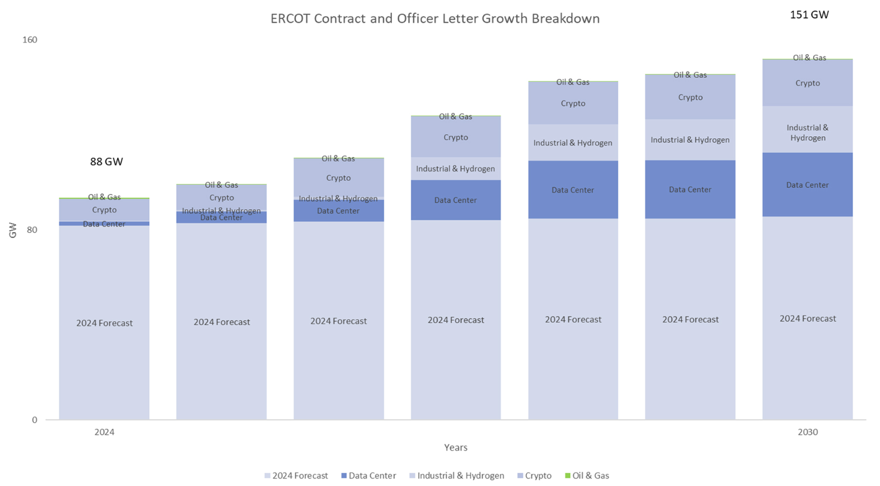
Additional Detail in Large Load Growth
Types of Large Loads being tracked:
Crypto, Oil & Gas, Industrial & Hydrogen, Data Centers.
Each of these large loads have different characteristics in consumption and ability to manage consumption.
Source: https://www.ercot.com/gridinfo/load/forecast

Slide 6
What is ERCOT tracking today?
CLR – Qualified as a Controllable Load Resource (CLR)
NCLR – Qualified as a Non-Controllable Load Resource (NCLR)
Other – Large Loads not qualified as CLR or NCLR.
 | CLR | NCLR w/ Relay | NCLR w/o Relay | Other
SCED Qualified | Yes | No | No | No
Provides Frequency Response | Yes | Yes | No | No
Ramping | Follows SCED Dispatch | No Ramp Limitation | No Ramp Limitation | No Ramp Limitation
Qualify for AS | RegUp/RegDn, RRS-PFR, ECRS, Non-Spin | RRS-UFR, ECRS | ECRS, Non-Spin | No

Slide 7
Controllable Load Resources qualified for RRS or ECRS
Currently we have 10 Controllable Load Resources qualified to provide ECRS or RRS.

Slide 8
Large Load Analysis Introduction
The following slides share analysis focused on LFLs that are not SCED Qualified, termed NSFL (Non SCED Qualified Flexible Loads).
Any mention of CLRs correspond to the LFLs that are SCED qualified and ramp to a SCED instruction.
Regulation Exhaustion is calculated used the PDCWG Reporting method, < 5 MW remaining over a 5-minute average.
The goal is to share the type of analysis ERCOT has conducted so far and looking to gain feedback on what other metrics this analysis should consider.
The data set used is 1 minute PI from 1/1/2024 – 7/1/2024.

Slide 9
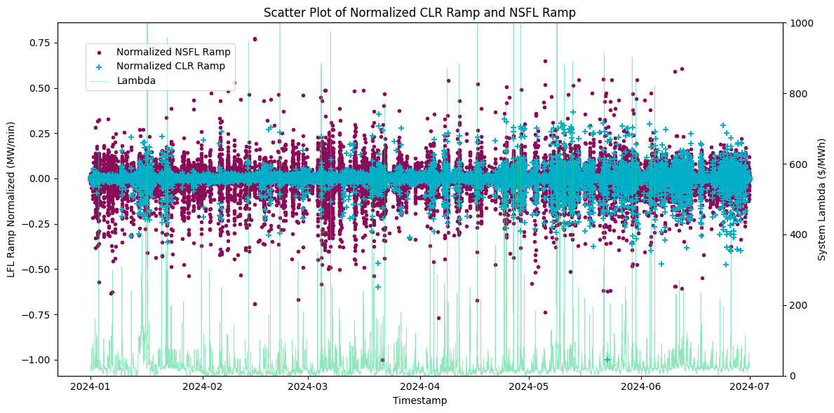
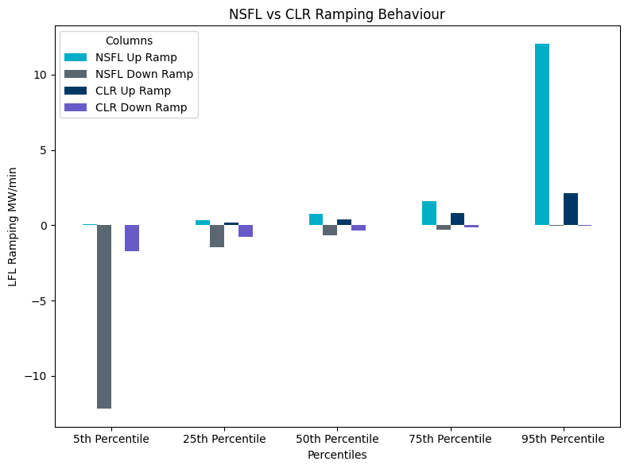
SCED Qualified vs Not Qualified LFL Ramping Behavior Normalized
Ramping percentiles show that NSFL ramp more erratically in both directions than CLRs.
CLRs start to have larger ramps in summer periods.

Slide 10
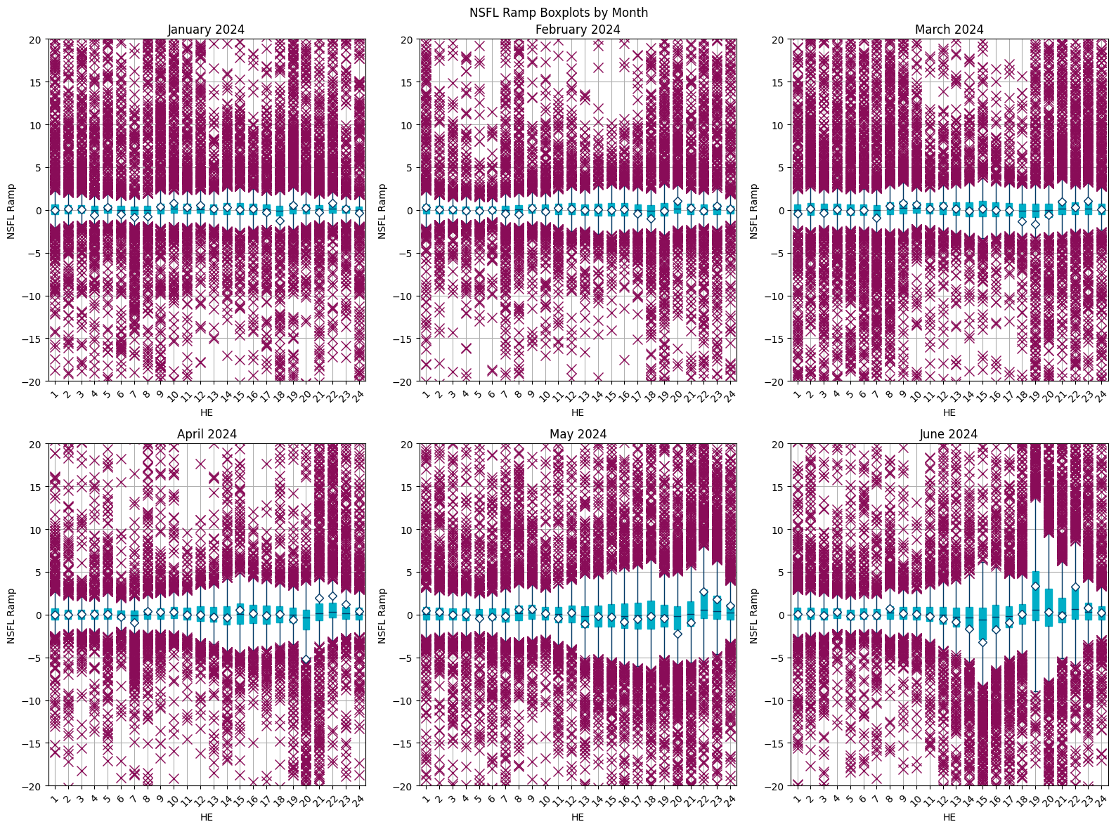
2024 Monthly NSFL Ramps
Ramping behavior has a wider distribution entering the Summer months.

Slide 11
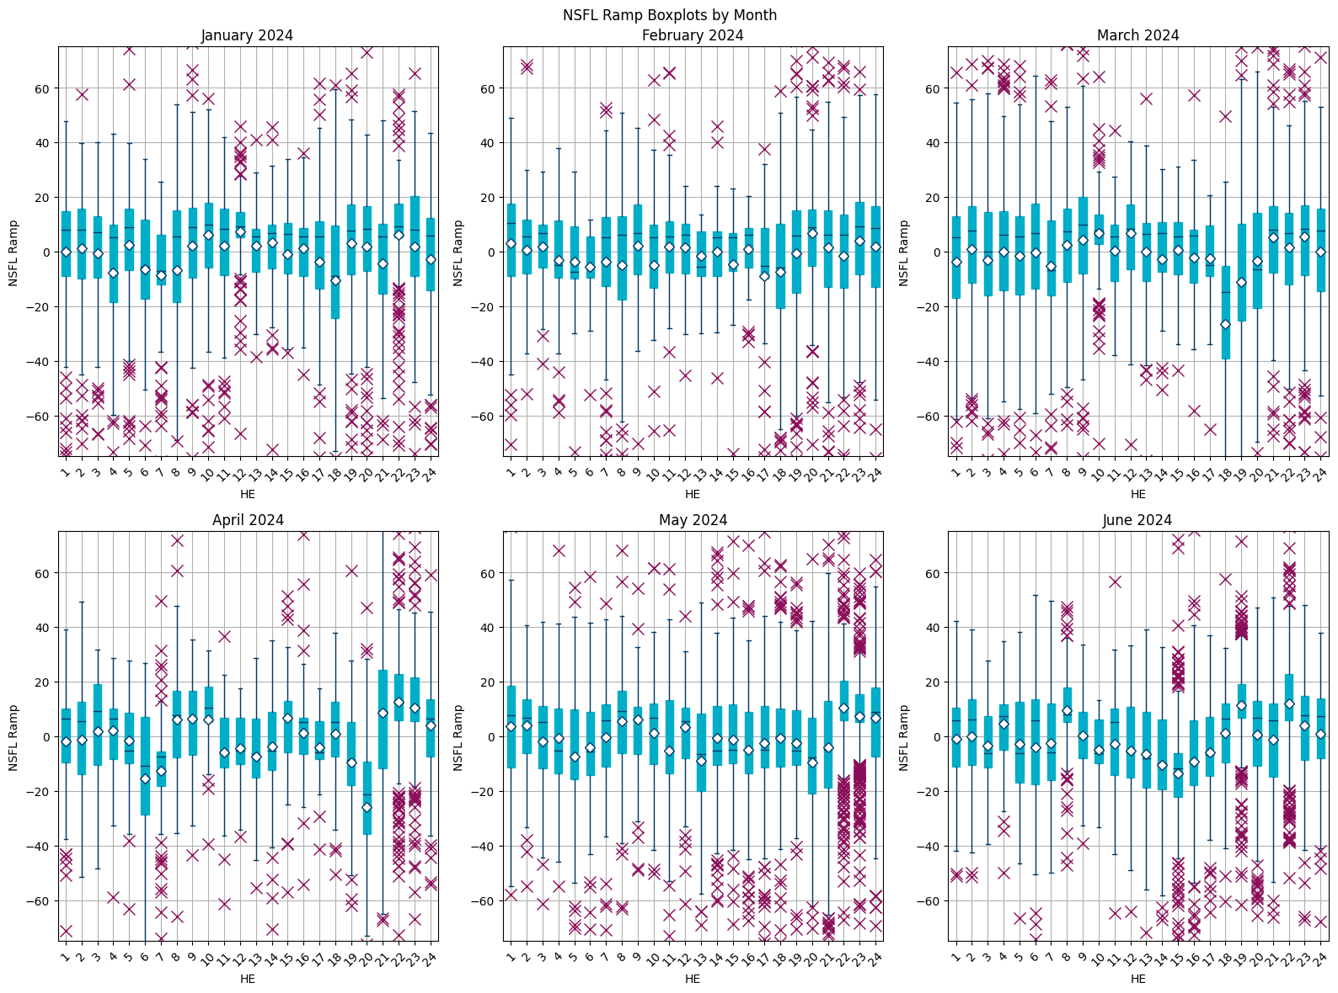
2024 Monthly NSFL Ramps Greater than 5 MW
Larger distributions are observed when small ramps are excluded.

Slide 12
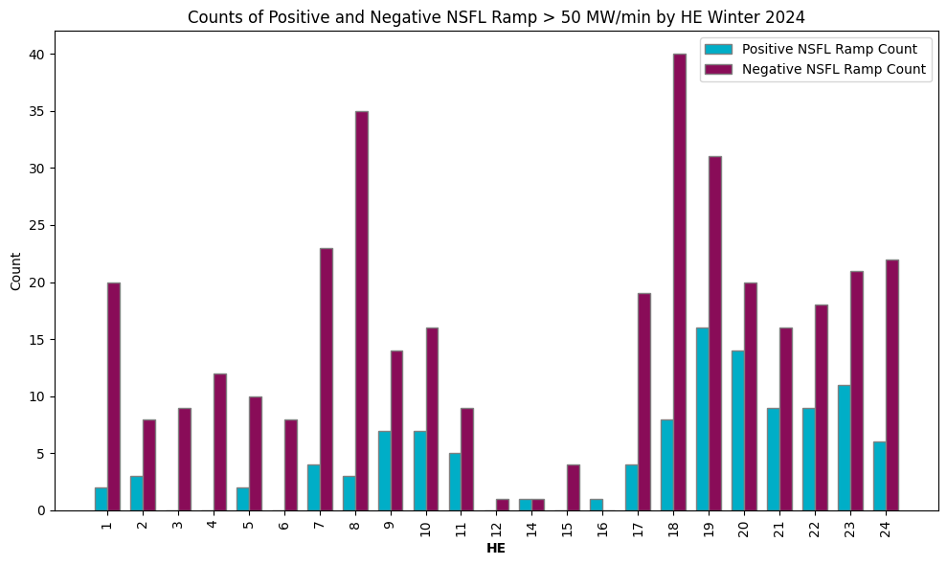
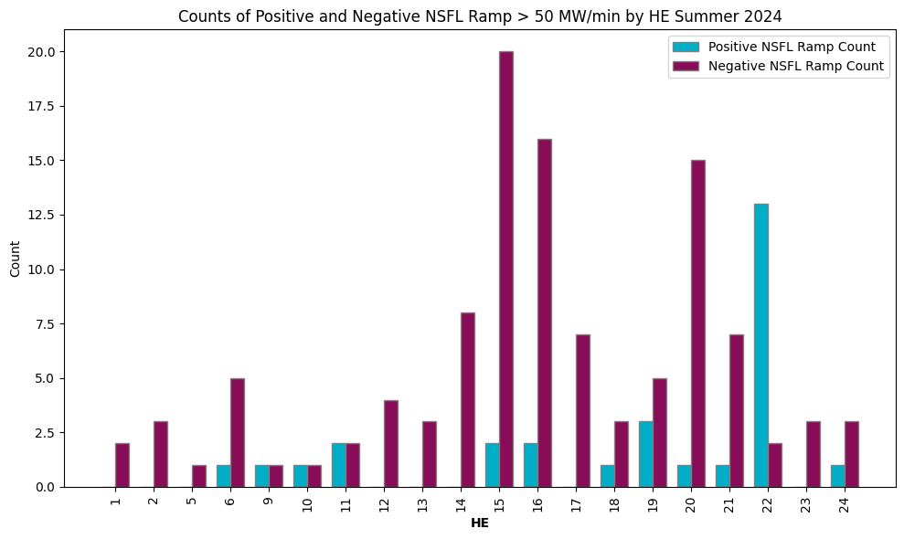
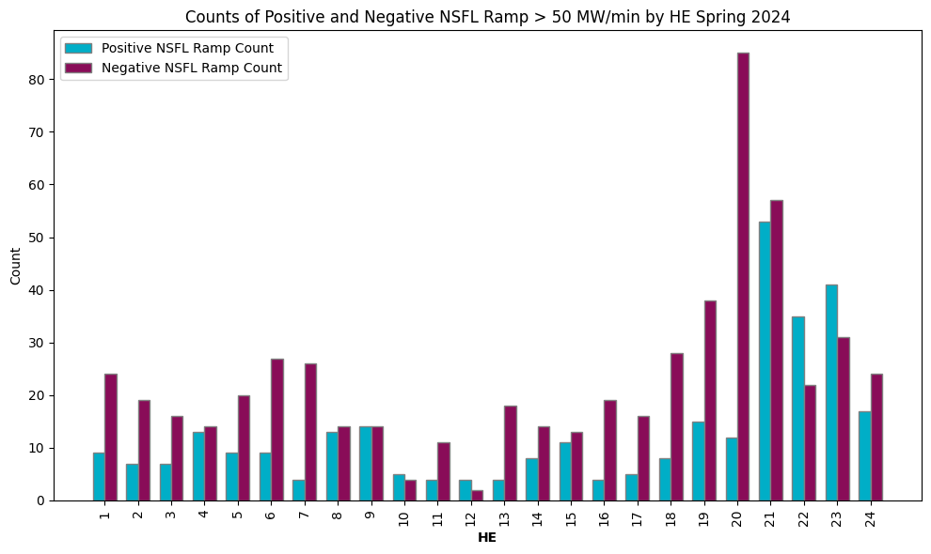
Large NSFL Ramps by Hour for 2024
Considering NSFL ramps of 50 MW/min or larger.
Large negative ramps occur more frequently than positive ramps.

Slide 13
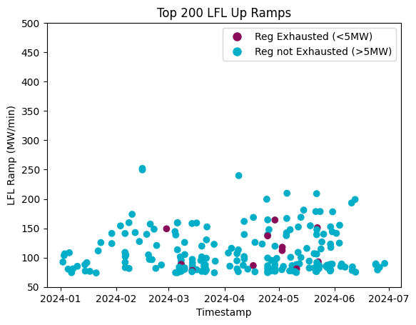
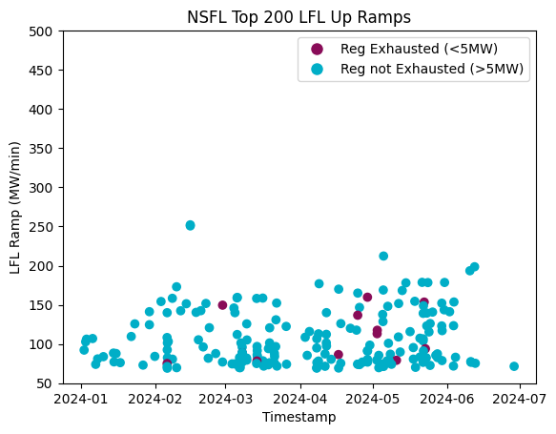
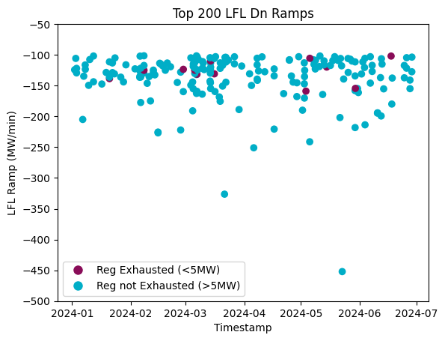
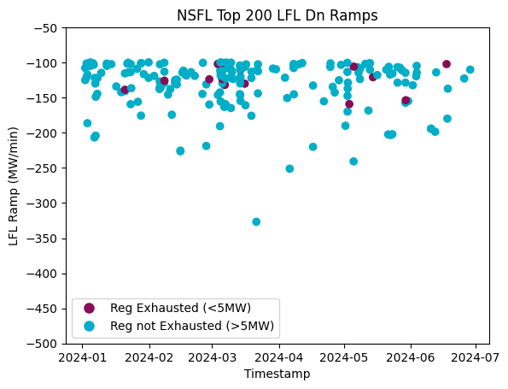
2024 LFL Ramping Regulation Exhaustion
Considering the largest magnitude ramps of all LFLs (NSFLs + CLRs) compared to those of the NSFLs.
Regulation Up Exhaustion is considered for Up Ramp plots, Regulation Down Exhaustion is considered for Down Ramp plots.

Slide 14
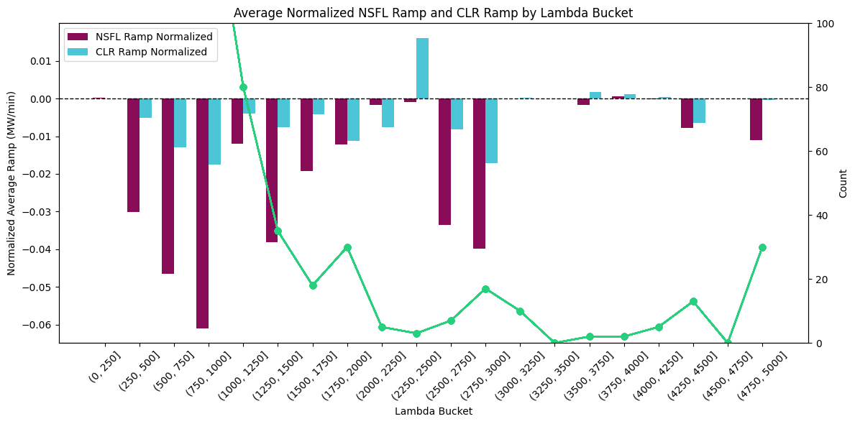
2024 Ramping Behavior by System Lambda – Normalized
Most significant NSFL ramping occurs in the 750-1000 $/MWh bucket.
Observation: Overall downward average ramp trend infers NSFL-LFLs ramp down more rapidly than ramp up.

Slide 15
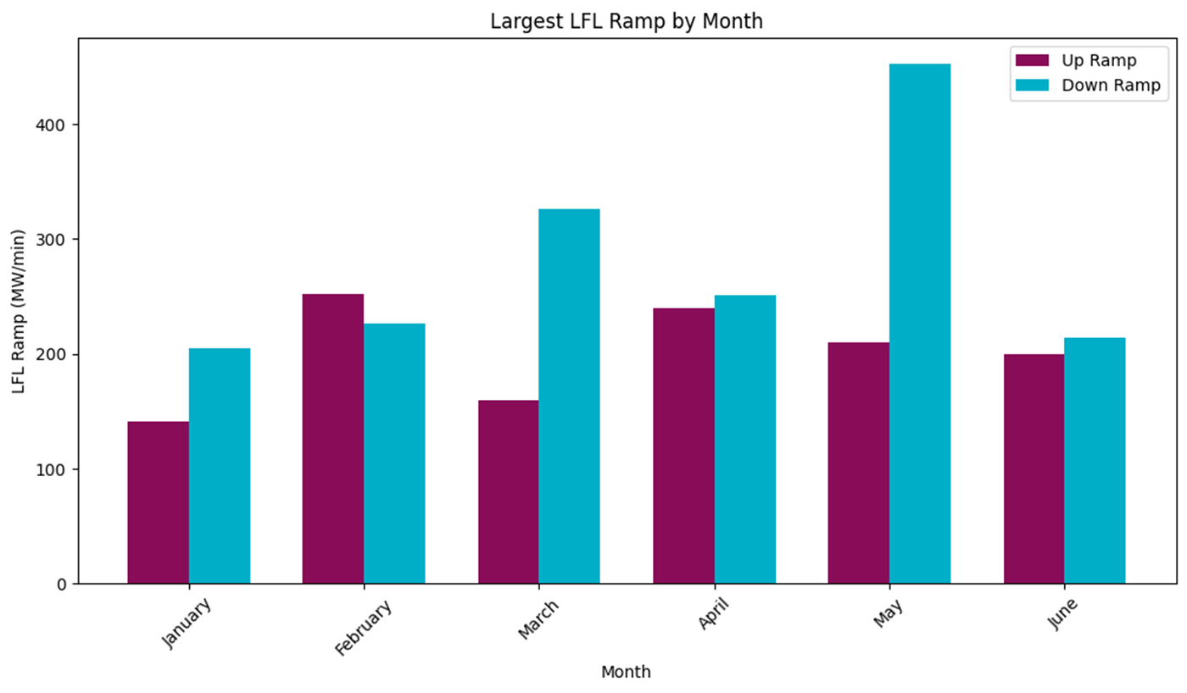
Monthly Largest Ramp
For 2024, this chart shows largest magnitude of up or down ramps by the LFL fleet in one minute interval for each month.

Slide 16
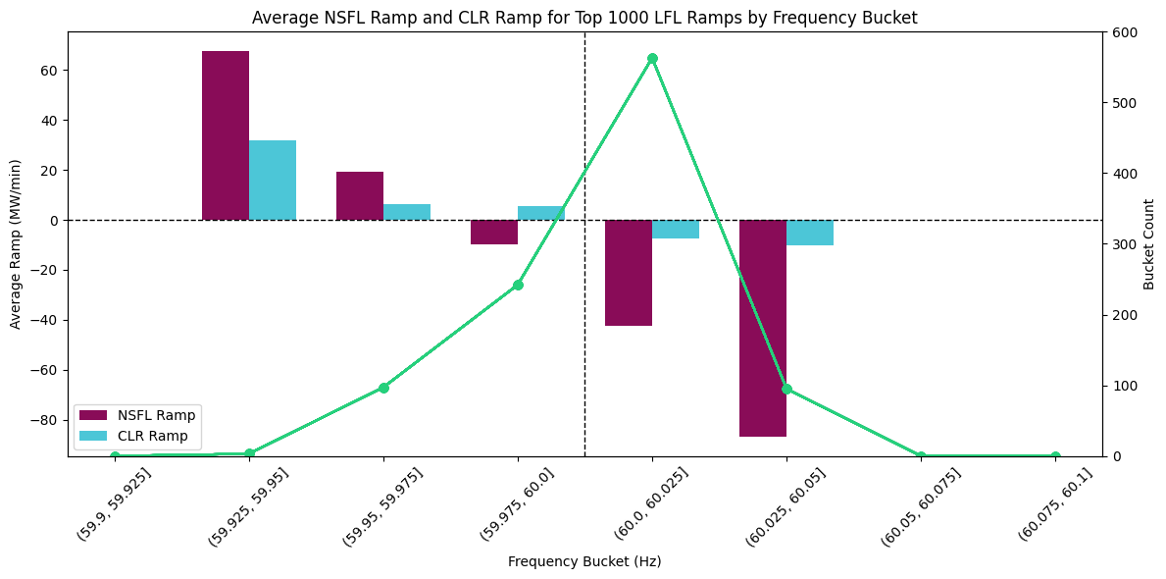
Monthly Average Ramp by Frequency Bucket, or Monthly Average Delta Frequency by LFL Ramp Bucket
Considering the top 1000 LFL Ramps and breaking out the Average Ramp for CLRs and NSFLs by frequency bucket.
Considering all intervals, breaking out the delta frequency for all LFLs by LFL Ramping Bucket.

Slide 17
Summary
Currently with the Large Loads energized today, there is not a deep correlation with Regulation exhaustion. Large Loads tend to ramp down more quickly than up, but overall there is minimal impact to frequency control. This could change with additional growth in the future.
ERCOT is monitoring the growth of Large Loads on the system and has and will be conducting analysis on their impacts to regulation and frequency control.
If desired, ERCOT can begin reporting metrics on LFL consumption, LFL ramping and frequency impacts to PDCWG.

Slide 18
Appendix

Slide 19
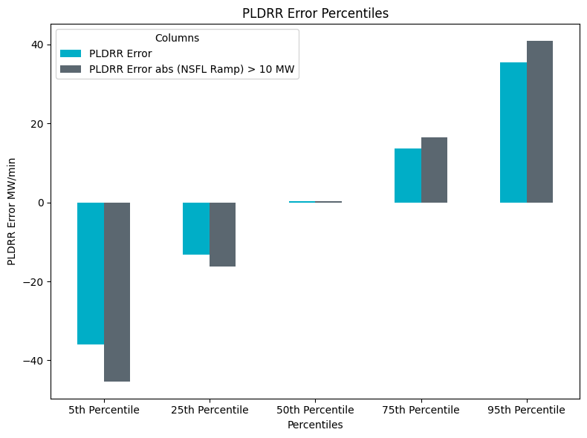
Predicted Load Ramp Rate (PLDRR) Error Statistics 2024
Looking at PLDRR we see there are minimal impacts on PLDRR when LFLs ramp. With more history and additional loads this may change.
PLDRR Error Stats compared to PLDRR Error Stats when NSFLs are ramping > 10 MW/min in either direction.
PLDRR error is greater when NSFLs ramp > 10MW/min.

Slide 20
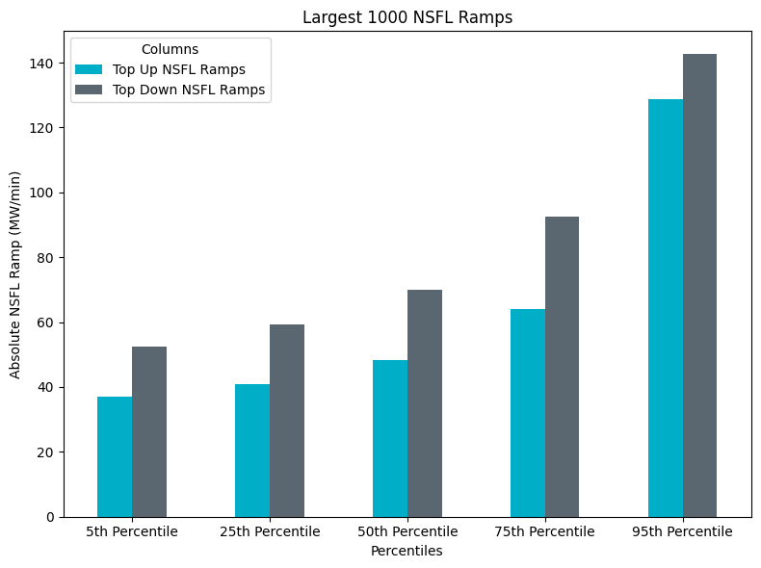
Percentiles of NSFL Ramping

