Slide 1
RTC+B Task Force
Update
Matt Mereness
TAC
July 31, 2024

Slide 2
Outline
Program update: RTC+B Program Update from June Board T&S
Current Issues for RTCBTF
Issue 3 - Framework for periodic analysis comparing RTC and the current ORDC design
Issue 9-10 - Market Readiness
Market Trials Plan
Draft QSE Attestation
Issue 15 – Clarifying Revision Requests
Draft NPRR for RTC
Draft NPRR, NOGRR, PGRR, OBDRR for Single Model
Issue 18 - Placeholder for MPs discussion of AS Demand Curves

Slide 3
RTC+B Program Update (excerpt from June Board T&S RTC Update)
ERCOT to publish go-live date before or during September

Slide 4
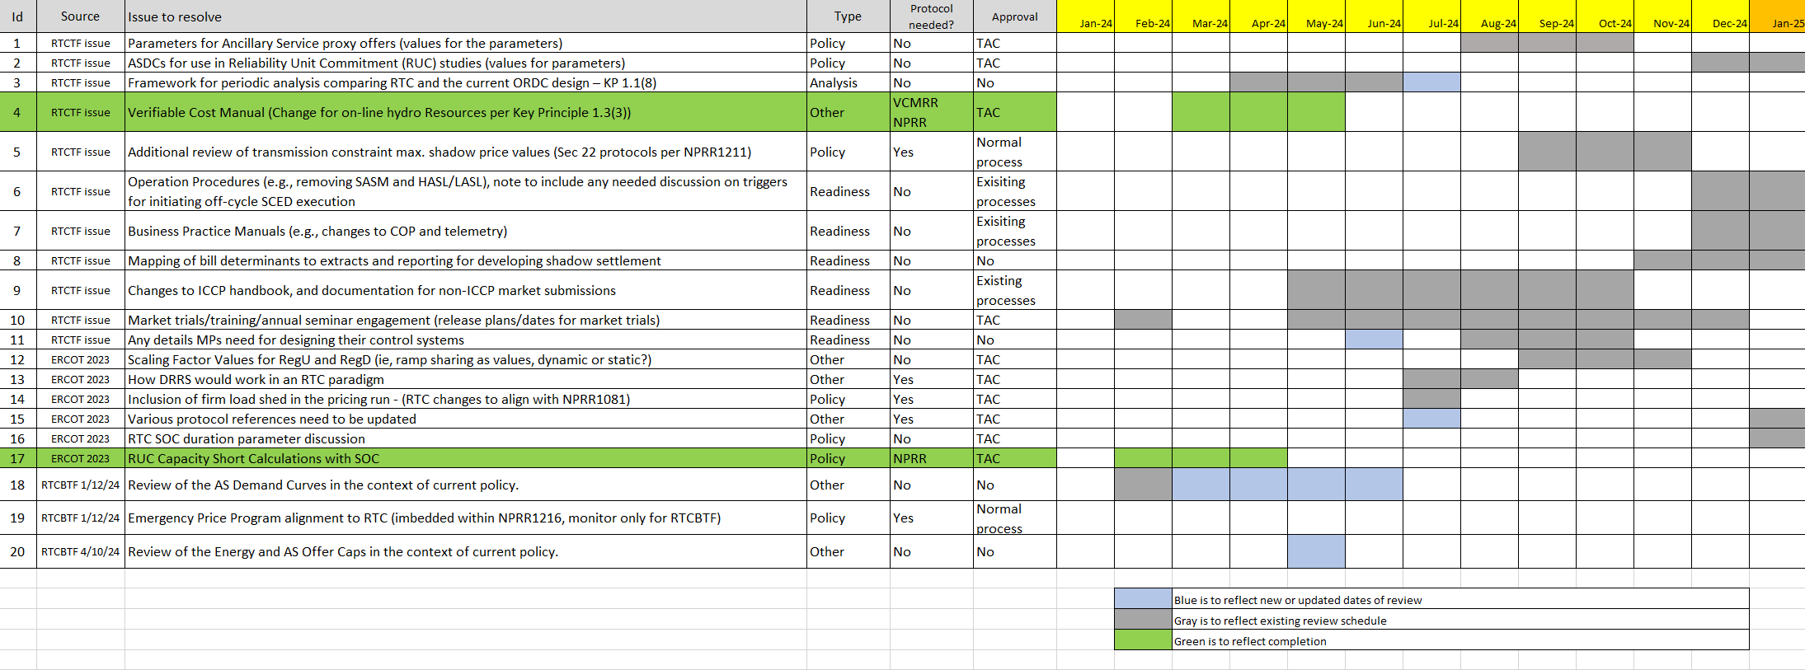
Current RTCBTF Issues List
Link to issues on RTCBTF home page

Slide 5
Reviewed at July RTCBTF
Issue 3 - Framework for periodic analysis comparing RTC and the current ORDC design
Update on capabilities
Estimated schedule for initial analysis in September 2024
Issue 9-10 - Market Readiness
Limited comments received to RTC+B Market Trials Plan (final review at August meeting)
Review Draft QSE Attestation (released to market July 24th with August 12th deadline)
Issue 15 – Clarifying Revision Requests to be filed last week of July
Draft NPRR for RTC
Draft NPRR, NOGRR, PGRR, OBDRR for Single Model
Issue 18 - Review of the AS Demand Curves in the context of current policy
No discussion at meeting

Slide 6
Sequence and Potential Dates for Market Trials (dates subject to change while in Planning phase)
May 2025
June 2025
July 2025
Aug 2025
Sep 2025
Oct 2025
Nov 2025
Dec 2025
QSE Attestation
9 months before Trials
Each activity will have a public-facing Scorecard and exit Criteria
3-4 months
2 months
1 month
DRAFT
RTC QSE Submission Testing
(Submit COP, RT AS Offers,
DAM Virtual AS, Outages for ESRs)
Open-loop RTC SCED
(QSE offers, SCED non-binding award/dispatch)
Closed-loop SCED/LFC
(QSE RTC offers and telemetry to support closed-loop frequency control test 2-3 tests of 2-4 hour durations)
Transition to Go-Live
Upon completion of testing, confirmation of ERCOT and market readiness for Go-Live.
RTC QSE Telemetry Check-out (QSEs add/verify new telemetry points for UDSP, New ramp rates, ESR telemetry)
QSE Telemetry Tests
(Individual QSE to follow UDSP and support new ramp rate and ESR telemetry)
Day-Ahead Market
(Non-binding DAM using QSE offers for at least 2 tests)
Current draft of the earliest possible dates for Market Trials and Go-Live that have been shared through TWG and the RTC+B Workshops, in support of Market Participants readiness at RTCBTF.
Actual Market Trials and Go-Live milestones are to be determined and will be communicated no later than 9/30/24.
1-2 months
Updated 2024-05-22

Slide 7
Draft Market Trials Planning Document

Slide 8
ERCOT interested in feedback
ERCOT is interested in feedback on Market Trials Plan:
Open to feedback on all 7 activities, especially any reliability risks not addressed by the trial activities, durations or frequencies.
Specific questions ERCOT asks:
What windows and frequency of requiring QSE production-like offers for the Open Loop SCED is best cost/beneficial (ie for dual entry by QSEs)?
Example, 8 hours/day twice per week for 2 months?
Any argument to make DAM participation a required activity or more iterations?
Metrics for required testing will focus on QSEs with Resources, unless DAM becomes required.
Understanding that while ERCOT will not be able to provide settlement invoices and extracts, that sample/generic versions will be provided from ERCOT test environment during iTest.
Higher level question- Market ideas on the priority of education/deep-dives to help QSEs in their development and readiness?

Slide 9
RTC+B Clarification NPRRs
RTC+B NPRR next steps:
RUC Capacity Short NPRR1236 is going to July PRS Meeting
Verifiable Cost Hydro MOC will be part of clarifying NPRR
ERCOT is developed two clarifying NPRRs:
Clarification NPRR after completing business requirements (eg, drift in baseline since 2019, discrepancies and/or small gaps found during business requirement development)
Clarification NPRR, NOGRR, PGRR, OBDRR as an extension of NPRR1014 Single Model to clarify single model language in other areas of protocols.
Note- All changes are intended to be “as designed” clarifications, aligned with Key Principles, and have no system impacts.
Shared initial drafts with July RTCBTF and ERCOT will formally file Revision Requests to allow vetting of comments via existing PRS/TAC process and supported by RTCBTF to thoroughly review.

Slide 10
Next Steps
Comments due on Market Trials Plan by August 9th and to be discussed at the August 14 RTCBTF Meeting.
RTCB Market Trials Plan link and send comments to Matt.Mereness@ercot.com
QSE Attestations for QSEs with Resources due August 12th, 2024:
Sent to QSE Authorized Representatives (and Backup AR)
QSEs with Resources will identify Accountable Executive
RTCB Accountable Executive will attest the QSE is aware of interface changes being posted and acknowledge the need to develop the necessary systems changes to engage the RTC+B Market Trials activities (potentially as early as May 2025).
Clarifying Revision Requests being filed this week
Next RTBTF meeting: August 14, 2024
August RTCBTF will include a focus session on Settlements & Billing
Questions?

