Slide 1
New/Modified Market Submissions in RTC+B
RTC+B Input Changes | Current Implementation | RTC+B Changes | Details
COP | Resource limits and status AS Responsibility from DAM/SASM AS Awards and Self-Arranged | AS Responsibility is replaced by AS Capability by AS type AS Capability represents a resource's total AS capacity available by AS type HSL, LSL, HEL, LEL can be negative for ESR | AS Capability Fields: REGUP REGDN RRSPFR RRSUFR RRSFFR ECRS – ECRSS/ECRSM based on Res Type NSPIN – OFFNS/ONNS/NSPNM SCED will use telemetered AS Capability
Resource AS Offers | Used by DAM/SASM | Resource AS Offers in the DAM will also be used in RUC and SCED if not cancelled prior to the relevant study interval SASM being removed | Existing AS Offer structure will be used for DAM, RUC, and SCED. RUC and SCED Resource AS Offers same as current DAM/SASM AS Offers
AS Only Offers(new) | N/A | Implement virtual AS Only Offers for DAM Only used by DAM | Virtual AS Offers are not associated with any resource Each offer can have up to 5 price/quantity block pairs Only 1 AS Type per AS Only Offer. Multiple offers for same AS Type allowed by Offer ID 5 AS Types for AS-Only REGUP REGDN RRSPF ECRSS ONNS

Slide 2
New/Modified Market Submissions in RTC+B
RTC+B Input Changes | Current Implementation | RTC+B Changes | Details
ESR Energy Bid/Offer Curve(new) | N/A | Single curve used for both gen and load side of ESR used by DAM/RUC/SCED | Existing TPO submission will be used EOC where negative MW values can be submitted as part of the curve. Negative MW values indicate the bid side (charging) while positive MW values indicate the offer side (discharging)
Three Part Offer | Used by DAM/RUC/SCED | Allow negative MW quantities for ESRs to implement ESR Energy Bid/Offer Curve for DAM/RUC/SCED | Only change is for ESR

Slide 3
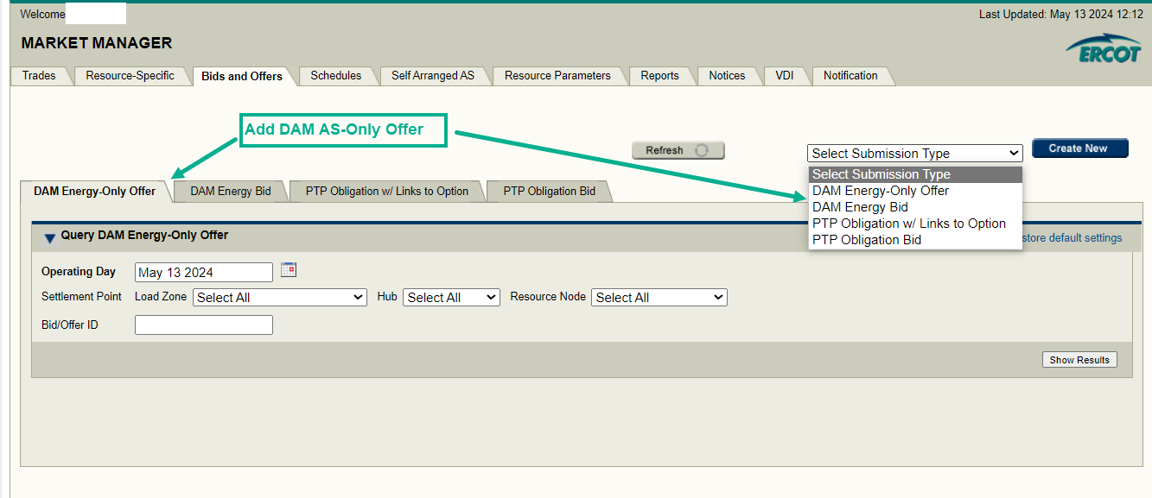
Market Manager UI RTC+B changes – DAM AS-Only Offers

Slide 4
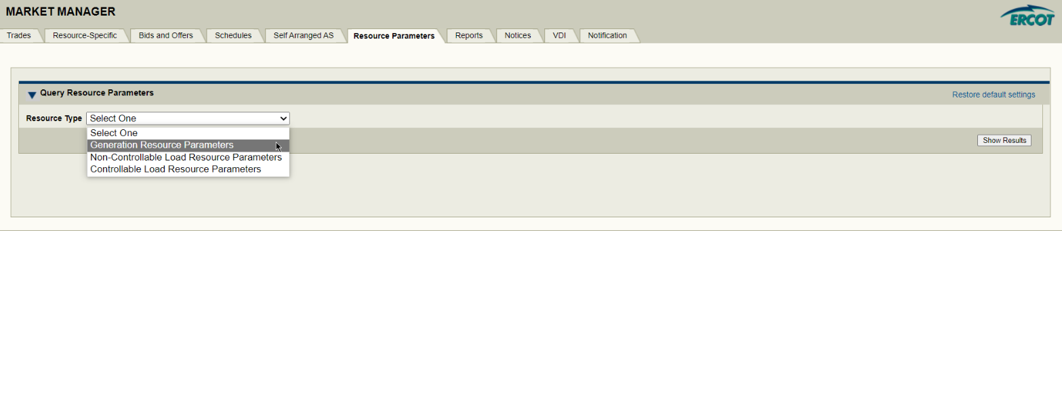
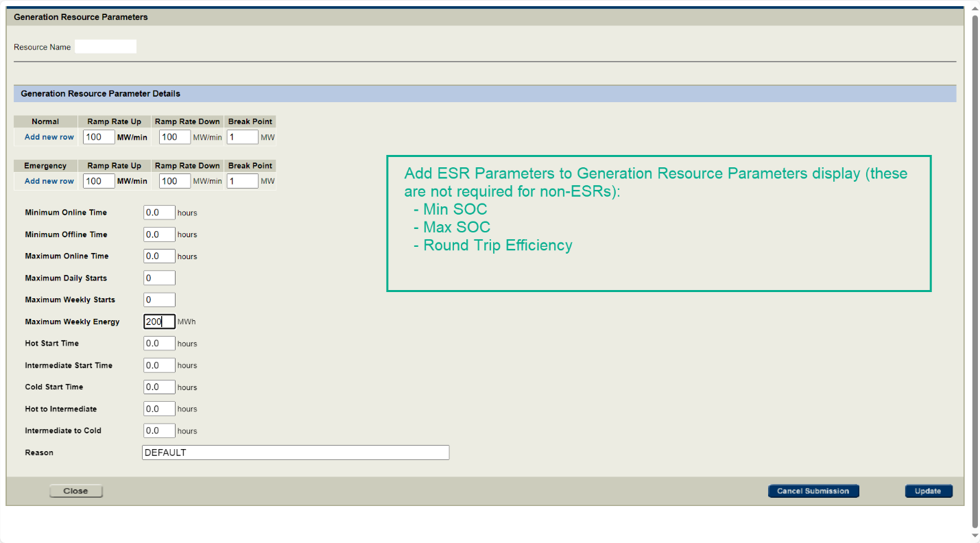
Market Manager UI RTC+B changes – Resource Parameters

Slide 5
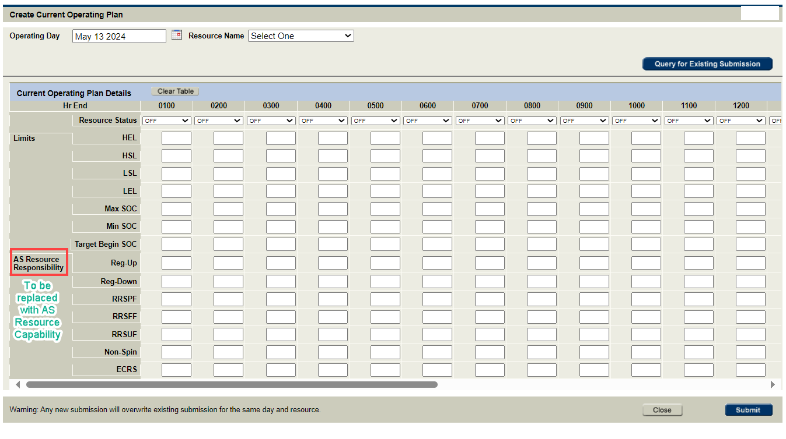
Market Manager UI RTC+B changes - COP

Slide 6
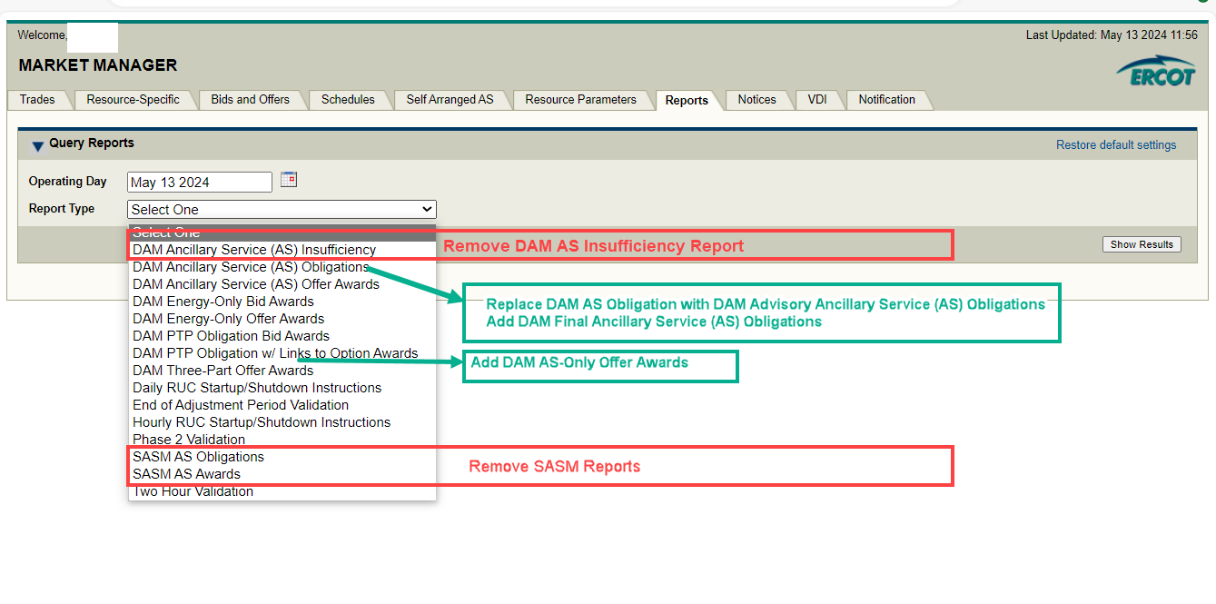
Market Manager UI RTC+B changes - Reports

