Slide 1
TX SET 5.0
FlightTrak Demo
Catherine Meiners
8/13/2024

Slide 2
Agenda
Flight Numbers
Review script assignments for the TX SET 5.0 Flight
CRs
TDSPs
Walk through required scripts
Overview of FlighTrak Dashboards
Post Flight Expectations
Important dates

Slide 3
Flight Numbers
142 CRs are registered for Flight 0924.
This includes 29 New or DUNS+4 CRs
Total number of scripts to be run in Flight 0924 is 1295
Existing CRs will not be testing with all of the TDSPs that they are qualified with
TDSPs will not be testing with all of the CRs that are qualified in their territory
IBANK01/MBANK01 scripts will only go to day 2 for existing CRs (ERCOT will manually complete these scripts once Day 2 is successfully completed)
Existing CRs will not test CON02 connectivity testing unless they are testing for something other than TX SET 5.0 (Example: Changing Service Provider)
The Testing Track in FlighTrak is not accurate for Flight 0924 as all of the scripts were manually assigned.
Test pairings may also be incorrect due to the manual assignment of scripts.

Slide 4
Script Assignments - Existing CRs
Existing CRs can make other changes during this Flight, like changing Service Provider or adding a territory. All scripts necessary for those changes will be assigned just like any other Flight.
New CRs joining the Market in this Flight will need to complete the expected scripts for a new CR.
 | IOU TDSPs (incl Lubbock) | Nueces
All CRs | CON05 (CR / ERCOT con) IBANK01 (Day 1 & 2 only) | MBANK01 (Day 1 & 2 only)
CSA CRs only | ICSA | MCSA

Slide 5
Script Assignments - TDSPs
TDSPs will be assigned any other scripts necessary for CRs to complete their testing objectives such as changing Service Providers or adding new Territories
IOU TDSPs (incl Lubbock) | Nueces | ERCOT Test TDSP
CON04 (ERCOT / TDSP con) | CON04 (ERCOT / TDSP con) | ICSA
IBANK01 (Round Robin) | MBANK01
 | MCSA

Slide 6
IBANK01: Day 1 - ESIID 1 and ESIID 2
Day 1 is September 23
CRs will need to request 9/12/2024 in DTM~375
Notes:
Key things to note here – the MVIs must be backdated by 7 business days. Two MVIs submitted – 1 with IA and 1 with CR in the BGN07 to test the new IAG values. Also note that even if CR needs to submit these MVIs late, they will still need to request 9/12.

Slide 7
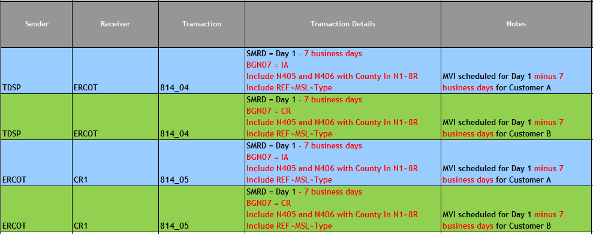
IBANK01: Day 1 (continued) - ESIID 1 and ESIID 2
Notes:
TDSPs will be returning the new County segment in the 814_04 and the CRs will be receiving it plus the BGN07 CR/IA in the 814_05. In addition, the TDSP will be sending back the REF~MSL – which is the new metered service type segment.

Slide 8
IBANK01: Day 2 - ESIID 1 and ESIID 2

Slide 9
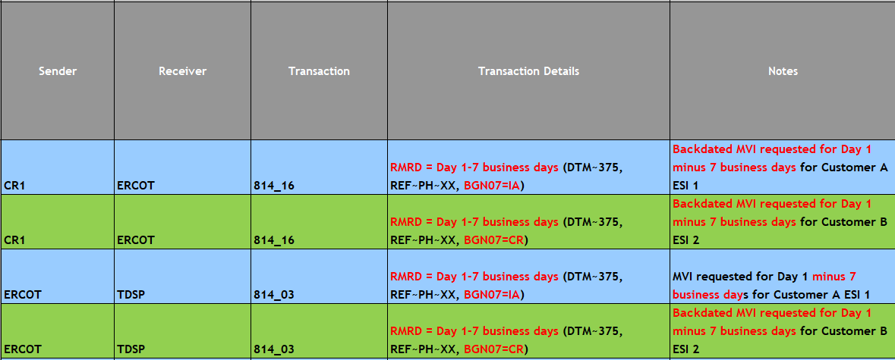
MBANK01: Day 1 - ESIID 1 and ESIID 2
Day 1 is September 23
CRs will need to request 9/12/2024 in DTM~375
Notes:
Key things to note here – the MVIs must be backdated by 7 business days. Two MVIs submitted – 1 with IA and 1 with CR in the BGN07 to test the new IAG values

Slide 10
MBANK01: Day 1 (continued) - ESIID 1 and ESIID 2
Notes:
Nueces will be returning the new County segment in the 814_04 and the CRs will be receiving it plus the BGN07 CR/IA in the 814_05. In addition, the TDSP will be sending back the REF~MSL – which is the new metered service type segment.

Slide 11
MBANK01: Day 2 - ESIID 1 and ESIID 2

Slide 12
IBANK01 and MBANK01
Since the 5.0 changes are tested in the first 2 days of the IBANK01 and MBANK01 script, existing CRs do not need to complete any of the other steps associated with these scripts.
ERCOT did not update the FlighTrak tool for this change so that we could avoid spending project money for a one time change that would never be used again.
Therefore, ERCOT will be manually completing these scripts once the first 2 days of transactions have processed.
Due to the large volume of MPs testing, please be patient with us as we work to complete those scripts.

Slide 13
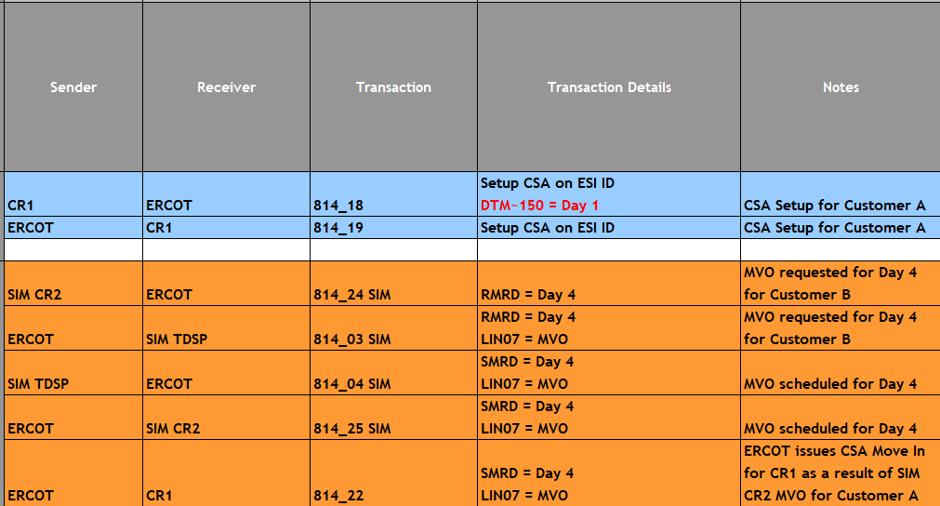
ICSA – Day 1 and Day 2
Notes:
Key things to note here – the CSA Add must contain the Start Date for the CSA. End date is optional in the 814_18 Establish. Note that unlike the Move In, CSAs cannot be backdated so if CR needs to send the CSA after Day 1 they should use the current date as the Start Date.

Slide 14
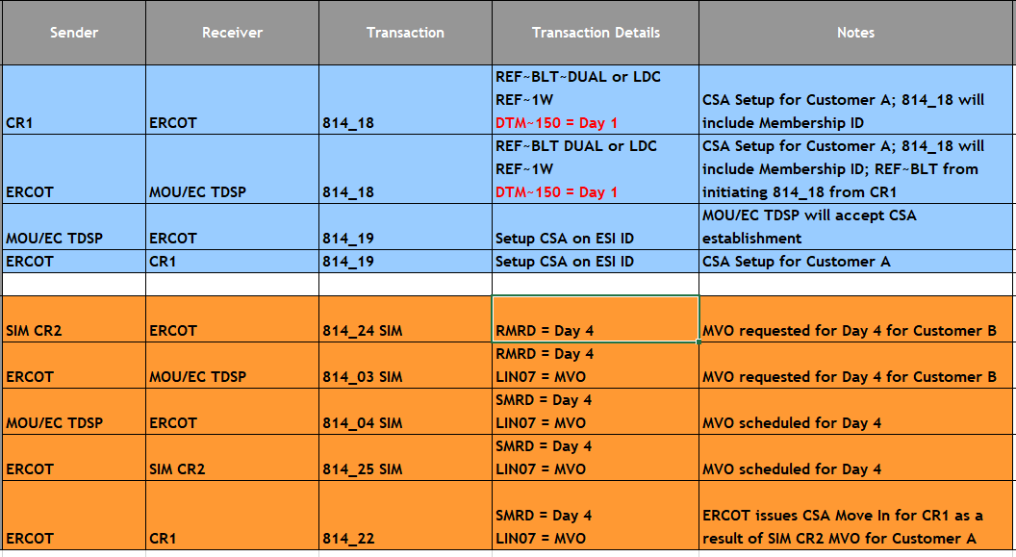
MCSA – Day 1 and Day 2
Notes:
Key things to note here – the CSA Add must contain the Start Date for the CSA. End date is optional in the 814_18 Establish. Note that unlike the Move In, CSAs cannot be backdated so if CR needs to send the CSA after Day 1 they should use the current date as the Start Date.

Slide 15
General FlighTrak Dashboard (CR)
Notes:
Note the Flight Information Websites with links to useful websites

Slide 16
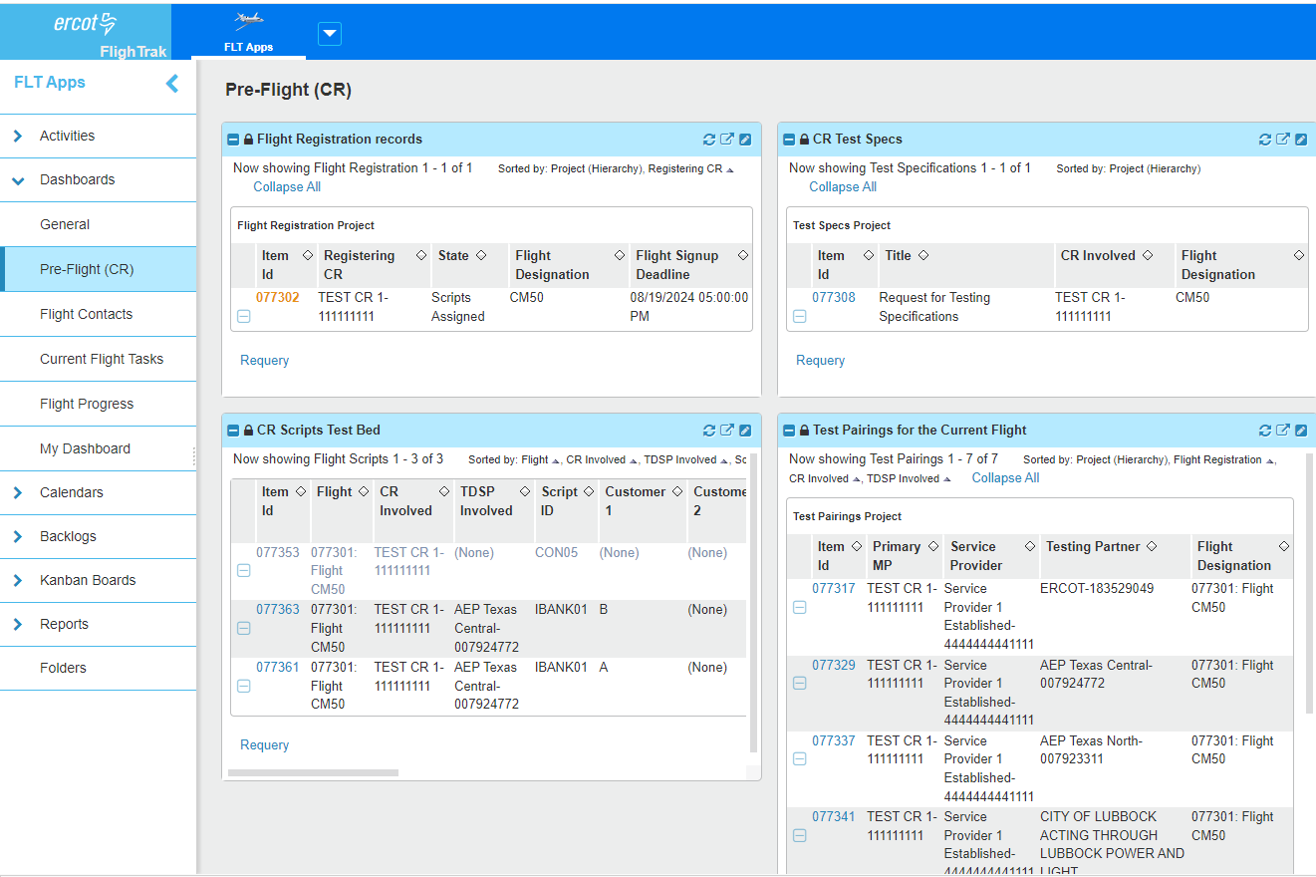
Pre-Flight (CR) Dashboard
Notes:
From the Pre-Flight CR dashboard – CRs can download their test beds and review Test Pairings. If any of the CR Test Specs need to be updated during the Flight, they can be accessed and updated from the report on this tab. The test pairings and testing track may not be accurate because we assigned scripts manually.

Slide 17
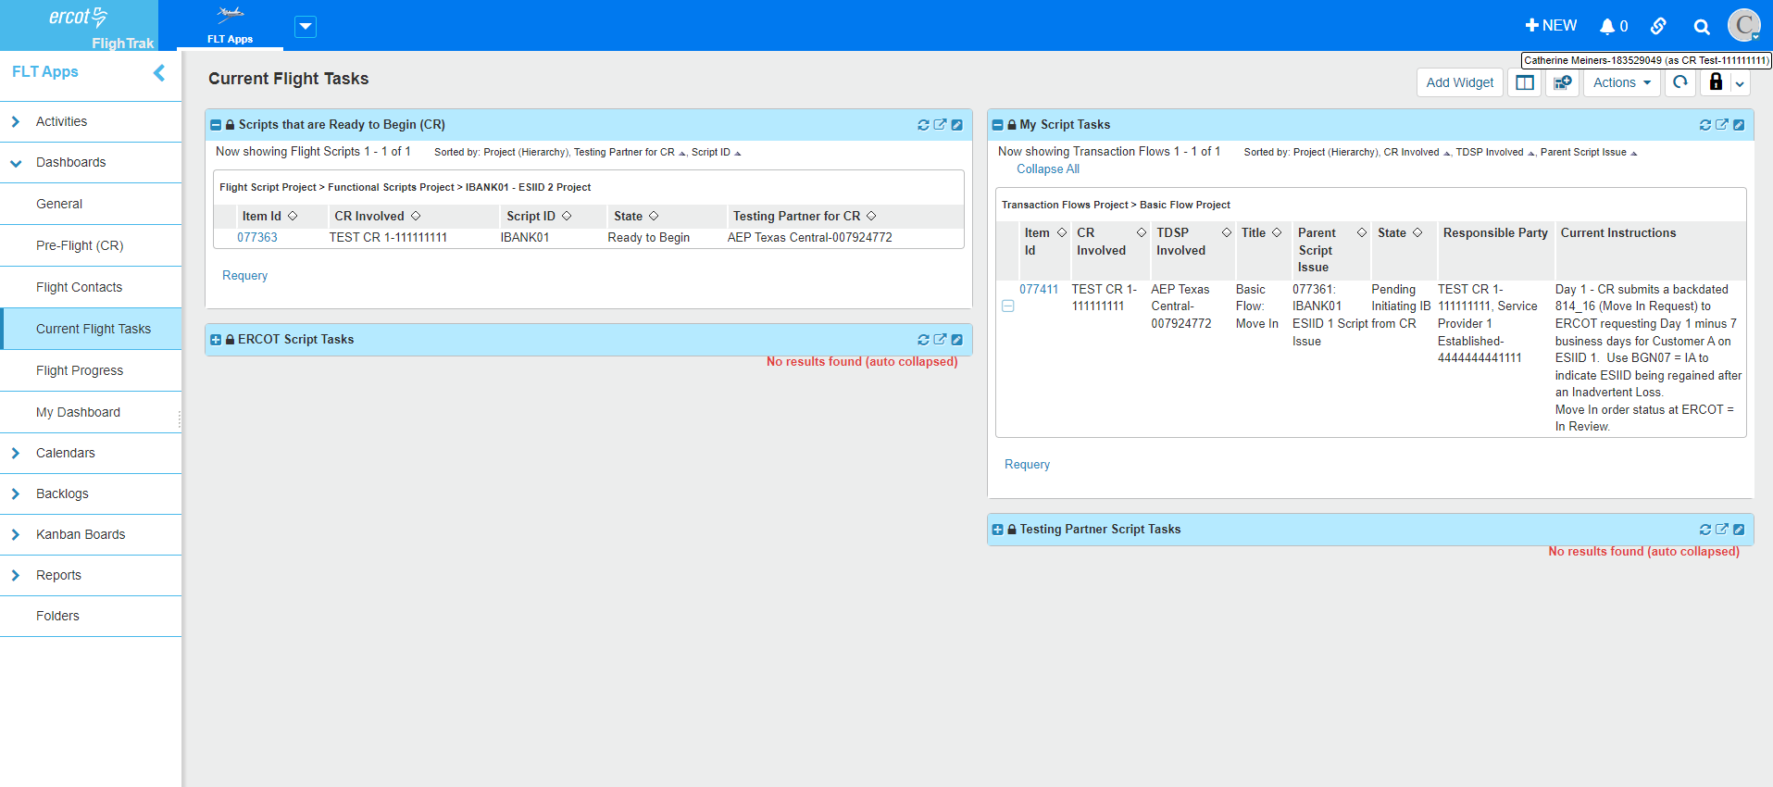
Current Flight Tasks
Notes:
Most useful tab during a Flight is the Current Flight Tasks dashboard. This shows the scripts that are ready for the CR to begin, the ones where the CR needs to take the next action, plus the CR can see any scripts that are currently in the TDSP or ERCOT’s court.

Slide 18
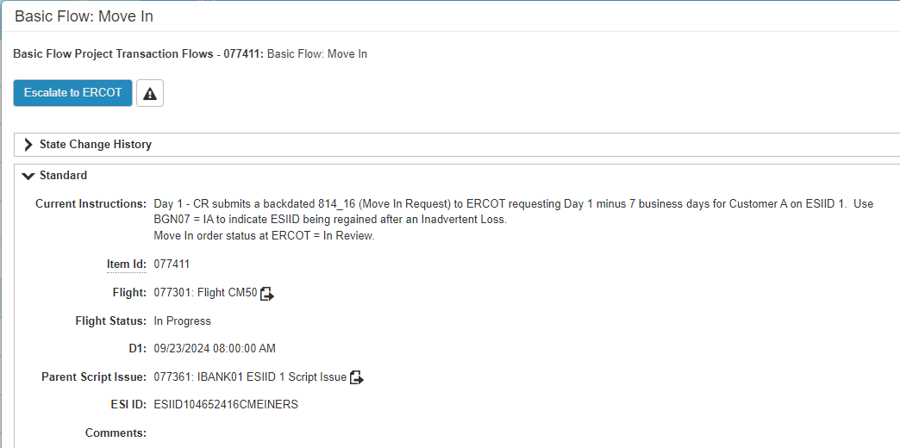
IBANK01 ESIID 1 Day 1
Notes:
Once the script is selected, the current instructions will explain the next steps. Also available is the ESIID and further down the screen is the TDSP involved.

Slide 19
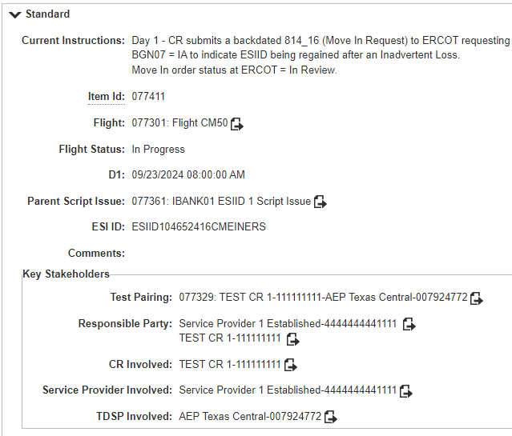
IBANK01 ESIID 1 Day 1

Slide 20
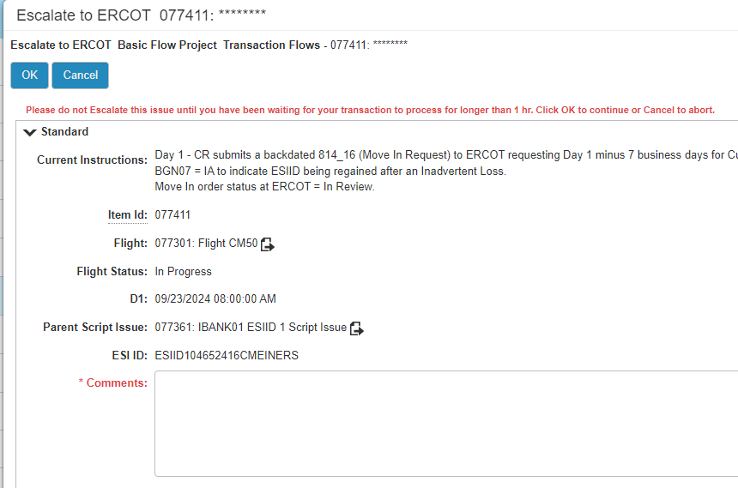
Escalate to ERCOT
Notes:
Please do NOT escalate to ERCOT unless you have a question or an issue. The FlighTrak system is automated for transactions that flow through ERCOT. If you send in an 814_16 with the correct ESIID, FlighTrak will find that transaction and automatically move the script along. If you sent in your transaction more than 1 hours ago but the status of the script has not changed, then go ahead and escalate to ERCOT so we can investigate.

Slide 21
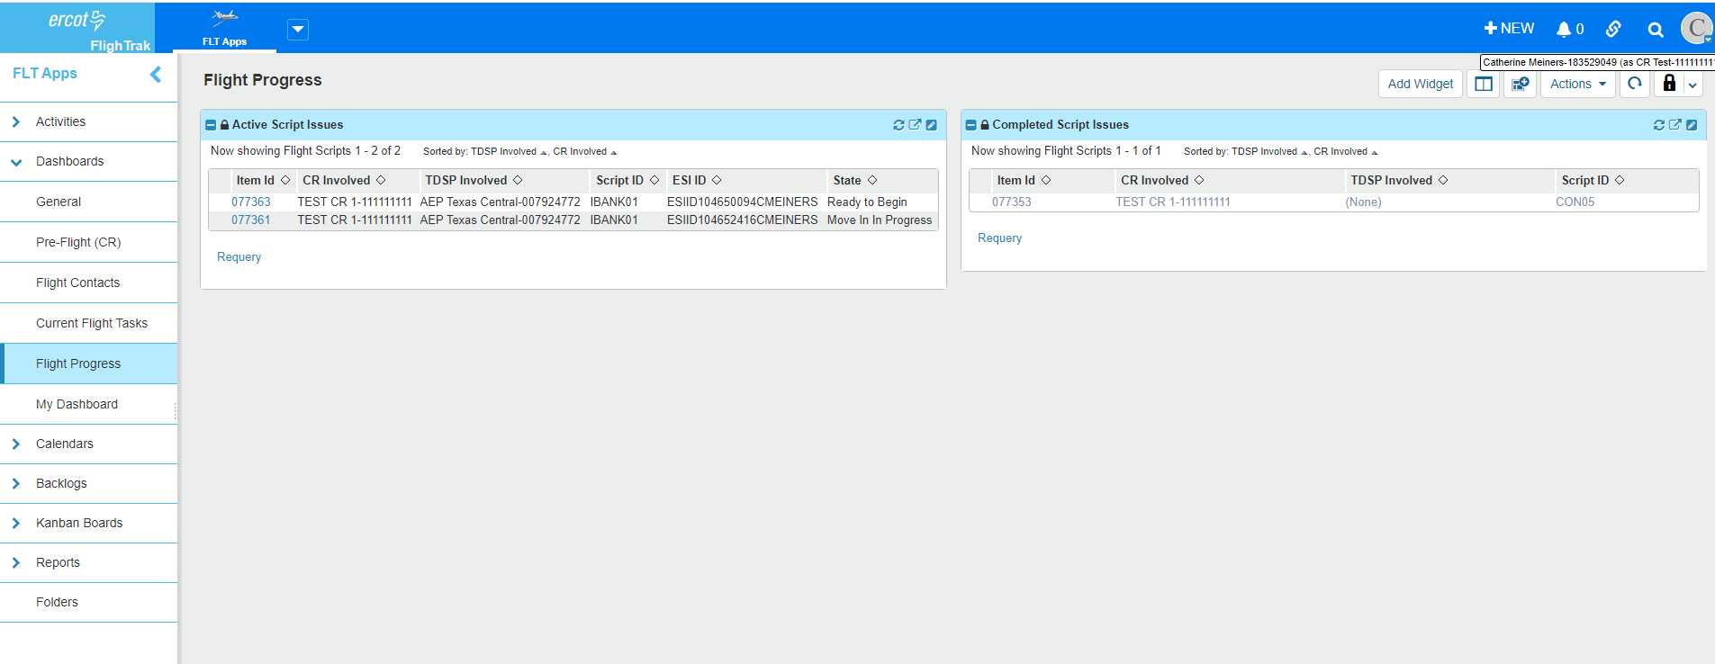
Flight Progress
Notes:
Also very helpful is the Flight Progress tab. Here you can see which scripts are active and which are completed.

Slide 22
Post Flight Expectations
After flight concludes, Retail Operations will work to send updated qualification letters out as quickly as possible to the AR/BAR. Please allow 3 - 4 weeks to receive your letter.
TDSPs will also receive a copy of the LSE letters for those that are qualified in their territory.
LSEs that still have remaining steps left to complete prior to becoming qualified will be receiving a Remaining Steps Letter

Slide 23
Important Dates
Connectivity is currently underway.
TDSP Test beds must be uploaded by September 16
Day 1 Transactions Flow – September 23, 2024
IBANK01 and MBANK01 scripts require Move Ins that are backdated 7 business days from Day 1 – which is 9/12/2024
814_16s sent in requesting a different date will work in the ERCOT source system but fail in FlighTrak and the CR will need to resend with the correct requested date.
The date to request – 9/12/2024 – does not change even if the CR is sending the transaction in on Day 2 or Day 3.
FlighTrak will be looking for 9/12/2024.
Contingency period is between October 7 and October 18.

