Slide 1
Reliability Standard & CONE/VOLL Updates
Pete Warnken
Resource Adequacy
Supply Analysis Working Group
August 26, 2024

Slide 2
Reliability Standard
PUCT staff filed a memo on August 22 summarizing stakeholder comments and providing Commissioner recommendations based on the input (Project 54584)
https://interchange.puc.texas.gov/Documents/54584_101_1417676.PDF
PUCT staff is working on the Proposal for Adoption; the filing is expected before the August 29 PUCT Open Meeting
Reliability Standard approval is expected at the August 29 Open Meeting

Slide 3
CONE and VOLL Studies
PUC staff adopted $140/kW-year as the CONE to use for planning studies (based on a frame CT reference technology)
ERCOT filed Brattle’s VOLL Study Final Report with the PUC in on August 22 (under Project 55837)
ERCOT recommended that an ERCOT Region-wide VOLL for a one-hour outage of $35,000/MWh be used as the VOLL for planning purposes, including for the reliability standard and PCM https://interchange.puc.texas.gov/search/documents/?controlNumber=55837&itemNumber=12
PUCT staff filed a memo on August 8th with a VOLL recommendation to use for cost-benefit analysis in planning studies
https://interchange.puc.texas.gov/Documents/55837_13_1422000.PDF
Staff recommended a VOLL of $30,000/MWh
The PUC is expected to discuss adoption of a VOLL for planning purposes at the August 29 Open Meeting

Slide 4
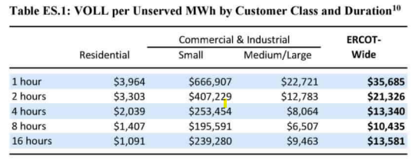
CONE and VOLL Studies

