Slide 1
NERC EMSWG Update
Wei Qiu, NERC EA
ERCOT TWG Conference Call
August 29, 2024

Slide 2
Updates
White Paper – AI/ML in Real-time System Operation
Reference Document - Risks and Mitigations for Losing EMS Functions Reference Document (2024)
2024 Monitoring and Situational Awareness Technical Conference

Slide 3
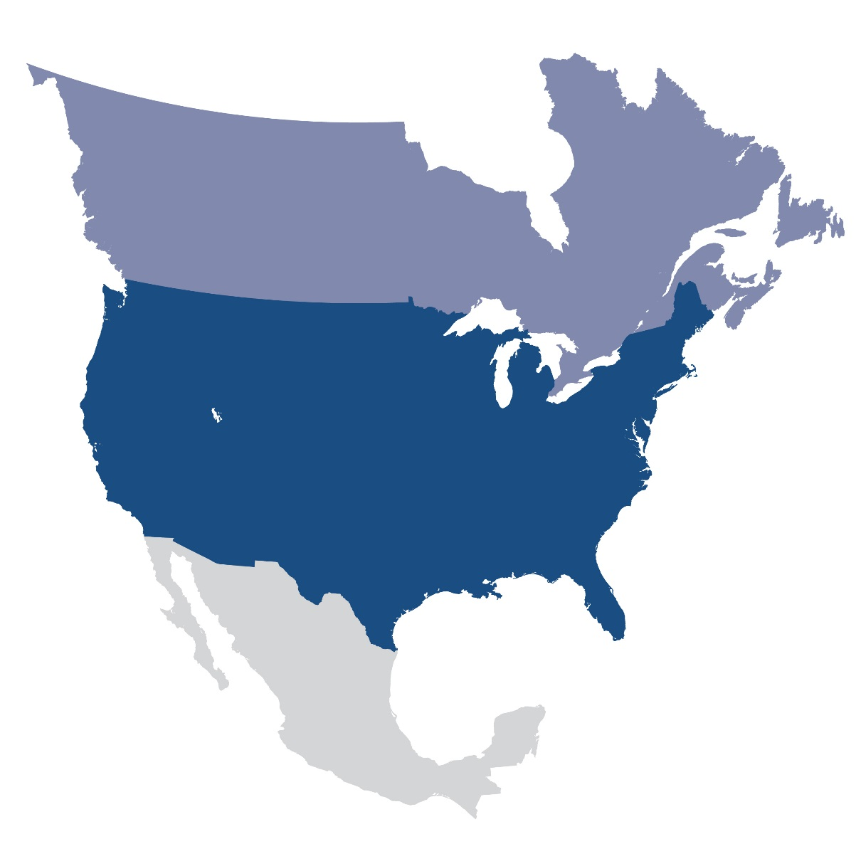
Questions and Answers
Contact Information:
wei.qiu@nerc.net

