Slide 1
Credit Exposure Update
Market Credit Work Group
ERCOT Public
September 18, 2024

Slide 2
Monthly Highlights July 2024 - August 2024
Market-wide average Total Potential Exposure (TPE) increased from $1.81 billion in July 2024 to $1.88 billion in August 2024.
TPE increased mostly due to higher real-time and day-ahead prices
Discretionary Collateral is defined as Secured Collateral in excess of TPE,CRR Locked ACL and DAM Exposure
Average Discretionary Collateral increased from $4.15 billion in July 2024 to $4.23 billion in August 2024
No unusual collateral call activity

Slide 3
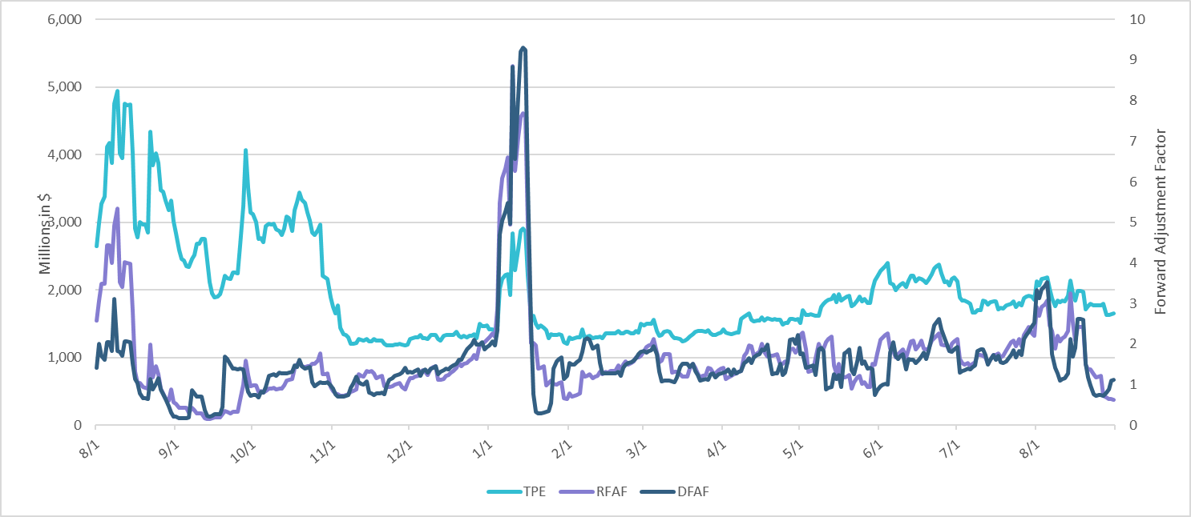
TPE and Forward Adjustment Factors: August 2023 – August 2024

Slide 4
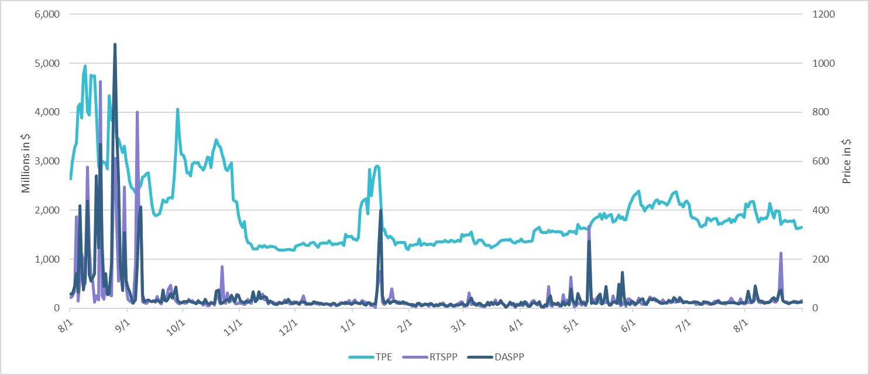
TPE/Real-Time & Day-Ahead Daily Average Settlement Point Prices for HB_NORT:H August 2023 – August 2024

Slide 5
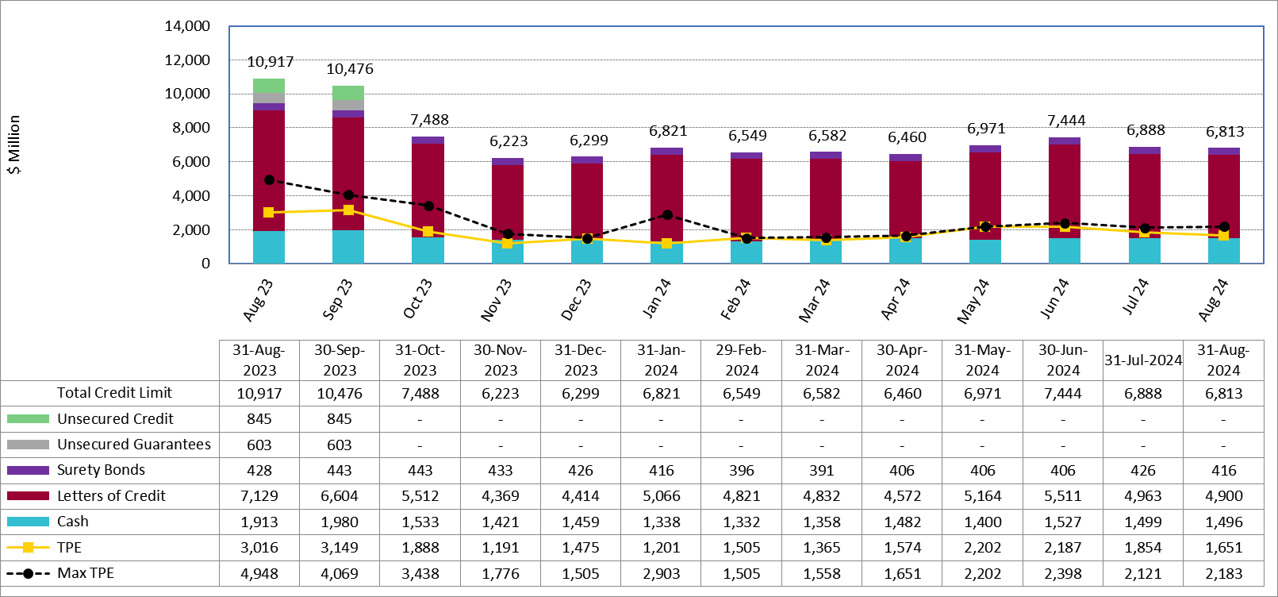
Available Credit by Type Compared to Total Potential Exposure (TPE): August 2023 – August 2024
Numbers are as of month-end except for Max TPE
Max TPE is the highest TPE for the corresponding month

Slide 6
Issuer Credit Limits vs Total LC Amounts Per Issuer: End-August 2024
As of August 31, 2024
There are a total of 39 banks that have issued LCs.

Slide 7
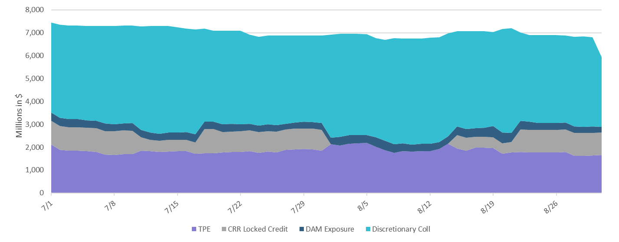
Discretionary Collateral Jul 2024 – Aug 2024

Slide 8
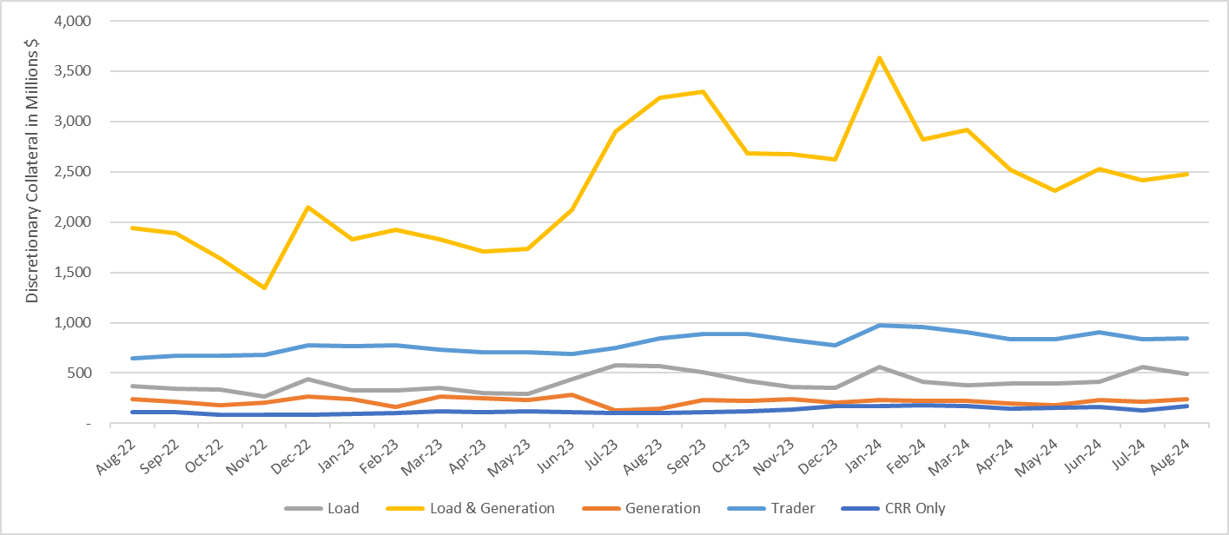
Discretionary Collateral by Market Segment August 2022 - August 2024
* Discretionary Collateral adjusted to exclude short pay amounts eliminating data skew

Slide 9
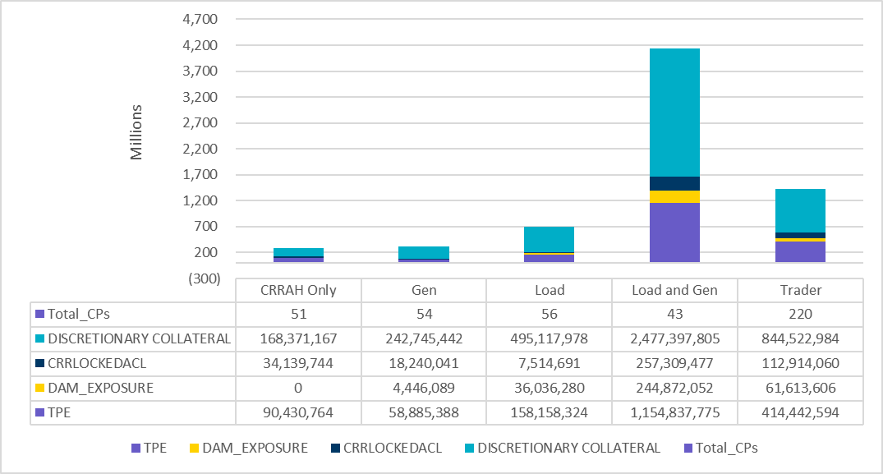
TPE and Discretionary Collateral by Market Segment - August 2024
Load and Generation entities accounted for the largest portion of discretionary collateral

Slide 10
TPEA Coverage of Settlements July 2023 - July 2024
Invoice Exposure | Historical | Future
Existing Invoice Exposure | RTLCNS + UDAA | M1 Days (including current day) Forward Charge Invoice Amounts
New Invoice Exposure | 7 Days Back Net Invoice Amounts (Charges & Credits) | M1 Days (including current day) Forward Net Invoice Amounts (Charges & Credits); Excluding: 1) Securitization Invoices; 2) CRR Auction Invoices; and 3) Subchapter N Funds Distribution Invoice
TPEA closely approximates actual/invoice exposure

Slide 11
TPEA Coverage of Settlements July 2023 - July 2024
Invoice Exposure | Historical | Future
Existing Invoice Exposure | RTLCNS + UDAA | M1 Days (including current day) Forward Charge Invoice Amounts
New Invoice Exposure | 7 Days Back Net Invoice Amounts (Charges & Credits) | M1 Days (including current day) Forward Net Invoice Amounts (Charges & Credits); Excluding: 1) Securitization Invoices; 2) CRR Auction Invoices; 3) Subchapter N Funds Distribution Invoice
*TPEA exceeds invoice exposure

Slide 12
TPEA Coverage of Settlements July 2023 - July 2024
Invoice Exposure | Historical | Future
Existing Invoice Exposure | RTLCNS + UDAA | M1 Days (including current day) Forward Charge Invoice Amounts
New Invoice Exposure | 7 Days Back Net Invoice Amounts (Charges & Credits) | M1 Days (including current day) Forward Net Invoice Amounts (Charges & Credits); Excluding: 1) Securitization Invoices; 2) CRR Auction Invoices; 3) Subchapter N Funds Distribution Invoice
Invoice exposure generally exceeds TPEA

Slide 13
TPEA Coverage of Settlements July 2023 – July 2024
Invoice Exposure | Historical | Future
Existing Invoice Exposure | RTLCNS + UDAA | M1 Days (including current day) Forward Charge Invoice Amounts
New Invoice Exposure | 7 Days Back Net Invoice Amounts (Charges & Credits) | M1 Days (including current day) Forward Net Invoice Amounts (Charges & Credits); Excluding: 1) Securitization Invoices; 2) CRR Auction Invoices; 3) Subchapter N Funds Distribution Invoice
*TPEA generally exceeds invoice exposure

Slide 14
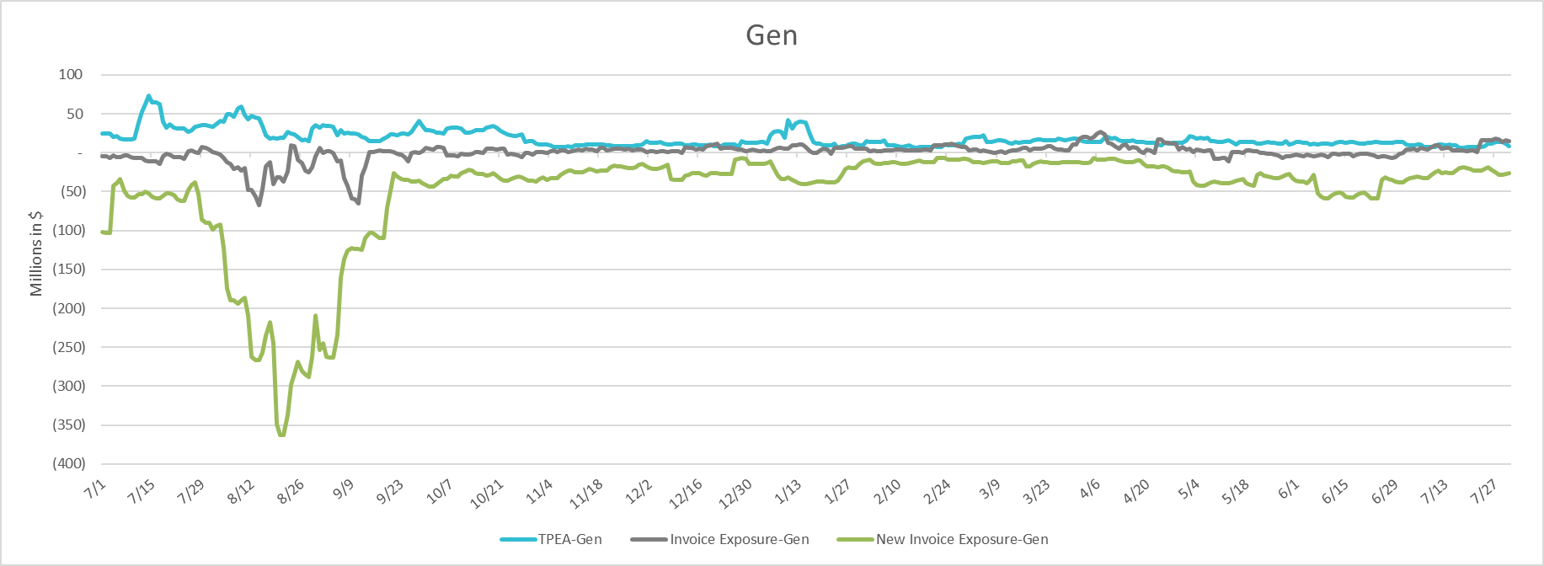
TPEA Coverage of Settlements July 2023 - July 2024
Invoice Exposure | Historical | Future
Existing Invoice Exposure | RTLCNS + UDAA | M1 Days (including current day) Forward Charge Invoice Amounts
New Invoice Exposure | 7 Days Back Net Invoice Amounts (Charges & Credits) | M1 Days (including current day) Forward Net Invoice Amounts (Charges & Credits); Excluding: 1) Securitization Invoices; 2) CRR Auction Invoices; 3) Subchapter N Funds Distribution Invoice
* TPEA generally exceeds Invoice exposure

Slide 15
TPEA Coverage of Settlements July 2023 - July 2024
Invoice Exposure | Historical | Future
Existing Invoice Exposure | RTLCNS + UDAA | M1 Days (including current day) Forward Charge Invoice Amounts
New Invoice Exposure | 7 Days Back Net Invoice Amounts (Charges & Credits) | M1 Days (including current day) Forward Net Invoice Amounts (Charges & Credits); Excluding: 1) Securitization Invoices; 2) CRR Auction Invoices; 3) Subchapter N Funds Distribution Invoice
*TPES exceeds actual/invoice exposure

Slide 16
Questions

