Slide 1
Monthly Review of Reliability Unit Commitment Market Impacts – August 2024
Wholesale Market Working Group
ERCOT Staff

Slide 2
RUC Resource-Hours
August 2024 | Total | Opt-Out | Non-Opt-Out
Instructed Resource-Hours
Total Count | 184.0 | 13.0 | 171.0
Effective Resource-Hours*
Total Count | 183.1 | 13.0 | 170.1
Average Megawatts (MW) for Effective Resource Hours
Average LSL | 35.7 | 57.0 | 34.1
Average LDL | 40.9 | 99.5 | 36.5
Average BP | 44.9 | 132.8 | 38.2
Average HSL | 126.2 | 189.0 | 121.4
* The difference between “Instructed” and “Effective” values is a result of Resources starting up, shutting down, receiving partial hour instructions, or otherwise not being dispatchable by SCED.

Slide 3
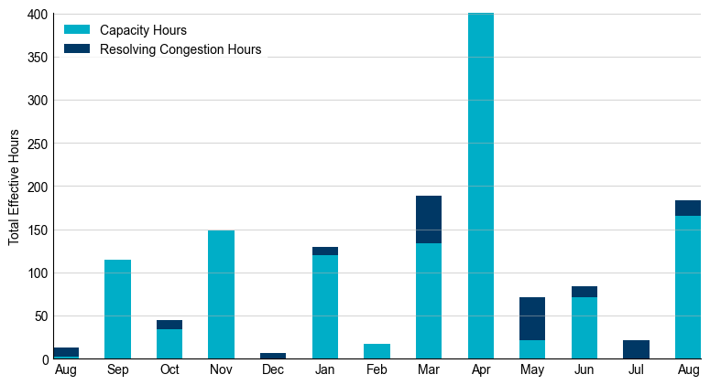
RUC Instruction Reasons: Last 13 Months RUC instructions in August 2024 were primarily to ensure sufficient capacity but also to resolve congestion.

Slide 4
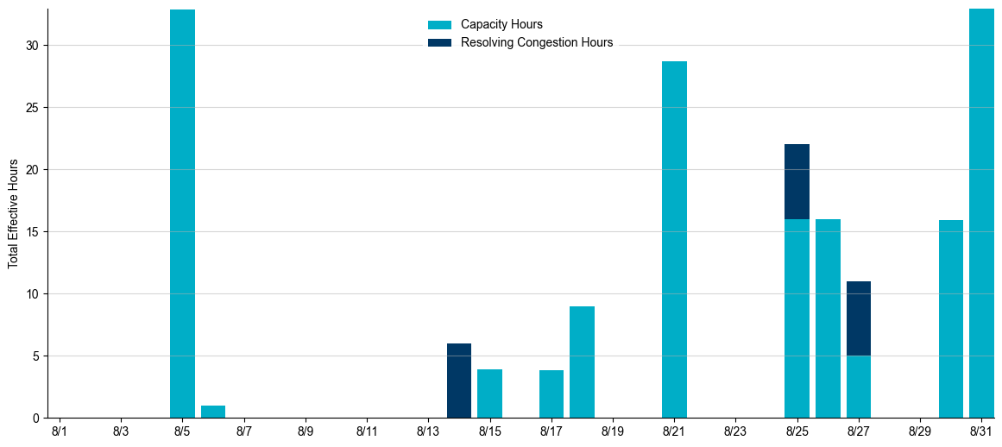
RUC Instruction Reasons in August 2024
183.1 RUC effective Resource-hours.
165.1 hours (90.17%) for capacity.
18.0 hours (9.83%) for congestion.

Slide 5
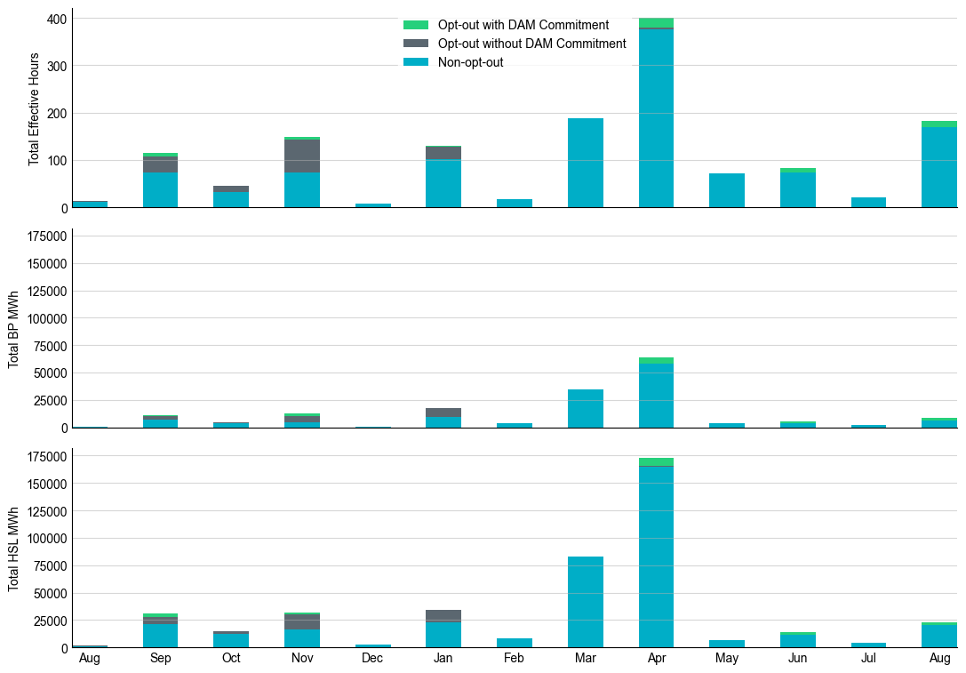
Non-opt-out and Opt-out Totals: Last 13 Months August 2024 had a total of 170.1 non-opt-out effective Resource-hours (92.90%) and 13.0 opt-out effective Resource-hours (7.10%).

Slide 6
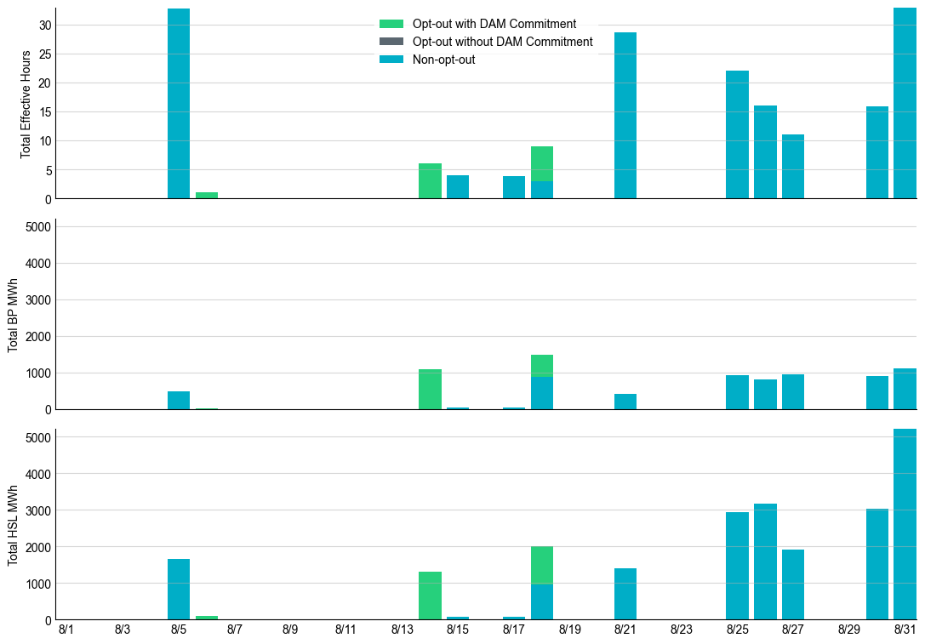
Non-opt-out and Opt-out Totals: August 2024

Slide 7
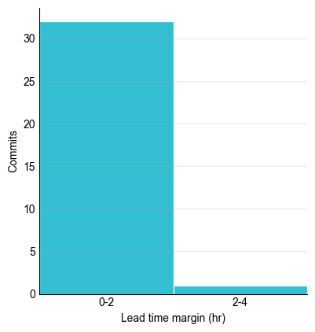
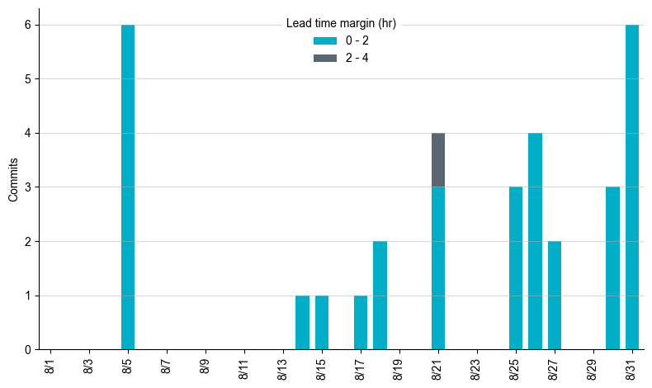
RUC Lead Time Margin: August 2024
Most RUC commitment windows had a lead time margin at or below 2 hours.
Lead time refers to the length of time between a RUC instruction and the start of the commitment window.
Lead time margin is the difference between lead time and the Resource’s startup time.
In cases where a Resource is committed for multiple back-to-back time blocks, lead time margin is calculated from the first instruction.

Slide 8
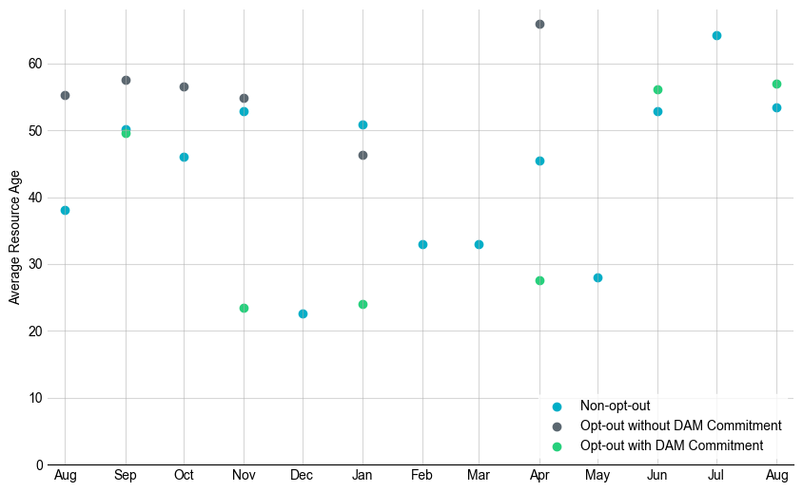
Average Resource Age: Last 13 Months In August 2024, the average age of RUC-committed Resources was 53.5 years for non-opt-out Resource-hours and 57.0 years for opt-out Resource-hours with DAM commitment.
Note: For Resource configurations with multiple physical generators, the age of the oldest generator is used.

Slide 9
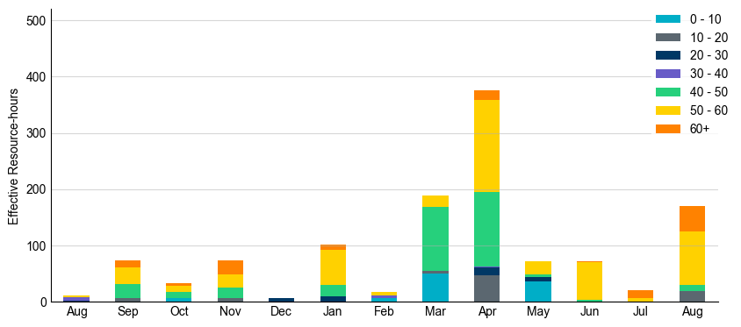
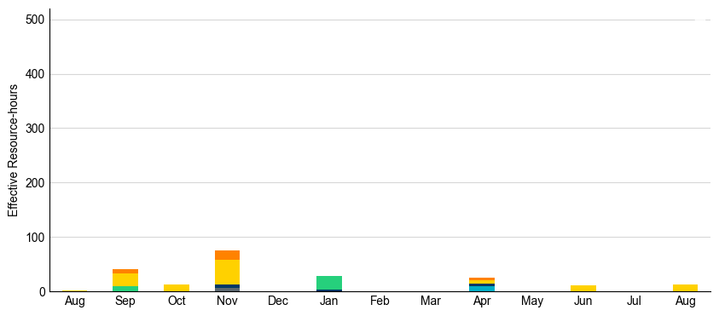
Age Category: Last 13 Months Most RUC-committed Resources in August 2024 were more than 50 years old.
Non-opt-out
Opt-out

Slide 10
RUC-Instructed Resource Dispatch above LDL
August 2024
There were 6.5 effective Resource-hours in which Resources that did not successfully opt out were dispatched above their LDL.
For 0.5 of these Resource-hours, the LMP for the RUC-instructed Resource was above the RUC offer floor.
For 6.0 of these Resource-hours, the LMP for the RUC-instructed Resource was below the RUC offer floor.
For 6.0 Resource-hours, the RUC-instructed Resource was mitigated.
There were no Exceptional Fuel Cost submissions for any RUC-committed Resources.
*Note: Numbers may not sum exactly due to rounding.

Slide 11
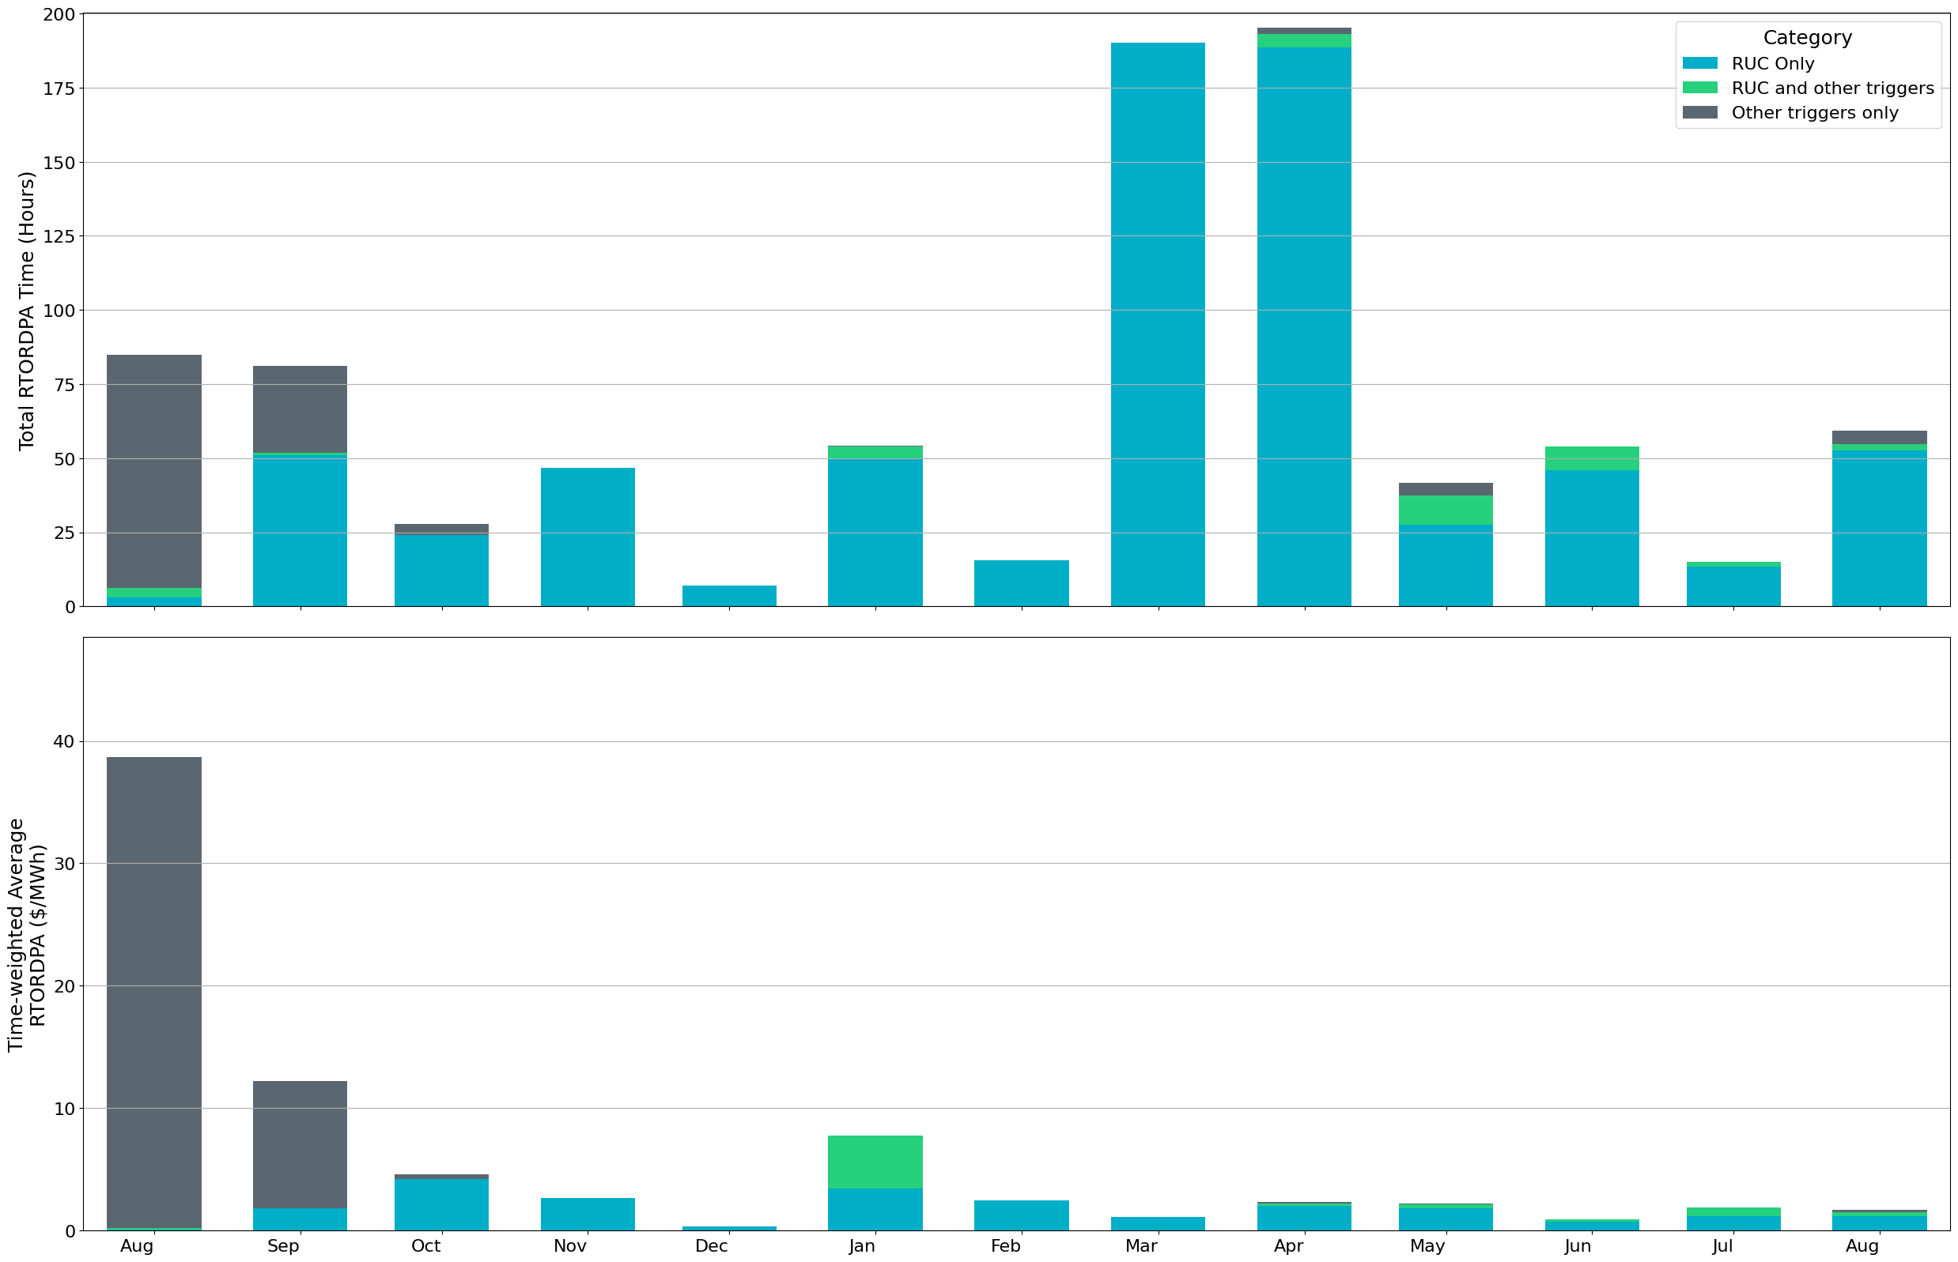
Reliability Deployment Price Adder: Last 13 Months August 2024 had a total of 67.25 RTORDPA hours with an average value of $0.87/MWh.
These graphs show RTORDPA instances by reliability action: 'RUC Only' for instances triggered solely by Reliability Unit Commitment, 'RUC and other triggers' for instances with RUC and additional triggers, and 'Other triggers only' for instances with non-RUC triggers. The daily average RTORDPA is calculated using the total duration across all categories. See ERCOT protocol section 6.5.7.3.1 for details.

Slide 12
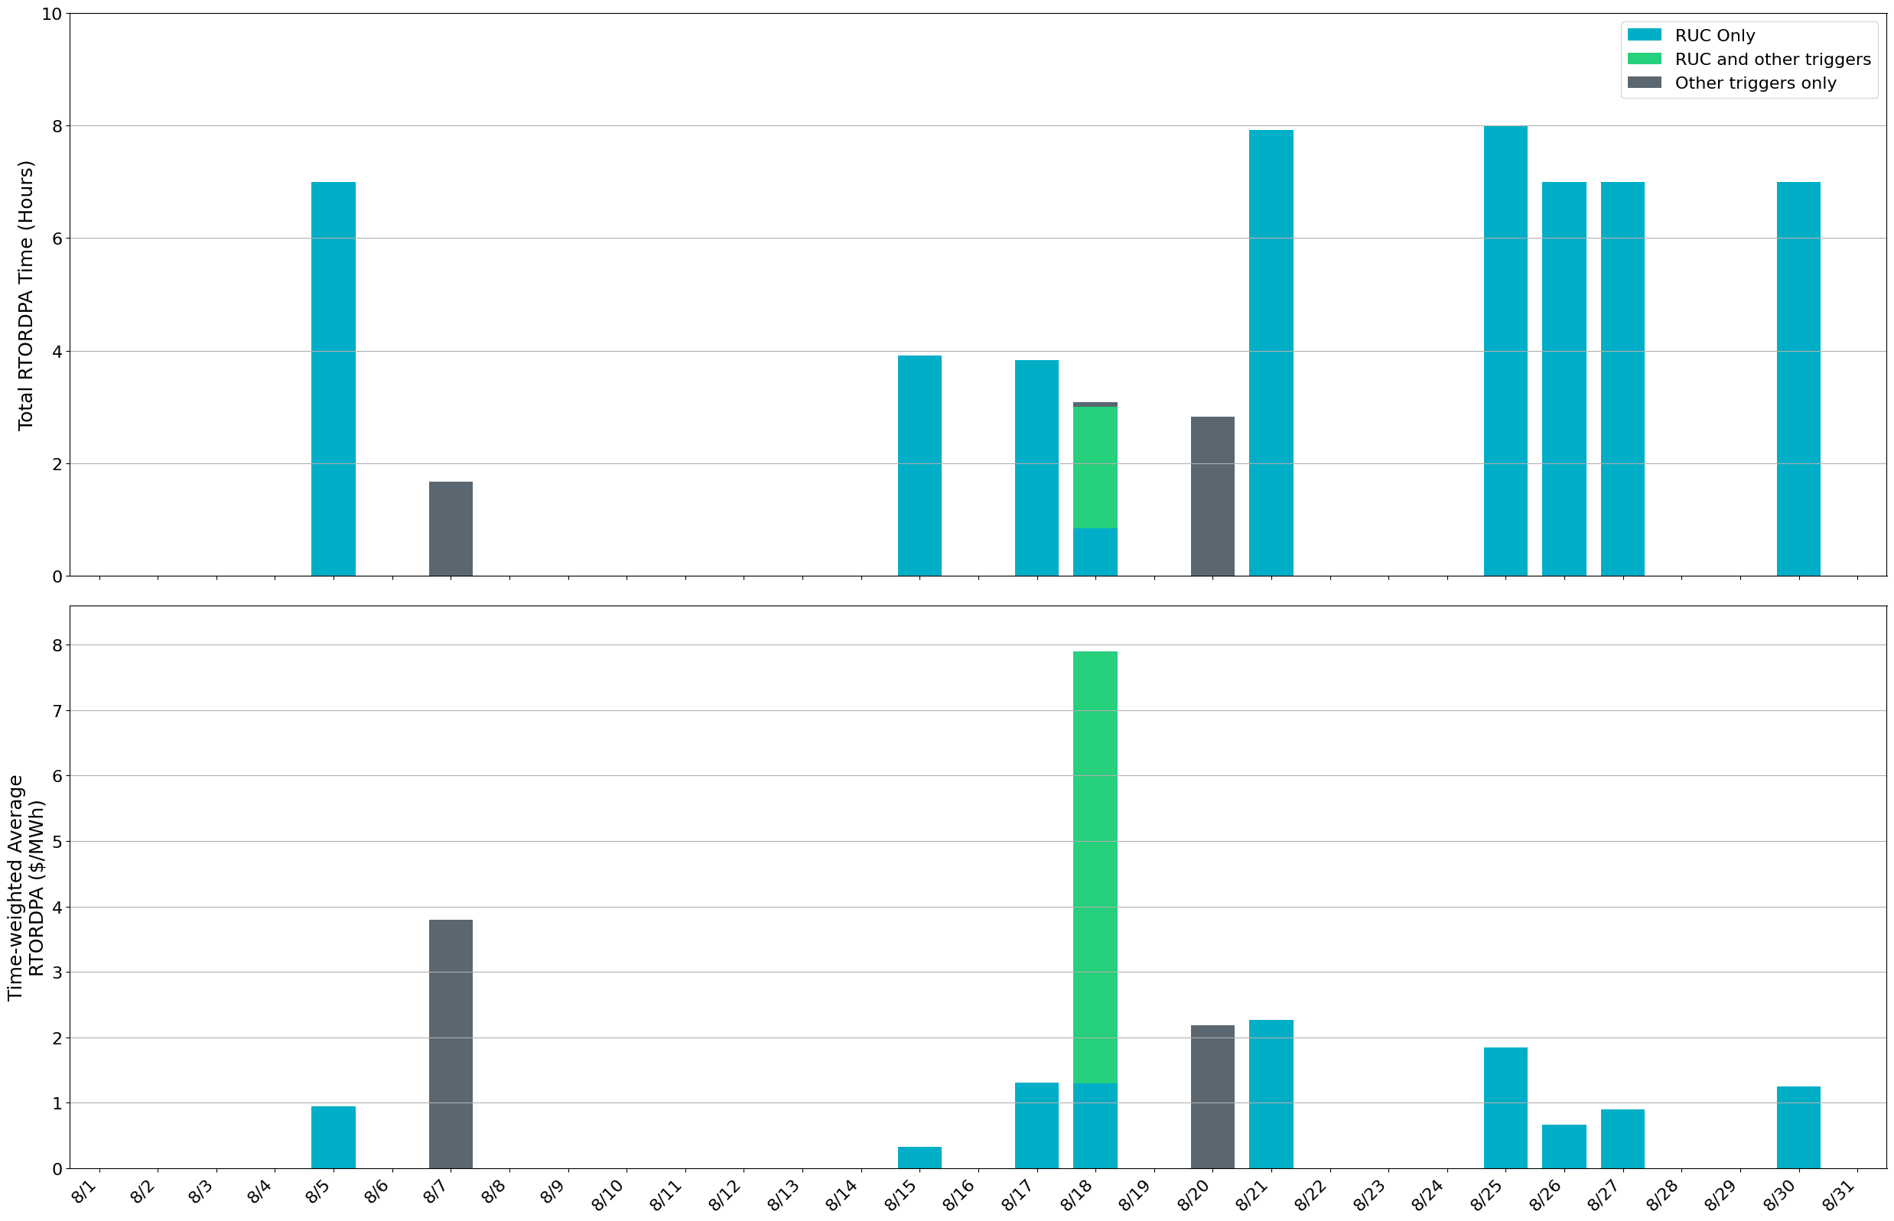
Reliability Deployment Price Adder: August 2024 OD 8/18 had the highest daily time-weighted average RTORDPA of $7.89/MWh.
These graphs show RTORDPA instances by reliability action: 'RUC Only' for instances triggered solely by Reliability Unit Commitment, 'RUC and other triggers' for instances with RUC and additional triggers, and 'Other triggers only' for instances with non-RUC triggers. The daily average RTORDPA is calculated using the total duration across all categories. See ERCOT protocol section 6.5.7.3.1 for details.

Slide 13
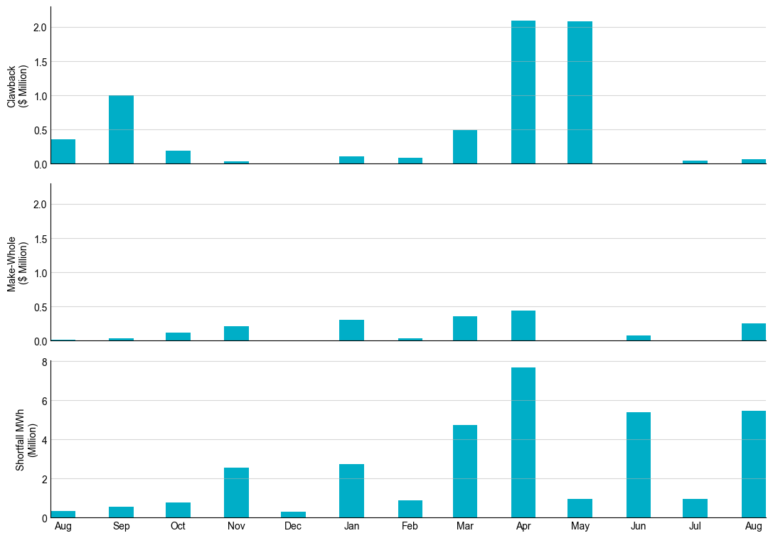
RUC Clawback, Make-Whole, and Shortfall For August 2024, the total Clawback Charge was $73,690. The total Make-Whole Payment was $305,171.
Of the $305,171 in Make-Whole Payments made in August 2024, $2.91 was uplifted to load due to rounding.
The remaining amount was collected through Capacity-Short Charges.
Data as of September 6th, 2024

Slide 14
RUC Clawback by Settlement Type
Month | Initial Settlement ($) | Final Settlement Change ($) | True-up Settlement Change ($) | Net as of August 12, 2024 ($)
Aug ‘23 | 352,002 | 0 | 0 | 352,002
Sep ‘23 | 997,843 | 0 | 0 | 997,843
Oct ‘23 | 190,721 | 0 | 0 | 190,721
Nov ‘23 | 29,684 | 0 | 0 | 29,684
Dec ‘23 | 0 | 0 | 0 | 0
Jan ‘24 | 107,176 | -4,657 | 0 | 102,519
Feb ‘24 | 88,220 | 0 | 0 | 88,220
Mar ‘24 | 487,193 | 0 | - | -
Apr ‘24 | 2,092,224 | 0 | - | -
May ‘24 | 2,084,416 | 0 | - | -
Jun ’24 | 58 | 0 | - | -
Jul ‘24 | 47,627 | - | - | -
Aug ‘24 | 73,690 | - | - | -
Negative dollars represent a payment from ERCOT to a market participant
“-” indicates settlement has yet to be completed.
Net figures may differ slightly due to rounding.

Slide 15
RUC Make-Whole by Settlement Type
Month | Initial Settlement ($) | Final Settlement Change ($) | True-up Settlement Change ($) | Net as of August 12, 2024 ($)
Aug ‘23 | -12,090 | 0 | 0 | -12,090
Sep ‘23 | -35,168 | 0 | 0 | -35,168
Oct ‘23 | -72,477 | -43,063 | 0 | -115,540
Nov ‘23 | -194,731 | 0 | -17,934 | -212,665
Dec ‘23 | -5,316 | 0 | 0 | -5,316
Jan ‘24 | -253,466 | -79,942 | 31,417 | -301,991
Feb ‘24 | -19,673 | 0 | -9,004 | -28,677
Mar ‘24 | -353,562 | 0 | - | -
Apr ‘24 | -443,178 | 0 | - | -
May ‘24 | -2,957 | 0 | - | -
Jun ’24 | -76,670 | 0 | - | -
Jul ‘24 | -4,297 | - | - | -
Aug ‘24 | -305,171 | - | - | -
Negative dollars represent a payment from ERCOT to a market participant
“-” indicates settlement has yet to be completed.
Net figures may differ slightly due to rounding.

