Slide 1
SCR799 – ERCOT Outage Study Cases in the System Operations Test Environment (SOTE)
Yugendher Karedla
September 26, 2024

Slide 2
SCR799 - ERCOT Outage Study Cases in the System Operations Test Environment (SOTE)
The System Operations Test Environment (SOTE) is an environment of the ERCOT Energy Management System (EMS) where the Network Operations Model and the results of the Real-Time State Estimator (SE) are available for review and analysis within five minutes of the Real-Time solution.
This environment is provided as a platform for Transmission Service Providers (TSPs) to perform power flow studies, contingency analyses and validation of SE results.
SCR799 enables ERCOT to provide Current month’s- 60 day and 90 day outage study cases in SOTE for TSPs on monthly basis.
Providing access to these ERCOT outage cases in SOTE improves the ability of TSPs to evaluate outages prior to submittal to ERCOT, there by increasing the likelihood of outage approvals by ERCOT.
Project Status: In execution phase.

Slide 3
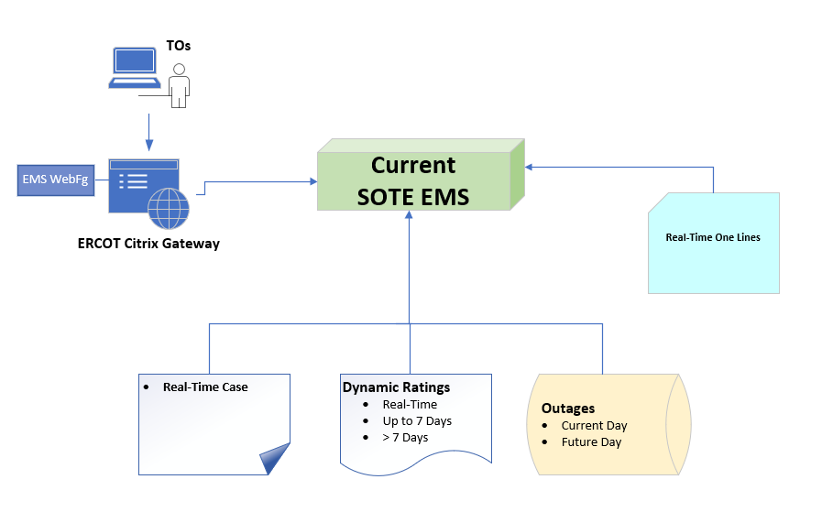
SOTE – Current State

Slide 4
SOTE – Future State (Post SCR799)

Slide 5
Project activities and milestones
Environment Readiness – 09/04
Completed
Testing –
09/10 – 10/01
Go Live – 10/09
Enhanced SOTE will be live 10/09.
Design
SOTE with 60/90-day outage study cases for the month of September are available.
Market Notification with Training Documentation – 09/26
Completed

