Slide 1
Parameters for Proxy Ancillary Service Offer Floors – 2nd Discussion
David Maggio
Principal, Market Design & Analytics
RTCBTF
October 22, 2024

Slide 2
Recap of the September ERCOT Presentations
At the last meeting in September, ERCOT staff had two presentations to get discussion going on proxy Ancillary Service Offer floors:
A refresher on the Ancillary Service Offer structure and process for creating the proxy Ancillary Service Offers under Real-Time Co-optimization (RTC). This included the role of the proxy Ancillary Service Offer floor.
A presentation looking at analyses of:
Energy Offer Curve (EOC) behavior and proxies being created as part of that existing proxy process; and
Historically Ancillary Service Offer behavior, where the historical offers available would be those primarily used for the Day-Ahead Market (DAM).

Slide 3
Recap of the September ERCOT Presentations cont.
ERCOT recommendation during the previous meeting was that a value of $0/MW per hour be used for the proxy offer floor parameter with the reasons being:
Risks that exist for the DAM that may warrant high Ancillary Service Offers in the Day-Ahead, such as Resource availability uncertainty, don’t exist in Real-Time. Resource availability and capabilities are known in Real-Time and are being provided through telemetry by the Qualified Scheduling Entity (QSE).
A proxy Ancillary Service Offer considers the floor values, QSE offers for that same product, and QSE offers for other Ancillary Services that the Resource is qualified to provide. The floors primarily come into play only when no offer is submitted by the QSE for the Resource at all.
Under RTC, a QSE has the ability to update Real-Time Ancillary Service Offers through the Operating Hour. This is in addition to other tools available to the QSE, such as Ancillary Service capability telemetry.

Slide 4
Feedback During the September Meeting
A group of market participants provided feedback during the task force meeting suggesting that the floor should be set at the System-Wide Offer Cap (SWCAP), e.g., $2,000/MWh for Real-Time under RTC.
The commenters largely pointed to the existing proxy EOC process as justification.
At a high-level, the proxy EOC process under RTC works as follows:
For Resources without any EOC that are not Intermittent Renewable Resources (IRRs), there is a proxy EOC going from -$250/MWh to $2,000/MWh at a MW value equal to the Resource’s “Output Schedule.”
For IRRs without any EOC, there is a proxy EOC going from -$250/MWh to $1,500/MWh at a MW value equal to the Resource’s High Sustained Limit (HSL).
For non-IRRs and IRRs without a full-range EOC, the EOC is extended using the highest submitted offer.
There are some similar rules for Energy Storage and Controllable Load Resources (ESRs and CLRs).
Some concern was already raised about market participants being unaware of the potential for Ancillary Service awards.

Slide 5
Thoughts Following the Task Force Discussion
The proxy Ancillary Service offer is the maximum of:
The proxy floor (the parameters being discussed);
The highest submitted Ancillary Service Offer price for that product; and
In certain cases, the highest submitted Ancillary Service Offer price for other products.
The effect of having a floor at SWCAP is that all proxy Ancillary Service Offers will be at the SWCAP. The other parts of the equation are not used or relevant anymore.
This is not really equivalent to the current EOC process.

Slide 6
Thoughts Following the Task Force Discussion cont.
Having proxy Ancillary Service Offers at the SWCAP could make the proxy process for Ancillary Services ineffective and, in some circumstances, entirely useless.
For Non-Spinning Reserve Service (Non-Spin), the majority or entirety of the Ancillary Service Demand Curve (ASDC) is currently expected to be less than SWCAP. Under an SWCAP proposal, proxy offers can’t be awarded and might as well not exist.
For ERCOT Contingency Reserve Service (ECRS), depending on the Ancillary Plan, this same concern exists to a smaller degree (i.e., less of the ASDC is typically below SWCAP).
This concern of being short on reserves is not applicable to Regulation Reserves (Reg-Up/Reg-Down) or Responsive Reserve Service (RRS) based on the current ASDCs, but these products would be impacted by an SWCAP proposal with “ramped in” ASDCs.
These points are focused on unwarranted Ancillary Service shortages and not Ancillary Service costs.
While certain proxy EOCs are at SWCAP, Resources with those EOCs can be dispatched with limited (current) or no (under RTC) shortage in actually meeting demand (i.e., power balance).

Slide 7
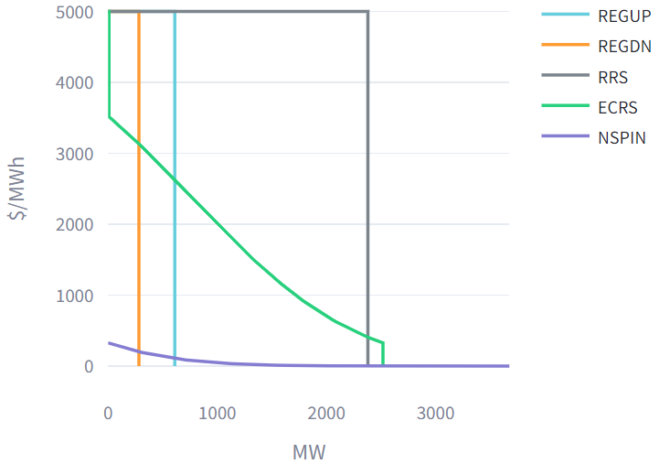
RTC Simulation Tool Illustration: June 20, 2023
Snapshot of ASDC for 12:00
Real-Time SWCAP under RTC
For any portion of an ASDC under the dotted line, an Ancillary Service offer at SWCAP cannot be awarded to meet that portion of the Ancillary Service.

Slide 8
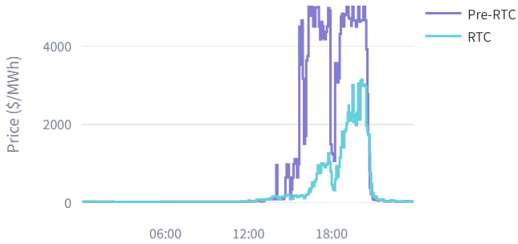
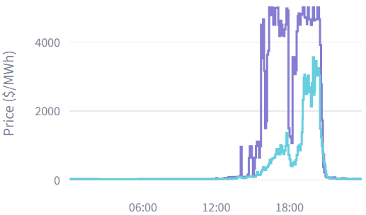
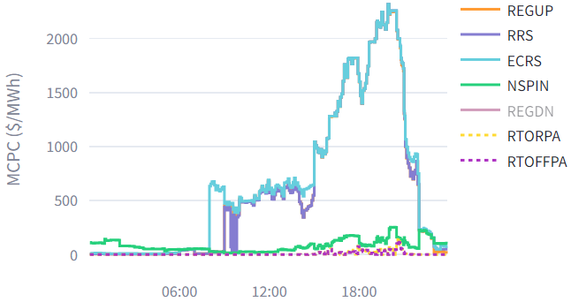
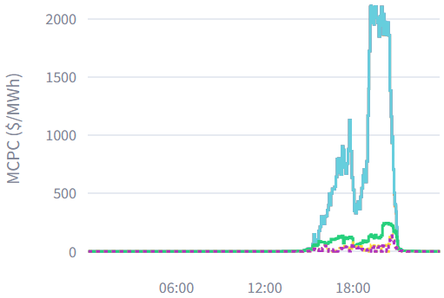
RTC Simulation Tool Illustration: June 20, 2023, cont.
Proxy Offer Floor = $2,000/MW per hour
Proxy Offer Floor = $0/MW per hour
Energy Prices
Energy Prices
Limited scarcity and lower prices
Limited scarcity and lower prices
Ancillary Service Prices
Ancillary Service Prices
High prices and lower awards
Limited scarcity and lower prices

Slide 9
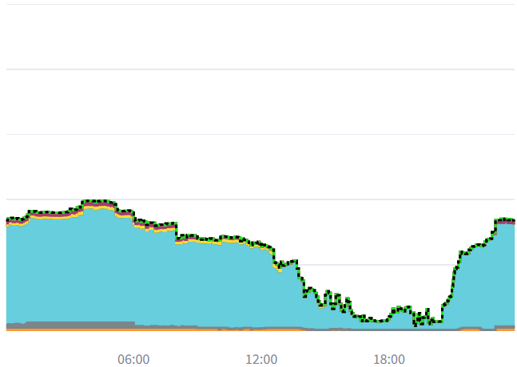
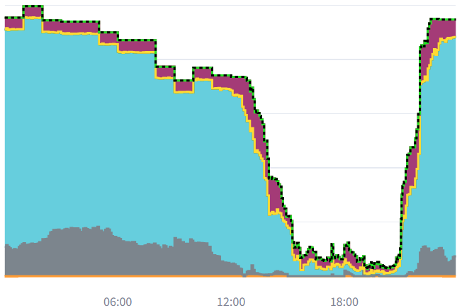
RTC Simulation Tool Illustration: June 20, 2023, cont.
Proxy Offer Floor = $2,000/MW per hour
Proxy Offer Floor = $0/MW per hour
RTC Non-Spin Awards
RTC Non-Spin Awards
3,678 MW
1,278 MW
Similar decreased levels of Non-Spin awards occur across evening hours, during periods of higher total scarcity and system-wide pricing, which is an intended outcome of RTC.
However, with proxy offer floors set to SWCAP, lower levels of Non-Spin awards are observed during periods with high levels of available reserves (e.g., at 12:00 total Operating Reserve Demand Curve (ORDC) reserve were >15 GW and PRC > 6 GW).
Award differences were largely for dispatchable Resources.
Note: The thin line of “Solar” is 0 across all hours in both cases

Slide 10
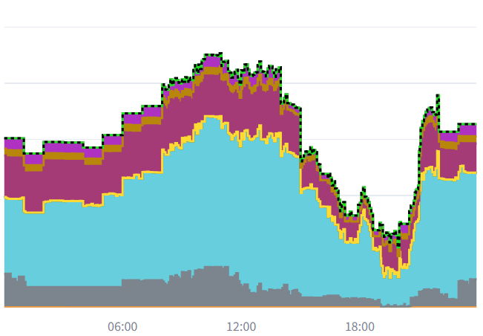
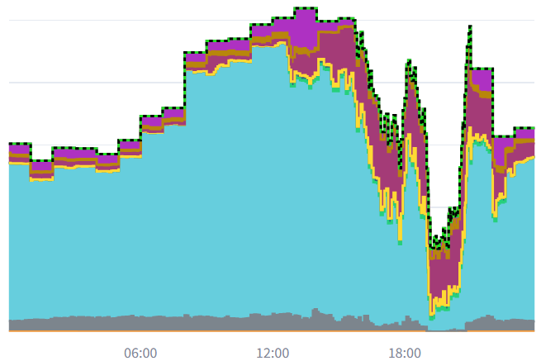
RTC Simulation Tool Illustration: June 20, 2023, cont.
Proxy Offer Floor = $2,000/MW per hour
Proxy Offer Floor = $0/MW per hour
RTC ECRS Awards
RTC ECRS Awards
2,117 MW
2,519 MW
Similar decreased levels of ECRS awards occur across evening hours, during periods of higher total scarcity and system-wide pricing, which is an intended outcome of RTC.
However, again, with proxy offer floors set to SWCAP, lower levels of ECRS awards are observed during periods with high levels of available reserves (e.g., at 12:00 total ORDC reserve were >15 GW, PRC > 6 GW).
Again, award differences were largely for dispatchable Resources.
Note: The thin line of “Solar” is 0 across all hours in both cases

Slide 11
Conclusions
It’s true that ERCOT’s recommendation for proxy Ancillary Service Offer floors creates a process that is not fully equivalent to the proxy EOC process. This is specifically true for the “no offer” condition.
Proxy Ancillary Service Offer floors at SWCAP are also not equivalent to current proxy EOCs.
In looking at initial analysis, proxy Ancillary Service Offer floors at SWCAP seem inappropriate, as they create unwarranted shortages in procurement and scarcity pricing for Ancillary Services in conditions of relatively high reserves.
While not directly comparable, DAM Ancillary Service prices for June 20, 2023, were also not elevated during the middle of the day.
At a minimum, any proposals that deviate from the initial ERCOT recommendation should not create significant, unwarranted shortages.

Slide 12
Questions, Additional Discussion, and Next Steps

