Slide 1
RTC Simulation Tool
Overview and Case Studies
Market Analysis
October 22, 2024

Slide 2
Agenda
Overview of RTC Simulator
Simulation Assumptions
Case Studies
Congestion Case – 07/10/2023
Scarcity Case – 09/06/2023
Reliability Deployment Price Adder (RDPA) Case – 10/20/2023
Acknowledgements
Jonas Kersulis + Raymund Lee: Primary Developers
Ike Urquhart: Pricing run, modeling, sequential run logic
Li Lau + Luke Gutierrez: Visualization application prototypes
Sai Moorty: Whitepaper (Summary of RTC formulation), SME
Zhengguo Chu: Supervisor and SME
Dave Maggio: SME
Jian Chen: SME

Slide 3
Simulator Overview
KP1.1 (8) - ERCOT will work with stakeholders prior to RTC go-live to develop a framework and reporting to periodically review RTC pricing outcomes relative to pricing outcomes that would have been realized through the ORDC for a reasonable period of time.
Inputs
Core Optimization
Outputs
System Data
GTBD
AS Plan
ASDC parameters
MCL, VOLL
System Outputs
System Lambda
Objective Function
Build and solve optimization problem
Resource Outputs
LMPs
Energy Awards
AS MCPCs
AS Awards
Resource Data
Status
Resource Type
Capacity and Ramping Limits
AS Capability and Qualification
Energy and AS Offers
Transmission Outputs
Constraint loading
Constraint shadow price
Transmission Constraints
Shift Factors

Slide 4
Simulation Assumptions and Limitations

Slide 5
Simulation Assumptions and Limitations
Only works for operating days post-ECRS implementation (06/10/2023)
Each interval was simulated individually, with no dependence upon the results of previous interval simulations
System parameters
VOLL = $5000/MWh
SWCAP = $2000/MWh
Undergeneration Penalty = $7001.01/MWh
Overgeneration Penalty = -$251/MWh
ASDCs
Created using the methodology presented during February RTCBTF
mu = 3760 and sigma = 1180
AS quantities were taken from the relevant hour of the AS plan
Energy Offers
SCED step 2 energy offers
Ancillary Service Offers
Prevailing AS offers during the time of RTC SCED execution are being used as-is. Future results will use DAM AS offers.
Proxy AS offer segment created using methodology presented during September RTCBTF
Proxy AS offer floor is a configurable parameter (studies have used $0/MWh and $2000/MWh)
Notes:
VOLL, SWCAP, PBPC

Slide 6
Simulation Assumptions
Ancillary Service Qualification
Use qualified MW quantity. If qualified without a quantity, assume it is qualified for 9999 MW.
Use qualification snapshot at the beginning of the operating day.
Ancillary service ramp rates
Assumed to equal real-time telemetered normal ramp rates
HDL LDL Constraints
5/7 of regulation capacity counted towards HDL and LDL constraints
Pre-RTC to RTC Status Mapping
Pre-RTC Status | Resource Type | RTC Status
ONREG, ONOSREG, ONDSRREG, ONFFRRRS | All | ON
FRRSUP, FRRSDN | GR, ESR | ON
ONRGL, ONCLR, ONRL, ONFFRRRSL, ONECL, FRRSUP, FFRSDN | CLR, NCLR | ONL
OFFNS | GR | OFF
ONRR, ONECRS | GR | ONSC
‘ ‘ | All | OUT

Slide 7
Simulation Assumptions
NCLR self-arranged quantities
Assumed to equal telemetered real-time responsibility.
Energy Storage Resources
Combo model (GR/CLR), single model not implemented
State of charge is not considered
Combined Cycle Frequency Responsive Capacity Telemetry Assumptions
Use today’s NFRC telemetry to estimate Frequency Responsive Capacity RTC telemetry
RespFactor
HiRespLim
LowRespLim
Transmission constraints
Use transmission constraints that were activated in real-time.

Slide 8
Case Studies

Slide 9
Case Study – Congestion Case (07/10/2023)
Congestion occurred in the South load zone during the solar ramp down. This caused Real-Time system lambda to reach as high as $4691.09/MWh.
Operators released up to 700 MW ECRS and 1232 MW offline Non-Spin to manage congestion.
System Lambda*
*Pre-RTC trendline includes ORDC Adders

Slide 10
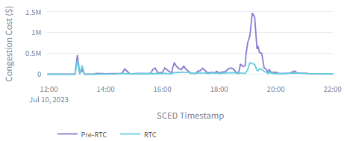
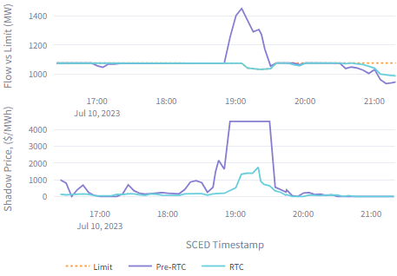
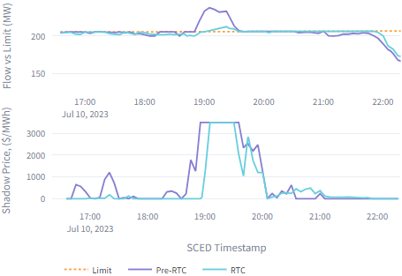
Case Study – Congestion Case (07/10/2023)
Observing reduced system congestion under RTC
Reduction in transmission limit violations
Generally lower shadow prices (not strictly lower)
Lower system-wide congestion rent
Pre-RTC Congestion Rent = $14,147,639
RTC Congestion Rent = $4,668,712
System Congestion Rent
PAWNEE_SPRUCE_1_DELMSAN5
COLETO_ROSATA1_1_SCO2EUL8

Slide 11
Case Study – Scarcity Case (09/06/2023)
Narrative
Low levels of dispatchable capacity resulted in Real-Time system lambda going above $1000/MWh for 70 SCED intervals between 15:00 and 20:15. System lambda was at $5001/MWh for 24 of these SCED intervals.
ERCOT frequency dropped as low as 59.769 Hz and was below 59.91 Hz for more than 15 minutes, which triggered a declaration of EEA 2.
As much as 132 MW of NSPIN, 2600 MW of ECRS, and 1100 MW of RRS were deployed to manage grid conditions.
System Lambda*
*Pre-RTC trendline includes ORDC Adders

Slide 12
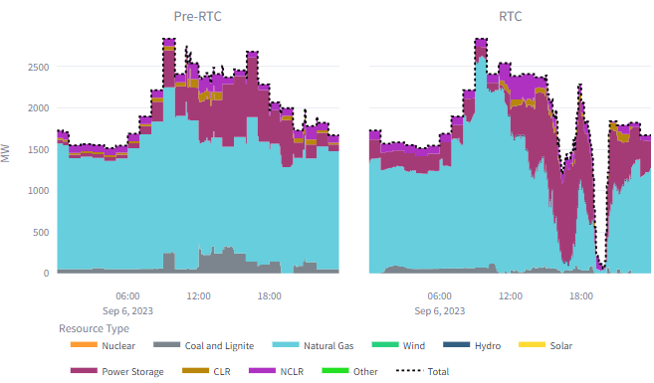
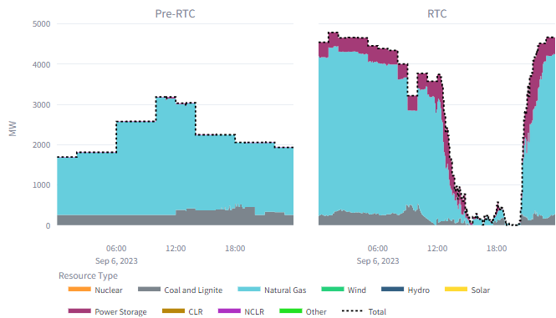
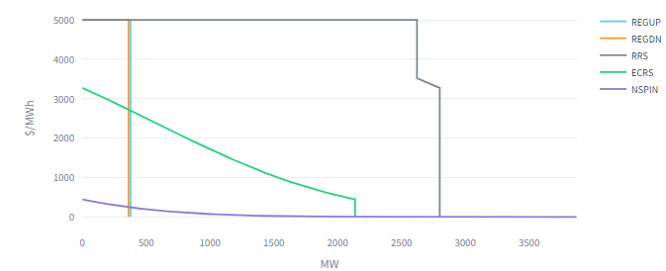
Case Study – Scarcity Case (09/06/2023)
Observations
When energy prices are high, RTC prioritizes awarding energy and goes short on awarding ancillary services
ECRS Awards
NSPIN Awards
ASDC HE 20

Slide 13
Case Study – Scarcity Case (09/06/2023)
A key benefit of RTC is the reallocation of ancillary services which can help reduce congestion. This behavior is illustrated in the figure below showing a snapshot at 18:55.
PAWNEE_SPRUCE_1_DELMSAN5 is at max shadow price ($4500/MWh) in RTC simulation and pre-RTC.
Under RTC, more AS is allocated to resources located in the South to help with the congestion.
These were Regulation, RRS, and ECRS. No Non-Spin was awarded in the RTC simulation this interval.
Geographic distribution of AS Allocation at 09/06/2023 18:55

Slide 14
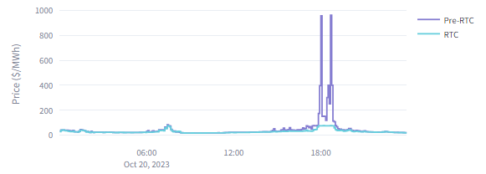
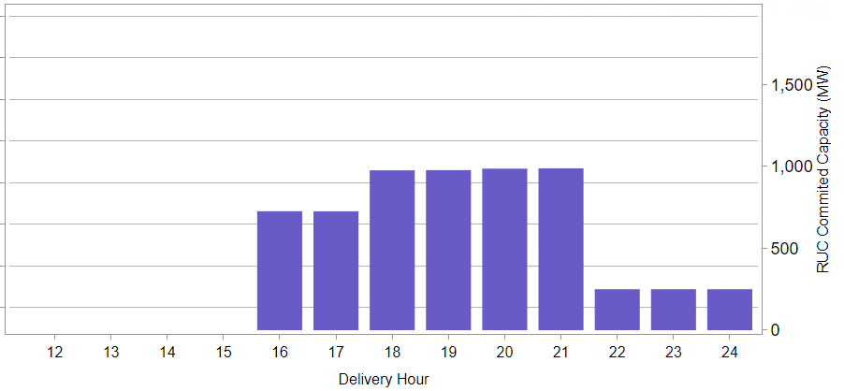
Case Study – RDPA Case (10/20/2023)
Two resources were committed for operating hours between HE16 – HE 24 due to a projected shortage in capacity.
System Lambda*
*Pre-RTC trendline includes Online ORDC Price Adder
Notes:
System lambda reached as high as $960.76/MWh

Slide 15
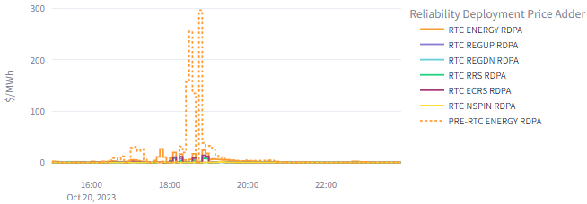
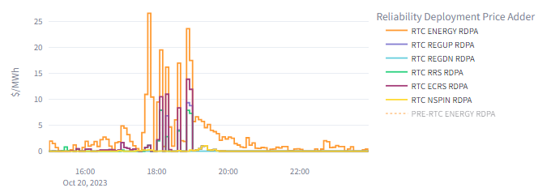
Case Study – RDPA Case (10/20/2023)
Under RTC, there is an RDPA for energy and each AS type
RTC RDPA magnitudes were much lower for this day
Same graph without showing
pre-RTC RDPA
Notes:
Pre-RTC RPDA is as high as $296.72/MWh
RTC Energy RDPA is as high as $26.57/MWh
Highest RTC AS RDPA is $13.88/MWh (ECRS)

Slide 16
Appendix

Slide 17
Case Study – Congestion Case (07/10/2023)
A key benefit of RTC is the reallocation of ancillary services which can help reduce congestion. This behavior is illustrated in the figure below.

