Slide 1
Update on Credit System Enhancements
Maruthi Gaddam
ERCOT Credit System Lead Analyst
ERCOT Public
October 23, 2024

Slide 2
CMM System and Report Enhancements in December 2024
Starting mid December 2024, ERCOT will implement the following changes:
1) NPRR1184 will be fully implemented, specifically the following parts of Section 16 of the Protocols will be “unboxed”:
16.11.3 (1) (c) (iii) Alternative Means of Satisfying ERCOT Creditworthiness Requirements
16.11.4.7 (2) and (3) Credit Monitoring and Management Reports
As a result, ERCOT market participants will be able to see the following reports on MIS:
Collateral History and Interest – Annual
Collateral History and Interest – Monthly
2) Letter of Credit (LC) and Surety Bond (SB) – Add/Amend/Terminate Email Notifications
Automated Emails to all CP Credit contacts will be sent whenever there is a change in LC/SB postings, including addition/acceptance, amendment or termination.
3) ACL Report Changes
Daily ACL reports will list Letters of Credit / Surety Bonds with the respective current balances for each instrument.

Slide 3
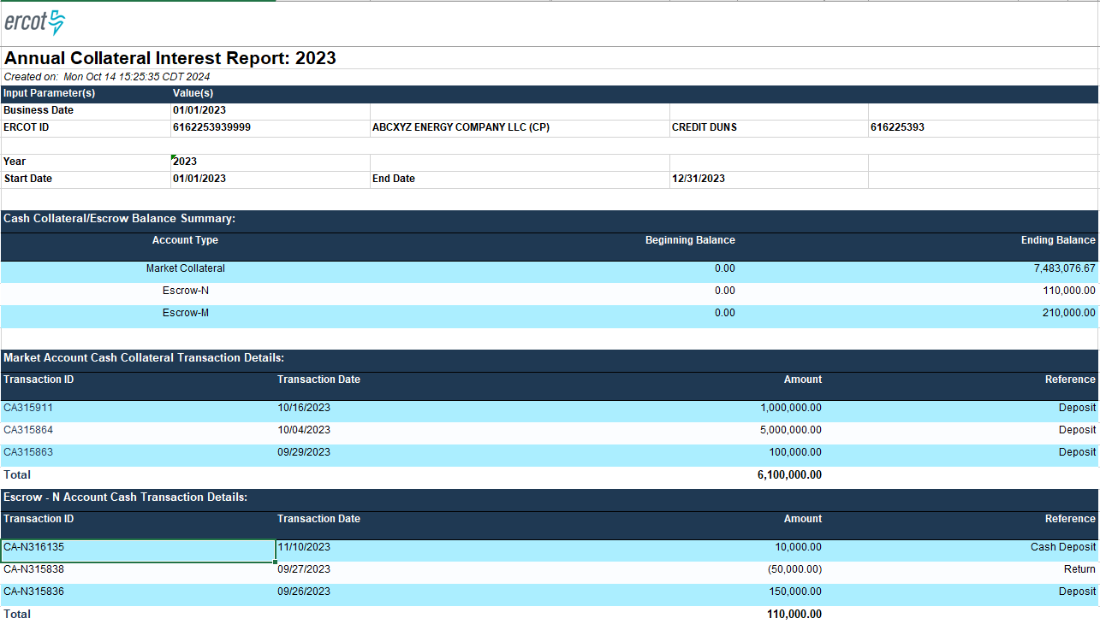
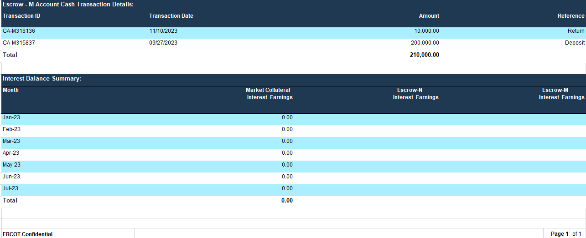
Upcoming CMM Report Enhancements – Sample Report
Collateral History and Interest Reports
* This is a draft representation of report to highlight information captured and final format may be different

Slide 4
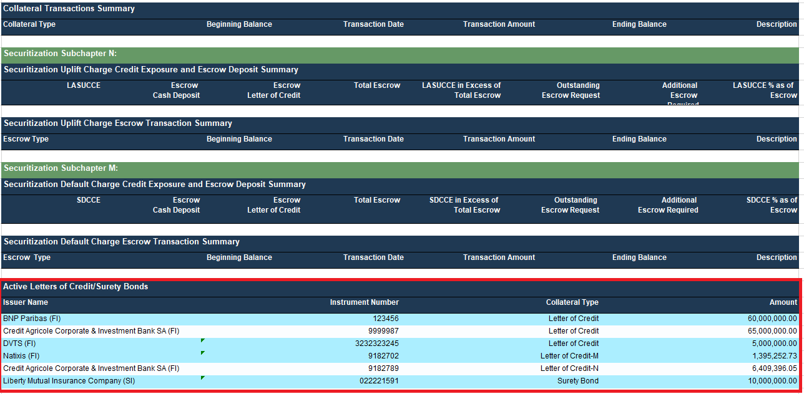
Upcoming CMM Report Enhancements – Sample
ACL Report - New section for LC/SBs will be added
* This is a draft representation of report to highlight information captured and final format may be different

