Slide 1
NERC EMSWG Update
Wei Qiu, NERC EA
ERCOT TWG Conference Call
October 24, 2024

Slide 2
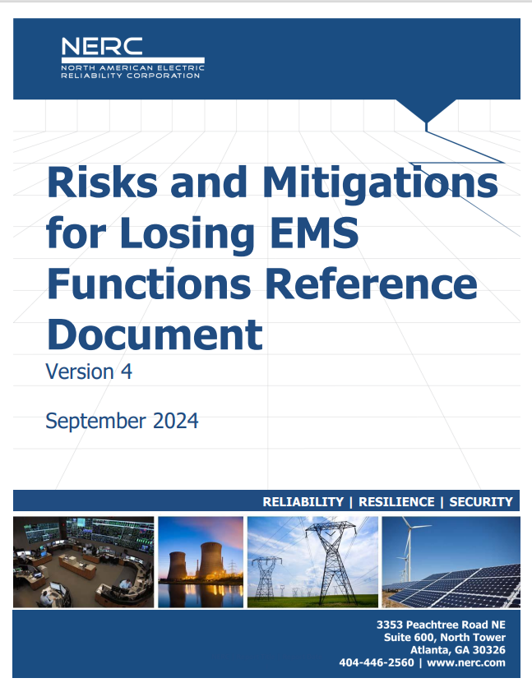
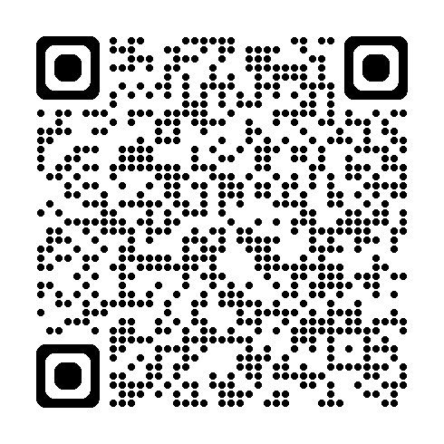
EMS Reference Document
Reference Document - Risks and Mitigations for Losing EMS Functions Reference Document (2024) – Posted on the NERC website
Risks and Mitigations for Losing EMS Functions (nerc.com)

Slide 3
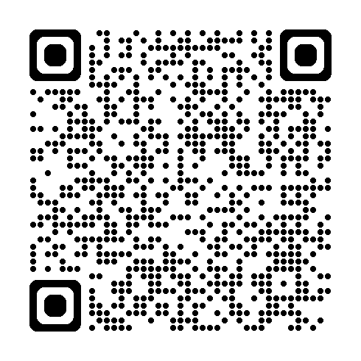
2024 MSA Conference
2024 Monitoring and Situational Awareness Technical Conference
10/8-10/9 at RF in Cleveland, OH
70 attendees from 34 Companies
Presentations_MSA_Conference_2024.pdf (nerc.com)

Slide 4
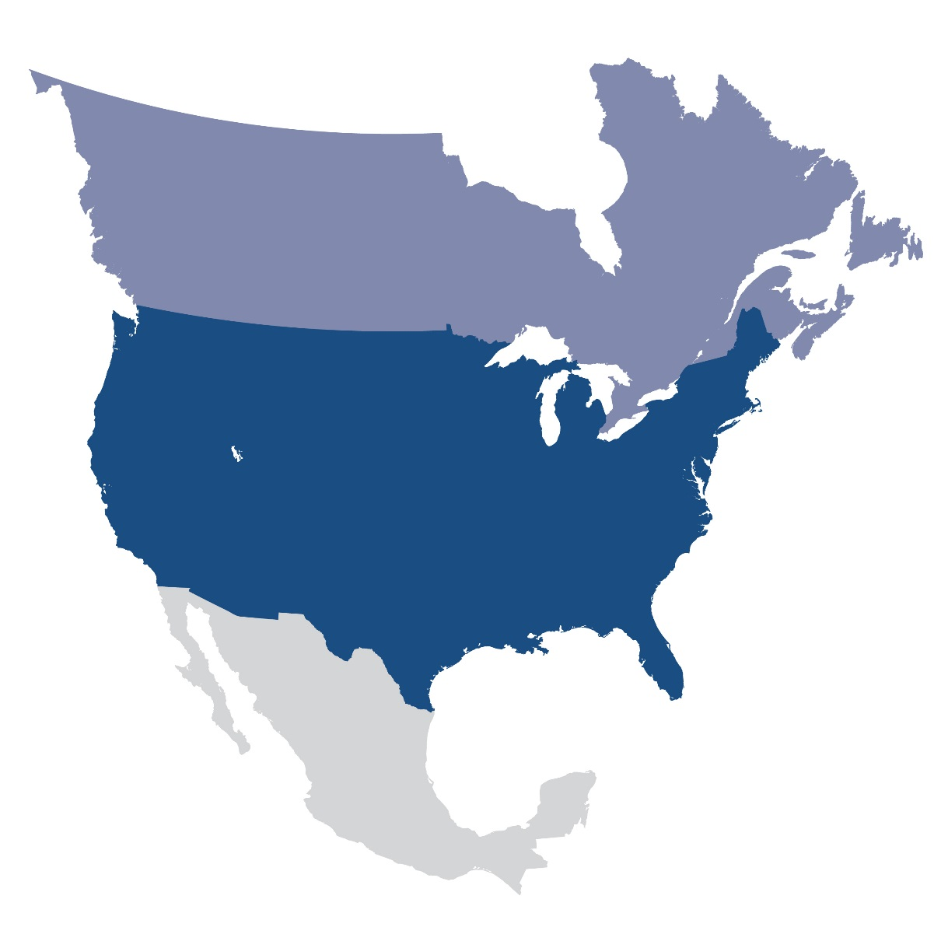
Questions and Answers
Contact Information:
wei.qiu@nerc.net

