Slide 1
Credit Exposure Update
Market Credit Work Group
ERCOT Public
October 23, 2024

Slide 2
Monthly Highlights: September 2024 – October 2024
Market-wide average Total Potential Exposure (TPE) remained relatively flat at $1.73 billion in October 2024
Real-time and day-ahead prices remained relatively flat
Discretionary Collateral is defined as Secured Collateral in excess of TPE,CRR Locked ACL and DAM Exposure
Average Discretionary Collateral slightly dropped from $3.92 billion in September 2024 to $3.82 billion in October 2024
No unusual collateral call activity

Slide 3
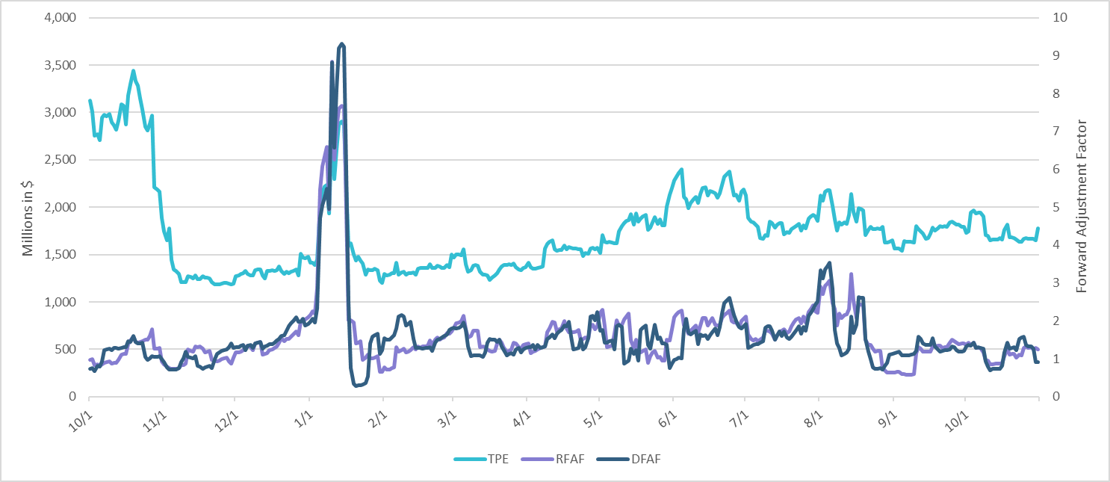
TPE and Forward Adjustment Factors: October 2023 – October 2024

Slide 4
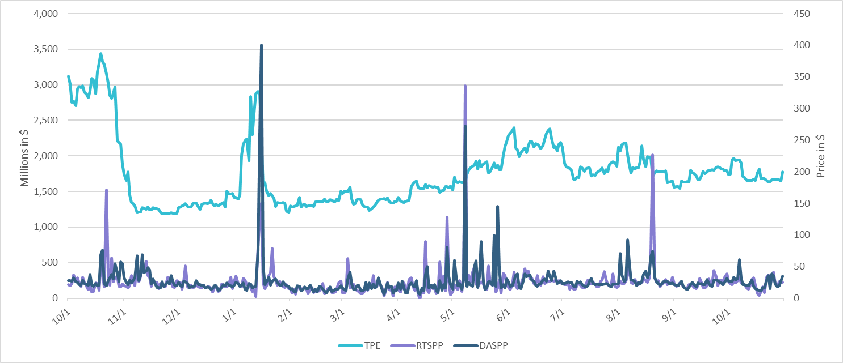
TPE/Real-Time & Day-Ahead Daily Average Settlement Point Prices for HB_NORT:H October 2023 – October 2024

Slide 5
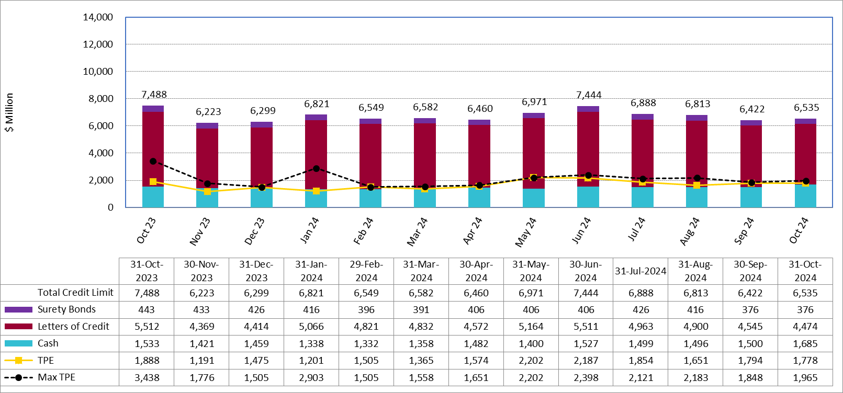
Available Credit by Type Compared to Total Potential Exposure (TPE): October 2023 – October 2024
Numbers are as of month-end except for Max TPE
Max TPE is the highest TPE for the corresponding month

Slide 6
Issuer Credit Limits vs Total LC Amounts Per Issuer: End-October 2024
As of October 31, 2024
There are a total of 38 banks that have issued LCs.

Slide 7
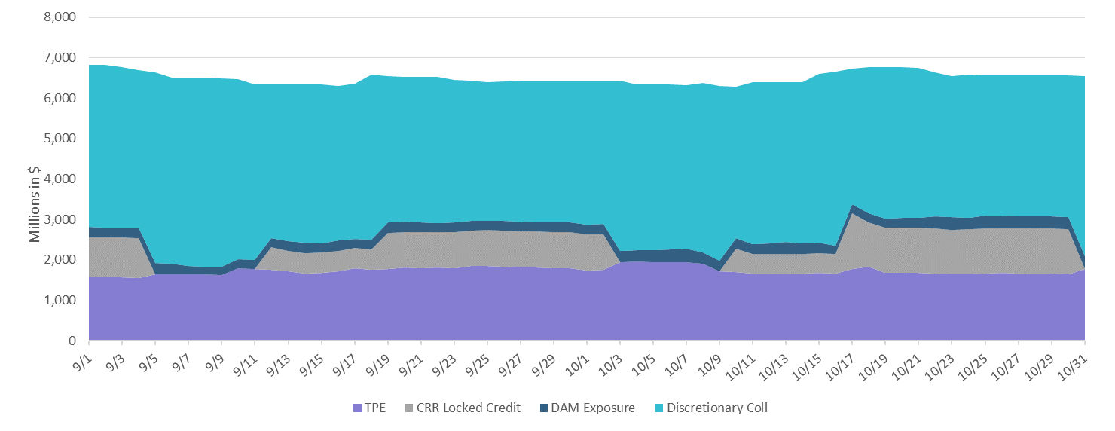
Discretionary Collateral September 2024 – October 2024

Slide 8
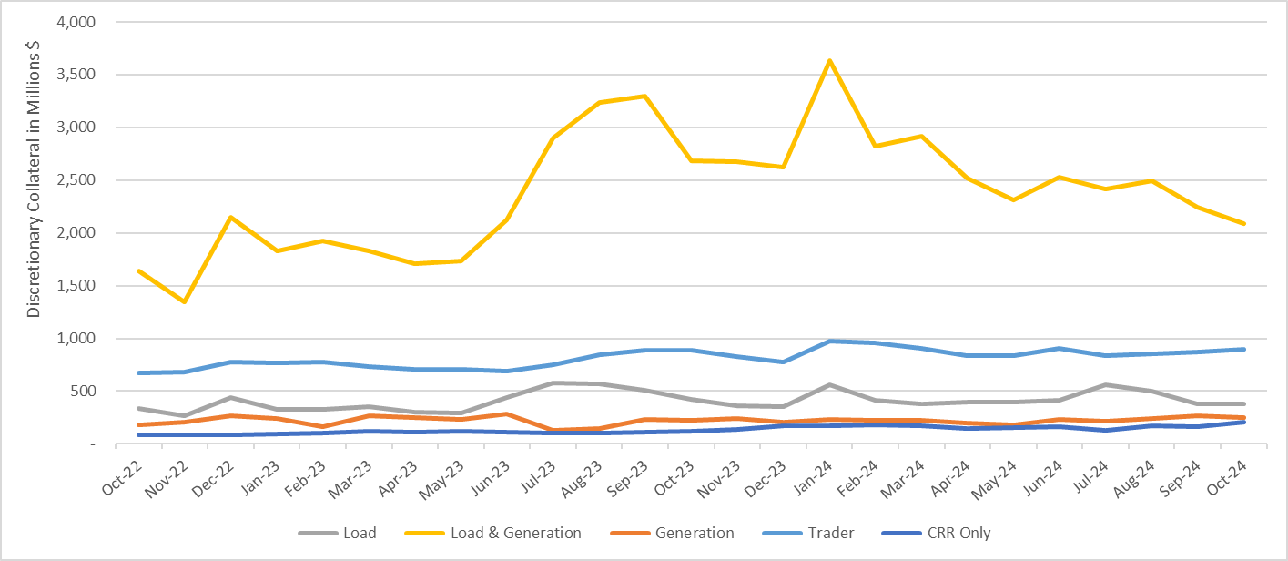
Discretionary Collateral by Market Segment October 2022 - October 2024
* Discretionary Collateral adjusted to exclude short pay amounts eliminating data skew

Slide 9
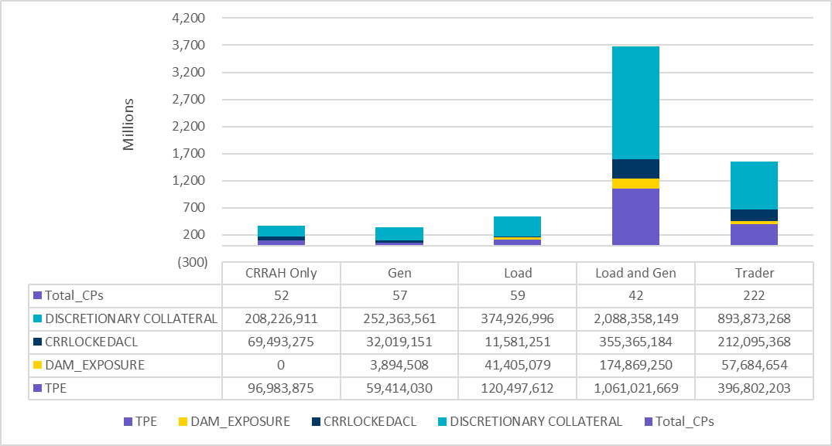
TPE and Discretionary Collateral by Market Segment - October 2024
Load and Generation entities accounted for the largest portion of discretionary collateral

Slide 10
TPEA Coverage of Settlements September 2023 - September 2024
Invoice Exposure | Historical | Future
Existing Invoice Exposure | RTLCNS + UDAA | M1 Days (including current day) Forward Charge Invoice Amounts
New Invoice Exposure | 7 Days Back Net Invoice Amounts (Charges & Credits) | M1 Days (including current day) Forward Net Invoice Amounts (Charges & Credits); Excluding: 1) Securitization Invoices; 2) CRR Auction Invoices; and 3) Subchapter N Funds Distribution Invoice
TPEA closely approximates actual/invoice exposure

Slide 11
TPEA Coverage of Settlements September 2023 - September 2024
Invoice Exposure | Historical | Future
Existing Invoice Exposure | RTLCNS + UDAA | M1 Days (including current day) Forward Charge Invoice Amounts
New Invoice Exposure | 7 Days Back Net Invoice Amounts (Charges & Credits) | M1 Days (including current day) Forward Net Invoice Amounts (Charges & Credits); Excluding: 1) Securitization Invoices; 2) CRR Auction Invoices; 3) Subchapter N Funds Distribution Invoice
*TPEA exceeds invoice exposure

Slide 12
TPEA Coverage of Settlements September 2023 - September 2024
Invoice Exposure | Historical | Future
Existing Invoice Exposure | RTLCNS + UDAA | M1 Days (including current day) Forward Charge Invoice Amounts
New Invoice Exposure | 7 Days Back Net Invoice Amounts (Charges & Credits) | M1 Days (including current day) Forward Net Invoice Amounts (Charges & Credits); Excluding: 1) Securitization Invoices; 2) CRR Auction Invoices; 3) Subchapter N Funds Distribution Invoice
Invoice exposure generally exceeds TPEA

Slide 13
TPEA Coverage of Settlements September 2023 - September 2024
Invoice Exposure | Historical | Future
Existing Invoice Exposure | RTLCNS + UDAA | M1 Days (including current day) Forward Charge Invoice Amounts
New Invoice Exposure | 7 Days Back Net Invoice Amounts (Charges & Credits) | M1 Days (including current day) Forward Net Invoice Amounts (Charges & Credits); Excluding: 1) Securitization Invoices; 2) CRR Auction Invoices; 3) Subchapter N Funds Distribution Invoice
*TPEA generally exceeds invoice exposure

Slide 14
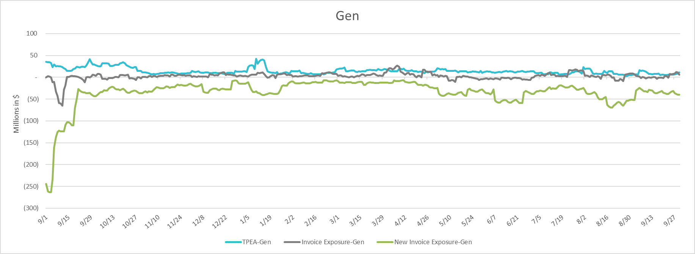
TPEA Coverage of Settlements September 2023 - September 2024
Invoice Exposure | Historical | Future
Existing Invoice Exposure | RTLCNS + UDAA | M1 Days (including current day) Forward Charge Invoice Amounts
New Invoice Exposure | 7 Days Back Net Invoice Amounts (Charges & Credits) | M1 Days (including current day) Forward Net Invoice Amounts (Charges & Credits); Excluding: 1) Securitization Invoices; 2) CRR Auction Invoices; 3) Subchapter N Funds Distribution Invoice
* TPEA generally exceeds Invoice exposure

Slide 15
TPEA Coverage of Settlements September 2023 - September 2024
Invoice Exposure | Historical | Future
Existing Invoice Exposure | RTLCNS + UDAA | M1 Days (including current day) Forward Charge Invoice Amounts
New Invoice Exposure | 7 Days Back Net Invoice Amounts (Charges & Credits) | M1 Days (including current day) Forward Net Invoice Amounts (Charges & Credits); Excluding: 1) Securitization Invoices; 2) CRR Auction Invoices; 3) Subchapter N Funds Distribution Invoice
*TPES exceeds actual/invoice exposure

Slide 16
Questions

