Slide 1
ERCOT Frequency Events
October 2024
ERCOT
Operations Planning
PDCWG | November 19, 2024

Slide 2
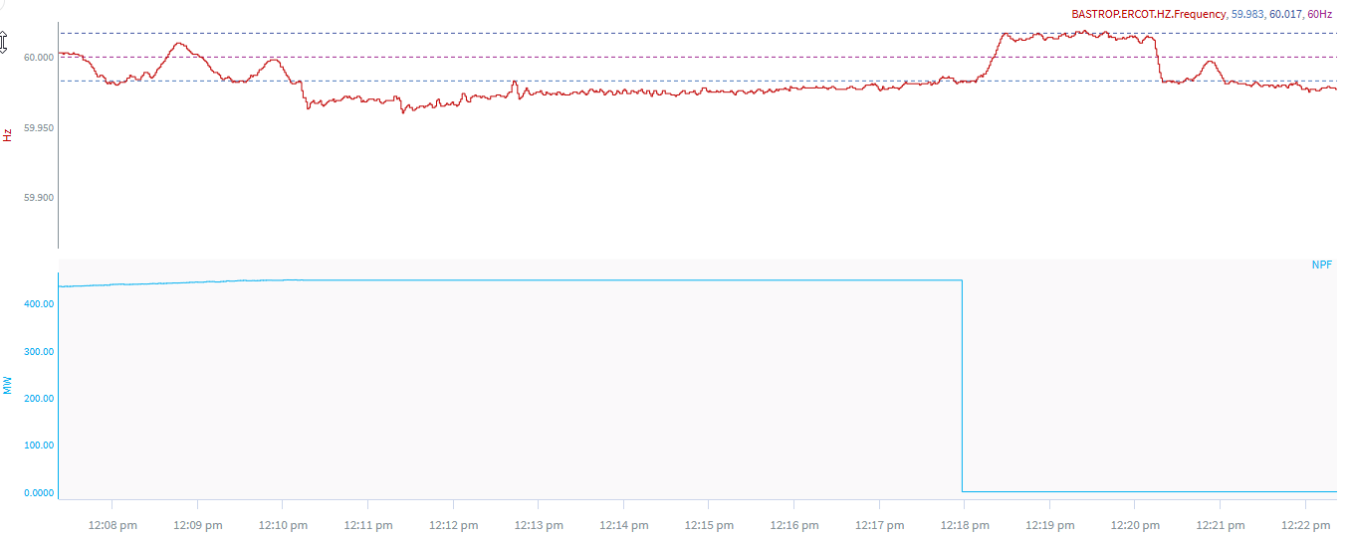
10/14/2024 12:10:11(Non-FME)
Notes:
The CC tripped in blocks for a loss of approximately 449 MW
Starting Frequency: 59.983 Hz
Minimum Frequency: 59.962 Hz
A-C Time :
Recovery Time(back to deadband): 7 minutes 30 seconds
ECRS Released: 0 MW
Trip Reason: Due to undervoltage
Contextual Information: A total of 495 MW of regulation Up was deployed during the event
No Selection Reason: unit trip is not clean and small event

Slide 3
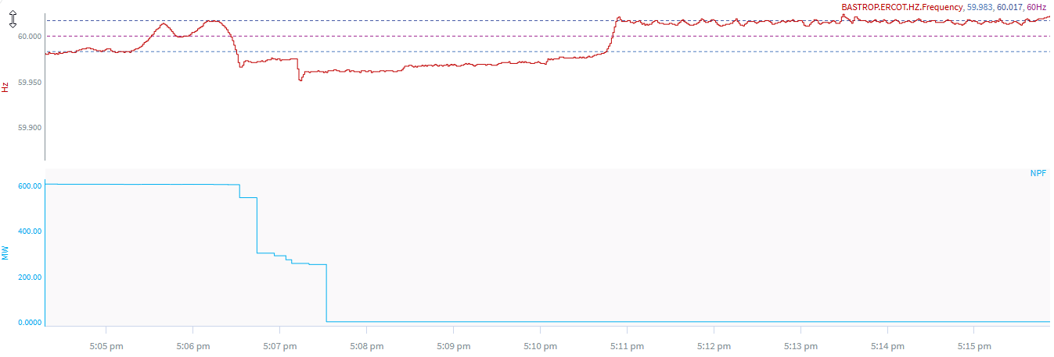
10/15/2024 17:06:19(Non-FME)
Notes:
The CC tripped in blocks for a loss of approximately 605 MW
Starting Frequency: 60.016 Hz
Minimum Frequency: 59.951 Hz
A-C Time :
Recovery Time(back to deadband): 4 minutes 26 seconds
ECRS Released: 0 MW
Trip Reason: loss of comms to fuel supply
Contextual Information: A total of 465 MW of regulation Up was deployed during the event
No Selection Reason: unit trip is not clean and small event

Slide 4
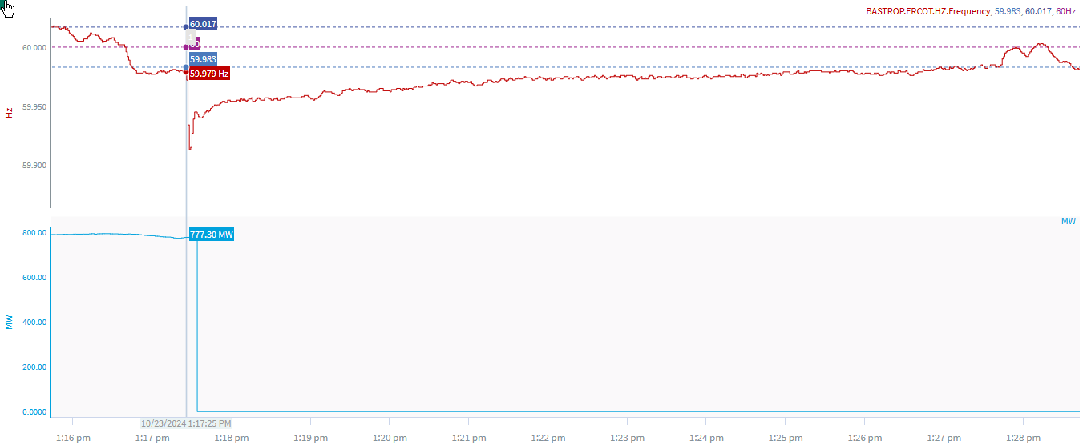
10/23/2024 13:17:25(Non-FME)
Notes:
The unit experienced runback and tripped offline while carrying ~777 MW
Starting Frequency: 59.979 Hz
Minimum Frequency: 59.915 Hz
A-C Time : 4 seconds
Recovery Time(back to deadband): 9 minutes 42 seconds
ECRS Released: 0 MW
Trip Reason: boiler air flow issues
Contextual Information: A total of 455 MW of regulation Up was deployed during the event
No Selection Reason: Frequency is outside low deadband and unit experienced runback

Slide 5
Questions?
Thank you!

