Slide 1
RTC+B Market Submissions – Digital Certificate Plan - Final
Sreenivas Badri
November 21, 2024

Slide 2
RTC+B Market Trials – Submissions Testing
This presentation covers the plan for ERCOT RTC+B Market Trial system configurations and digital certificates to support the stages of market trials and go-live to achieve the following:
Isolate initial testing path for QSE/Vendor Sandbox testing from current production
Minimize risk of RTC+B market submissions impacting current production
Start
03/2025
Start
05/2025
Start
07/2025
Start
09/2025
Go-Live
12/5/25*
Feb 2025
Feb 2025
Mar 2025
Apr 2025
May 2025
June 2025
July 2025
Aug 2025
Sep 2025
Oct 2025
Nov 2025
Dec 2025
Optional: RTC QSE/Vendor Developer
Submission Testing
RTC QSE
Submission Testing
Open-loop
RTC SCED
RTC Vendor
Submission Testing
RTC QSE
Submission Testing
Open-loop
RTC SCED
Ongoing Open-Loop
& Periodic Closed-loop SCED/LFC
Ongoing Open-Loop
& Periodic Closed-loop SCED/LFC
* Go-Live date reflects 12/5/2025 as first Operating Day
where 12/4/2025 is planned software migration.

Slide 3
RTC+B Market Submissions - Systems configurations
Start
03/2025
Start
05/2025
Start
07/2025
Start
09/2025
Go-Live
12/5/25*
Feb 2025
Mar 2025
Apr 2025
May 2025
June 2025
July 2025
Aug 2025
Sep 2025
Oct 2025
Nov 2025
Dec 2025
Optional: RTC QSE/Vendor Developer
Submission Testing
RTC QSE
Submission Testing
Open-loop
RTC SCED
Ongoing Open-Loop
& Periodic Closed-loop SCED/LFC
Certificate: Current MOTE
Env: ERCOT RTC Market Trial
URL: RTC MIS MOTE URL
Certificate: Current Production
Env: ERCOT RTC Market Trial
URL: RTC MIS Market Trial
Cert: Production
Env: Prod
URL: MIS Prod
QSE/Vendor developer can use MOTE certificates & RTC MIS MOTE API URL to test the submissions until end of submission testing phase (end of June) as needed. At the start of the Open Loop testing, RTC MOTE MIS URLs will be disabled.
URL links: RTC MOTE and Market Trial URL links to be used for MMSUI, OSUI and API submissions. Actual links will be communicated to QSEs by Feb 2025.
For notifications/responses to MPs from RTC Market Trials environment, MP will need to provide the listener URL to ERCOT

Slide 4
RTC+B Market Submissions - Systems configurations
Currently,
 | Digital Certificate | MMSUI/OSUI | API
Current MOTE | Current MOTE | MOTE MIS URL: testmis.ercot.com/mmsui testmis.ercot.com/osui | MOTE MIS API URL: testmisapi.ercot.com /2007-08/Nodal/eEDS/EWS/ testmisapi.wan.ercot.com:9443/2007-08/Nodal/eEDS/EWS/
Current Prod | Current Production | PROD MIS URL: mis.ercot.com/mmsui mis.ercot.com/osui | PROD MIS API URL: misapi.ercot.com/2007-08/Nodal/eEDS/EWS/ api.wan.ercot.com:8443/2007-08/Nodal/eEDS/EWS/
RTC+B Market Trials and Go-live
RTC Phase | Digital Certificate | MMSUI/OSUI URL | API URL
Vendor/QSE Submissions Testing | Current MOTE | RTC MOTE MIS URL | RTC MOTE API/WAN URL
Open Loop and Closed Loop Testing | Current Production | RTC Market Trial URL | RTC Market Trial API/WAN URL
From RTC Go-live onwards | Current Production | Current Prod MIS URL mis.ercot.com/mmsui mis.ercot.com/osui | New Production API/WAN URL

Slide 5
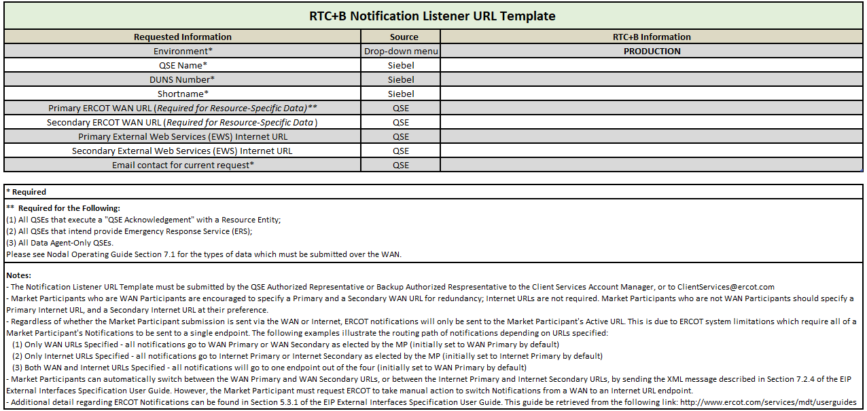
Market Communication
ERCOT RTC+B API, Market Manager UI and Outage Scheduler UI actual URLs will be communicated to Market Participants in January through Market Notice.
ERCOT Client Services Account Manager will utilize existing process to request QSEs RTC+B notification listener URLs starting from February.

