Slide 1
ERCOT ELCC Study Update
Kevin Carden

Slide 2
Purpose

Slide 3
Purpose
To generate ELCCs by technology for 2 non-dispatchable technologies (e.g. 0-60GW Solar PV, 0-60GW Wind) and unlimited combinations of storage duration (X GW of 2 Hr Battery, Y GW of 4 Hr Battery, Z GW of 8 Hr Battery, etc.)
Approach allows the user to define any given portfolio within a specified range
This approach avoids intractable number of simulations to generate ELCCs

Slide 4
Simulated Surface
Simplify problem by leveraging SERVM to produce numerous LOLE Events for combinations of solar and wind at 0.1 LOLE, and utilizing out of model approach to establish storage value for each portfolio
 |  | Wind MW
 |  | 0 | 30,000 | 35,000 | 40,000 | 45,000 | 50,000 | 55,000 | 60,000
Solar MW | 0
 | 20,000
 | 25,000
 | 30,000
 | 35,000
 | 40,000
 | 45,000
 | 50,000
 | 55,000
 | 60,000

Slide 5
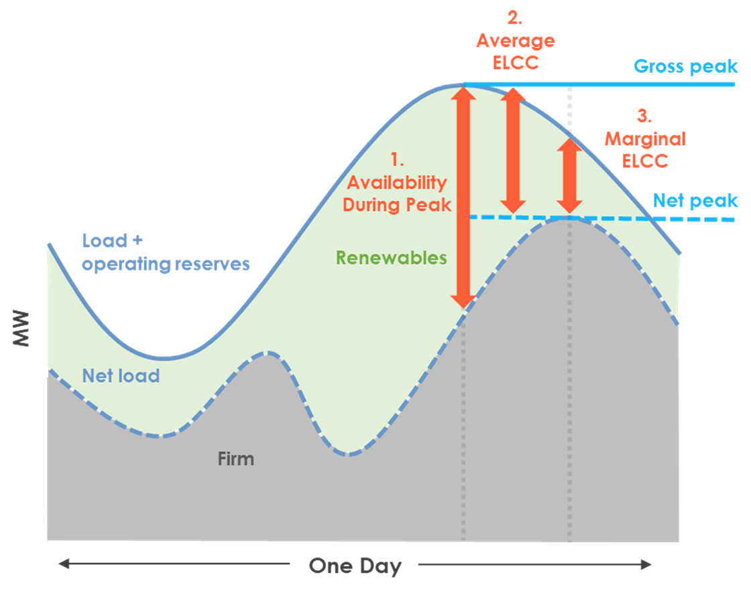
Marginal Versus Average ELCC
For each solar and wind combination at 0.1 LOLE, and for each day with any EUE, the peak shaving capability of storage technology/ technologies can be calculated in Excel, then calibrated to SERVM simulations
Adapted from:
A review of the latest developments in ISO/RTOs across the country Zachary Ming, E3
https://www.naruc.org/core-sectors/electricity-energy/bulk-power-system/bulk-power-system-learning-modules/

Slide 6
Risk Period Mapping
Risk periods were an output of the model; NOT a predefined input to the study
Winter risk did not shift between gross load and net load
Gross Load – Afternoon Risk Period – Average ELCC
Net Load – Evening Risk Period – Marginal ELCC

Slide 7
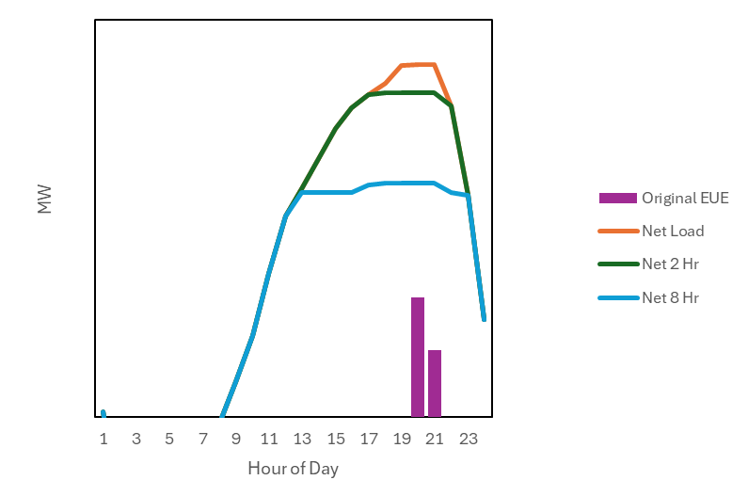
ELCC Calculation Strategy
For each solar and wind combination at 0.1 LOLE*, and for each day with any EUE, the peak shaving capability of storage technology/ technologies can be calculated in Excel, then calibrated to SERVM simulations
*0.1 LOLE is a proxy for the reliability standard

Slide 8
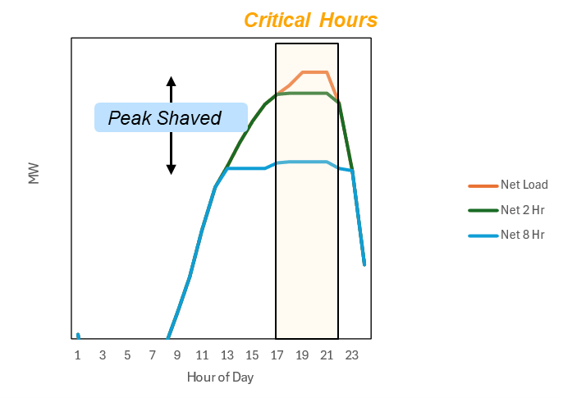
Storage ELCC Quantification
Storage is used to shave the net load peak in ascending order of storage duration
Peak shaved MW for each class of duration defines its average ELCC
Resource Class | Installed MW | Total Peak Shaved (MW) | Avg ELCC (%) | Avg Output During Energy Constrained Period (MW) | Marginal ELCC (%)
All Storage | 12,000 | 10,425 | - | 10,012 | -
2 Hour | 4,000 | 2,425 | 61% | 2,012 | 50%
8 Hour | 8,000 | 8,000 | 100% | 8,000 | 100%

Slide 9
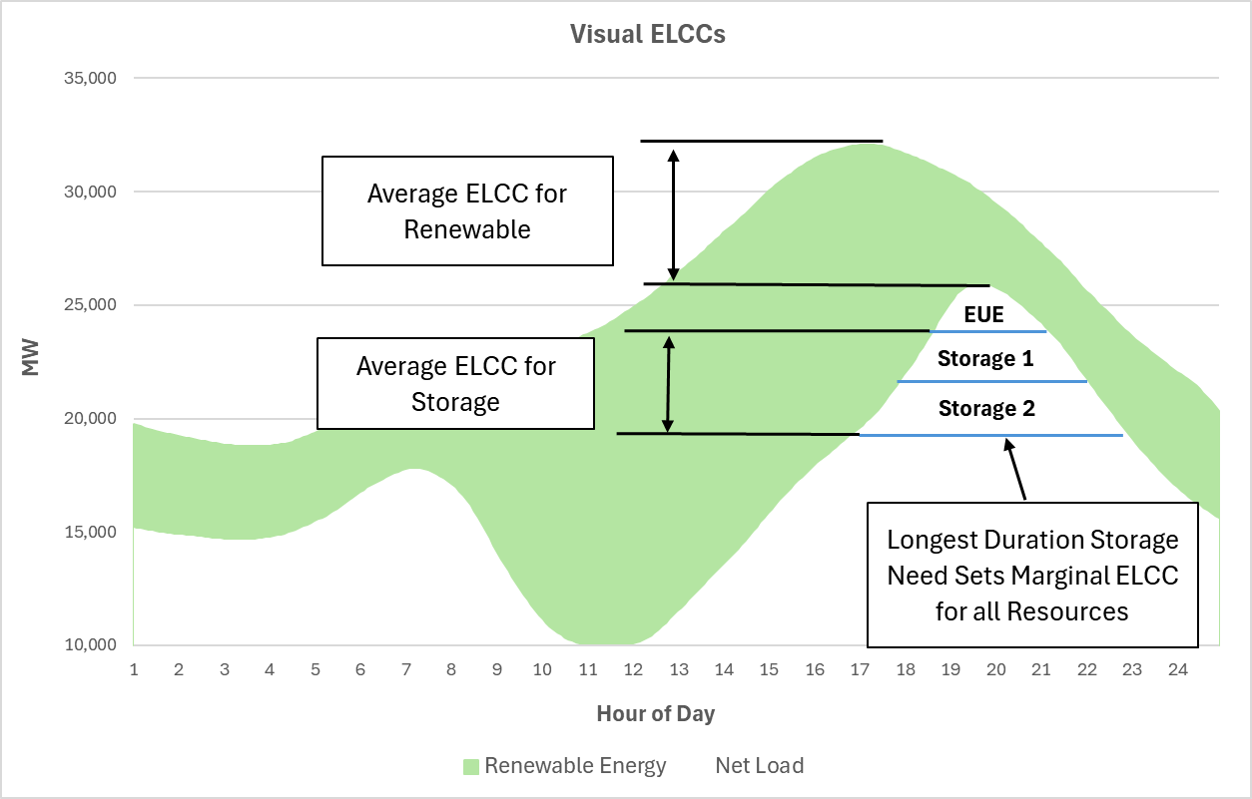
ELCC Visualization

Slide 10
ELCC Calculations
Average ELCC
Renewables
Heuristic: reduction from gross load peak to net load peak
Calculated as portfolio ELCC from SERVM simulations
Technology ELCCs allocated via integration method
Storage
Heuristic: net load peak shaving
Calculated as portfolio ELCC from analytical approach calibrated with SERVM simulations
In the case of multiple durations of storage, value can be allocated amongst durations according to each tranche’s contribution to the reduction in net load peak
Marginal ELCC
All technologies assessed at average output during storage constrained periods

Slide 11
Expected Process Summary
Portfolio
User defines Solar, Wind, Battery Penetration
Event Lookup
LOL events are pulled from corresponding solar and wind penetration cases
Storage Value
For each LOL event day, storage performs peak shaving
Storage Class
For differing storage durations assessed, average ELCC is allocated based on reduction in net load peak
Solar + Wind
Renewable average ELCC is assessed from integration method from SERVM simulations
Aggregate
Reduction in net load peak for each duration is probability weighted into one annual and/or seasonal value
Marginal ELCC
Marginal ELCC is separately calculated for storage and renewables based on output during critical hours

Slide 12
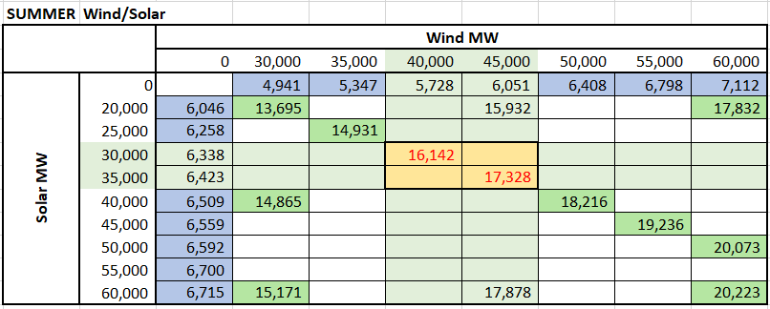
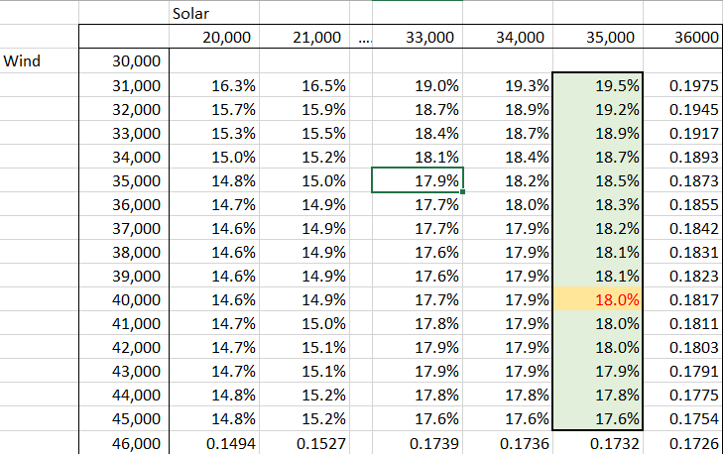
ELCC Calculator – Solar and Wind
Input CDR Capacity
Calculate Portfolio ELCC
Interpolate
Integrate Marginal ELCCs
Allocate Solar and Wind Contributions
Allocate Location-Specific Contributions

Slide 13
ELCC Calculator – Solar/Wind - Summer
ELCC Type | Technology | 2025 ELCC (%)
Portfolio ELCC | Solar – West | 36.1%
 | Solar – Other | 27.2%
Marginal ELCC | Solar – West | 7.3%
 | Solar - Other | 5.5%
ELCC Type | Technology | 2025 ELCC (%)
Portfolio ELCC | Wind - Panhandle | 33.6%
 | Wind - Coast | 30.8%
 | Wind - Other | 15.7%
Marginal ELCC | Wind - Panhandle | 17.8%
 | Wind - Coast | 16.4%
 | Wind - Other | 8.3%

Slide 14
ELCC Calculator – Solar/Wind - Winter
ELCC Type | Technology | 2025 ELCC (%)
Portfolio ELCC | Solar – West | 2.6%
 | Solar – Other | 2.0%
Marginal ELCC | Solar – West | 0.4%
 | Solar - Other | 0.3%
ELCC Type | Technology | 2025 ELCC (%)
Portfolio ELCC | Wind - Panhandle | 32.6%
 | Wind - Coast | 29.9%
 | Wind - Other | 15.2%
Marginal ELCC | Wind - Panhandle | 16.0%
 | Wind - Coast | 14.7%
 | Wind - Other | 7.5%

Slide 15
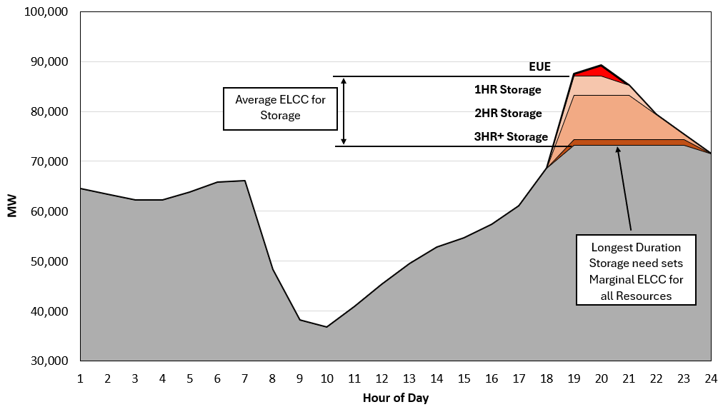
ELCC Calculator – Storage
Input CDR Capacity
Dispatch Storage in Excel Against SERVM EUE Days
Apply SERVM Calibration

Slide 16
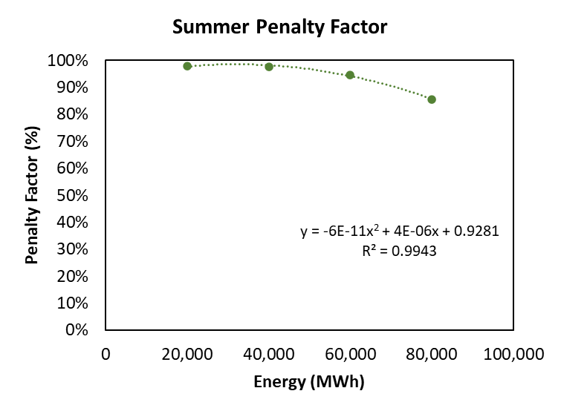
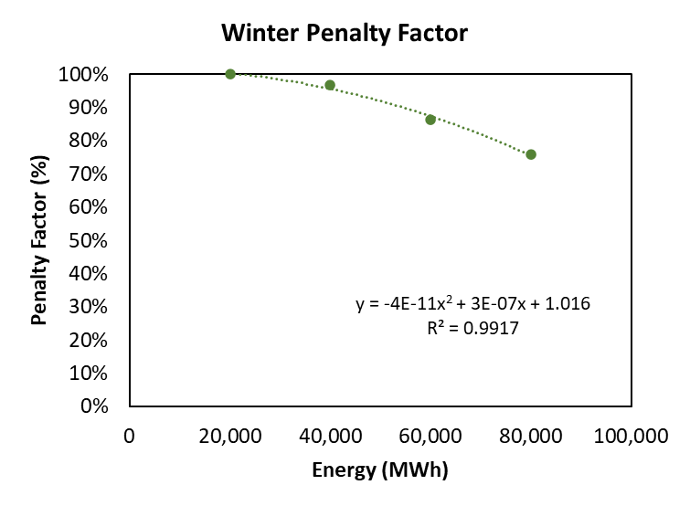
SERVM/Excel Calibration
Penalty factors were established through calibration to apply to ELCCs obtained in the Excel workbook to better match the SERVM results
Penalty factors capture both additional benefits and constraints not in Excel model
Benefits: ancillary service contribution, interactions with other resources
Constraints: Starting SOC, outage effects on other resources

Slide 17
Discussion and Observations
Approach avoids limitations seen in ELCC Surface approach (limited flexibility in selecting battery duration and combinations of batteries)
Calibrated to actual SERVM simulations
Wide range of portfolios used for calibration to ensure fidelity
Desired portfolios not included within original renewable combinations require interpolation of results

Slide 18
Results

Slide 19
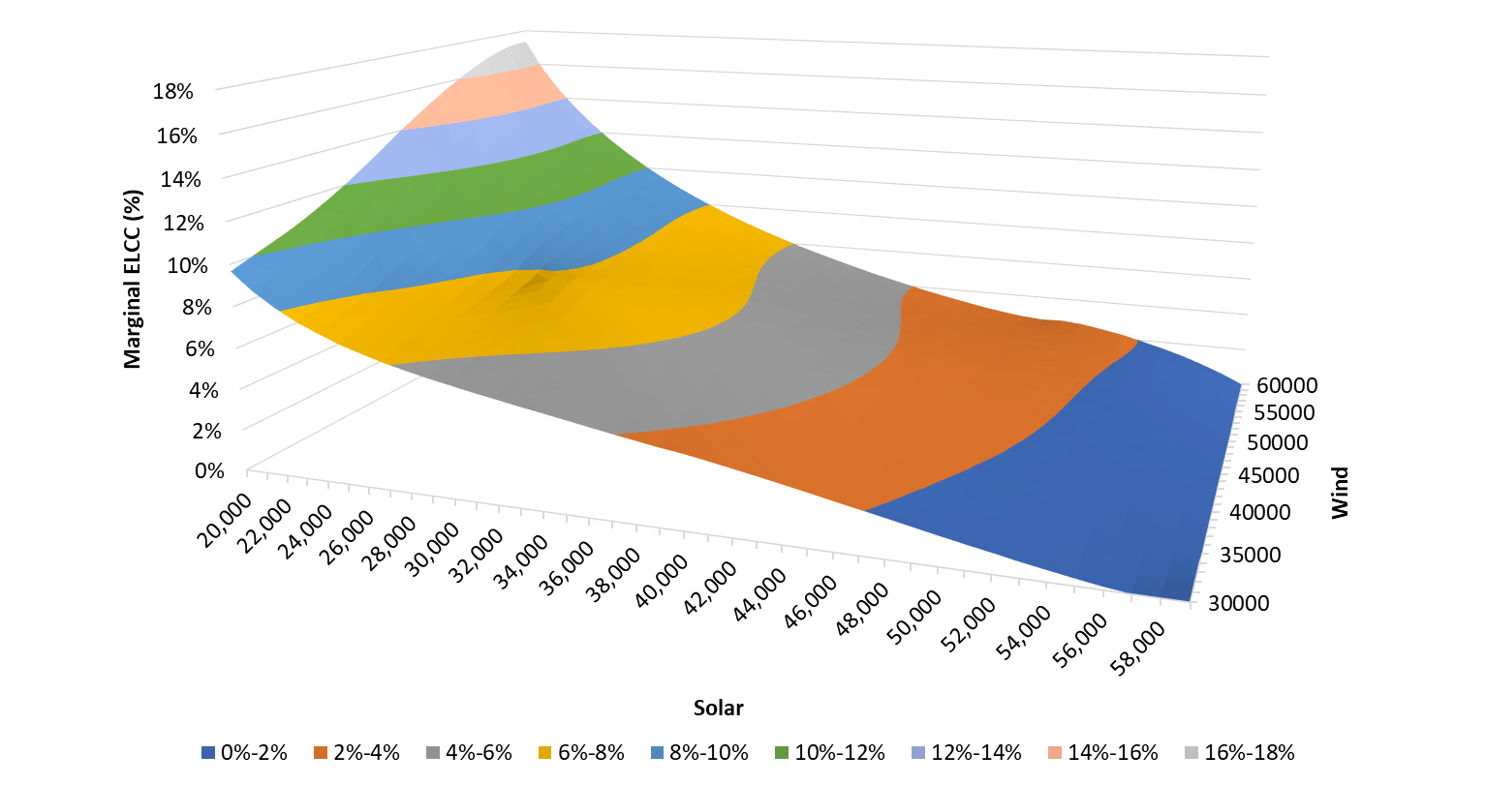
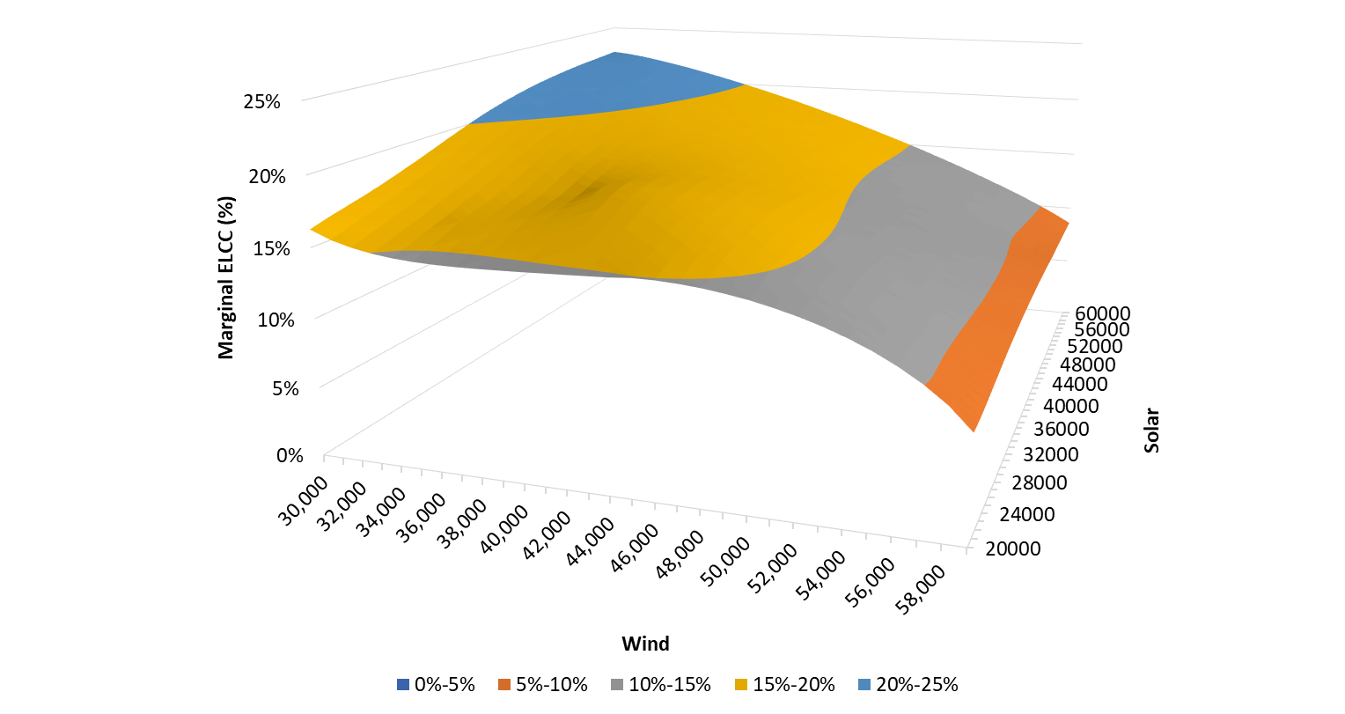
SERVM Simulation Results – Summer
Solar Marginal ELCCs
Wind Marginal ELCCs

Slide 20
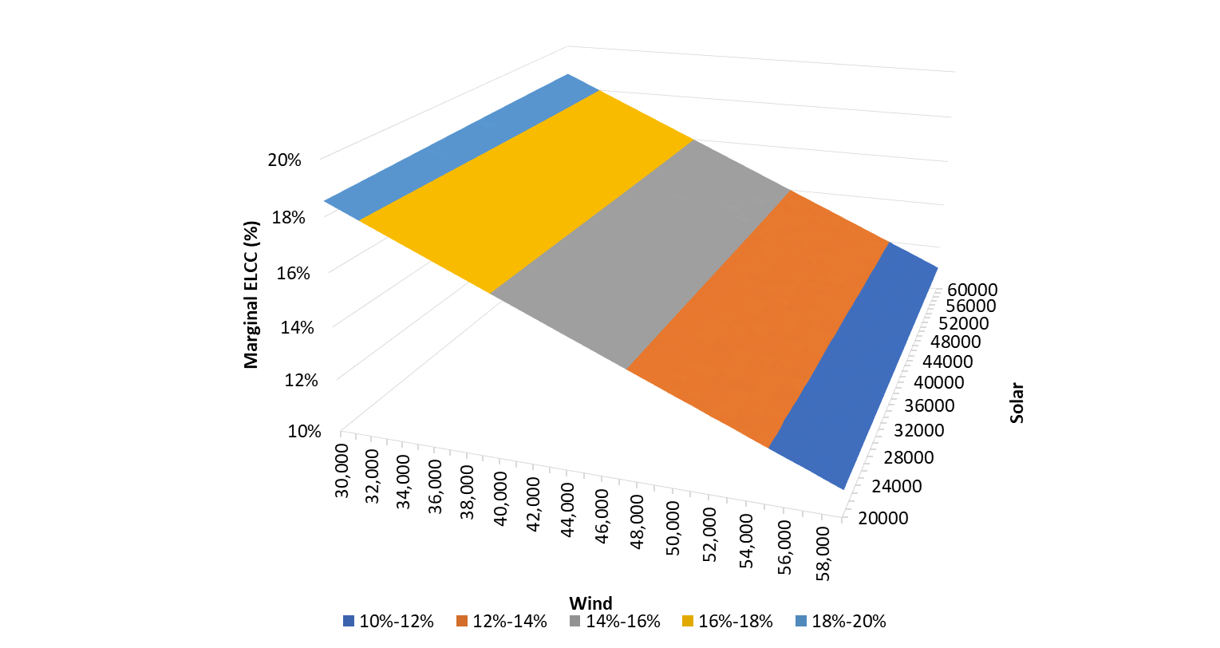
SERVM Simulation Results – Winter
Solar Marginal ELCCs
All Values <1%
Wind Marginal ELCCs

Slide 21
SERVM Simulation Results – EUE Reports
Loss of load events are pulled from all solar and wind penetration cases
Perform storage peak shaving on loss of load events

Slide 22
Locational Adjustments
Locational wind and solar ELCCs were calculated at 2025 penetrations for a 1 GW marginal unit
Wind-C
Wind-O
Wind-P
Solar-West
Solar-Other

Slide 23
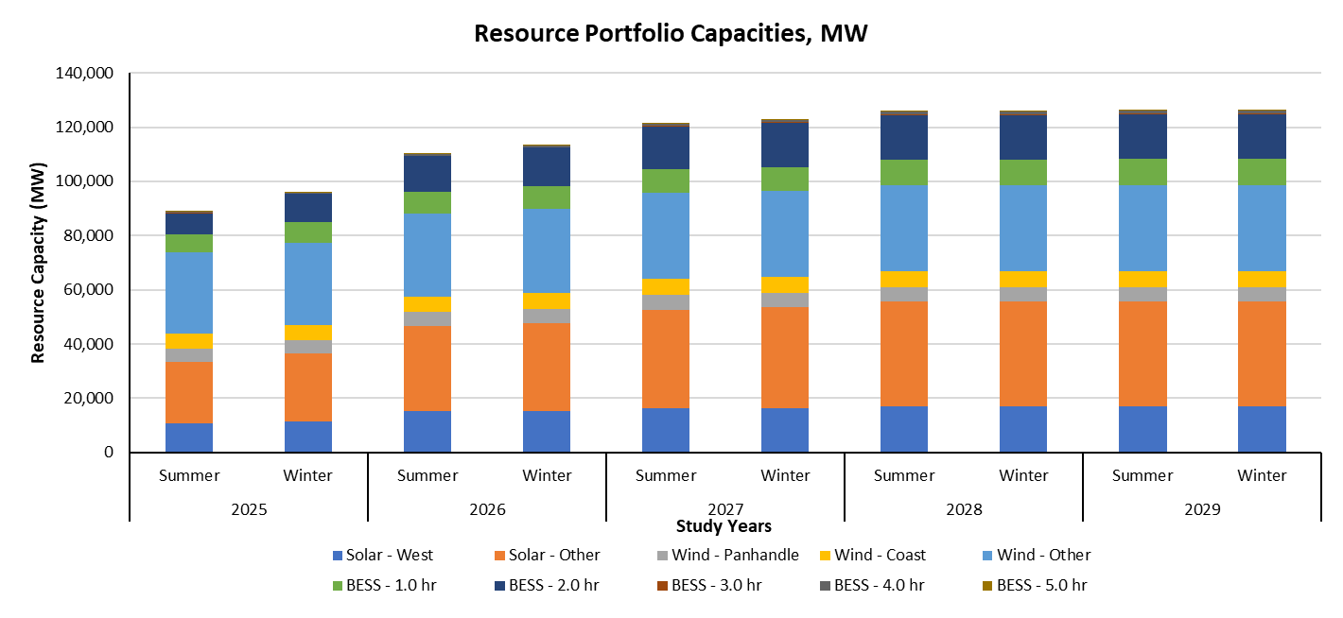
ELCC Calculator – Inputs
Inputs based on CDR capacities
1 MW is included for any storage penetration/duration combination that is without capacity in the CDR

Slide 24
ELCC Calculator – Outputs

Slide 25
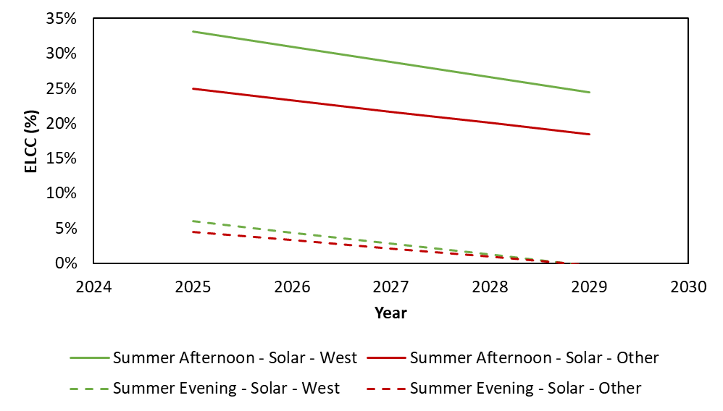
ELCC Calculator – Summer Results - Solar

Slide 26
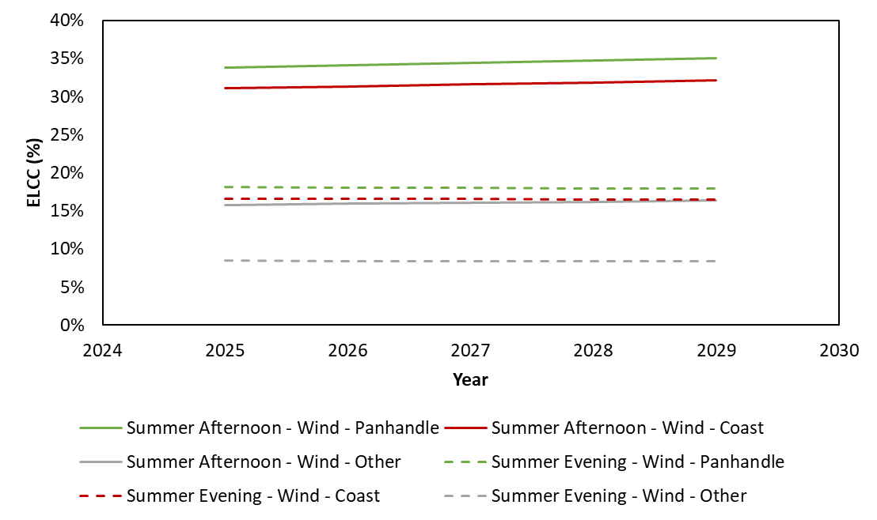
ELCC Calculator – Summer Results – Wind

Slide 27
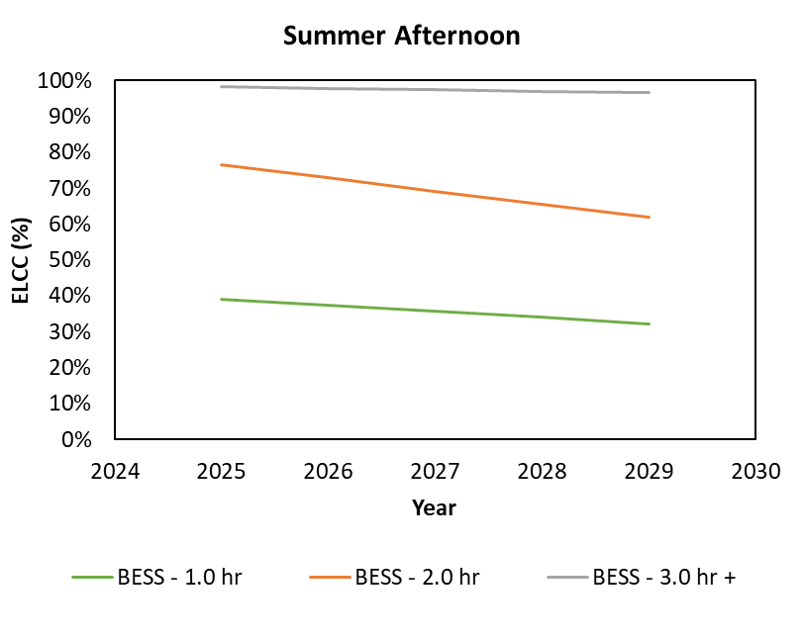
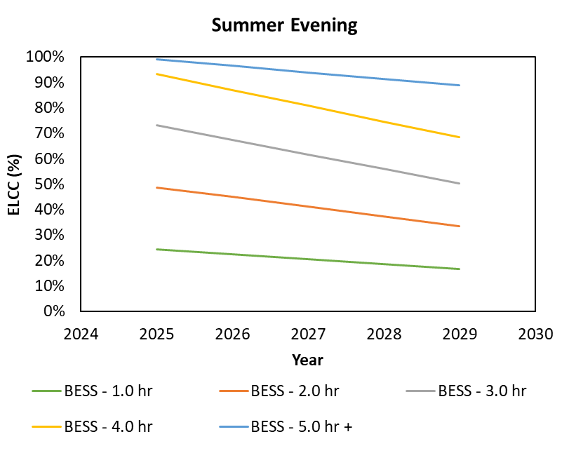
ELCC Calculator – Summer Results – Storage
All Storage ELCCs to be adjusted by EFORd

Slide 28
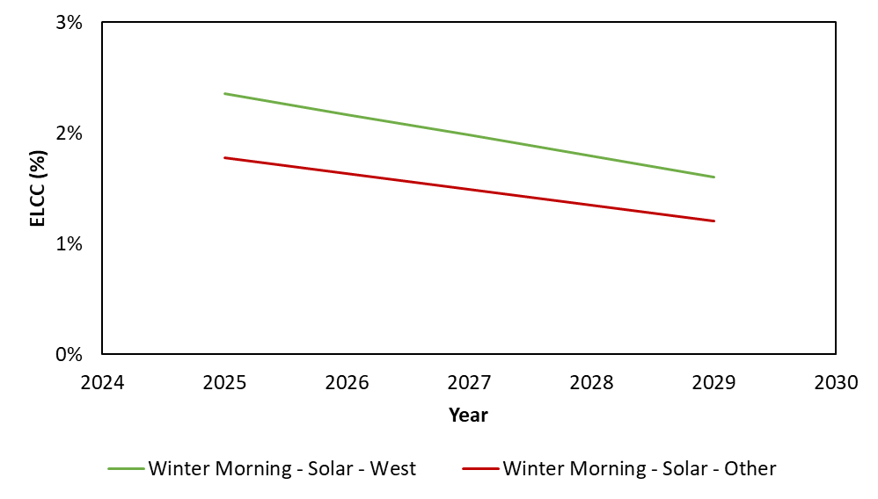
ELCC Calculator – Winter Results - Solar

Slide 29
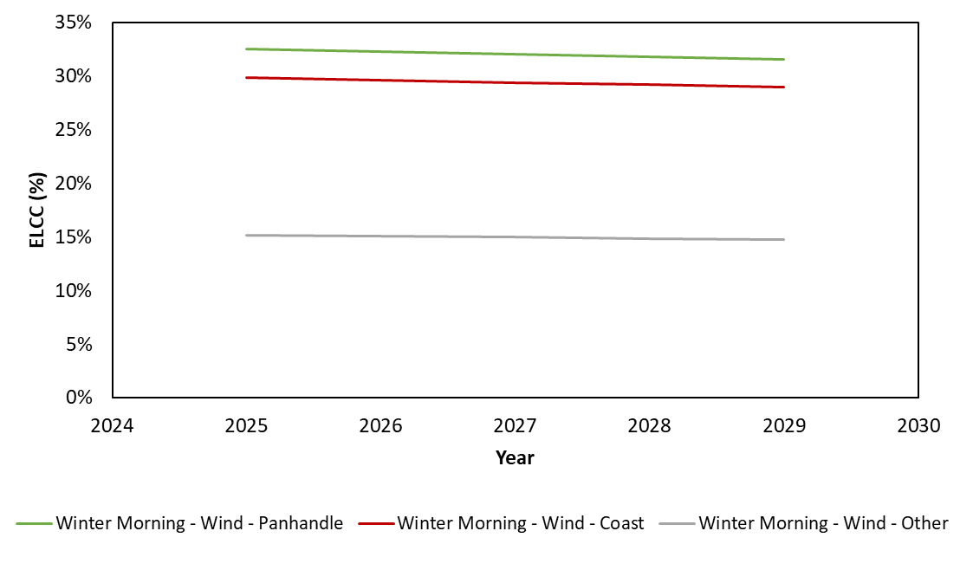
ELCC Calculator – Winter Results – Wind

Slide 30
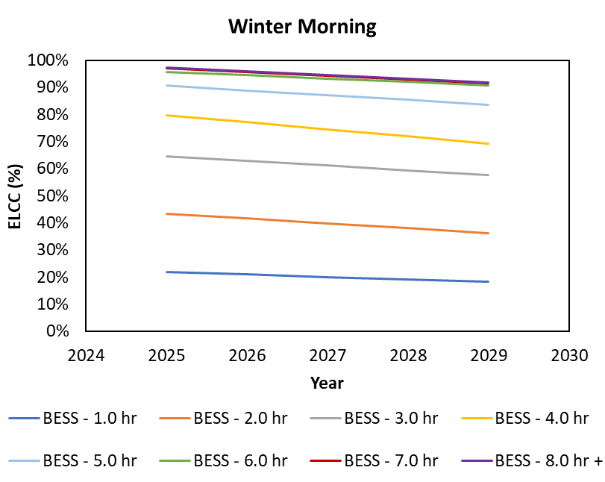
ELCC Calculator – Winter Example – Storage
All Storage ELCCs to be adjusted by EFORd

