Slide 1
Frequency Control concerns Due to poor IRR telemetry under curtailment
Luis Hinojosa
Ancillary Services & Operations Analytics
December 6, 2024
CMWG

Slide 2
SCR819 - Improving IRR Control to Manage GTC Stability Limits
SCR819 was implemented on May 31, 2024 to improve GTC management
Additional logic was implemented to instruct all Intermittent Renewable Resource (IRR) behind a binding GTC not to exceed (NTE) its Base Point.
This would apply to all IRR units behind a binding GTC with a shift factor impact greater than 2% on the GTC flow should NOT exceed their SCED BP when NTE is triggered.
With outage season now in full effect we have seen an increase in curtailment and additionally more NTE curtailments related to SCR819. These additional curtailments are now sent to a broader fleet of IRRs which in the past may not have seen curtailments.
ERCOT has observed that many of the IRRs which are now receiving curtailment flags have issues related to their Real Time Power Potential (RTPP) calculation which is sent via HSL telemetry during curtailment only.
This inaccuracy of HSL telemetry has brought on frequency control concerns as the RTPP that is being sent to ERCOT is unrealistic/undeliverable, but SCED is utilizing the telemetry to send dispatch instruction. This has lead to many dragging frequency periods, regulation exhaustion, and additional manual operator actions.
Data in the following deck will represent information related to the impact of poor telemetry into our system beginning the week of October 28th when we began seeing concerns.

Slide 3
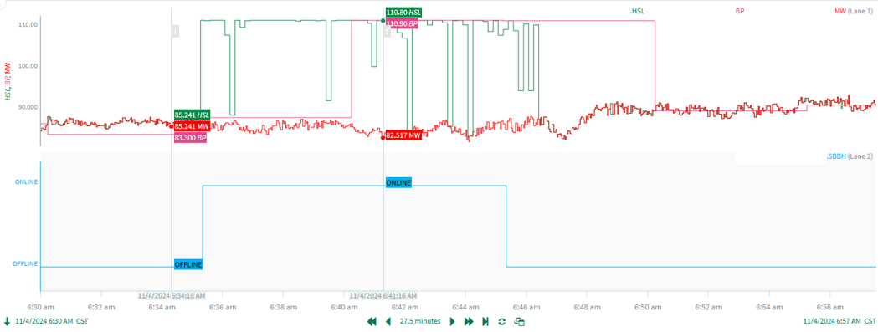
Example: Poor HSL Telemetry (Increase)
Unit is operating at 85 MW (red) and receives a curtailment signal.
HSL jumps to 110 MW (green) and SCED pick up this HSL in the next run and sends a new BP (pink) instruction
The unit is never able to respond to that new setpoint.
HSL drops after the curtailment instruction is removed.

Slide 4
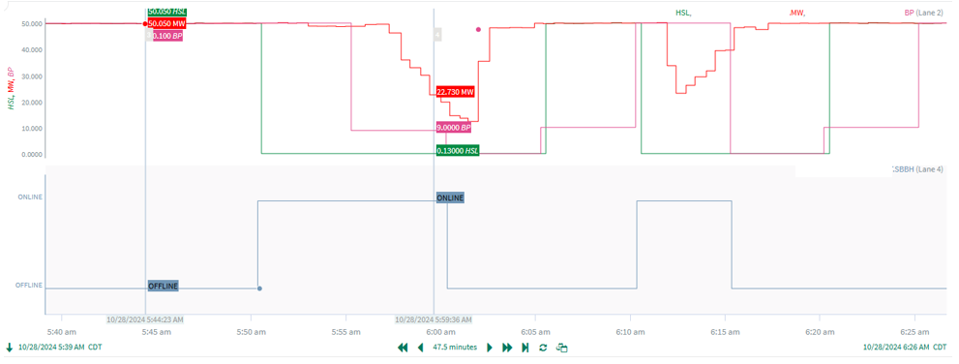
Example: Poor HSL Telemetry (Reduction)
Unit Drops its HSL to 0 (green) when they receive a curtailment signal
SCED picks up the HSL in the next run and dispatches them down and they reduce output

Slide 5
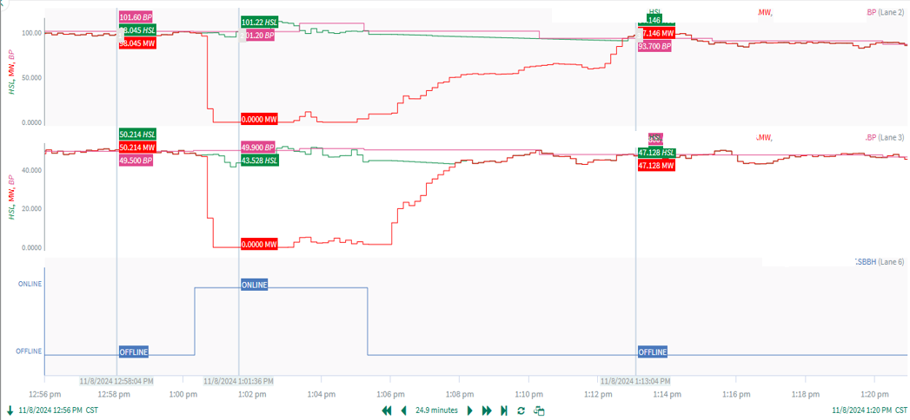
Example: Poor Curtailment Logic
Units curtail them self to 0 MW (red)when they receive an NTE instruction instead of not exceeding their BP.
We have ~150 MW of Expected Generation Deviation with these 2 units alone.

Slide 6
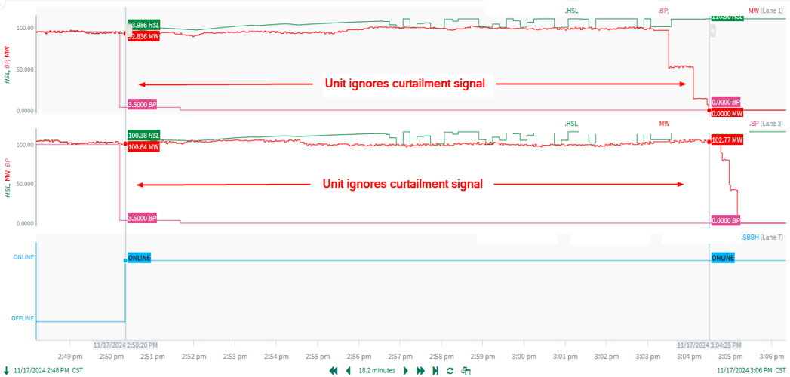
Example: Curtailment Ignored
These 2 units receive a curtailment close to 0 at 2:50pm, but ignore the dispatch for 15 mins
Approximately 200 MW of expected generation deviation
This contributed to an exceedance of a IROL for 5 mins.

Slide 7
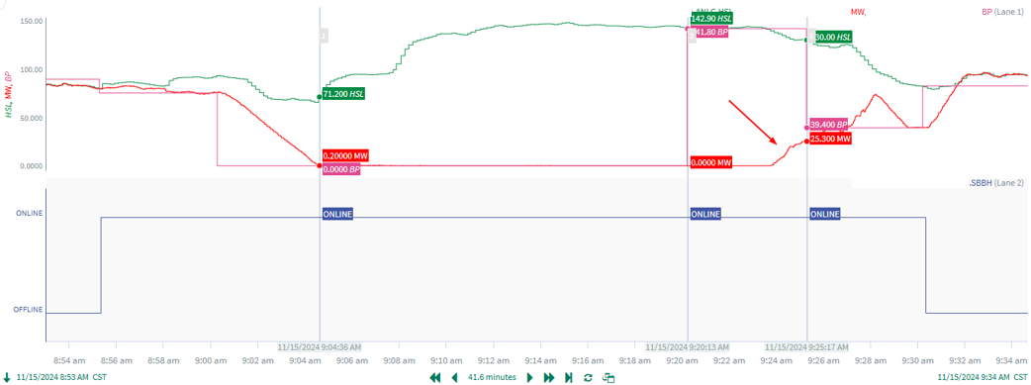
Example: No ramp after release
This unit is curtailed to 0 at 09:00
They are still curtailed but get an NTE BP of 140 MW.
Units takes roughly 3 minutes to start ramping, but never reaches 140 MW BP.

Slide 8
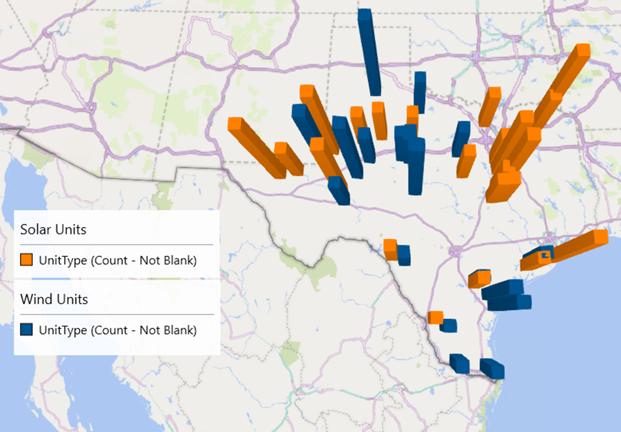
Location of Telemetry Issues
Telemetry issues are broadly spread across Texas and not associated to one particular GTC

Slide 9
RFI Summary
Ops Analysis began sending RFIs on November 1st
RFI’s have been sent to 61 Resources (55 QSEs)
As of 12/5/24:
RFI responses have been received for 58 Resources.
No response from 3 resources
Only 17 Resources have acknowledged and addressed the issue
41 Resources acknowledged, but did not address the issue or working with their OEM’s to address the issue
Ops Analysis continues to review for Resources with telemetry issues
An additional set of 70 Resources have been identified to have telemetry issues when curtailed and will need corrective actions.
Some of these units are under a QSE which already has received the previous RFI
We are preparing to reach out to those that have not had an RFI yet.

Slide 10
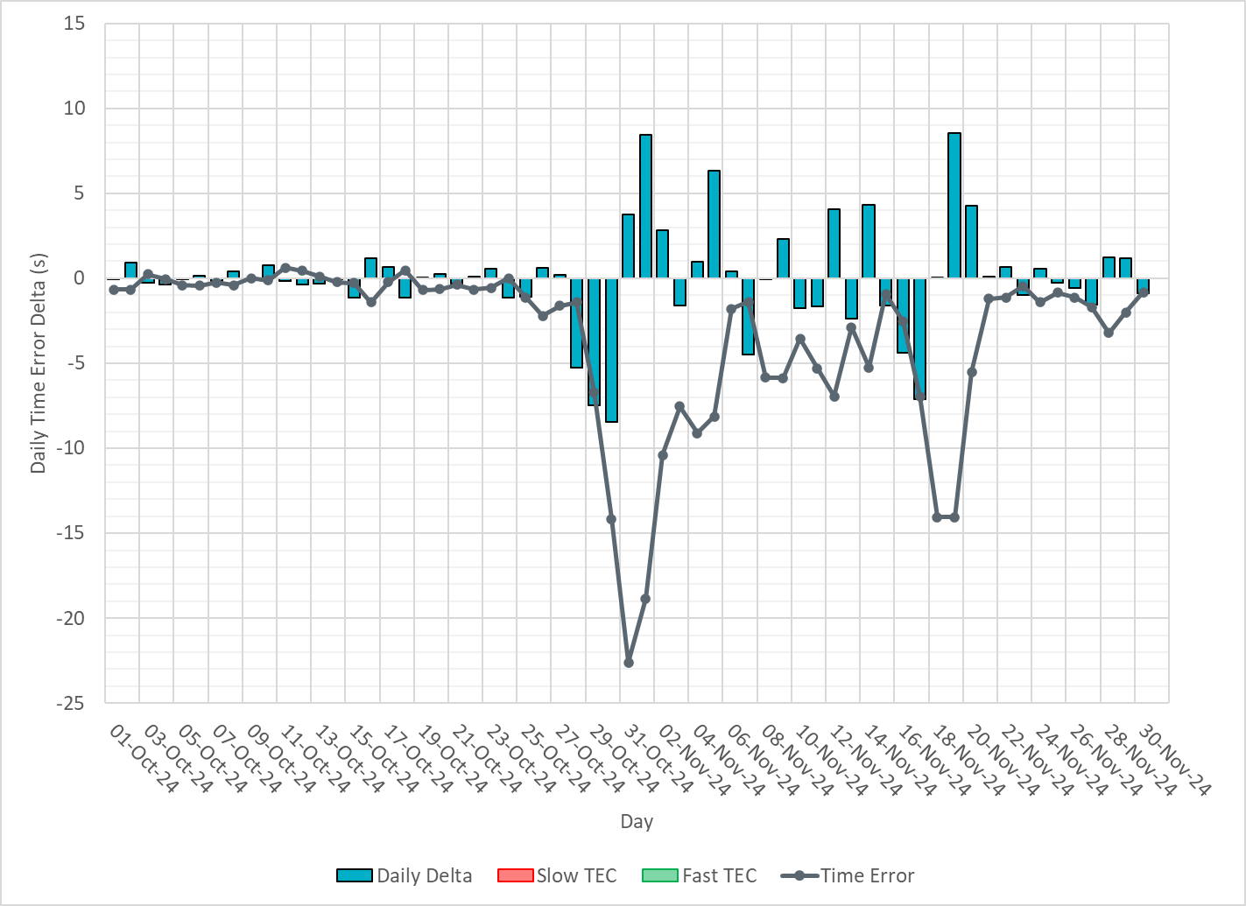
Time Error (TE) Loss
Time Error Began sliding quickly starting on 10/28/24
Manual Time Error Correction actions are taken at -30 seconds
Notes:
Last Time Error Correction (TEC) was on 12/3/16
Lowest Time Error was -23.

Slide 11
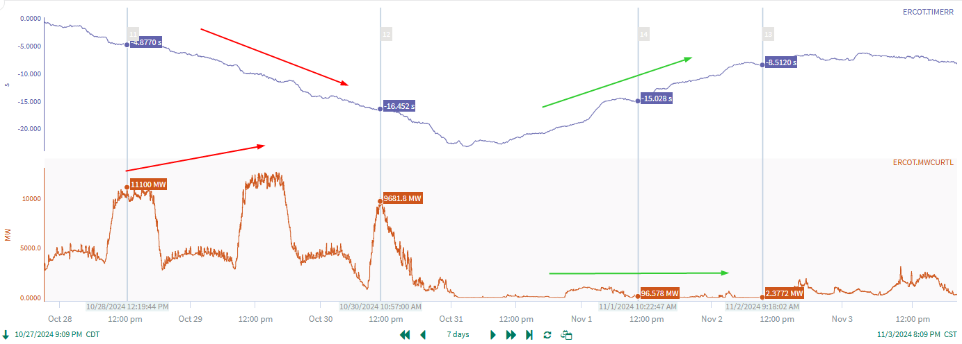
High Curtailment
We were able to correlate Time Error Loss to high curtailment periods
Some Manual actions taken to help recover TE

Slide 12
System Summary of Frequency Control
High correlation of dragging frequency with suspiciously high step changes in curtailment
Regulation Up is consistently exhausted during these periods
PRC is oscillating when we see step changes in curtailment
Additionally, this is leading to the need for more Operator Manual Offsets to help recover frequency

Slide 13
Daily CPS1 with TE (10/1/24-12/1/24)

Slide 14
Regulation Up Exhaustion

Slide 15
Regulation Down Exhaustion

Slide 16
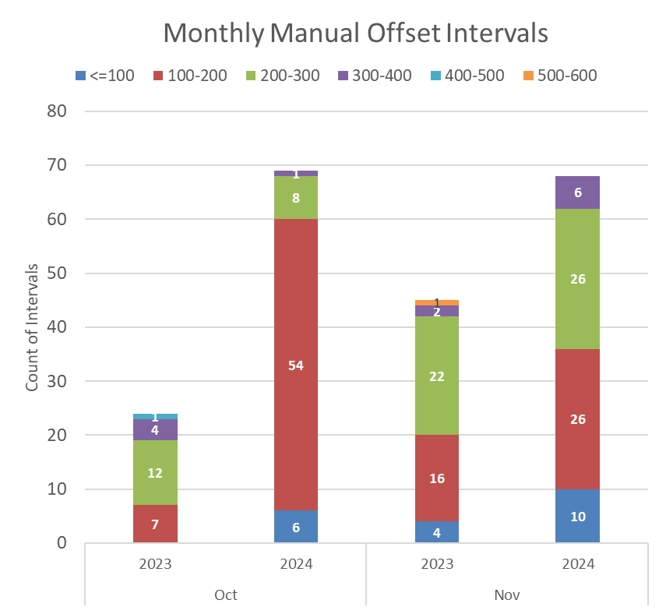
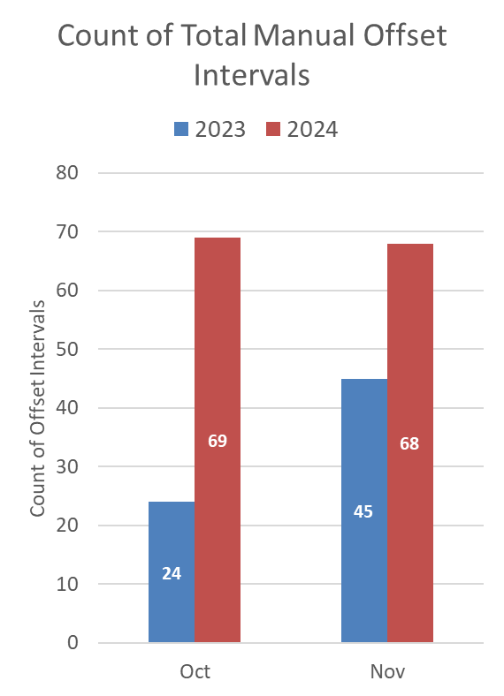
Review of Manual Operator Actions
Overall increase in number of intervals where an Operator Manual Offset was in place in comparison to the same month from last year.
89% of intervals in October 2024 occurred in the last 4 days of October

Slide 17
GTBD ACE Integral Adjustments
Ops Analysis and Control Room have been working to adjust Generation To Be Dispatched (GTBD) application to battle the frequency concerns and loss of Time Error.
These changes adjust the amount of impact Ace Integral Feedback to GTBD in pushing additional MWs in to SCED dispatch.
This is an artificial adjustment to regain TE in order to counter bad telemetry. This forces Frequency to be high, impacts SCED dispatch and requires more frequent governor action.
Date | Ace Integral K Factor Change | Time Error
Starting Parameters | 0.5 | -1.0s
10/31/2024 | 1.0 | -22s
11/1/2024 | 0.75 | -11s
11/5/2024 | 0.5 | -3.9s
11/18/2024 | 0.75 | -15s
11/22/2024 | 0.5 | -0.5s

Slide 18
Next Steps…
At this point our frequency control is being impacted by poor telemetry being sent to ERCOT by curtailed IRR units.
We have sent out RFIs to get corrective actions, but we are not seeing action being taken fast enough. As we continue to monitor, we find more units that need outreach
Operators are taking more manual actions with SCED offsets, Ops Analysis has taken manual action in adjusting GTBD to artificially maintain higher frequency, regulation is being exhausted and not available for other needs, and PRC is including headroom that is not available.
At this moment, any Market Participants who have not responded to our RFIs or implemented corrective actions will be sent to Compliance and Reliability Monitor. Additionally, the control room is prepared to take additional manual action including bringing units offline when an IRR is identified to contributing to reliability concerns.

Slide 19
Questions?

