Slide 1
Overview of RTC Benefit Study Results
Market Analysis
RTCBTF
January 14, 2025

Slide 2
Agenda
Value Categories and Metrics
Consumer Value
Reliability Value
Efficiency Value (currently under review)
Estimation Methodology
Results Summary

Slide 3
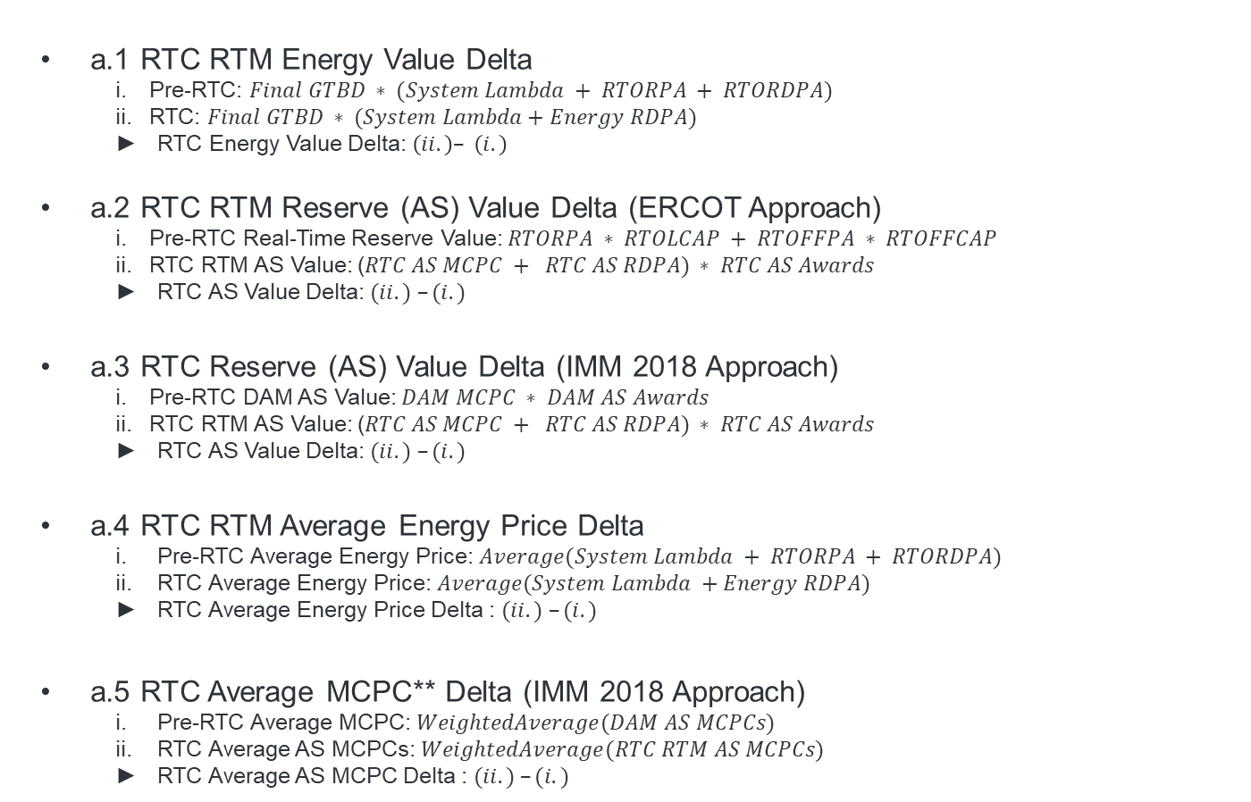
1. a) Consumer Value
a.1 RTC RTM Energy Value Delta
Pre-RTC: $Final GTBD ∗ (System Lambda + RTORPA + RTORDPA)$
RTC: $Final GTBD ∗ (System Lambda+Energy RDPA)$
RTC Energy Value Delta: $\left(ii.\right)– \left(i.\right)$
a.2 RTC RTM Reserve (AS) Value Delta (ERCOT Approach)
Pre-RTC Real-Time Reserve Value: $RTORPA ∗ RTOLCAP + RTOFFPA ∗ RTOFFCAP$
RTC RTM AS Value: ($RTC AS MCPC + RTC AS RDPA) ∗ RTC AS Awards$
RTC AS Value Delta: $(ii.) –(i.)$
a.3 RTC Reserve (AS) Value Delta (IMM 2018 Approach)
Pre-RTC DAM AS Value: $DAM MCPC ∗ DAM AS Awards$
RTC RTM AS Value: ($RTC AS MCPC + RTC AS RDPA) ∗ RTC AS Awards$
RTC AS Value Delta: $(ii.) –(i.)$
a.4 RTC RTM Average Energy Price Delta
Pre-RTC Average Energy Price: $Average(System Lambda + RTORPA + RTORDPA)$
RTC Average Energy Price: $Average(System Lambda +Energy RDPA)$
RTC Average Energy Price Delta : $(ii.) –(i.)$
a.5 RTC Average MCPC** Delta (IMM 2018 Approach)
Pre-RTC Average MCPC: $WeightedAverage(DAM AS MCPCs)$
RTC Average AS MCPCs: $WeightedAverage(RTC RTM AS MCPCs)$
RTC Average AS MCPC Delta : $(ii.) –(i.)$
*
*
* Final GTBD $= GTBD + offset$
** AS sub-type awarded MW weighted average

Slide 4
1. b) Reliability Value
b.1 RTC RTM Congestion Rent Delta
Pre-RTC: $Shadow Price ∗Line Loading MW$
RTC: the same as $(i)$
RTC Congestion Rent Delta: $\left(ii.\right)– \left(i.\right)$
b.2 RTC RTM Constraint Violation Cost Delta
Pre-RTC: $Shadow Price Cap ∗ Overloading MW$ (for violated constraint, please note that c is part of b)
RTC: the same as $(i)$
RTC Constraint Violation Cost Delta: $\left(ii.\right)– \left(i.\right)$

Slide 5
Sampling and Extrapolation Methodology
Generate random sample of 50 operating days between June 2023 and August 2024 (10 days per season)
Run RTC Simulator (v. 1.0, RTCBTF 10.13.2024) to compute RTM outputs for the random sample of 50 days
Calculate average value of results for each metric for the 10 days of each season
Extrapolate to seasonal estimate by multiplying with each season's total number of days (summer=92, fall=91, winter=91, and spring=92)
Aggregate the seasonal estimates to generate annual estimate for the two scenarios:
Annual estimate with Summer 2023 = summer 2023 + fall + winter + spring
Annual estimate with Summer 2024 = fall + winter + spring + summer 2024

Slide 6
Estimated Annual Savings of Real Time Co-optimization (RTC) Compared to 2018 Independent Market Monitor (IMM) Report
Annual Estimate with Summer 2023
Summer 2023
Fall 2023
Winter 2023-24
Spring 2024
Summer 2024
Annual Estimate with Summer 2024
Impact Category | Annual Est. w/ Summer 2023 | Annual Est. w/ Summer 2024 | IMM report (2018)
Average ∆ Energy Price * | ($11.76) /MWh | ($6.04) /MWh
Average ∆ MCPC ** | ($17.34) /MW/h | ($6.89) /MW/h
Agg. ∆ Energy Value | ($6.0) billion | ($2.4) billion | ($1.6) billion***
Agg. ∆ AS Value (ERCOT) | $25 million | $10.2 million
Agg. ∆ AS Value (IMM 2018) | ($1.2) billion | ($461.8) million | ($155) million
Agg. ∆ Congestion Rent | ($408.2) million | ($147.3) million | ($257) million
Agg. ∆ Constraint Violation Value | ($10.1) million | 3.1 million | ($4.3) million
Note: * Simple average ** AS sub-type awarded MW weighted average. *** IMM 2018 Study estimate did not include ORDC adders
Study results indicate overall savings in terms of the consumer and reliability value metrics analyzed, except for the AS Value (ERCOT Approach).
The results comprising Summer 2023 show an impact that across most metrics is more than twice as large compared to the results with Summer 2024.
Direct comparisons with the IMM Report (2018) should be treated with caution due to methodological differences, but generally show, especially in terms of energy value, a more significant impact of RTC under current market conditions.

Slide 7
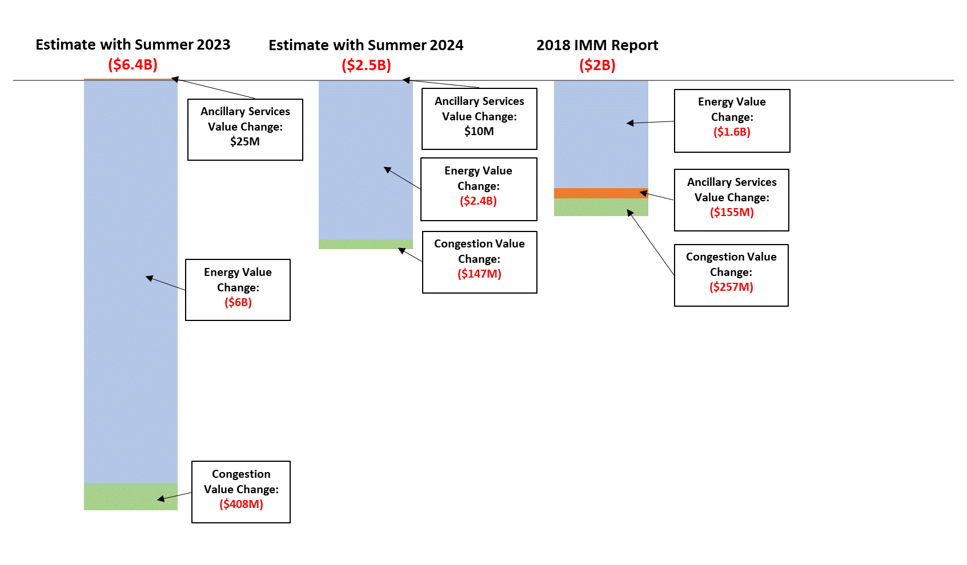
Estimated Annual Savings of Real Time Co-optimization (RTC) Compared to 2018 Independent Market Monitor (IMM) Report
Annual Estimate with Summer 2023
Summer 2023
Fall 2023
Winter 2023-24
Spring 2024
Summer 2024
Annual Estimate with Summer 2024

Slide 8
Outlook
Update estimates with efficiency value metric
Production Cost
AS Provision Cost
Pending the finalization of the RTC RTM market parameters, an updated version of the study is under consideration

