Slide 1
Credit Exposure Update
Market Credit Work Group
ERCOT Public
January 17, 2025

Slide 2
Monthly Highlights: December 2024 – December 2024
Market-wide average Total Potential Exposure (TPE) increased from $1.62 billion in November 2024 to $1.76 billion in December 2024
Forward adjustment factors increased towards year-end ahead of the cold front in January
Discretionary Collateral is defined as Secured Collateral in excess of TPE,CRR Locked ACL and DAM Exposure
Average Discretionary Collateral remained flat in December 2024 at $3.98 billion

Slide 3
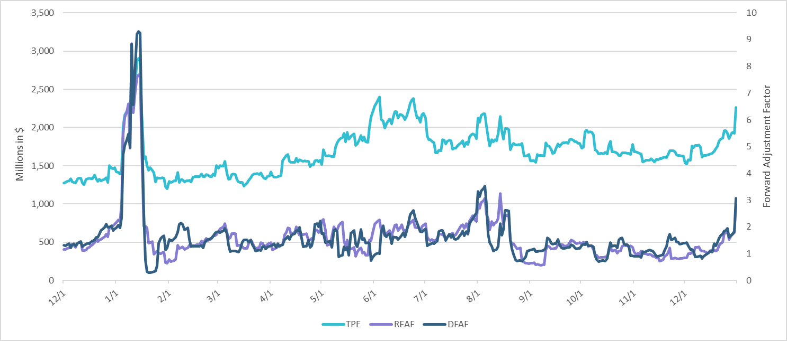
TPE and Forward Adjustment Factors: December 2023 – December 2024

Slide 4
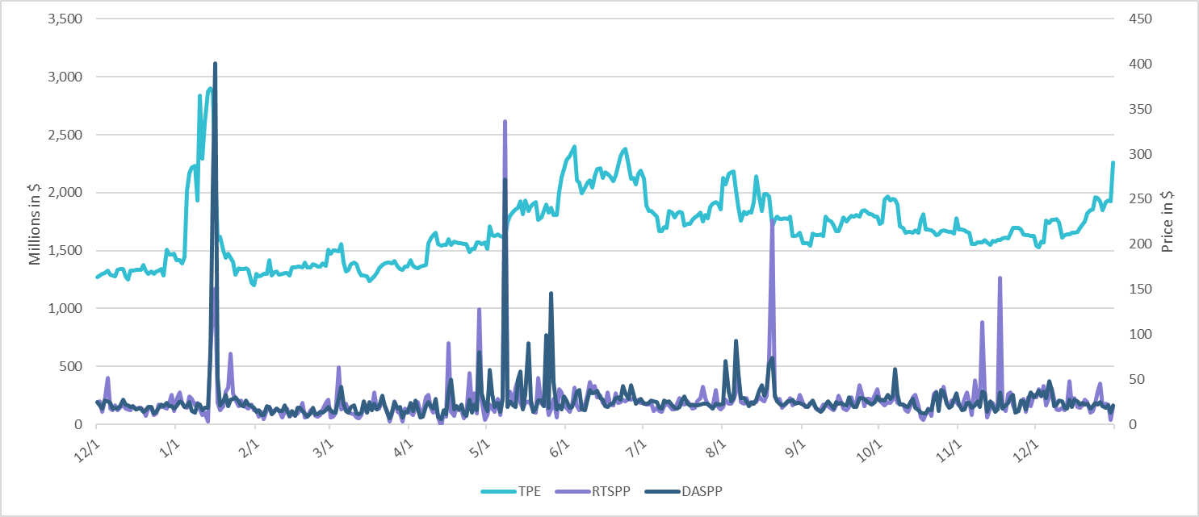
TPE/Real-Time & Day-Ahead Daily Average Settlement Point Prices for HB_NORT:H December 2023 – December 2024

Slide 5
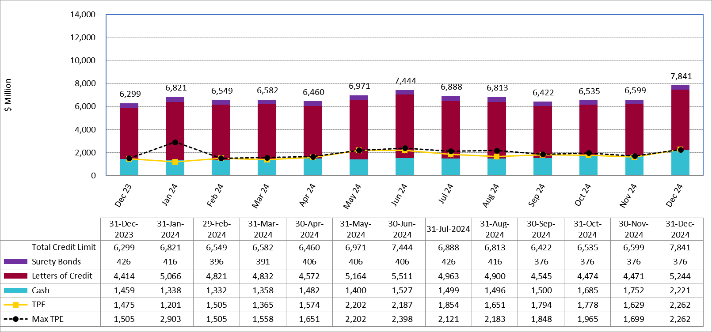
Available Credit by Type Compared to Total Potential Exposure (TPE): December 2023 – December 2024
Numbers are as of month-end except for Max TPE
Max TPE is the highest TPE for the corresponding month

Slide 6
Issuer Credit Limits vs Total LC Amounts Per Issuer: End-December 2024
As of December 31, 2024
There are a total of 35 banks that have issued LCs.

Slide 7
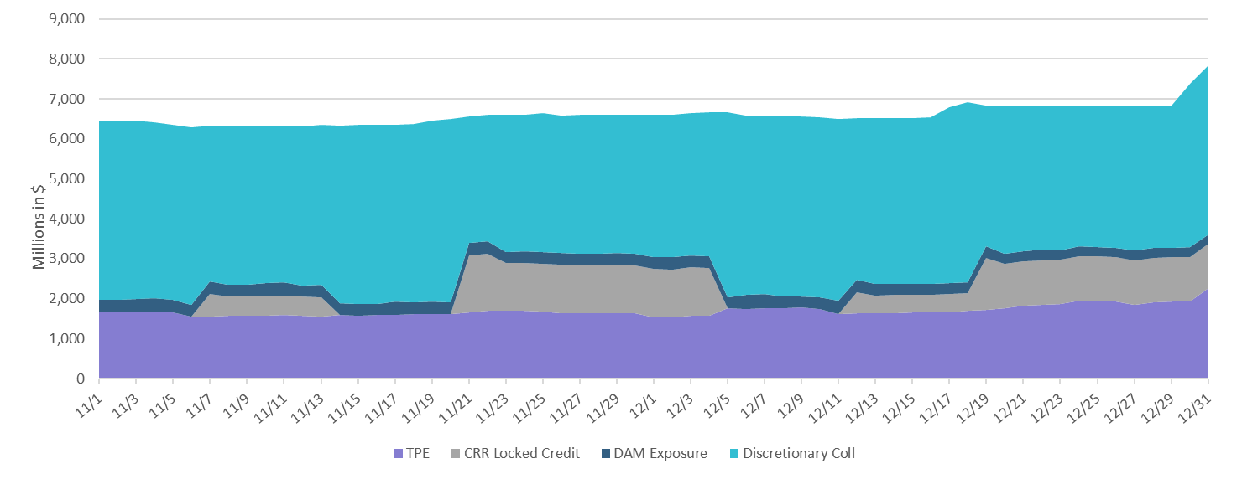
Discretionary Collateral November 2024 – December 2024

Slide 8
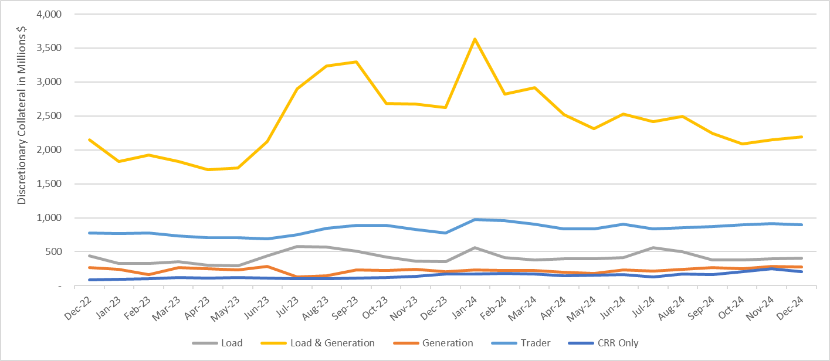
Discretionary Collateral by Market Segment December 2022 - December 2024
* Discretionary Collateral adjusted to exclude short pay amounts eliminating data skew

Slide 9
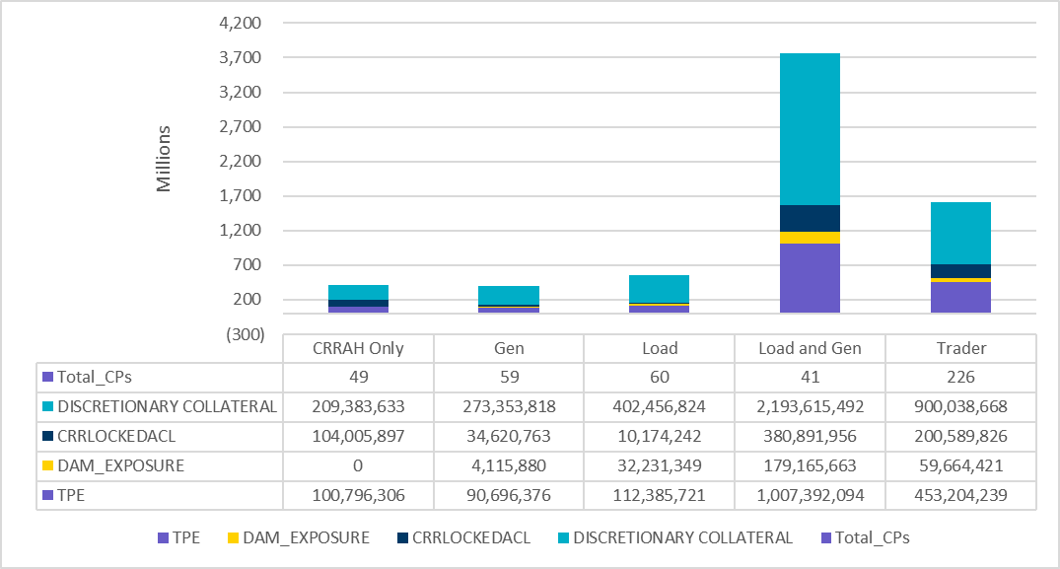
TPE and Discretionary Collateral by Market Segment - December 2024
Load and Generation entities accounted for the largest portion of discretionary collateral

Slide 10
TPEA Coverage of Settlements November 2023 - November 2024
Invoice Exposure | Historical | Future
Existing Invoice Exposure | RTLCNS + UDAA | M1 Days (including current day) Forward Charge Invoice Amounts
New Invoice Exposure | 7 Days Back Net Invoice Amounts (Charges & Credits) | M1 Days (including current day) Forward Net Invoice Amounts (Charges & Credits); Excluding: 1) Securitization Invoices; 2) CRR Auction Invoices; and 3) Subchapter N Funds Distribution Invoice
TPEA closely approximates actual/invoice exposure

Slide 11
TPEA Coverage of Settlements November 2023 - November 2024
Invoice Exposure | Historical | Future
Existing Invoice Exposure | RTLCNS + UDAA | M1 Days (including current day) Forward Charge Invoice Amounts
New Invoice Exposure | 7 Days Back Net Invoice Amounts (Charges & Credits) | M1 Days (including current day) Forward Net Invoice Amounts (Charges & Credits); Excluding: 1) Securitization Invoices; 2) CRR Auction Invoices; 3) Subchapter N Funds Distribution Invoice
*TPEA exceeds invoice exposure

Slide 12
TPEA Coverage of Settlements November 2023 - November 2024
Invoice Exposure | Historical | Future
Existing Invoice Exposure | RTLCNS + UDAA | M1 Days (including current day) Forward Charge Invoice Amounts
New Invoice Exposure | 7 Days Back Net Invoice Amounts (Charges & Credits) | M1 Days (including current day) Forward Net Invoice Amounts (Charges & Credits); Excluding: 1) Securitization Invoices; 2) CRR Auction Invoices; 3) Subchapter N Funds Distribution Invoice
Invoice exposure generally exceeds TPEA

Slide 13
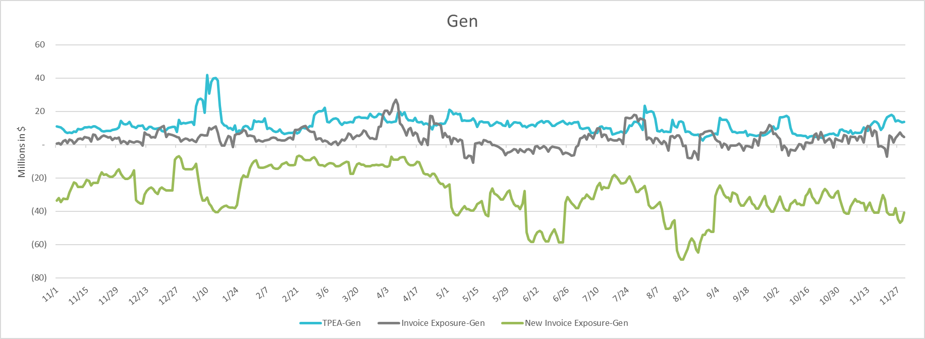
TPEA Coverage of Settlements November 2023 - November 2024
Invoice Exposure | Historical | Future
Existing Invoice Exposure | RTLCNS + UDAA | M1 Days (including current day) Forward Charge Invoice Amounts
New Invoice Exposure | 7 Days Back Net Invoice Amounts (Charges & Credits) | M1 Days (including current day) Forward Net Invoice Amounts (Charges & Credits); Excluding: 1) Securitization Invoices; 2) CRR Auction Invoices; 3) Subchapter N Funds Distribution Invoice
* TPEA generally exceeds Invoice exposure

Slide 14
TPEA Coverage of Settlements November 2023 - November 2024
Invoice Exposure | Historical | Future
Existing Invoice Exposure | RTLCNS + UDAA | M1 Days (including current day) Forward Charge Invoice Amounts
New Invoice Exposure | 7 Days Back Net Invoice Amounts (Charges & Credits) | M1 Days (including current day) Forward Net Invoice Amounts (Charges & Credits); Excluding: 1) Securitization Invoices; 2) CRR Auction Invoices; 3) Subchapter N Funds Distribution Invoice
*TPEA generally exceeds invoice exposure

Slide 15
TPEA Coverage of Settlements November 2023 - November 2024
Invoice Exposure | Historical | Future
Existing Invoice Exposure | RTLCNS + UDAA | M1 Days (including current day) Forward Charge Invoice Amounts
New Invoice Exposure | 7 Days Back Net Invoice Amounts (Charges & Credits) | M1 Days (including current day) Forward Net Invoice Amounts (Charges & Credits); Excluding: 1) Securitization Invoices; 2) CRR Auction Invoices; 3) Subchapter N Funds Distribution Invoice
*TPES exceeds actual/invoice exposure

Slide 16
Questions

