Slide 1
Resource Integration Topics
Jenifer Fernandes
ERCOT
Resource Integration Working Group
February 11th, 2025

Slide 2
Quarterly Stability Assessment (QSA)
Planning Guide 5.3.5
Next Deadline for QSA
If a GINR is not included in QSA, its Initial Synchronization date will be automatically delayed to the next quarter
All-Inclusive Generation Resource Initial Synchronization Date | Last Day for an IE to meet prerequisites as listed in paragraph (4) below | Completion of Quarterly Stability Assessment
Upcoming January, February, March | Prior August 1 | End of October
Upcoming April, May, June | Prior November 1 | End of January
Upcoming July, August, September | Prior February 1 | End of April
Upcoming October, November, December | Prior May 1 | End of July

Slide 3
Quarterly Stability Assessment (QSA)
Planning Guide 5.3.5, Quarterly Stability Assessment
Issue’s seen in previous QSA’s
  10 day comment period for FIS
    Needs to be complete before QSA deadline
    TSPs need to plan for it
  Dynamic/PSCAD Model Review
    Dependent on FIS Stability study
    Need to meet PG 6.9 15 to 30 days prior to QSA deadline
PSSE Model Quality Test Required
PSCAD Model Quality Test, Unit Model Validation and Template is required. PSCAD template is required starting August 1st QSA.
TSAT Model Required – If PSSE model is UDM, then TSAT model should be UDM and should include MQT

Slide 4
QSA 45 day deadline
FIS studies finalized and posted in RIOO-IS 45 days prior to quarterly stability assessment deadline.
Dynamic models (PSEE, PSCAD, TSAT (UDM)) and MQT report submitted in RIOO-IS.
From Planning guide Section 5.3.5 (2): Last Day for an IE to meet prerequisites as listed in paragraph (4) below | 45 day deadline
Prior August 1 | June 17
Prior November 1 | September 17
Prior February 1 | December 18
Prior May 1 | March 17

Slide 5
QSA Checklist
QSA checklist for the Interconnecting Entity (IE) or Resource Entity (RE) to verify that all requirements for QSA have been submitted:
  Checklist for PGRR112
  Checklist for the final QSA
IE will be required to submit the checklist along with the dynamic model submission and final QSA submission for ERCOT review prior to the deadlines.
Resource Integration will no longer send initial QSA status emails.

Slide 6
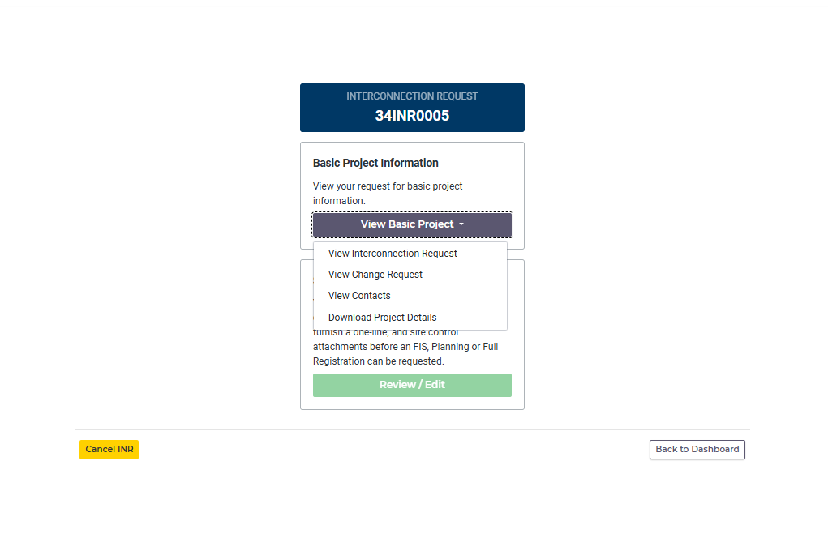
Downloading Project Details from RIOO-IS
Log in to RIOO-IS. On the main INR screen click on “View Basic project” select “Download Project Details” from the drop down.

Slide 7
EPS Design Meter Proposal for planned GIM projects
EPS Meter Design Proposal will be part of the technical documentation that is required to be submitted to ERCOT for modeling per Nodal Protocol (NP) 3.10.1 and is subject to the modeling timeline in NP 3.10.1 (3).
  EPS Meter Design Proposal is required to be submitted to ERCOT metering prior to approval of the Resource Registration Data for full registration.
  EPS Meter Design Proposal will be required for projects planning to meet July 2nd,2025 PLD but recommended for June 4th,2025 PLD to avoid delays.

Slide 8
NPRR1254 Implementation
Status - Pending PUCT approval
Implementation Date - March 1st, 2025
  Per the Production Load Schedule, the March 1st implementation date will affect 7/2/2025 Production Load Date (PLD) onwards.
  According to NP 3.10.1 (4) Table, the 7/2/2025 PLD Full registration data must be submitted by March 1st , 2025 for ERCOT review.
Deadline for Resource Entity to Submit Complete Information to ERCOT Note 1 | Deadline for Resource Registration Data to Meet Criteria for ERCOT Acceptance Note 2 | Model Complete and Available for Test Note 3 | Updated Network Operations Model Testing Complete Note 4 Paragraph (6) | Update Network Operations Model Production Environment | Target Physical Equipment included in Production Model Note 5
December 1 | January 1 | February 15 | March 15 | April 1 | Month of April
January 1 | February 1 | March 15 | April 15 | May 1 | Month of May
February 1 | March 1 | April 15 | May 15 | June 1 | Month of June
March 1 | April 1 | May 15 | June 15 | July 1 | Month of July
April 1 | May 1 | June 15 | July 15 | August 1 | Month of August
May 1 | June 1 | July 15 | August 15 | September 1 | Month of September
June 1 | July 1 | August 15 | September 15 | October 1 | Month of October
July 1 | August 1 | September 15 | October 15 | November 1 | Month of November
August 1 | September 1 | October 15 | November 15 | December 1 | Month of December
September 1 | October 1 | November 15 | December 15 | January 1 | Month of January (the next year)
October 1 | November 1 | December 15 | January 15 | February 1 | Month of February (the next year)
November 1 | December 1 | January 15 | February 15 | March 1 | Month of March (the next year)

Slide 9
Active RR’s
No Active RR’s

Slide 10
Commissioning Requests Submission- Clarification
ERCOT has established a new, dedicated email address for Market Participants to submit new generator Commissioning Checklist for review.
Starting June 10, 2024, all new Commissioning Checklists (Parts 1-3) should be emailed to CommissioningRequests@ercot.com in addition to being submitted to RIOO-IS.
Commissioning Checklists (Parts 1-3) submitted to ResourceIntegrationDepartment@ercot.com after June 21, 2024, will not be processed.
Commissioning Plans should not be emailed for review to the new Commissioning Request email address.

Slide 11
Generation Interconnection Requests
1,917 active generation interconnection requests totaling 379 GW as of December 31st, 2024
(Solar 154 GW, Wind 34 GW, Gas 28 GW, and Battery 160 GW)
(Excludes capacity associated with projects designated as Inactive per Planning Guide Section 5.7.6)

Slide 12
Generation Interconnection Requests
Small Gen- 30 projects Not Model Ready, 46 projects Model Ready

Slide 13
Other contact information
ResourceIntegrationDepartment@ercot.com is distribution list for Resource Integration department
Mailing List
  RESOURCE_INTEGRATION@LISTS.ERCOT.COM

Slide 14

Questions?
Thank you!

