Slide 1
Resource Integration - Small Generation Reactive Capability
John Lawson, Supervisor of Small Generation
RIWG Meeting
February 11, 2025

Slide 2
Background
Per Nodal Protocol Section 3.15 (as revised by NPRR1016), the requirement to meet Voltage Support Services (VSS) is required only of Generation Resources (including self-serve generating units) and Energy Storage Resources that are connected to Transmission Facilities and that have a gross unit rating greater than 20 MVA or those units connected at the same Point of Interconnection Bus (POIB) that have gross unit ratings aggregating to greater than 20 MVA, that supply power to the ERCOT Transmission Grid.”

Slide 3
Zero and Non-zero CURLs
If the Interconnection Agreement states that the DGR/DESRs must operate in unit pf then the DGR/DESRs should provide zero CURL values.
If the TDSP/DSP requires the DGR/DESRs to provide voltage support, then it should clearly be stated in the Interconnection Agreement and the RE should submit non-zero CURL values. The CURL will then be evaluated based on Nodal Operating Guide 3.3.2.2.

Slide 4
RARF Data Requirements (Feb 2022 RIWG) – Control Modes
Reactive Capability – Unity PF Control Mode:
Reactive Capability – Voltage Control Mode:

Slide 5
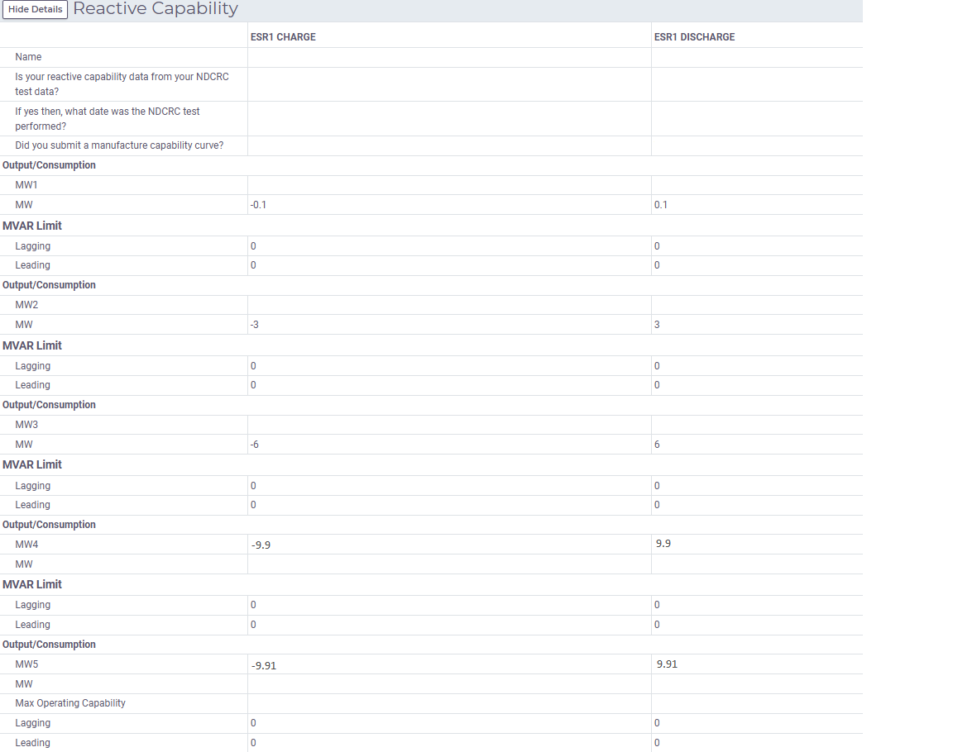
Zero and Non-zero CURLs

