Slide 1
HRL in aggregated units
IBRWG 02.21.2025
Ismael Moral Diaz
Antonio Richmond

Slide 2
ACCIONA ENERGÍA IN THE WORLD
+40
NORTH AMERICA
CANADA USA MEXICO
EUROPE
SPAIN POLAND ITALY PORTUGAL SWEDEN GREECE GERMANY CROATIA NORWAY HUNGARY NETHERLANDS ROMANIA DENMARK UNITED KINGDOM AUSTRIA TURKEY UKRAINE
Countries operations
LATIN AMERICA
BRAZIL CHILE COLOMBIA PERU PANAMA DOMINICAN REP. COSTA RICA ECUADOR NICARAGUA TRINIDAD AND TOBAGO
MIDDLE EAST & AFRICA
UAE MOROCCO SOUTH AFRICA SAUDI ARABIA ALGERIA GABON OMAN CATAR EGYPT KENYA
ASIA & OCEANIA
AUSTRALIA INDIA PHILIPPINES NEW ZEALAND SINGAPORE

Slide 3
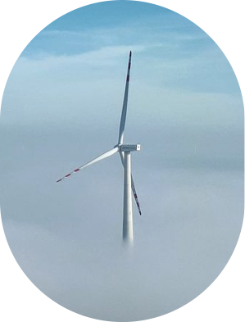
Difference between Planning and Operation
Planning:
FIS Study:
Includes Steady State, Short Circuit, Stability and Facility analyses.
All studies are conducted based on the injection at the Point of Interconnection (POI) rather than the generation from each individual unit.
Studies do not consider the variability of the primary resource.
SGIA:
Bilateral agreement between the Transmission Service Provider (TSP) and the generator.
Specifies the MW output at the POI, not on a per-unit basis
Operation:
ERCOT operates with two different High Reasonability Limits (HRLs) per unit and generates an alert if a unit exceed its limit.
Control is not limited to the POI level; it also considers individual unit operation
Difference between planning stage and operation of facilities

Slide 4
HRL explanation
High Reasonability Limit: HRL, a theoretical value of net generation above which the generator is not expected to operate under most conceivable conditions. This value is used by ERCOT market systems to validate COP submissions of HSL, telemetered HSL, and certain offers which may have been entered in error by the QSE⁽¹⁾ .
HRL was particularly relevant for steam turbines, coal plants, and other non-inverter-based resources, where generating units often vary in age, efficiency, and production costs. In contrast, inverter-based resources (IBRs) are typically built simultaneously, utilizing uniform technology and resource characteristics. As a result, IBR plants tend to have more standardized performance and cost structures.
High Reasonability Limit
(1): ERCOT Resource Registration Glossary

Slide 5
Solar Plant in ERCOT
Configuration: 2 units controlled by 1 Power Plant Controller (PPC/EMS).
SGIA Specifications:
Plant capacity: 300MW -> Reactive Power Requirement: 98.7MVAr
Total Installed Capacity:
Available Active Power : 350MW
The number of solar panels is oversized to maximize the radiation exposure (More DC power available)
Number of inverters can be larger to avoid capacitor banks.
Reactive Power: 110 MVar
Unit 1:
High Reasonability Limit (HRL): 160MW
Active Power: 180MW
Reactive Capability: 60MVar
Unit 2:
High Reasonability Limit (HRL): 140MW
Active capacity: 170 MW
Reactive capability: 50MVar
Plant description

Slide 6
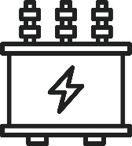
Case 1: Perfect Conditions, very sunny day
POI
Q Requirement= 98 MVar
300 MW
98 MVar
160 MW
50 MVar
140 MW
48 MVar
P Capacity: 180 MW
HRL: 160 MW
Q capability: 60 MVar
P injection : 160MW
Q injection: 50 MVar
P injection : 140MW
Q injection: 48 MVar
P Capacity: 170 MW
HRL: 140 MW
Q capability: 50 MVar
Unit 1
Unit 2

Slide 7
Case 2: Sunny day but some little clouds over unit 1
POI
Q Requirement= 98 MVar
290 MW
98 MVar
150 MW
50 MVar
140 MW
48 MVar
P Capacity: 180 MW
HRL: 160 MW
Q capability: 60 MVar
P injection : 150MW
Q injection: 50 MVar
P injection : 140MW
Q injection: 48 MVar
P Capacity: 170 MW
HRL: 140 MW
Q capability: 50 MVar
Unit 1
Unit 2

Slide 8
Proposal: aggregation of HRLs in aggregated units.
Grouped units: A group of two or more IRRs whose performance in responding (SCED) Dispatch Instructions will be assessed as an aggregate for:
Generation Resource Energy Deployment Performance (GREDP)
Base Point Deviation.
Resource Entities have the flexibility to group IRRs at their discretion.
The proposal suggests implementing a single High-Reliability Limit (HRL) for grouped Intermittent Renewable Resources (IRRs) instead of assigning individual HRLs to each unit.
We believe that ERCOT may be losing potential generation due to the current limitation of having separate HRLs per unit.
The models used during the planning phase do not account for different HRLs per unit. Therefore, grouping the units will not impact the results of the studies conducted with these models.

Slide 9
Case 2b: Sunny day but some little clouds over unit 1
POI HRL=300MW
Q Requirement= 98 MVar
300 MW
98 MVar
150 MW
55 MVar
150 MW
43 MVar
P Capacity: 180 MW
Q capability: 60 MVar
P injection : 150MW
Q injection: 50 MVar
P injection : 150MW
Q injection: 48 MVar
P Capacity: 170 MW
Q capability: 50 MVar
Unit 1
Unit 2

Slide 10
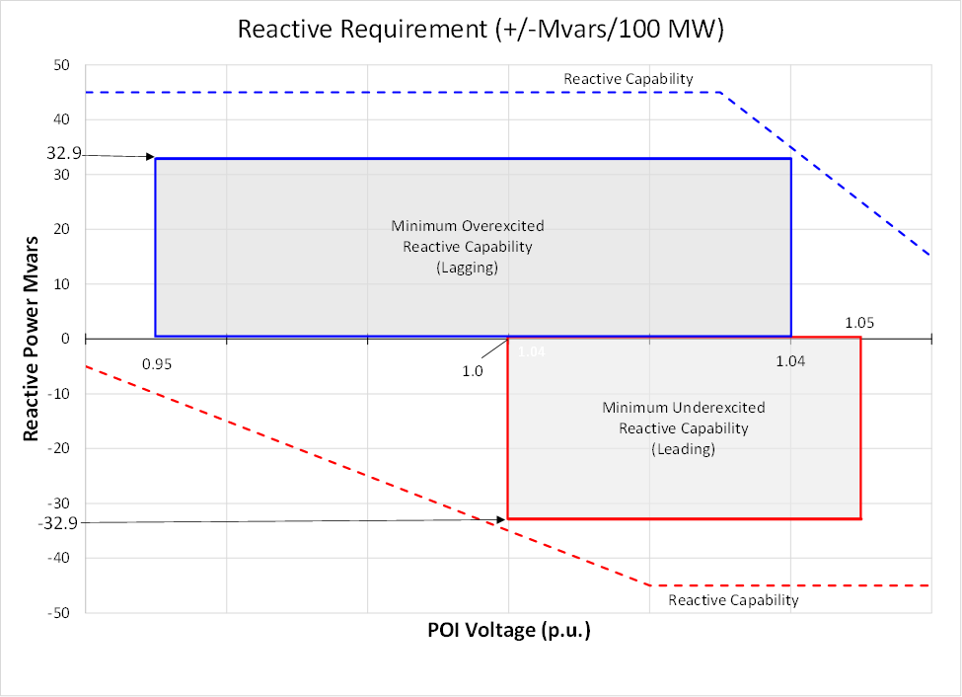
2 key aspects to consider
00 M
ERCOT Reactive Requirements
PPC functionality

Slide 11
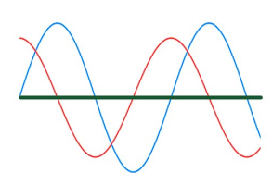
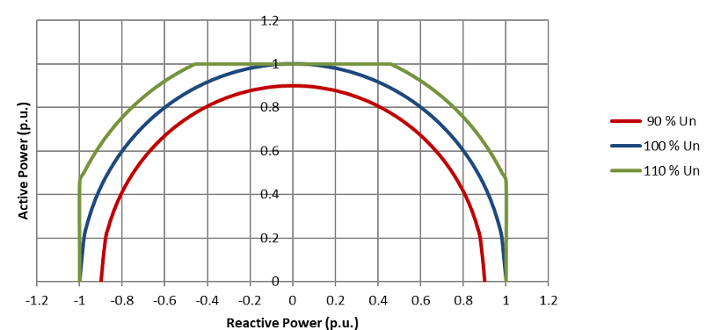
ERCOT reactive requirements
MVA Rating & Power Capacity in Solar Inverters
Inverter Reactive Power Capability
🔹 MVA Rating (Apparent Power): Defines the inverter’s total power capacity (S = √P² + Q²) Combination of Active Power (P, kW) & Reactive Power (Q, kVAR)
🔹 Active Power (P, kW): Real power delivered to the grid. Limited by DC generation from solar panels
🔹 Reactive Power (Q, kVAR): Supports voltage stability & grid requirements. Can be generated even with low solar power input
Voltage & Current Adjustment: Inverter can shift voltage and current up to ±90°.
Operation under low solar generation: Even with reduced real power generation from the PV array (e.g., cloud coverage 🌥️), inverters can still produce reactive power, ensuring grid support

Slide 12
Power Plant Controller (PPC) Functionality.
Setpoint Distribution
Dynamic Adjustment
Reactive Power Priority
PPC sends power setpoints to all inverters.
Under ideal conditions, each inverter produces the requested power.
If resources are limited, some inverters may generate less than required.
PPC detects power shortfalls and increase the setpoint.
Inverters with available capacity adjust to meet the new setpoint
When system limits are reached, inverters must decide:
Increase active power or
Maintain limits to ensure ERCOT reactive power compliance
PPC can prioritize reactive power output
Always ensure ERCOT’s Q requirement is met

Slide 13
Recap:Proposal, solution and considerations.
Disconnection between Planning and Operation
HRL aggregation: When units are grouped, a single HRL value is assigned per plant instead of separate HRLs for each unit.
Operational Benefits:
Maintains compliance with ERCOT requirements, including reactive power.
Allows for increased stabilization of generation injection in the ERCOT area helping to maintain a stable grid, for instance during Energy Emergency Level (EEA).
Flexibility:
This approach is optional - if units prefer to have different setpoints and participate with separate bids at different prices, they can retain individual HRLs.

Slide 14
14

