Slide 1
Monthly Review of Reliability Unit Commitment Market Impacts – January 2025
Wholesale Market Working Group
ERCOT Market Analysis

Slide 2
RUC Resource-Hours
January 2025 | Total | Capacity |  | Congestion
 |  | Opt-Out | Non-Opt-Out | Opt-Out | Non-Opt-Out
Instructed Resource-Hours
Total Count | 339.6 | 1.0 | 140.6 | 0.0 | 198.0
Effective Resource-Hours*
Total Count | 322.0 | 1.0 | 134.9 | 0.0 | 186.1
Average Megawatts (MW) for Effective Resource-Hours
Average LSL | 99.9 | 60.0 | 56.1 | - | 131.8
Average LDL | 103.6 | 60.0 | 61.5 | - | 134.2
Average BP | 104.5 | 60.0 | 61.7 | - | 135.5
Average HSL | 256.0 | 230.0 | 186.0 | - | 306.7
* The difference between “Instructed” and “Effective” values is a result of Resources starting up, shutting down, receiving partial hour instructions, or otherwise not being dispatchable by SCED.

Slide 3
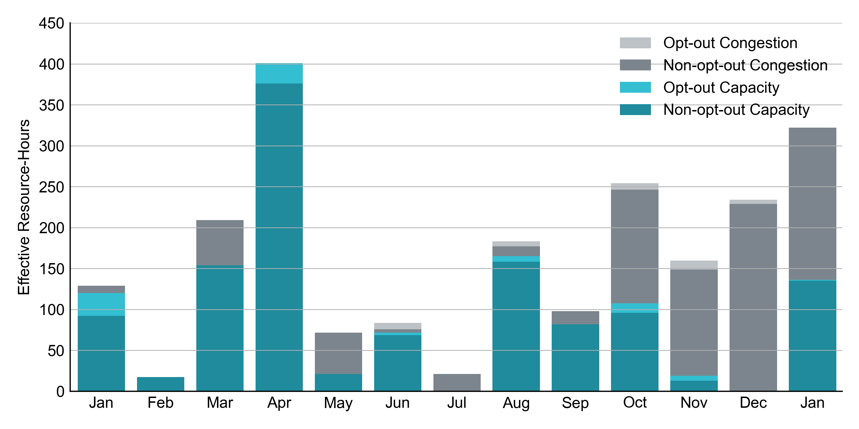
RUC Instruction Reasons: Last 13 Months RUC instructions in January 2025 were primarily to resolve congestion but also to ensure sufficient capacity.

Slide 4
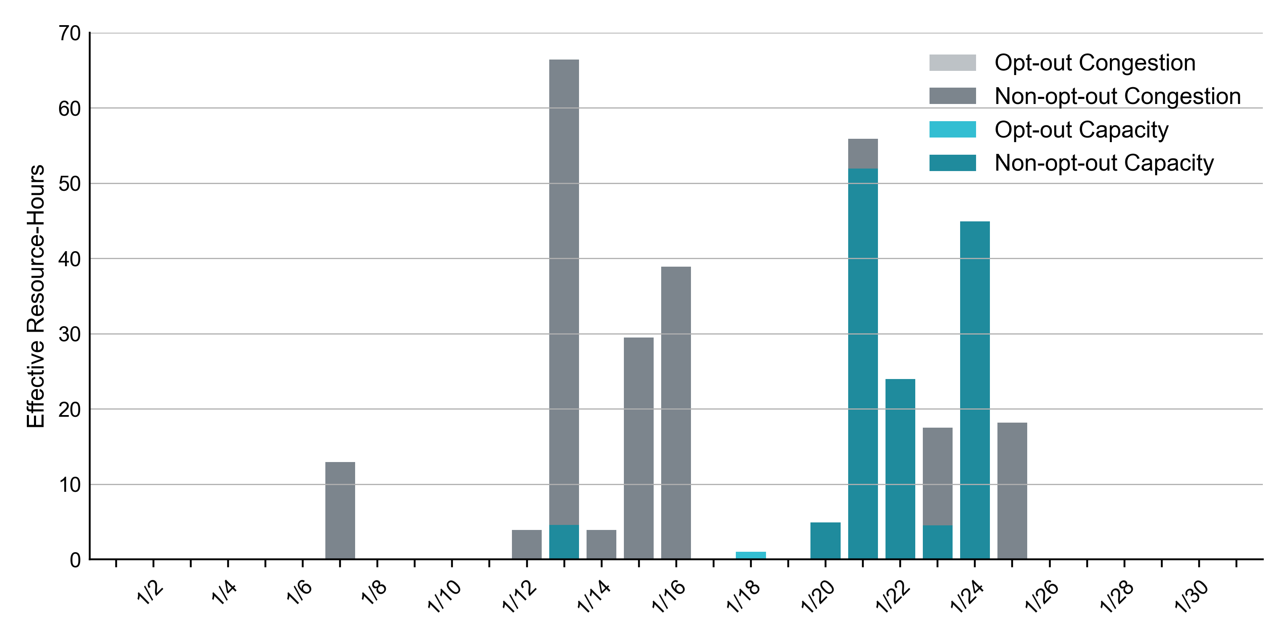
RUC Instruction Reasons in January 2025
322.0 RUC effective Resource-hours.
186.1 hours (58%) for congestion.
RUC for Capacity in later January is aligned with Winter Storm Enzo, for which ERCOT issued an Advisory for extreme cold weather.

Slide 5
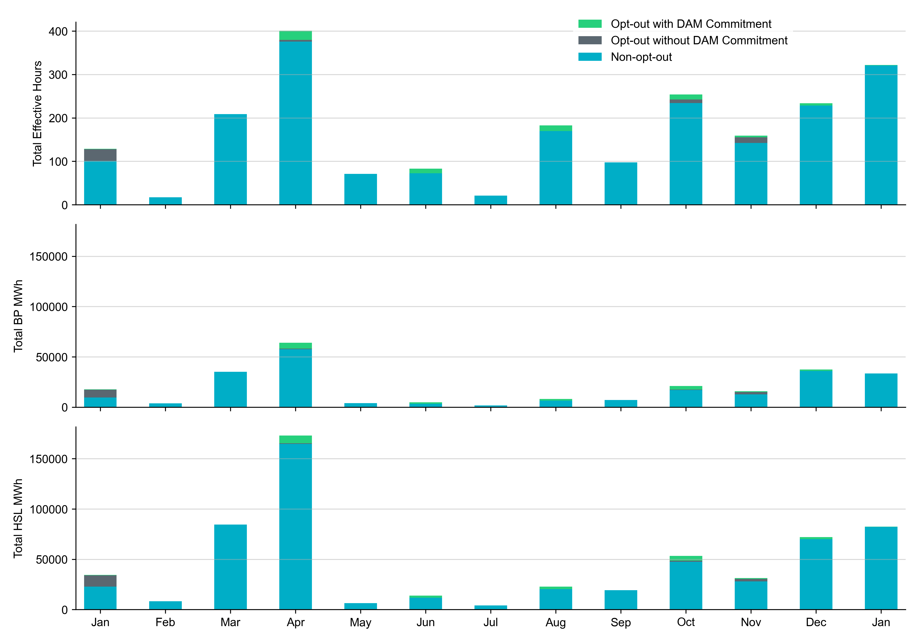
Non-opt-out and Opt-out Totals: Last 13 Months January 2025 had a total of 321.0 non-opt-out effective Resource-hours (99.7%) and 1 opt-out effective Resource-hours (0.3%).

Slide 6
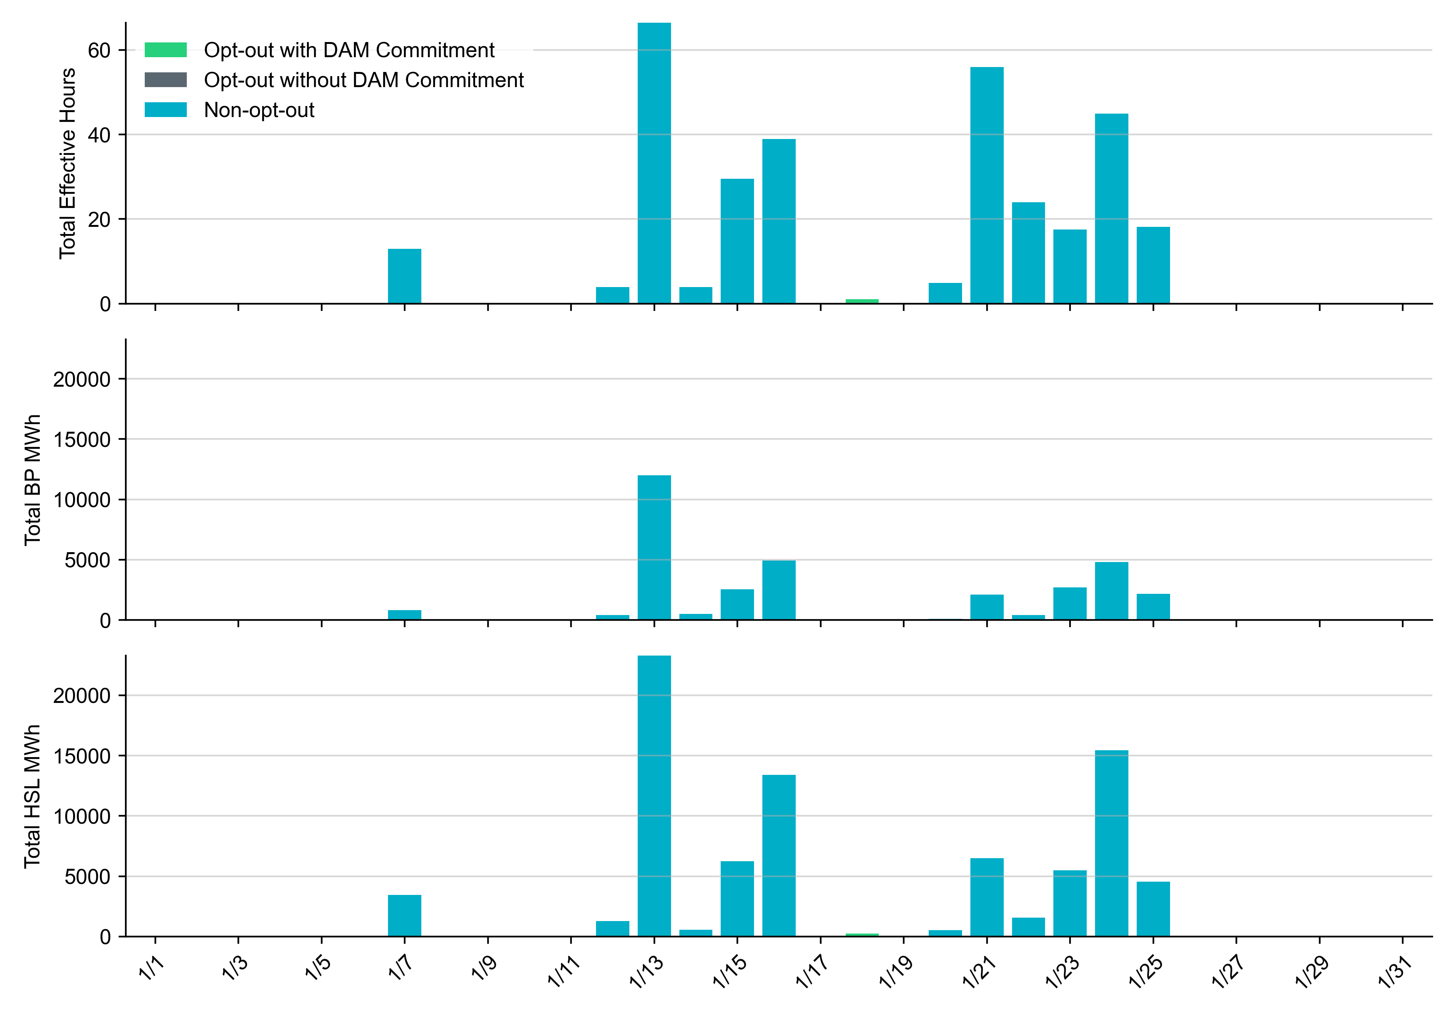
Non-opt-out and Opt-out Totals: January 2025

Slide 7
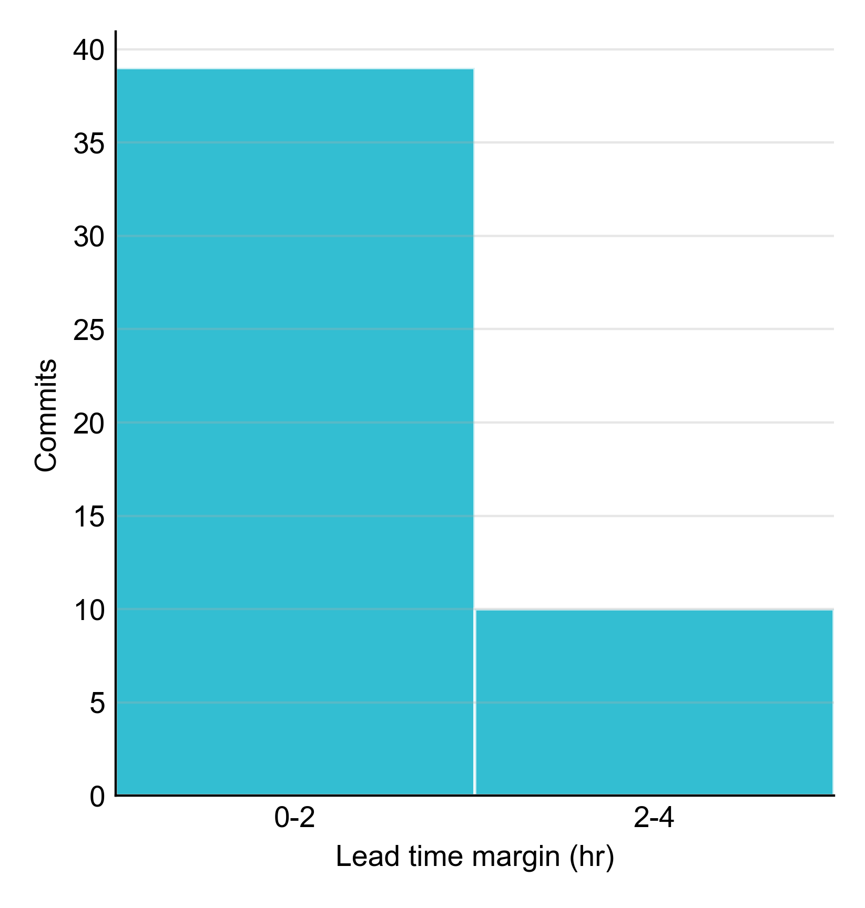
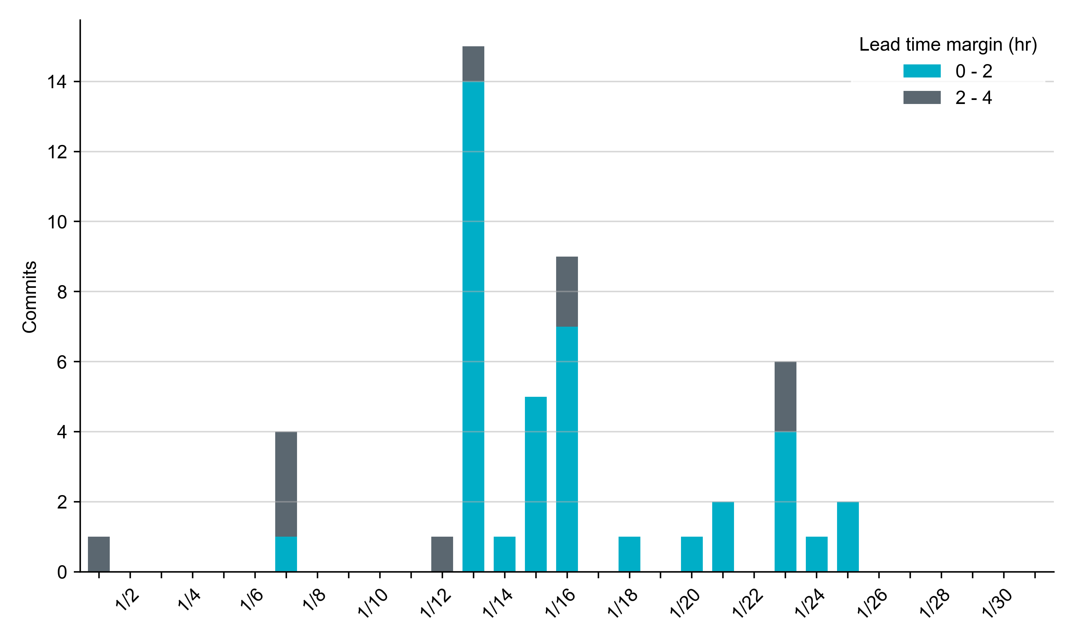
RUC Lead Time Margin: January 2025
Most RUC commitment windows (80%) had a lead time margin of 2 hours or less. However, 10 commitment windows (20%) had lead times between 2 and 4 hours.
Lead time refers to the length of time between a RUC instruction and the start of the commitment window.
Lead time margin is the difference between lead time and the Resource’s startup time.
In cases where a Resource is committed for multiple back-to-back time blocks, lead time margin is calculated from the first instruction.

Slide 8
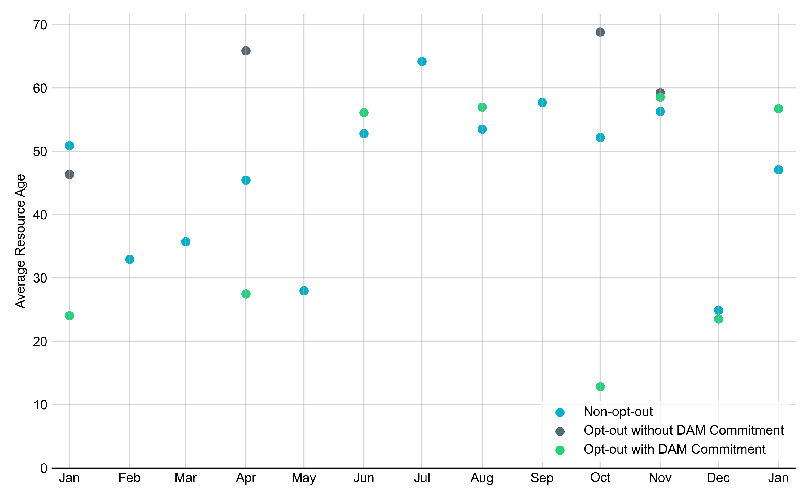
Average Resource Age: Last 13 Months In January 2025, the average age of RUC-committed Resources was 47.1 years for non-opt-out Resource-hours and 56.7 years for opt-out Resource-hours with DAM Commitments.
Note: For Resource configurations with multiple physical generators, the age of the oldest generator is used.

Slide 9
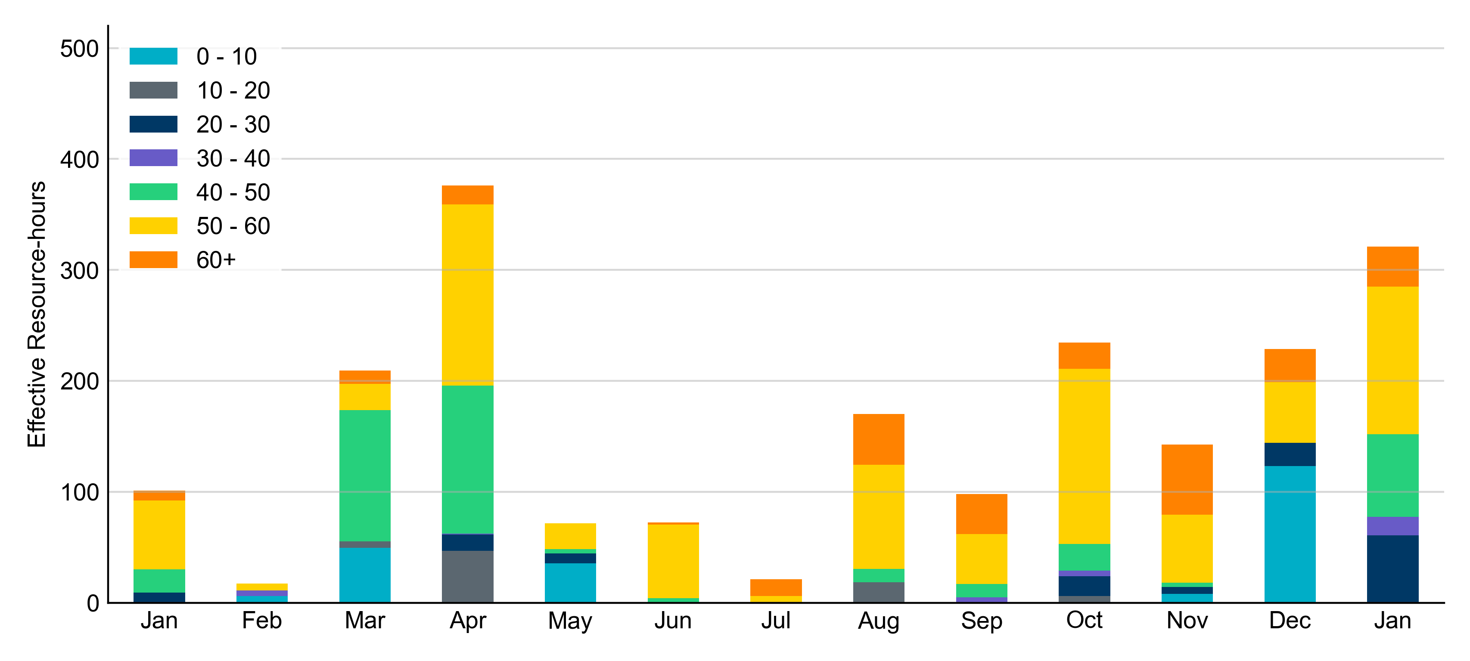
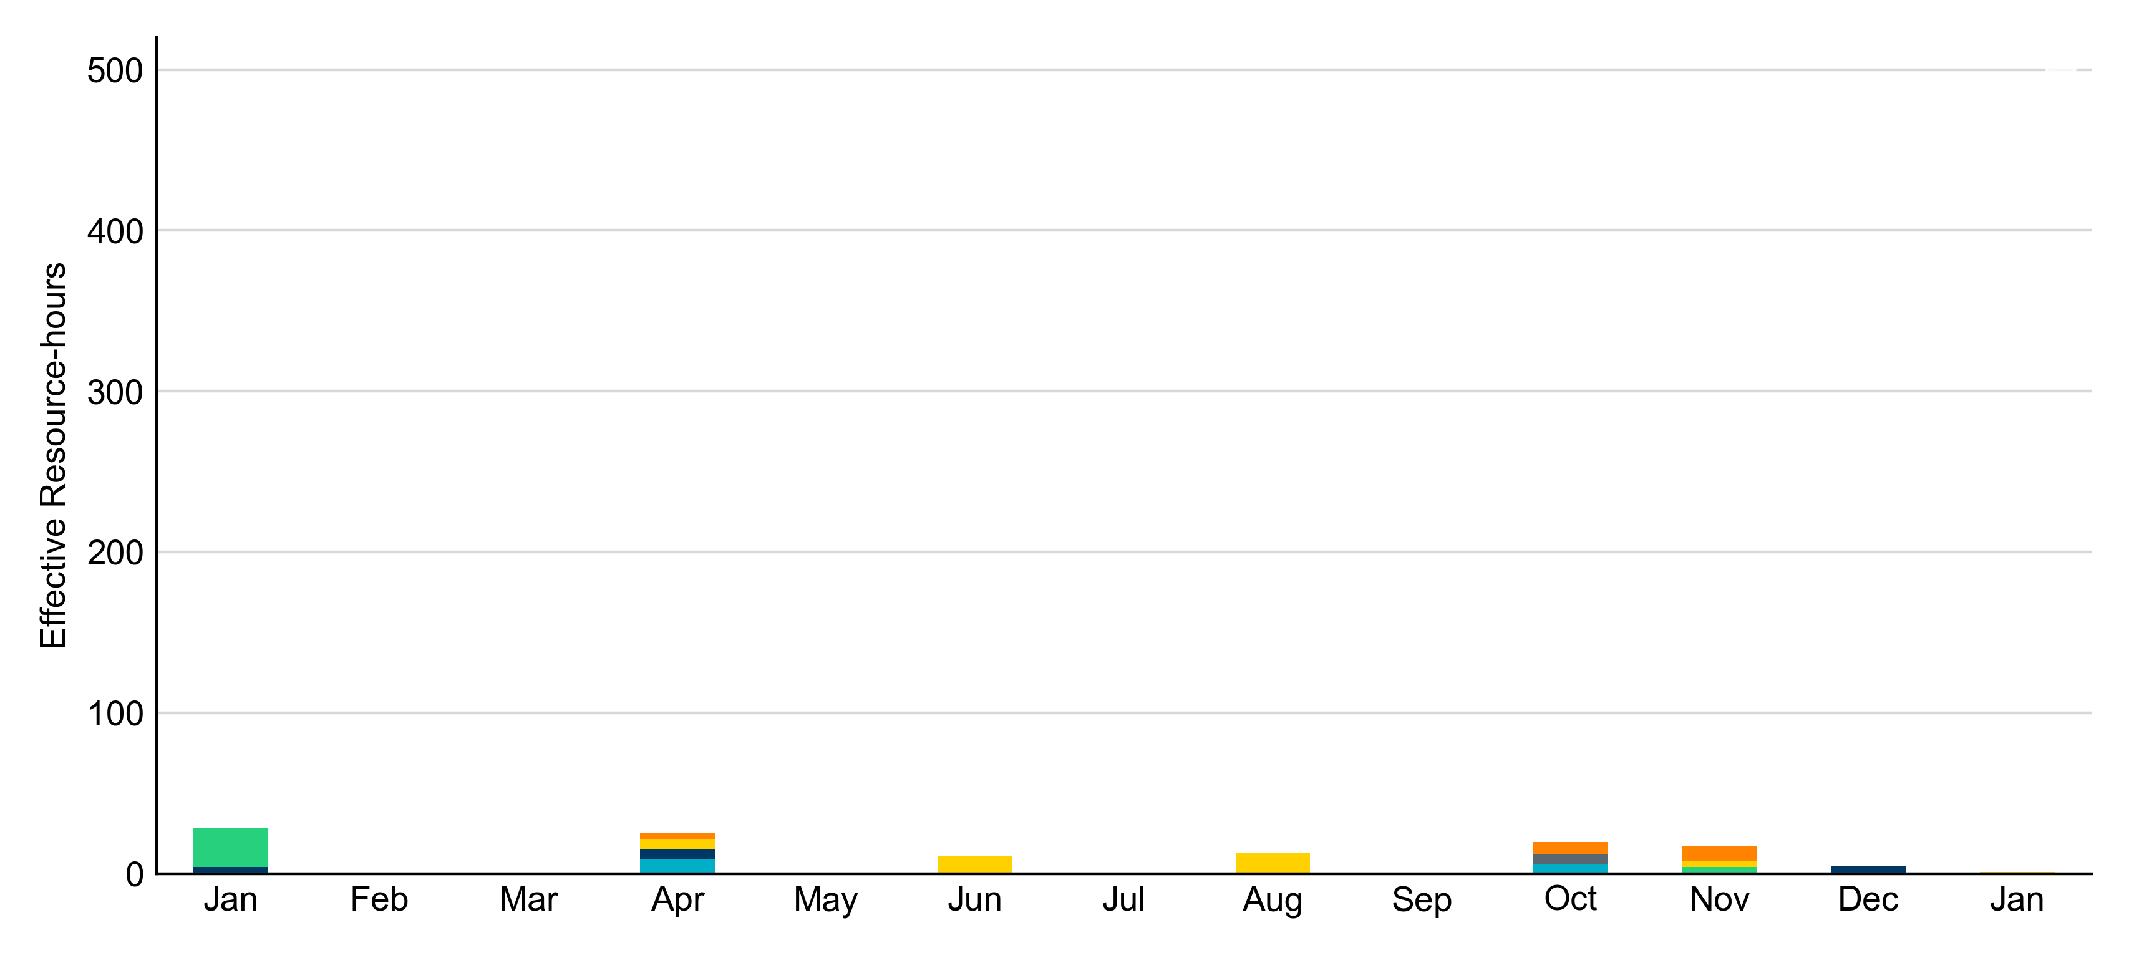
Age Category: Last 13 Months Most RUC-committed Resources in January 2025 were more than 50 years old.
Non-opt-out
Opt-out

Slide 10
RUC-Instructed Resource Dispatch above LDL
January 2025
There were 9.6 effective Resource-hours in which Resources that did not successfully opt out were dispatched above their LDL.
For 3.2 of these Resource-hours, the LMP for the RUC-instructed Resource was above the RUC offer floor.
For 6.4 of these Resource-hours, the LMP for the RUC-instructed Resource was below the RUC offer floor.
For all of these 6.4 Resource-hours, the RUC-instructed Resource was mitigated.
There were no Exceptional Fuel Cost submissions for any RUC-committed Resources.

Slide 11
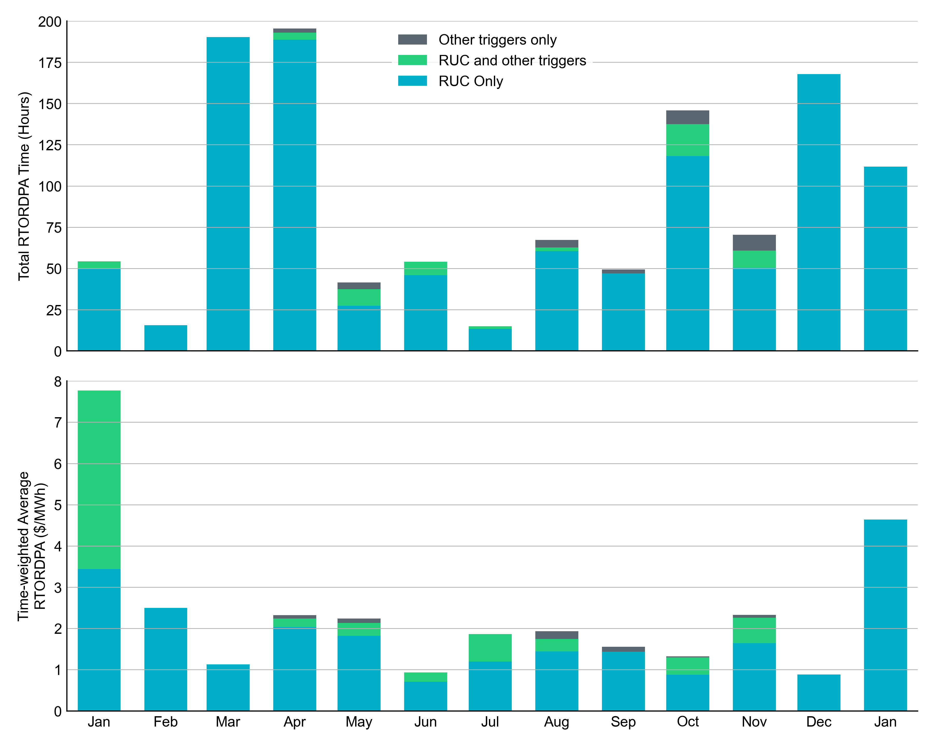
Reliability Deployment Price Adder: Last 13 Months January 2025 had a total of 111.75 RTORDPA hours with an average value of $4.64/MWh.
These graphs show RTORDPA instances by reliability action: 'RUC Only' for instances triggered solely by Reliability Unit Commitment, 'RUC and other triggers' for instances with RUC and additional triggers, and 'Other triggers only' for instances with non-RUC triggers. The daily average RTORDPA is calculated using the total duration across all categories. See ERCOT protocol section 6.5.7.3.1 for details.

Slide 12
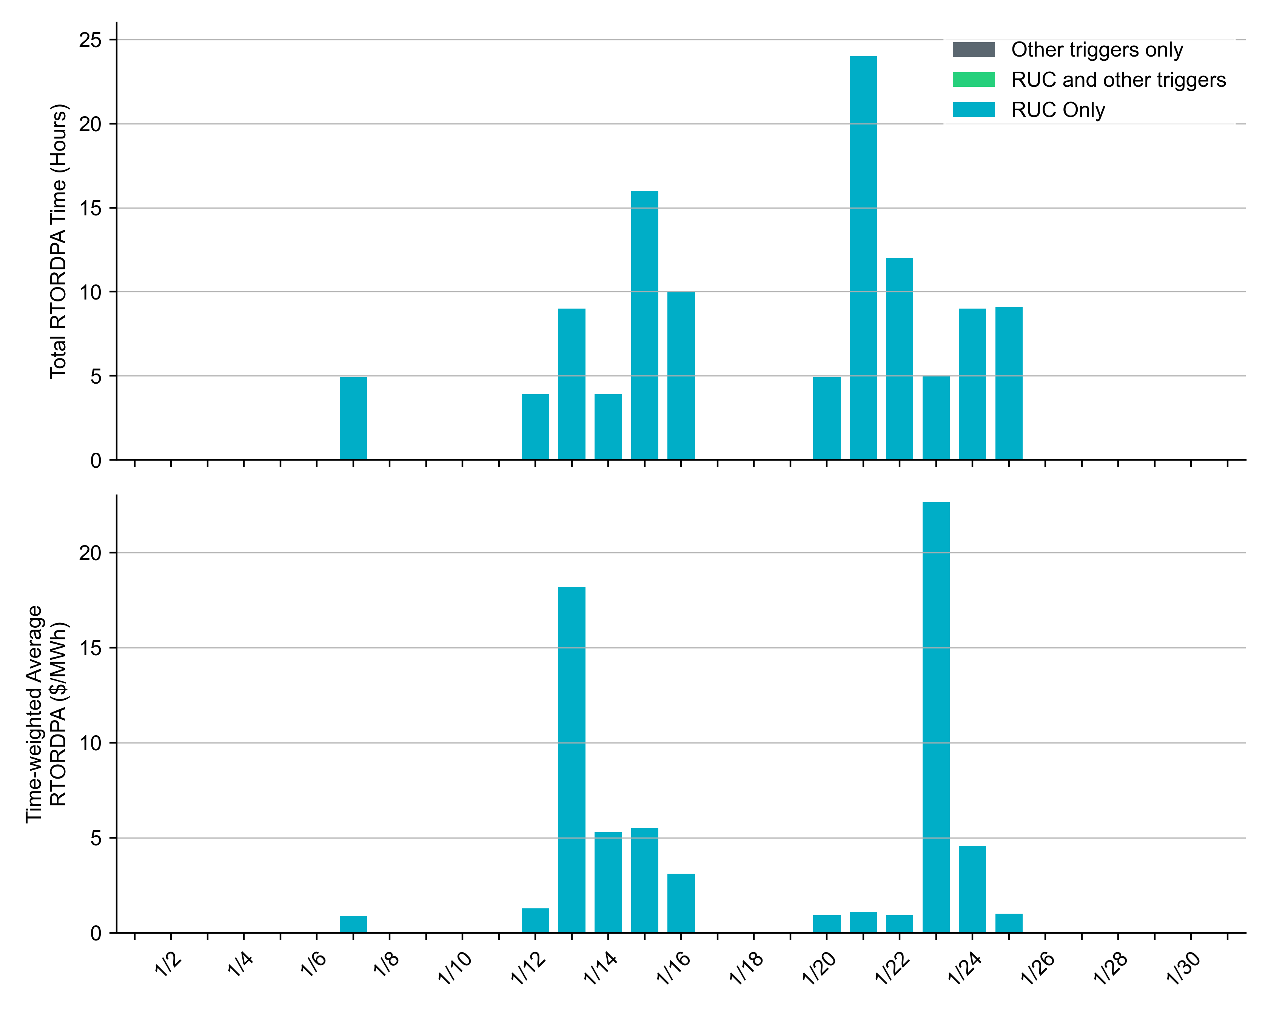
Reliability Deployment Price Adder: January 2025 OD 01/23 had the highest daily time-weighted average RTORDPA of $22.65/MWh.
These graphs show RTORDPA instances by reliability action: 'RUC Only' for instances triggered solely by Reliability Unit Commitment, 'RUC and other triggers' for instances with RUC and additional triggers, and 'Other triggers only' for instances with non-RUC triggers. The daily average RTORDPA is calculated using the total duration across all categories. See ERCOT protocol section 6.5.7.3.1 for more details.

Slide 13
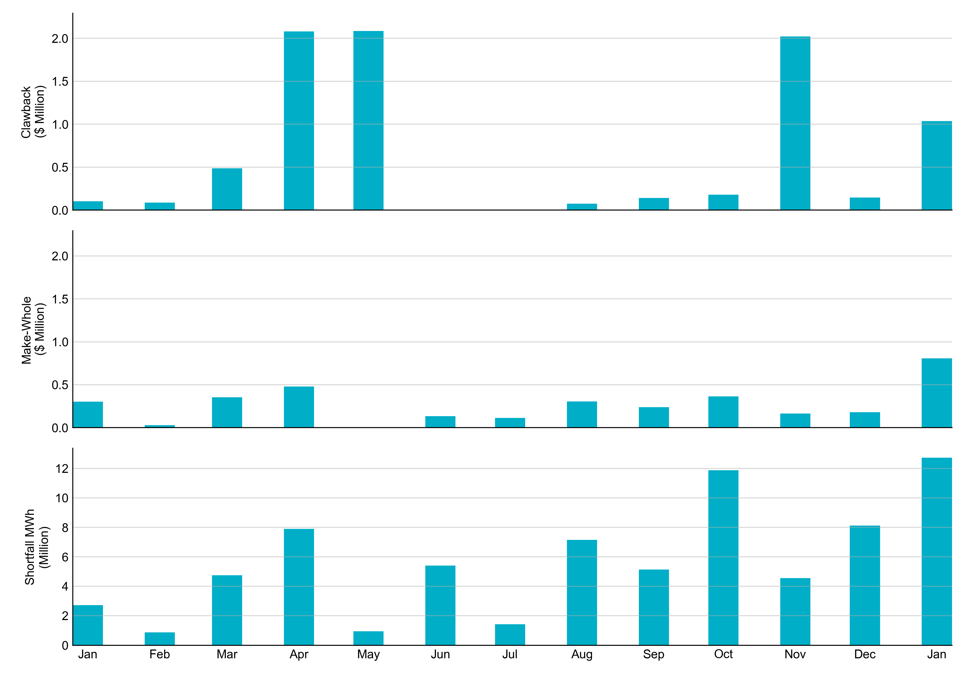
RUC Clawback, Make-Whole, and Shortfall For January 2025, the total Clawback Charge was $1,037,717. The total Make-Whole Payment was $807,944.
Of the $807,944 in Make-Whole Payments made in January 2025, $2.47 was uplifted to load due to rounding.
The remaining amount was collected through Capacity-Short Charges.
Data as of February 18th, 2025

Slide 14
RUC Clawback by Settlement Type
Month | Initial Settlement ($) | Final Settlement Change ($) | True-up Settlement Change ($) | Net as of February 18, 2025 ($)
Jan ‘24 | 107,176 | -4,657 | 0 | 102,519
Feb ‘24 | 88,220 | 0 | 0 | 88,220
Mar ‘24 | 487,193 | 0 | 0 | 487,193
Apr ‘24 | 2,092,224 | 0 | -11,819 | 2,080,406
May ‘24 | 2,084,416 | 0 | 0 | 2,084,416
Jun ’24 | 58 | 0 | 0 | 58
Jul ‘24 | 47,627 | 0 | -47,627 | 0
Aug ‘24 | 73,690 | 0 | 0 | 73,690
Sep ‘24 | 140,239 | 0 | - | -
Oct ‘24 | 179,331 | 0 | - | -
Nov ‘24 | 2,022,874 | 0 | - | -
Dec ‘24 | 147,389 | -3 | - | -
Jan ‘25 | 1,037,717 | - | - | -
Negative dollars represent a payment from ERCOT to a market participant
“-” indicates settlement has yet to be completed.
Net figures may differ slightly due to rounding.

Slide 15
RUC Make-Whole by Settlement Type
Month | Initial Settlement ($) | Final Settlement Change ($) | True-up Settlement Change ($) | Net as of February 18, 2025 ($)
Jan ‘24 | -253,466 | -79,942 | 31,417 | -301,990
Feb ‘24 | -19,673 | 0 | -9,004 | -28,678
Mar ‘24 | -353,562 | 0 | 0 | -353,562
Apr ‘24 | -443,178 | 0 | -35,271 | -478,449
May ‘24 | -2,957 | 0 | 0 | -2,957
Jun ’24 | -76,670 | 0 | -57,341 | -134,011
Jul ‘24 | -4,297 | 0 | -109,781 | -114,078
Aug ‘24 | -305,171 | 0 | 0 | -305,171
Sep ‘24 | -239,681 | 0 | - | -
Oct ‘24 | -364,395 | 0 | - | -
Nov ‘24 | -164,191 | 0 | - | -
Dec ‘24 | -179,587 | 0 | - | -
Jan ‘25 | -807,944 | - | - | -
Negative dollars represent a payment from ERCOT to a market participant
“-” indicates settlement has yet to be completed.
Net figures may differ slightly due to rounding.

