Slide 1
WMWG update to wms March 5, 2025

Slide 2
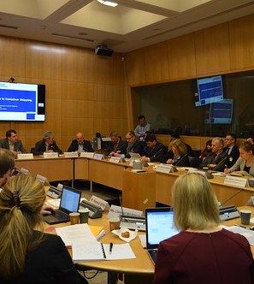
AGENDA
General itemS
RUC Timing Discussion
CARD/CRRBA Allocation Discussion
NPRRS ready for WMS vote:
nprr 1229, RT CMP Energy Payment
nprr 1264, Creation of EAC Program
This Photo by Unknown Author is licensed under CC BY-NC-ND

Slide 3
General items
WMWG meeting held on March 3, 2025.
Ryan King (ERCOT), Andy Nguyen (Constellation), and Eric Goff (Residential Consumers) discussed operational issues related to RUC opt-out timing since implementation of NPRR1092. While stakeholders support NPRR1092 policies that have contributed to increased self-commitment, Constellation believes the operational timing can be further refined to increase opt-out frequency. This topic will be discussed further during the March 31, 2025 WMWG meeting.
Austin Rosel (ERCOT) announced that ERCOT would be shelving efforts to adjust the current CARD/CRRBA allocation methodology citing existing compliance solutions, market sensitivity, and resource constraints. ERCOT has posted its historic analysis of the Vistra, City of Georgetown, and IMM CARD allocation methodologies alongside 7 years of TCOS + CARD/CRRBA trends on the March 3, 2025 WMWG meeting page. ERCOT will be available for questions about this analysis during the March 31, 2025 WMWG meeting.

Slide 4
NPRRS Ready for WMS
NPRR1229, Real-Time Constraint Management Plan Energy Payment.
Lucas Turner (STEC) presented February 26, 2025 Comments to STEC-sponsored NPRR1229 which include a $3.5M annual review threshold for CMP cost recovery. Exceeding this threshold in a single year would require ERCOT to report to TAC the causes of the payments and to provide recommendations on how to reduce these costs. Residential consumers expressed concerns about expanding out-of-market payments. WMWG has concluded discussions on NPRR1229.
NPRR1264, Creation of a New Energy Attribute Certificate Program.
Eric Goff (Texas Energy Buyers Alliance) reviewed the attributes to be tracked within the proposed voluntary Energy Attribute Certificate (EAC) program, including the accounting of energy storage charging / discharging. Stakeholders noted that certain attributes (carbon content of natural gas, dispatchability, etc.) may be more effectively tracked through third-party verification. Texas Energy Buyers Alliance is seeking an endorsement from PRS to generate an Impact Analysis for NPRR1264. Austin Rosel (ERCOT) previewed potential implementation approaches for the EAC program which range from ERCOT contracting a third-party administrator to ERCOT developing the program in-house. WMWG has concluded discussions on NPRR1264.

Slide 5
THANK YOU

