Slide 1
ERCOT Frequency Events
February 2025
ERCOT
Operations Planning
PDCWG | Mar 17, 2025

Slide 2
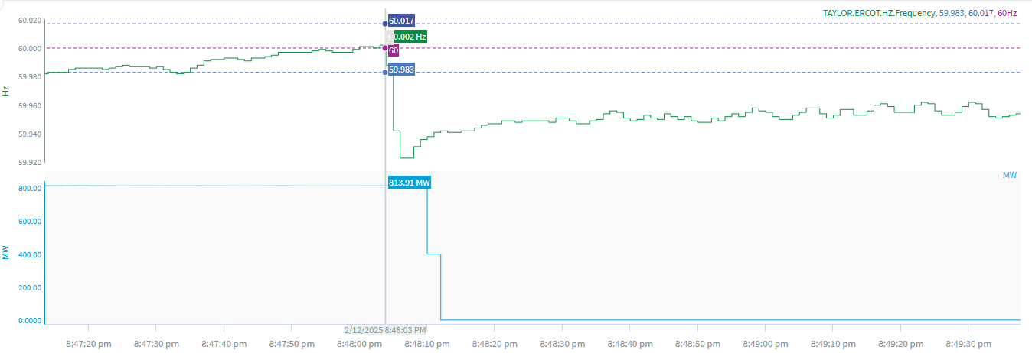
2/12/2025 20:48:03 (Non-FME)
Notes:
The unit experienced runback while carrying ~813 MW and tripped offline
Starting Frequency: 60.002 Hz
Minimum Frequency: 59.923 Hz
A-C Time : 3 seconds
Recovery Time(back to deadband): 4 minutes 06 seconds
ECRS Released: 0 MW
Trip Reason: Unknown at this time
Contextual Information: A total of 224 MW of regulation Up was deployed during the event.
Reason for no selection: C point is 59.923 and unit experienced a runback

Slide 3
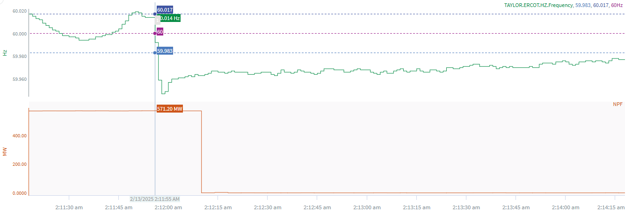
2/13/2025 2:11:55 (Non-FME)
Notes:
The unit tripped offline while carrying ~ 571 MW
Starting Frequency: 60.014 Hz
Minimum Frequency: 59.947 Hz
A-C Time : 3 seconds
Recovery Time(back to deadband): 2 minutes 54 seconds
ECRS Released: 0 MW
Trip Reason: Unknown at this time
Reason for no selection: The C point is 59.947

Slide 4
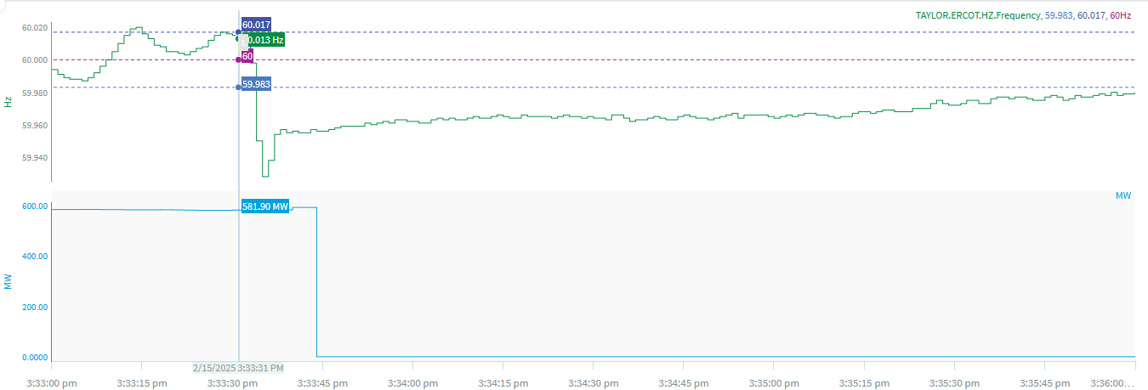
2/15/2025 15:33:32 (Non-FME)
Notes:
A unit tripped for loss of ~582 MW
Starting Frequency: 60.013 Hz
Minimum Frequency: 59.928 Hz
A-C Time :
Recovery Time(back to deadband): 2 minutes 42 seconds
ECRS Released: 0 MW
Trip Reason: Boiler circulating water pump
Reason for no selection: The C point is 59.928

Slide 5
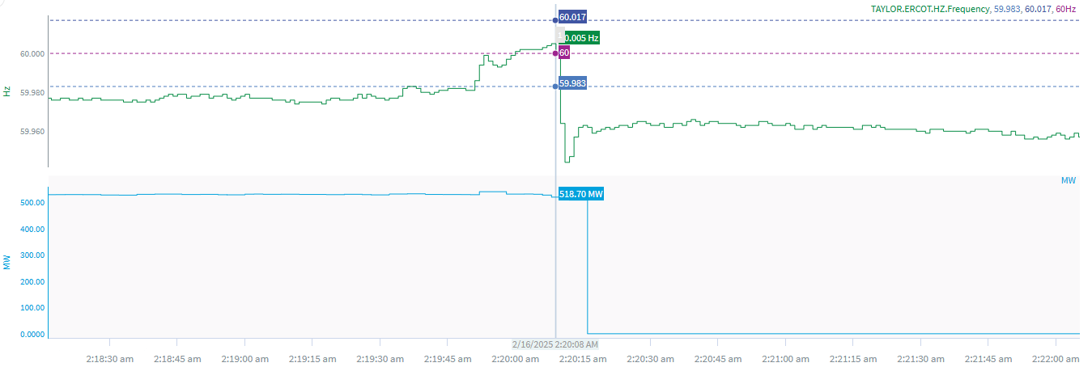
2/16/2025 2:20:08 (Non-FME)
Notes:
A unit tripped for loss of ~582 MW
Starting Frequency: 60.005 Hz
Minimum Frequency: 59.944 Hz
A-C Time :
Recovery Time(back to deadband): 6 minutes 6 seconds
ECRS Released: 0 MW
Trip Reason: Unknown at this time
Contextual Information: A total of 255 MW of regulation up was deployed during the event
Reason for no selection: The C point is 59.944

Slide 6
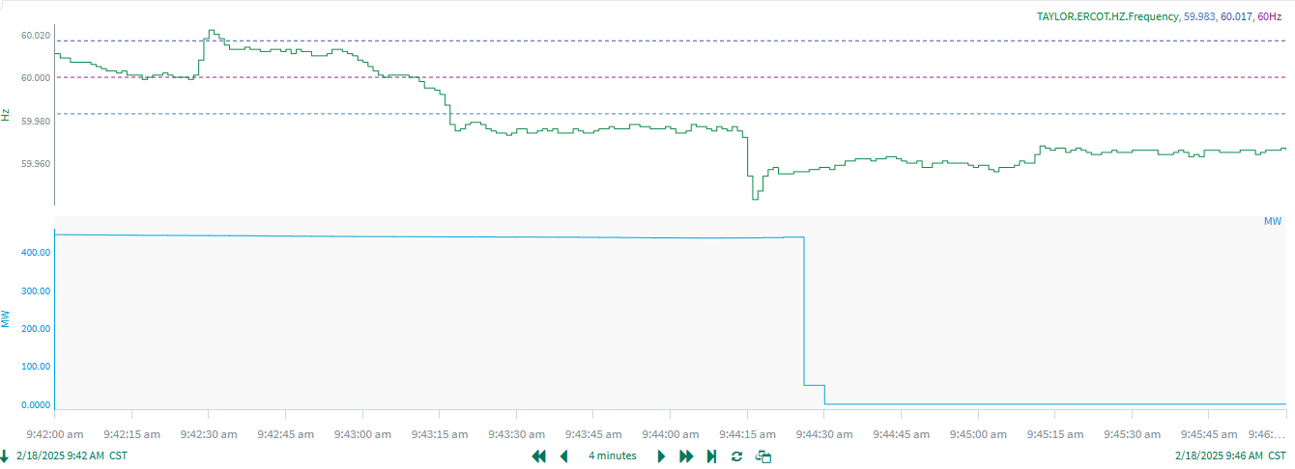
2/18/2025 9:44:12 (Non-FME)
Notes:
A unit tripped for loss of ~437 MW
Starting Frequency: 59.975 Hz
Minimum Frequency: 59.943 Hz
A-C Time :
Recovery Time(back to deadband): 4 minutes 55 seconds
ECRS Released: 0 MW
Trip Reason: Unknown at this time
Contextual Information: A total of 352 MW of regulation up was deployed during the event
Reason for no selection: The C point is 59.943 and A point was below the deadband

Slide 7
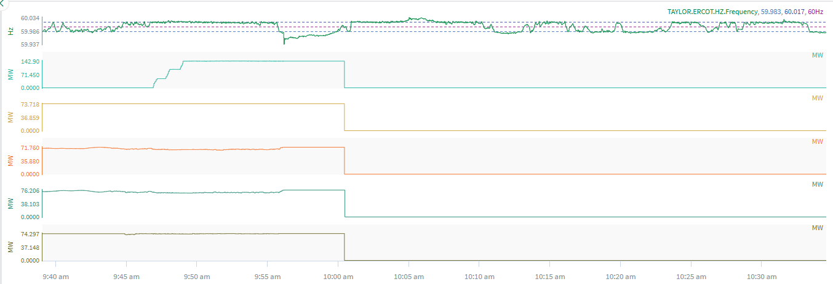
2/25/2025 9:56:07 (Non-FME)
Notes:
Multiple units tripped for a total loss of ~582 MW
Starting Frequency: 59.980 Hz
Minimum Frequency: 59.937 Hz
A-C Time :
Recovery Time(back to deadband): 3 minutes 42 seconds
ECRS Released: 0 MW
Trip Reason: Unknown at this time
Reason for no selection: The C point is 59.937 and A point was below the deadband

Slide 8
Questions?
Thank you!

